Slide 1
KINECT AR
TECHNICAL COMPONENTS - BIS

Slide 2
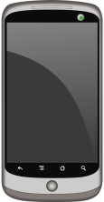
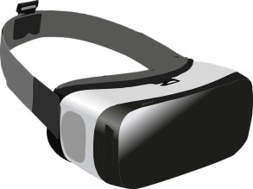


COMPONENTS – REVISITED
SERVER
Unity
SpaceBrew client
Kinect interface
Tracking module
SpaceBrew
CLIENT
Node.js
Unity
SpaceBrew client
(Orientation manager)
Gyroscope
Kinect SDK
DISPLAY
AR/VR
CAMERA
KINECT

Slide 3
SERVER
Requirements:
Hardware:
Kinect v2
Software:
Windows
Unity
Kinect SDK
SpaceBrew
Node.js
Role:
Inputs from Kinect:
RGB image
Depth image
Bodies/skeletons
Process data
Determine heads orientation
Detect “collisions”
Update global game state
Outputs to Client i:
Position of Client i Head
Orientation of Client i Head
Position of Client i Hand(s)
Relevant game data
SERVER
Unity
SpaceBrew client
Kinect interface
Tracking module
SpaceBrew
Can be integrated in
Unity project
Node.js
Kinect SDK
KINECT

Slide 4
CLIENT
Requirements:
Hardware:
(Gyroscope)
=> Optional *
Screen
Camera
=> Display only
Software:
Android
Unity
Role:
Inputs from Server:
Orientation of Head
Position of Head
Position of Hand(s)
Relevant game data
Process data
Update local game state
Update position
Update orientation
=> * Could combine with
gyroscope data
Display world
Outputs to Server:
(nothing)
(Head orientation?)
CLIENT
Unity
SpaceBrew client
(Orientation manager)
For calibration?
Gyroscope
DISPLAY
AR/VR
CAMERA

Slide 5
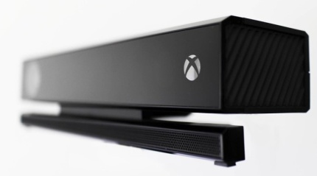
SERVER – KINECT
Position & Orientation:
=> Unity scene must be a close representation of real world
Position:
- Provided body joints positions are relative to centre of Kinect sensor
=> Need to offset the objects:
Use Kinect world centre as centre of the scene
OR
Position objects locally in a container located at Kinect’s position
OR
Add required offsets to each object’s position
Orientation:
- Kinect and Unity scene should have same orientation
=> Same “up” & “right” vectors (not “forward”*)
YAW = 0.0
PITCH = 0.0
=> Make sure the Kinect is not tilted! (REMOVE/ADJUST STAND)
ROLL = 0.0

Slide 6
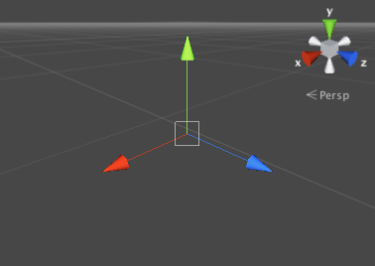
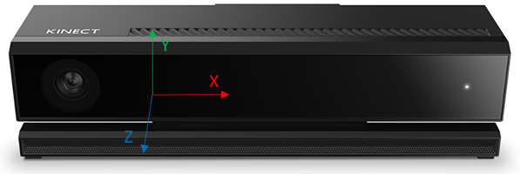
SERVER – KINECT
Position offset:
Kinect position relative to centre of world, to be determined based on scene
Typical initial offset:
- X = 0.0
- Y = (Height from floor)
=> Hardcoded? Provided input? Automatically measured?
- Z* = 3.0 (meters) – (ideal)
=> Determine based on scene.
* – Kinect data is mirrored from real world, Z axis is facing the opposite direction!
=> Z values need to be inverted if mimicking real world

Slide 7
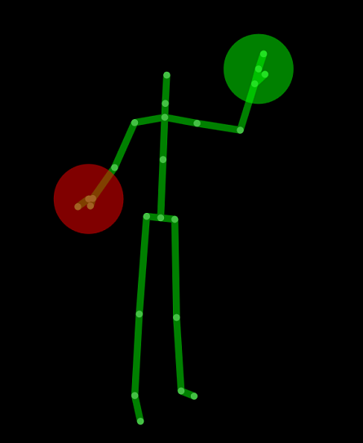
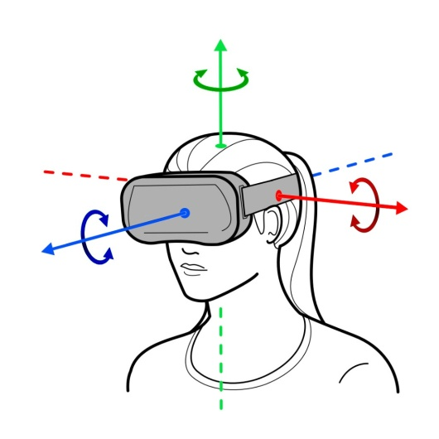
CLIENT – HEAD
Position:
In scene: Provided by server from Kinect skeletal joints (body frames)
In real world: Need to consider offset
=> Screen/VR headset offset in regards to head central position
? => How to determine?
=> Current world position + “offset” correctly oriented
Orientation:
In real world: Provided by gyroscope (Android API)
! - Gyroscope not reliable! (esp YAW)
=> Compute from Kinect RGB images
In scene: Need to be calibrated at initialisation
=> Relative to Kinect orientation
=> Initial scene orientation + current world orientation
1
2

Slide 8
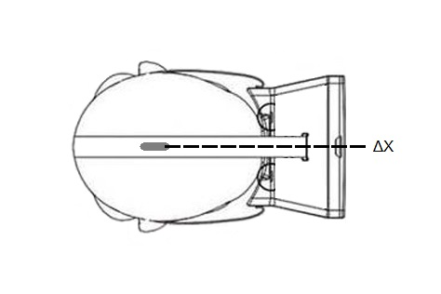
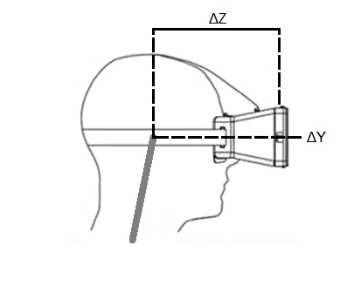
CLIENT – HEAD
1
Position offset:
=> Screen/VR headset offset in regards to head central position
ΔX = 0.0 (unless camera not centered!)
! => To be tested/checked
ΔY should be close to 0.0
! => To be tested/checked
ΔZ to be measured
? => Can have same values for every player? Or based on height?
Kinect head joint
Kinect head joint

Slide 9
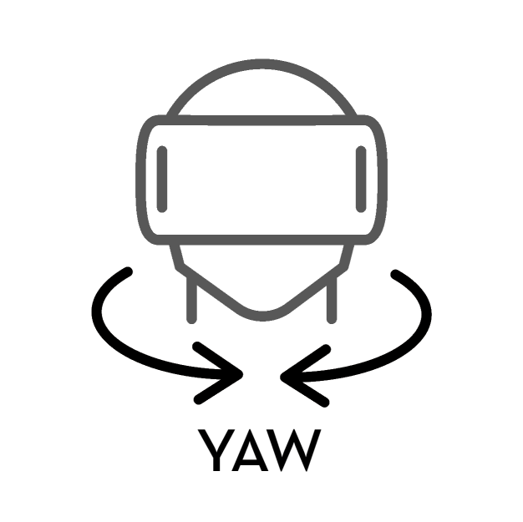
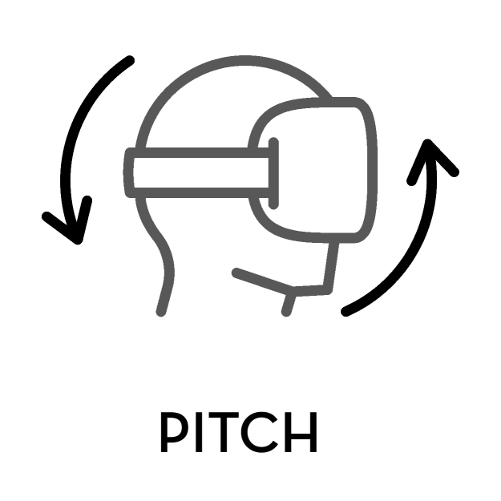
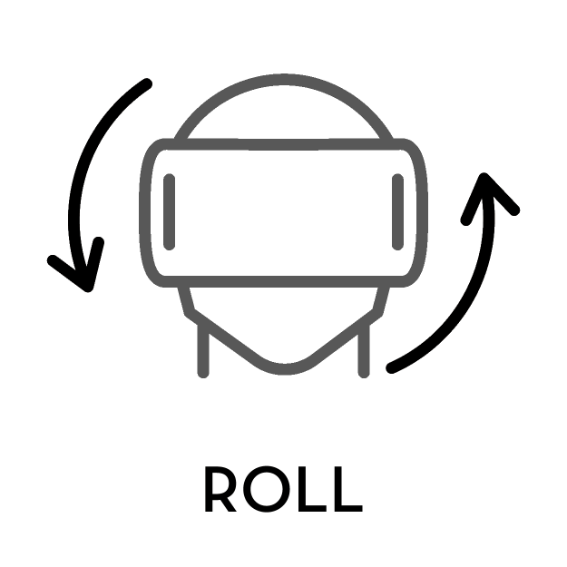
CLIENT – HEAD
2
Orientation determination:
=> Using Kinect RGB video feed to determine head orientation
YAW
PITCH
ROLL
=> PITCH & ROLL can be combined/validated with gyroscope data
! – Kinect must be properly aligned to world!

Slide 10
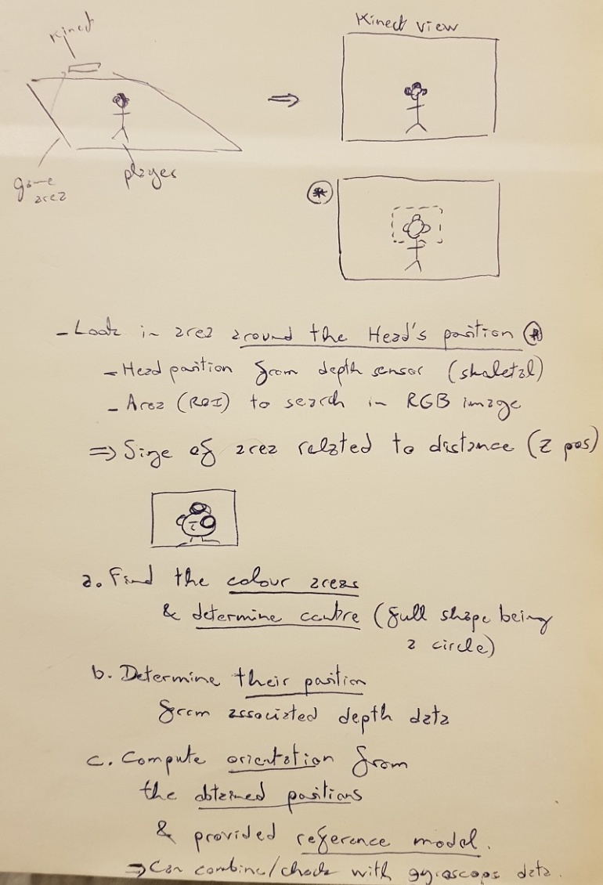
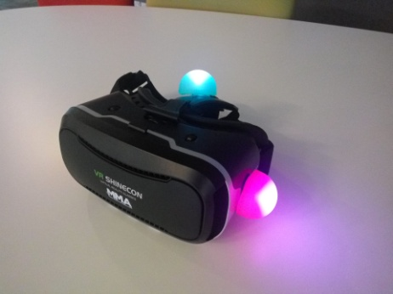
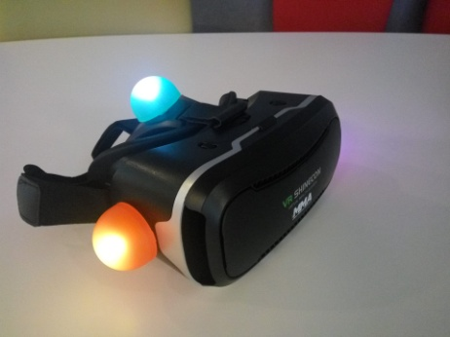
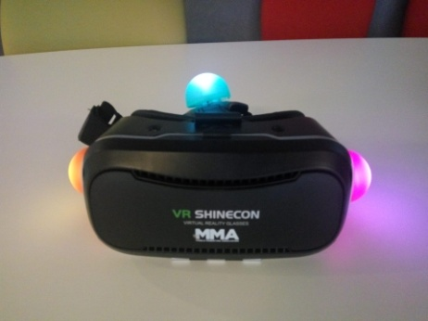
CLIENT – HEAD
!!!! TODO !!!!
Orientation:
=> ... (TODO: explain Kinect image analysis method ...

Slide 11
CLIENT – HEAD
!!!! TODO !!!!
HEAD TRACKING:
- Tracking using the Kinect:
=> Colour tracking in area around the head (area size related to distance from camera)
Process:
1 - Colour Segmentation - Blobs Detection
=> Biggest clusters of specific colours in RGB image.
2 - Positions Determination
=> From values in depth image at corresponding positions.
3 - Pose Estimation
=> Determine transformation from original model to found model.
(Only orientation is required, no position)

Slide 12
CLIENT – HEAD
!!!! TODO !!!!
HEAD TRACKING:
Requirements:
- Hardware:
- Minimum 4 (3?) markers to determine the rotation matrix
- Markers need to be unique and easily trackable
=> Bright/luminescent colours.
- Markers physical layout must be deterministic
=> Combined ears and "mohawk"?
(Could use flashy 80s earpuffs)
- Players need to wear a special headset holding markers
- Players can't get out of Kinect FOV
(shouldn't anyway, as positioning will not work either)
=> If losing tracking, use the device's gyroscope? (How to manage?)

Slide 13
CLIENT – HEAD
!!!! TODO !!!!
HEAD TRACKING:
Image Analysis Libraries:
AForge.NET (in C#):
=> How to integrate in Unity? How powerful? ...?
http://www.aforgenet.com
https://www.codeproject.com/Questions/738734/blob-detection-in-csharp
http://www.emgu.com/forum/viewtopic.php?t=477
OpenCV:
OpenCV Unity Asset
https://assetstore.unity.com/packages/tools/integration/opencv-for-unity-21088
=> Not free!
OpenCV from sources (via ++ DLL)
https://thomasmountainborn.com/2016/09/11/unity-and-opencv-part-one-install/
https://thomasmountainborn.com/2016/09/12/unity-and-opencv-part-two-project-setup/
https://thomasmountainborn.com/2017/03/05/unity-and-opencv-part-three-passing-detection-data-to-unity/
=> Best way, but complex.
OpenCV precompiled libraries (via C++ DLL)
http://amin-ahmadi.com/2017/05/24/how-to-use-opencv-in-unity-example-project/
=> Easy and powerful – Need to check quality of libraries!
OpenCV & Unity using sockets:
https://github.com/hasanavi/OpenCV-Unity3D-Object-Tracking
https://www.raywenderlich.com/5475-introduction-to-using-opencv-with-unity
=> Not ideal, as Kinect is already integrated in Unity.

Slide 14
CLIENT – HEAD
!!!! TODO !!!!
HEAD TRACKING:
Colour Detection with OpenCV
Colour tracking in Unity (using OpenCV plugin)
https://handmap.github.io/opencv-colour-tracking-unity3d/
Invisibility Cloak using Color Detection and Segmentation with OpenCV:
https://www.learnopencv.com/invisibility-cloak-using-color-detection-and-segmentation-with-opencv/
=> Need to subscribe to download the code
Blob detection with OpenCV SimpleBlobDetector:
https://www.learnopencv.com/blob-detection-using-opencv-python-c/
https://github.com/spmallick/learnopencv/tree/master/BlobDetector
https://docs.opencv.org/3.4.3/d0/d7a/classcv_1_1SimpleBlobDetector.html
Circular blob detection:
https://riptutorial.com/opencv/example/22518/circular-blob-detection
Fast Color Based Object Tracking Using OpenCV and Kinect:
https://imufeed.wordpress.com/2013/04/03/fast-color-based-object-tracking-using-opencv-and-kinect/
https://www.youtube.com/watch?v=d_c0Bqqvj6c
Object pose estimation
=> Might not need to use specific algorithms: only need to determine orientation from the different points.

Slide 15
CLIENT – HANDS
!!!! TODO !!!!
...
Hand tracking
=> Using Kinect body frames
! – Tracking struggle when hands in front of body!
Could hold coloured devices to allow different types of interactions
=> Colour tracking with Kinect RGB image (using OpenCV?)

