Slide 1
Xiang Deng
Professor
Computer Science Department
Harbin Institute of Technology (Shenzhen)
Research Interests: Embodied AI, Multimodal Large Language Models

Slide 2
Course: Advanced Machine Learning
Instructors: Xianming Liu (csxm@hit.edu.cn)，Xiang Deng (dengxiang@hit.edu.cn)
Grading Policy:
The course will be graded based on participation (10%), project (40%), and final exam (50%).

Slide 3
Lesson1: Introduction to Machine Learning

Slide 4
Outline
Introduction
Terminology
Hypothesis Space
Inductive Bias
Brief History
Application Status
Further Reading

Slide 5
What is Machine Learning?
(Layman’s term)

Slide 6

Human can learn from past experience and make decision of its own
2

Slide 7
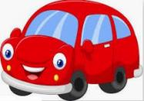

What is this object?
3

Slide 8
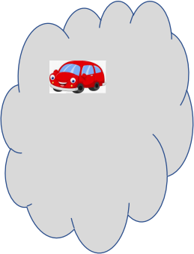



What is this object?
CAR
CAR
BIKE
BIKE
It is a CAR
4

Slide 9


Let us ask the same question to him
What is this object?
5

Slide 10
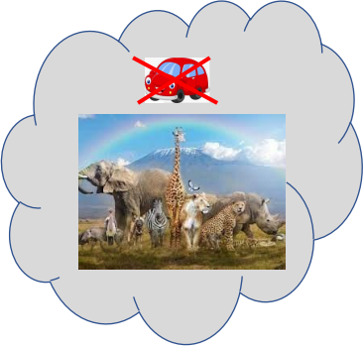
Let us ask the same question to him
?
What is this object?
6

Slide 11
[ But, he is a human being. He can observe and learn ]

Slide 12

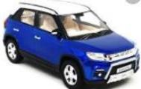

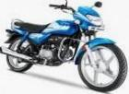
Let us make him learn
show him
8

Slide 13
Let us make him learn
CAR
CAR
BIKE
BIKE
show him
9

Slide 14




Let us ask the same question now
What is this object?
CAR
CAR
BIKE
BIKE
Past experience
10

Slide 15
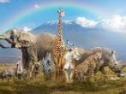

Let us ask the same question now
CAR
What is this object?
CAR
CAR
BIKE
BIKE
11

Slide 16

What about a Machine ?
Machines follow instructions
[ It can not take decision of its own]
12

Slide 17
What about a Machine ?
We can ask a machine
• To perform an arithmetic operations such as
• Addition
• Multiplication
• Division
Machines follow instructions
13

Slide 18
What about a Machine ?
• Comparison
• Print
• Plotting a chart
Machines follow instructions
14

Slide 19
What is Machine Learning?
[ We want a machine to act like a human]
15

Slide 20

What is Machine Learning?
[ to identify this object.]
16

Slide 21
What is Machine Learning?
Price in 2026?
[ predict the price in future]
17

Slide 22
What is Machine Learning?
I made met him
yesterday
[ Natural Language understand, and correct grammar ]
18

Slide 23

What is Machine Learning?
recognize face
[ Recognize Faces ]
19

Slide 24
What is Machine Learning?
[ What do we do?
Just like, what we did to human,
we need to provide experience to the machine.
]
20

Slide 25
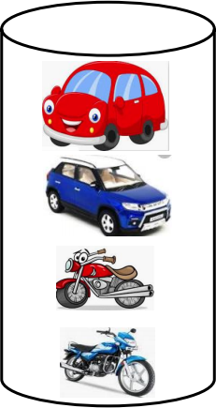

What is Machine Learning?
[
This what we called as Data or Training dataset
So, we first need to provide training dataset to the
machine
]
+
Dataset
21

Slide 26

What is Machine Learning?
+
+
[ Then, devise algorithms and execute programs on the data
With respect to the underlying target tasks ]
Dataset
22

Slide 27

What is Machine Learning?
+
+
+
Dataset
[ Then, using the programs, Identify required rules ]
23

Slide 28

What is Machine Learning?
+
[extract required patterns ]
+
+
Dataset
24

Slide 29

What is Machine Learning?
+
+
+
Dataset
[ Identify relations ]
25

Slide 30

What is Machine Learning?
+
+ =
+
Dataset
[ So that machine can derive inferences from the data ]
26

Slide 31




In summary, what is machine learning?
Given a machine learning problem
• Identify and create the appropriate dataset
• Perform computation to learn
• Required rules, pattern and relations
• Output the decision
27

Slide 32
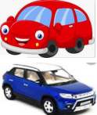


What is Supervised Learning?
Samples | CAR + BIKE Labels
CAR
₌ Training Dataset
BIKE
[In supervised learning, we need some thing called a Labelled Training Dataset ]
29

Slide 33


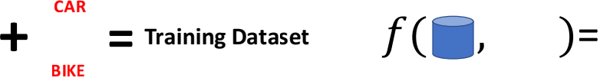
What is Supervised Learning?
 | CAR
BIKE Samples Labels
[ Given a labelled dataset, the task is to devise a function which takes the dataset, and a new sample, and produces an output value.]
30

Slide 34

What is Supervised Learning?
Samples | CAR + BIKE Labels
CAR
= Training Dataset f( , )=
BIKE
Test data
[ Given a labelled dataset, the task is to devise a function which takes the dataset, and a new sample, and produces an output value.]
31

Slide 35
What is Supervised Learning?
Samples | CAR + BIKE Labels
CAR
₌ Training Dataset f( , )= CAR
BIKE
Test data
[ Given a labelled dataset, the task is to devise a function which takes the dataset, and a new sample, and produces an output value.]
32

Slide 36
What is Supervised Learning?
Samples | CAR + BIKE Labels
Classification
₌ Training Dataset f( , )= CAR
CAR
BIKE
Test data
[ If the possible output values of the function are predefined and discrete/categorical, it is called Classification
33

Slide 37

What is Supervised Learning?
Samples | CAR + BIKE Labels
Classification
₌ Training Dataset f( , )= CAR
CAR
BIKE
Test data
[ Predefined classes means, it will produce output only from the labels defined in the dataset. For example, even if we input a bus, it will produce either CAR or BIKE ]
34

Slide 38
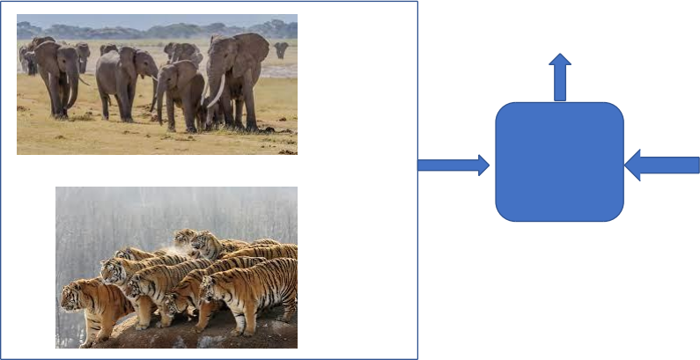
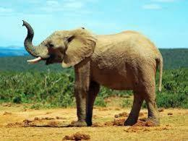
Classifier
Elephant
Classifier
Elephant
Tiger
Identify the Animal ?
Dataset
35

Slide 39
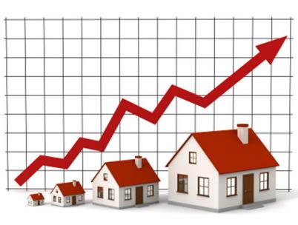

Regression
Regression
f( , )= 20500.50
Dataset
[ If the possible output values of the function are continuous real values, then it is called Regression]
36

Slide 40
[
The classification and Regression problems are supervised, because the decision depends on the
characteristics of the ground truth labels or values present in the dataset, which we define as experience
]
37

Slide 41
What is Unsupervised Learning
CAR
CAR
BIKE
BIKE
Dataset
[ In the unsupervised learning, we do not need to know the labels or Ground truth values ]
38

Slide 42
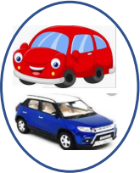
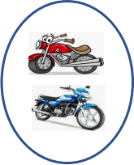
What is Unsupervised Learning
Clustering
Dataset
[ The task is to identify the patterns like group the similar objects together ]
39

Slide 43


What is Unsupervised Learning
Association Rules Mining
Dataset
[ Association rules like ]
40

Slide 44

More Example Unsupervised Learning
Dataset
41

Slide 45
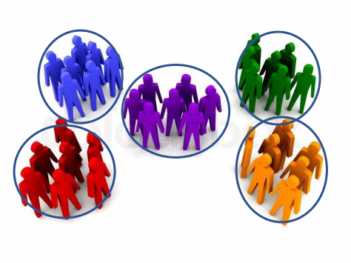
More Example Unsupervised Learning
Dataset
42

Slide 46


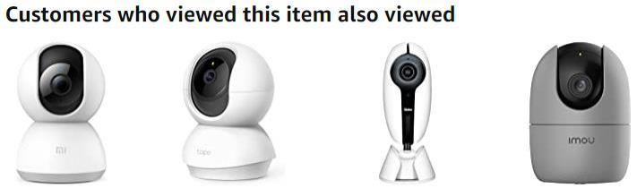
More Example Unsupervised Learning
43

Slide 47
What is Reinforcement Learning
[ It is also known as learning from trials and errors ]
44

Slide 48


What is Reinforcement Learning
45

Slide 49

What is Reinforcement Learning
46

Slide 50


What is Reinforcement Learning
47

Slide 51

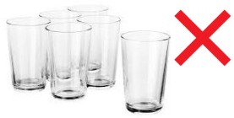


Another Example
Agent
Task
Environment
48

Slide 52


Reinforcement Learning
Punishment
49

Slide 53
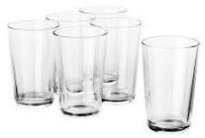
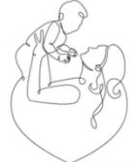
Reinforcement Learning
Reward
50

Slide 54
Reinforcement Learning
Reward
Baby Learn from the Trials and Errors
Reinforcement Learning
51

Slide 55
Outline
Introduction
Terminology
Hypothesis Space
Inductive Bias
Brief History
Application Status
Further Reading

Slide 56
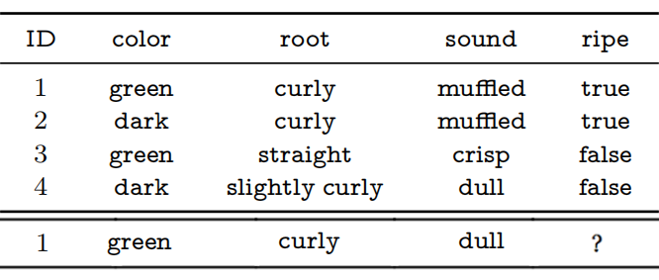
Terminology-Data
Watermelon Classification
feature
label
Training set
Testing set

Slide 57
Terminology-Task
Labeled or unlabeled information
Supervised learning: classification, regression
Unsupervised learning: clustering
Semi-supervised learning: a combination of the above two

Slide 58
Terminology-generalization ability
The objective of machine learning is to learn models that can work well on the “new samples”, rather than the training examples. The ability to work on the new samples is called the generalization ability.
We generally assume that all samples in a sample space follow a distribution , and all samples are independently sampled from this distribution, that is, independent and identically distributed (i.i.d.). Generally speaking, the more samples we have, the better-generalized model we can learn.

Slide 59
Outline
Introduction
Terminology
Hypothesis Space
Inductive Bias
Brief History
Application Status
Further Reading

Slide 60
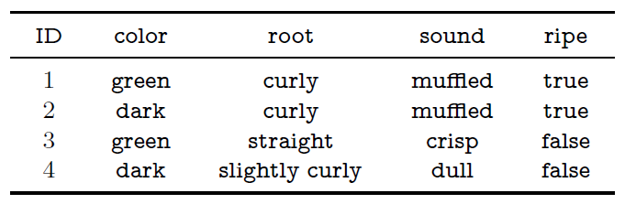

Hypothesis Space
(color=?)$⋀\text{(}\text{root}\text{=?)}⋀$(sound=?)$↔$ripe
Filtering out all hypotheses that are inconsistent with the training examples.
Hypothesis Space Size：3*4*4+1=49

Slide 61
Outline
Introduction
Terminology
Hypothesis Space
Inductive Bias
Brief History
Application Status
Further Reading

Slide 62
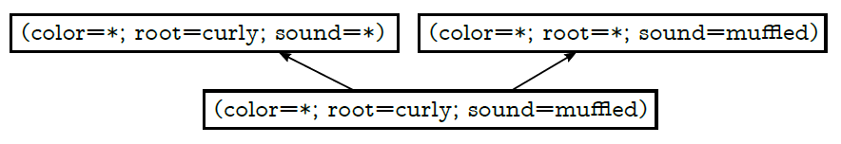
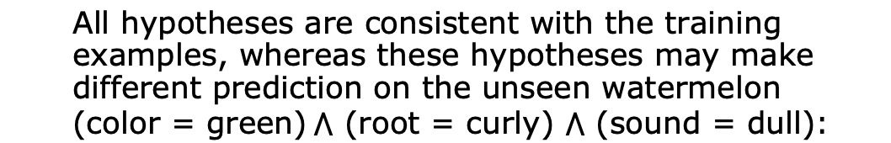
Inductive Bias
All hypotheses are consistent with the training examples, whereas these hypotheses may make different prediction on the unseen watermelon (color = green)$⋀$ (root = curly) $⋀$ (sound = dull):
ripe
unripe
(color = green, root= curly, sound = dull)
unripe
In this case, which model (or hypothesis) should we use?

Slide 63
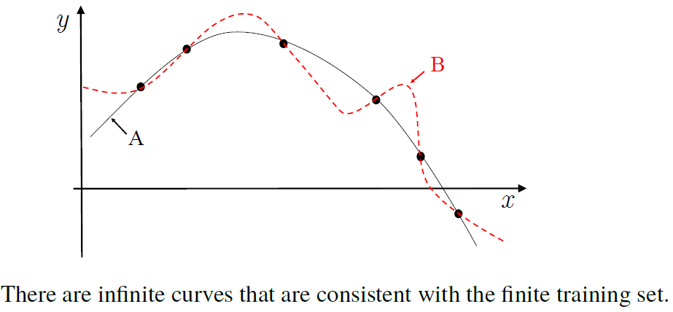
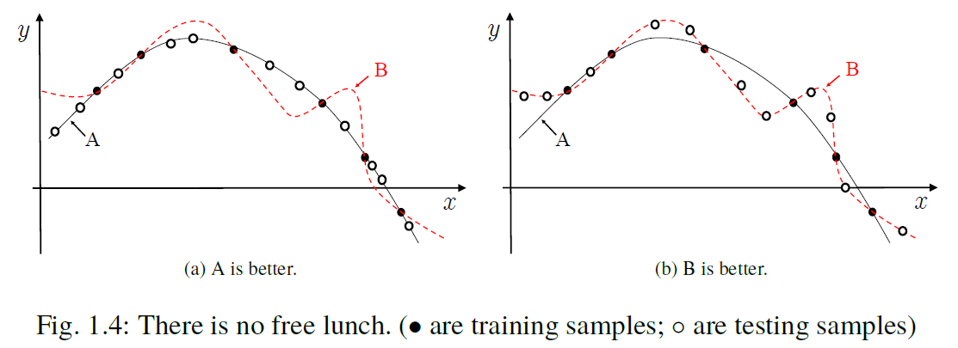
Inductive Bias
The bias of a learning algorithm towards a particular class of hypotheses is called the inductive bias.
A or B?

Slide 64
Inductive Bias
We can regard inductive bias as the heuristic or value philosophy of learning algorithms for search in potentially huge hypothesis spaces.
A fundamental and widely used principle for this question in natural science is the Occam’s razor principle, which says that we should choose the simplest hypothesis when there is more than one hypothesis consistent with the observations.
In practice, whether this hypothesis matches the specific problem or not usually determines the performance of the model.

Slide 65




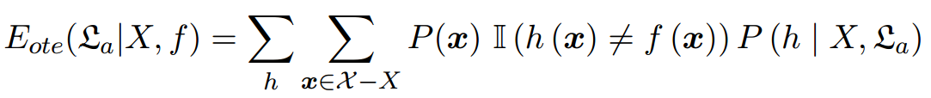

No Free Lunch
To simplify the discussion, let both the sample space and the hypothesis space be discrete. Let denote the probability of getting the hypothesis h from the algorithm based on the training set X, and let f be the ground-truth target function that we wish to learn. Then the error on all samples except those in the training set is
is the indicator function that returns 1 for true and 0 otherwise.

Slide 66


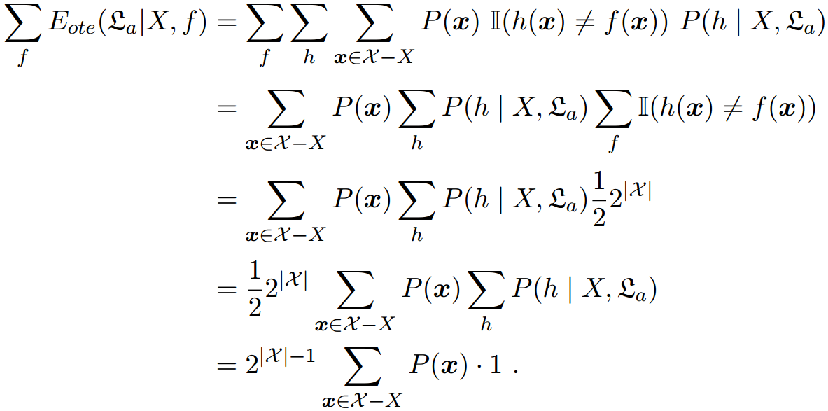
No Free Lunch
In binary classification problems, the target function could be any functions with a function space of . Summing the errors of f with respect to uniform distribution gives：
The sum of errors is independent of the learning algorithm！
All learning algorithms are equally good considering all contexts.
Debating “which learning algorithm is better” is meaningless without considering the specific task

Slide 67
Outline
Introduction
Terminology
Hypothesis Space
Inductive Bias
Brief History
Application Status
Further Reading

Slide 68
Brief History
Reasoning age：
Seminal works in that period include the Logic Theorist program developed by A. Newell and H. Simon and later on the General Problem Solving program.
In 2006, Carnegie Mellon University founded the world’s first school of machine learning, which is directed by Professor T. Mitchell, one of the pioneers in machine learning research.
Knowledge age：
A large number of expert systems with numerous successful applications are developed in a wide range of domains;
It is difficult to extract and summarize knowledge into a form that computers can learn.

Slide 69
Brief History
Learning age：
Symbolism learning
Decision tree: relies on information theory to simulate the tree-based decision process of humans by minimizing the information entropy.
Logic-based learning: employs first-order logic to represent knowledge and induces data by updating and extending the logic expressions.
Connectionism learning
Neural networks
Statistical learning
Support Vector Machine (SVM) or kernel methods

Slide 70
Brief History
reasoning age
knowledge age
learning age
Symbolism learning: decision tree and logic-based learning
Connectionism learning: based on neural networks
Statistical learning: Support Vector Machine (SVM) or kernel methods
Connectionism learning: deep learning

Slide 71
Outline
Introduction
Terminology
Hypothesis Space
Inductive Bias
Brief History
Application Status
Further Reading

Slide 72
Application Status
One of the most current computer science technologies：
In 2001, scientists from NASA-JPL published an article in the Science magazine pointed out that machine learning is playing an increasingly important role in supporting scientific research.
In 2003, DARPA started the PAL project, which puts machine learning to the level of national security.
In 2006, Carnegie Mellon University founded the world’s first school of machine learning, which is directed by Professor T. Mitchell, one of the pioneers in machine learning research.
Strongly influences our daily life：
Weather forecasting, energy exploration, environmental monitoring, search engines, autonomous vehicles, etc.

Slide 73
Application Status
Affect the political life of human society:：
During the 2012 U.S. election, Obama's machine learning team analyzed various data such as social networks to prompt him for the next campaign action.
Sense of exploring the universe like natural science.：
The Sparse Distributed Memory (SDM) model was proposed by P. Kanerva in the middle 1980s, there is no intentional imitation to the biological structure of the human brain. However, neuroscience researchers figured out that the sparse encoding mechanism in SDM widely exists in the cortex controlling vision, hearing, and olfactory, thus inspiring more neuroscience research.

Slide 74
Further Reading
ICML、NeurIPS、ICLR and ect al.

Slide 75
My first machine learning model from Scratch
1

Slide 76

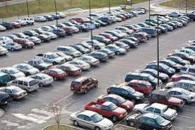
Teach a machine to identify vehicle types
2

Slide 77




3

Slide 78
Represent the sample
#Wheel Height Weight Color
4

Slide 79
Represent the sample
#Wheel Height Weight Color
Identify the features which can represent the objects
F = {f1f2f3 … fk}
Feature set={ #Wheel Height Weight Color }
5

Slide 80
Represent the sample
#Wheel Height Weight Color
Identify the features which can represent the objects
F = {f1f2f3 … fk}
For every sample, assign value to corresponding feature
vi = {wi1wi2wi3 … wik}
where wijis the value assigned for the feature fj
6

Slide 81
Represent the sample
#Wheel Height Weight Color
4
4
4
2
2
2
6
5.5
5
3
3.5
4
500
600
550
200
150
250
Red
Blue
Yellow
Red
blue
Yellow
For every object, assign value to corresponding feature
vi = {wi1wi2wi3 … wik}
where wij is the value assigned for the feature fj
7

Slide 82

Vector Space Model
#Wheel Height Weight Color
4 6 500 Red
Features Vectors
4 5.5 600 Blue
4 2 2 2 | 5 3 3.5 4 | 550 200 150 250 | Yellow Red blue Yellow
This form of representation is called Vector Space Model
8

Slide 83


Are all features useful?
Features
Features Vectors
#Wheel
4
4
4
2
2
2
Height
6
5.5
5
3
3.5
4
Weight Color
500 Red
600 Blue
550 Yellow
200 Red
150 blue
250 Yellow
Good Features
• #Wheel
• Height
• Weight
Bad Feature
• Colour
9

Slide 84
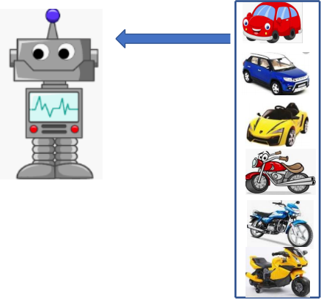
Let us consider single feature
#Wheel Class Label
4 CAR Training Dataset
Feature vector with Class label
4 CAR
4 CAR
2 BIKE
2 BIKE
2 BIKE
10

Slide 85

Given the #Wheel, identify the vehicle
#Wheel Class Label
4 CAR
4 CAR
4 CAR
2 BIKE
2 BIKE
2 BIKE
2
?
11

Slide 86
Let us estimate
#Wheel Class Label
4 CAR
4 CAR
Pr(Vehicle type| #Wheel) = ?
4 CAR
2 BIKE
2 BIKE
2 BIKE
12

Slide 87
Let us estimate the probability (type|#wheel)
#Wheel
4
4
4
2
2
2
Class Label
CAR
CAR
CAR
BIKE
BIKE
BIKE
Pr(CAR Pr(BIKE
Pr(CAR Pr(BIKE
4) = 100%
4) = 0%
2) = 0%
2) = 100%
13

Slide 88
Ask the question now
#Wheel
4
4
4
2
2
2
Class Label
CAR
CAR
CAR
BIKE
BIKE
BIKE
Pr(CAR Pr(BIKE
Pr(CAR
Pr(BIKE
4) = 100%
4) = 0%
2) = 0%
2) = 100%
{2}
?
2
Classifier Pr(BIKE|2) > Pr(CAR|2) => BIKE
BIKE
14

Slide 89

There are multiple ways
#Wheel Class Label
4 CAR
4 CAR
4 CAR
2 BIKE
2 BIKE
2 BIKE
1
3
5
_{BIKE} _{CAR} ^{#Wheel}
15

Slide 90


There are multiple ways
#Wheel Class Label
4 CAR
4 CAR
4 CAR
2 BIKE
2 BIKE
2 BIKE
3
1
5
#Wheel
BIKE CAR
Classifier If #Wheel < 3, then it is BIKE
2
BIKE
16

Slide 91


If selected feature is not sufficient
#Wheel
4
4
4
2
2
2
4
2
Class Label
CAR
CAR
CAR
BIKE
BIKE
BIKE
BIKE
CAR
Pr(CAR Pr(BIKE
Pr(CAR Pr(BIKE
4) = 75%
4) = 25%
2) = 25%
2) = 75%
2
?
17

Slide 92
If selected feature is not sufficient
#Wheel
4
4
4
2
2
2
4
2
Class Label
CAR
CAR
CAR
BIKE
BIKE
BIKE
BIKE
CAR
Pr(CAR Pr(BIKE
Pr(CAR Pr(BIKE
4) = 75%
4) = 25%
2) = 25%
2) = 75%
2
BIKE
Pr(BIKE|2) > Pr(CAR|2) => BIKE
18

Slide 93
More Features
#Wheel Height
4 H
4 H
4 H
2 L
2 L
2 L
4 L
2 H
Class Label
CAR
CAR
CAR
BIKE
BIKE
BIKE
BIKE
CAR
H: High, height >= 5
L: Low, height < 5
19

Slide 94
Estimate the probabilities, and ask the same question
#Wheel Height
4 H
4 H
4 H
2 L
2 L
2 L
4 L
2 H
Class Label
CAR
CAR
CAR
BIKE
BIKE
BIKE
BIKE
CAR
Pr(CAR Pr(BIKE Pr(CAR Pr(BIKE Pr(CAR Pr(BIKE Pr(CAR Pr(BIKE
|
|
|
|
|
|
|
|
4,H) = 100%
4,L) = 100%
2,H) = 100%
2,L) = 100%
4,L) = 0%
4,H) = 0%
2,L) = 0%
2,H) = 0%
{2 H}
?
20

Slide 95
Estimate the probabilities, and ask the same question
#Wheel Height
4 H
4 H
4 H
2 L
2 L
2 L
4 L
2 H
Class Label
CAR
CAR
CAR
BIKE
BIKE
BIKE
BIKE
CAR
Pr(CAR Pr(BIKE
Pr(CAR
Pr(BIKE
Pr(CAR Pr(BIKE Pr(CAR Pr(BIKE
|
|
|
|
|
|
|
|
4,H) = 100%
4,L) = 100%
2,H) = 100%
2,L) = 100%
4,L) = 0%
4,H) = 0%
2,L) = 0%
2,H) = 0%
{2 H}
CAR
21

Slide 96



Multiple ways
#Wheel Height
4 H
4 H
4 H
2 L
2 L
2 L
4 L
2 H
Class Label
CAR
CAR
CAR
BIKE
BIKE
BIKE
BIKE
CAR
Height
H
L
3 5 #Wheel
22

Slide 97







Multiple ways
#Wheel Height
4 H
4 H
4 H
2 L
2 L
2 L
4 L
2 H
Class Label
CAR
CAR
CAR
BIKE
BIKE
BIKE
BIKE
CAR
Height
H
L
³ 5 #Wheel
#Wheel = 4?
No
Yes
#Height = H?
#Height = H?
No
Yes
No
Yes
23

Slide 98
Thanks!

