Slide 1
Final Presentation Group B
Bozhidar Bozhikov, Nikita Smolianinov, Vladyslav Uhrik
700.865/866 Basic Lab: Robot Design

Slide 2
REPORTING AND GROUP OVERVIEW GROUP MEMBERS: 3
Bozhidar Bozhikov: PCB design, circuit design, report and presentation
Nikita Smolianinov: CAD design, research
Vladyslav Uhrik: Physical and electrical calculations

Slide 3
Isokpehi Faith Task Description & Specifications

Slide 4
Requirement/Spec | Details | Achieved?
Main specs
Robot Weight | 800g | 576g
Nominal speed | 100mm/s | Yes
Cost of material and components | 300€ | 232,34€
Footprint shape, ~30cm in diam. | Circular | Yes
Obstacles
Gaps | 6cm | Yes
Darkness |  | Yes
Tasks
Minimal running time | 15min | 22min
Line-tracking |  | Yes
RC capability |  | Yes
Acoustic feedback | ~70-75dB | Yes

Slide 5
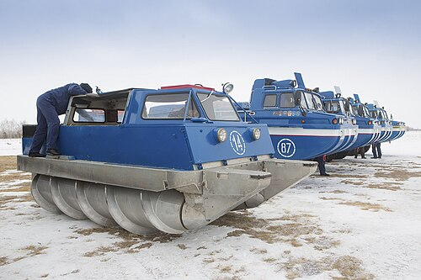
Screw propulsion
Ideal in loose terrain (snow, mud) and ice.

Slide 6
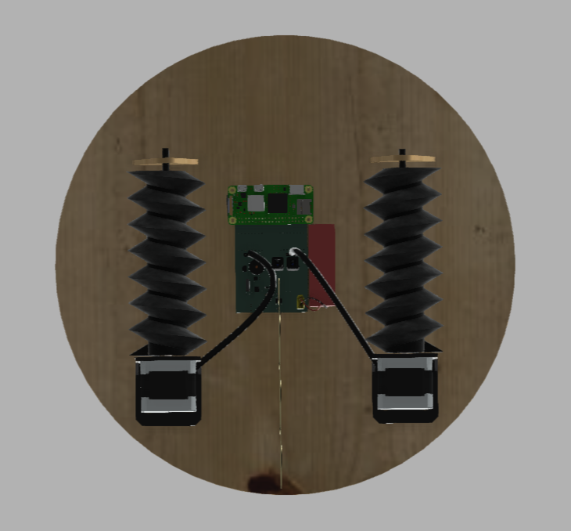
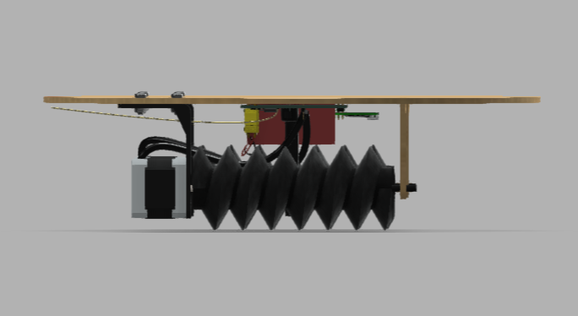

Slide 7
3. Screw-propelled robot
CW helix and CCW helix provide 3 degrees of movement:
Forward/back movement when motors rotate in opposite directions
Sideways movement when they rotate in the same direction
Rotation when only one of the motors is engaged

Slide 8
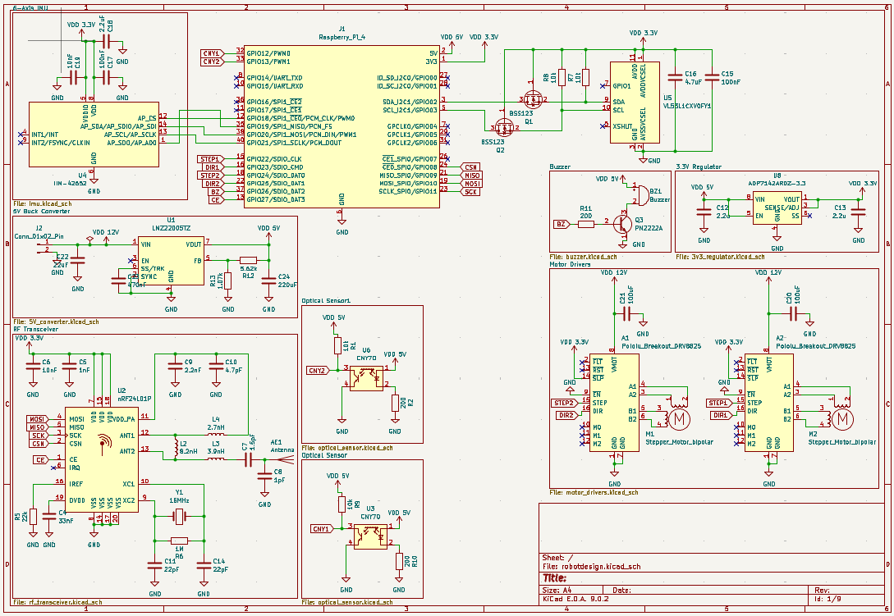
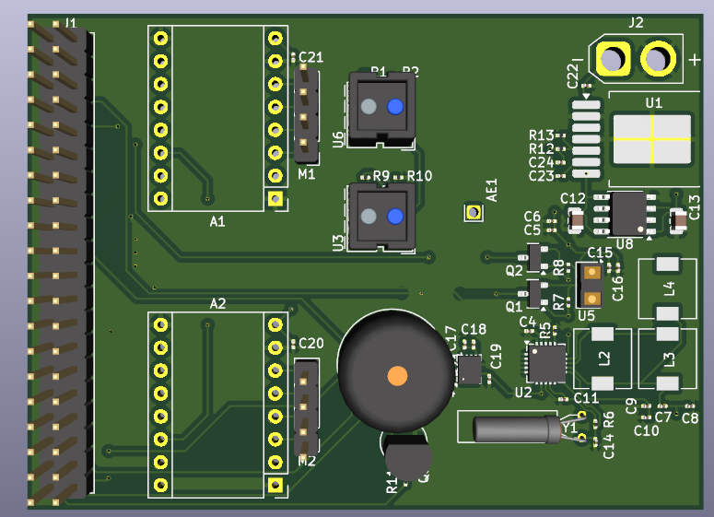
4. Circuits and PCB
Circuits
PCB

Slide 9
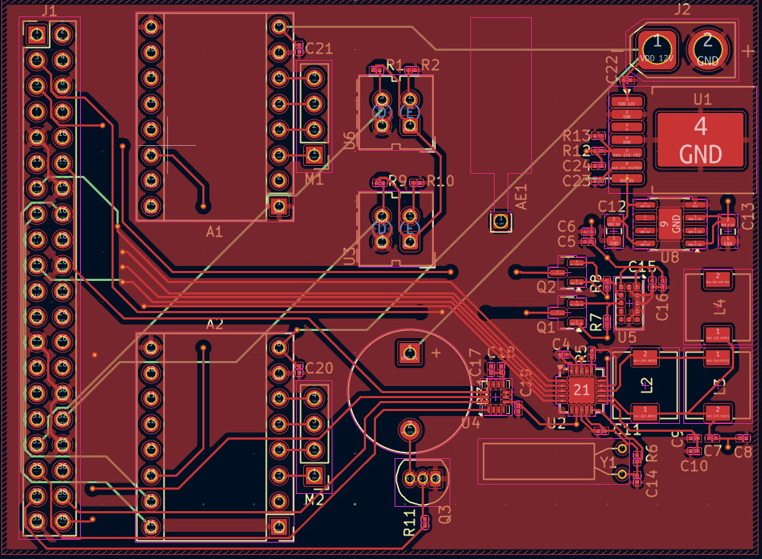
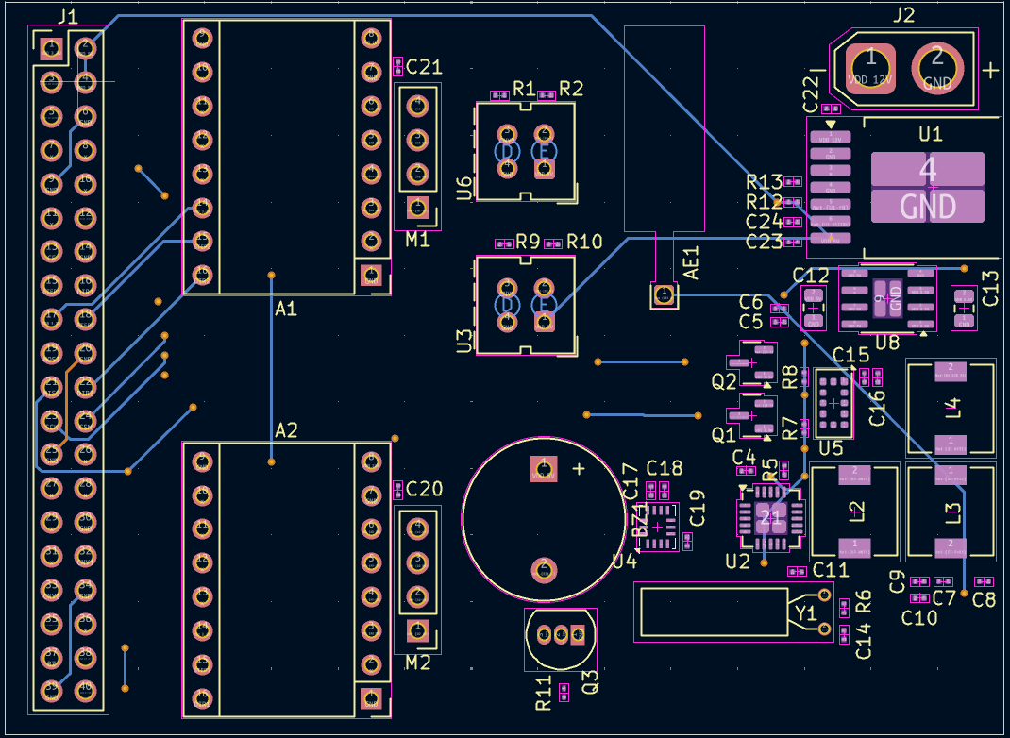
4. Circuits and PCB
Top-view
Bottom-view

