Slide 1
Final Presentation Group B
Bozhidar Bozhikov, Nikita Smolianinov, Vladyslav Uhrik
700.865/866 Basic Lab: Robot Design

Slide 2
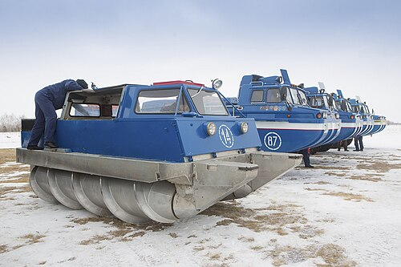
1. Screw propulsion
Ideal in loose terrain (snow, mud) and ice.

Slide 3
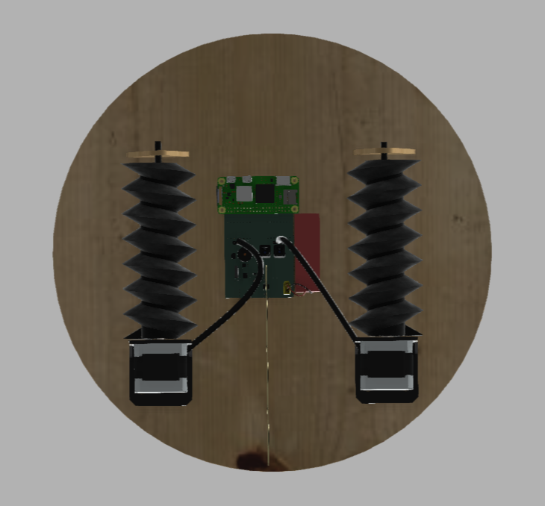
2. Requirements
Main specs: 800g, 100mm/s, 300€
Obstacles: 6cm gaps, darkness
Tasks: 15min running time, line-tracking, RC capability, acoustic feedback

Slide 4
3. Screw-propelled robot
CW helix and CCW helix provide 3 degrees of movement:
Forward/back movement when motors rotate in opposite directions
Sideways movement when they rotate in the same direction
Rotation when only one of the motors is engaged

Slide 5
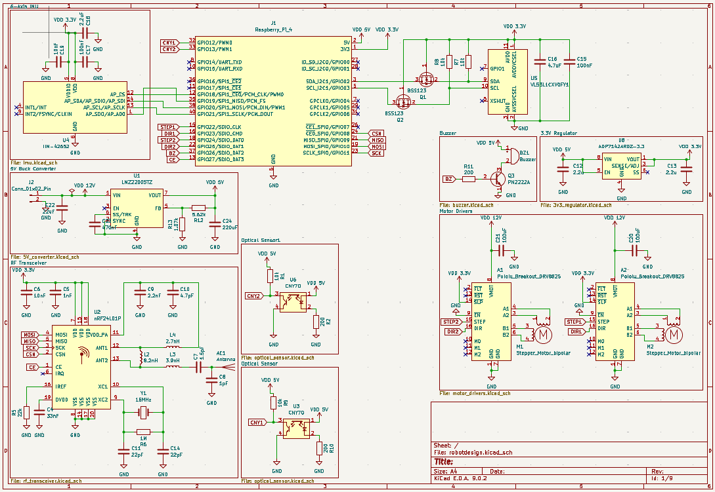
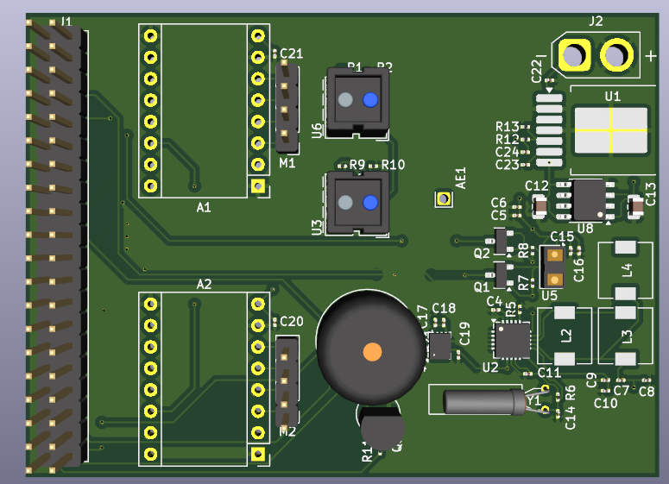
4. Circuits and PCB
Circuits
PCB

