Slide 1
AS005 Supplementary Slides for the activity Surface of the Galilean Moons AA005

Slide 2
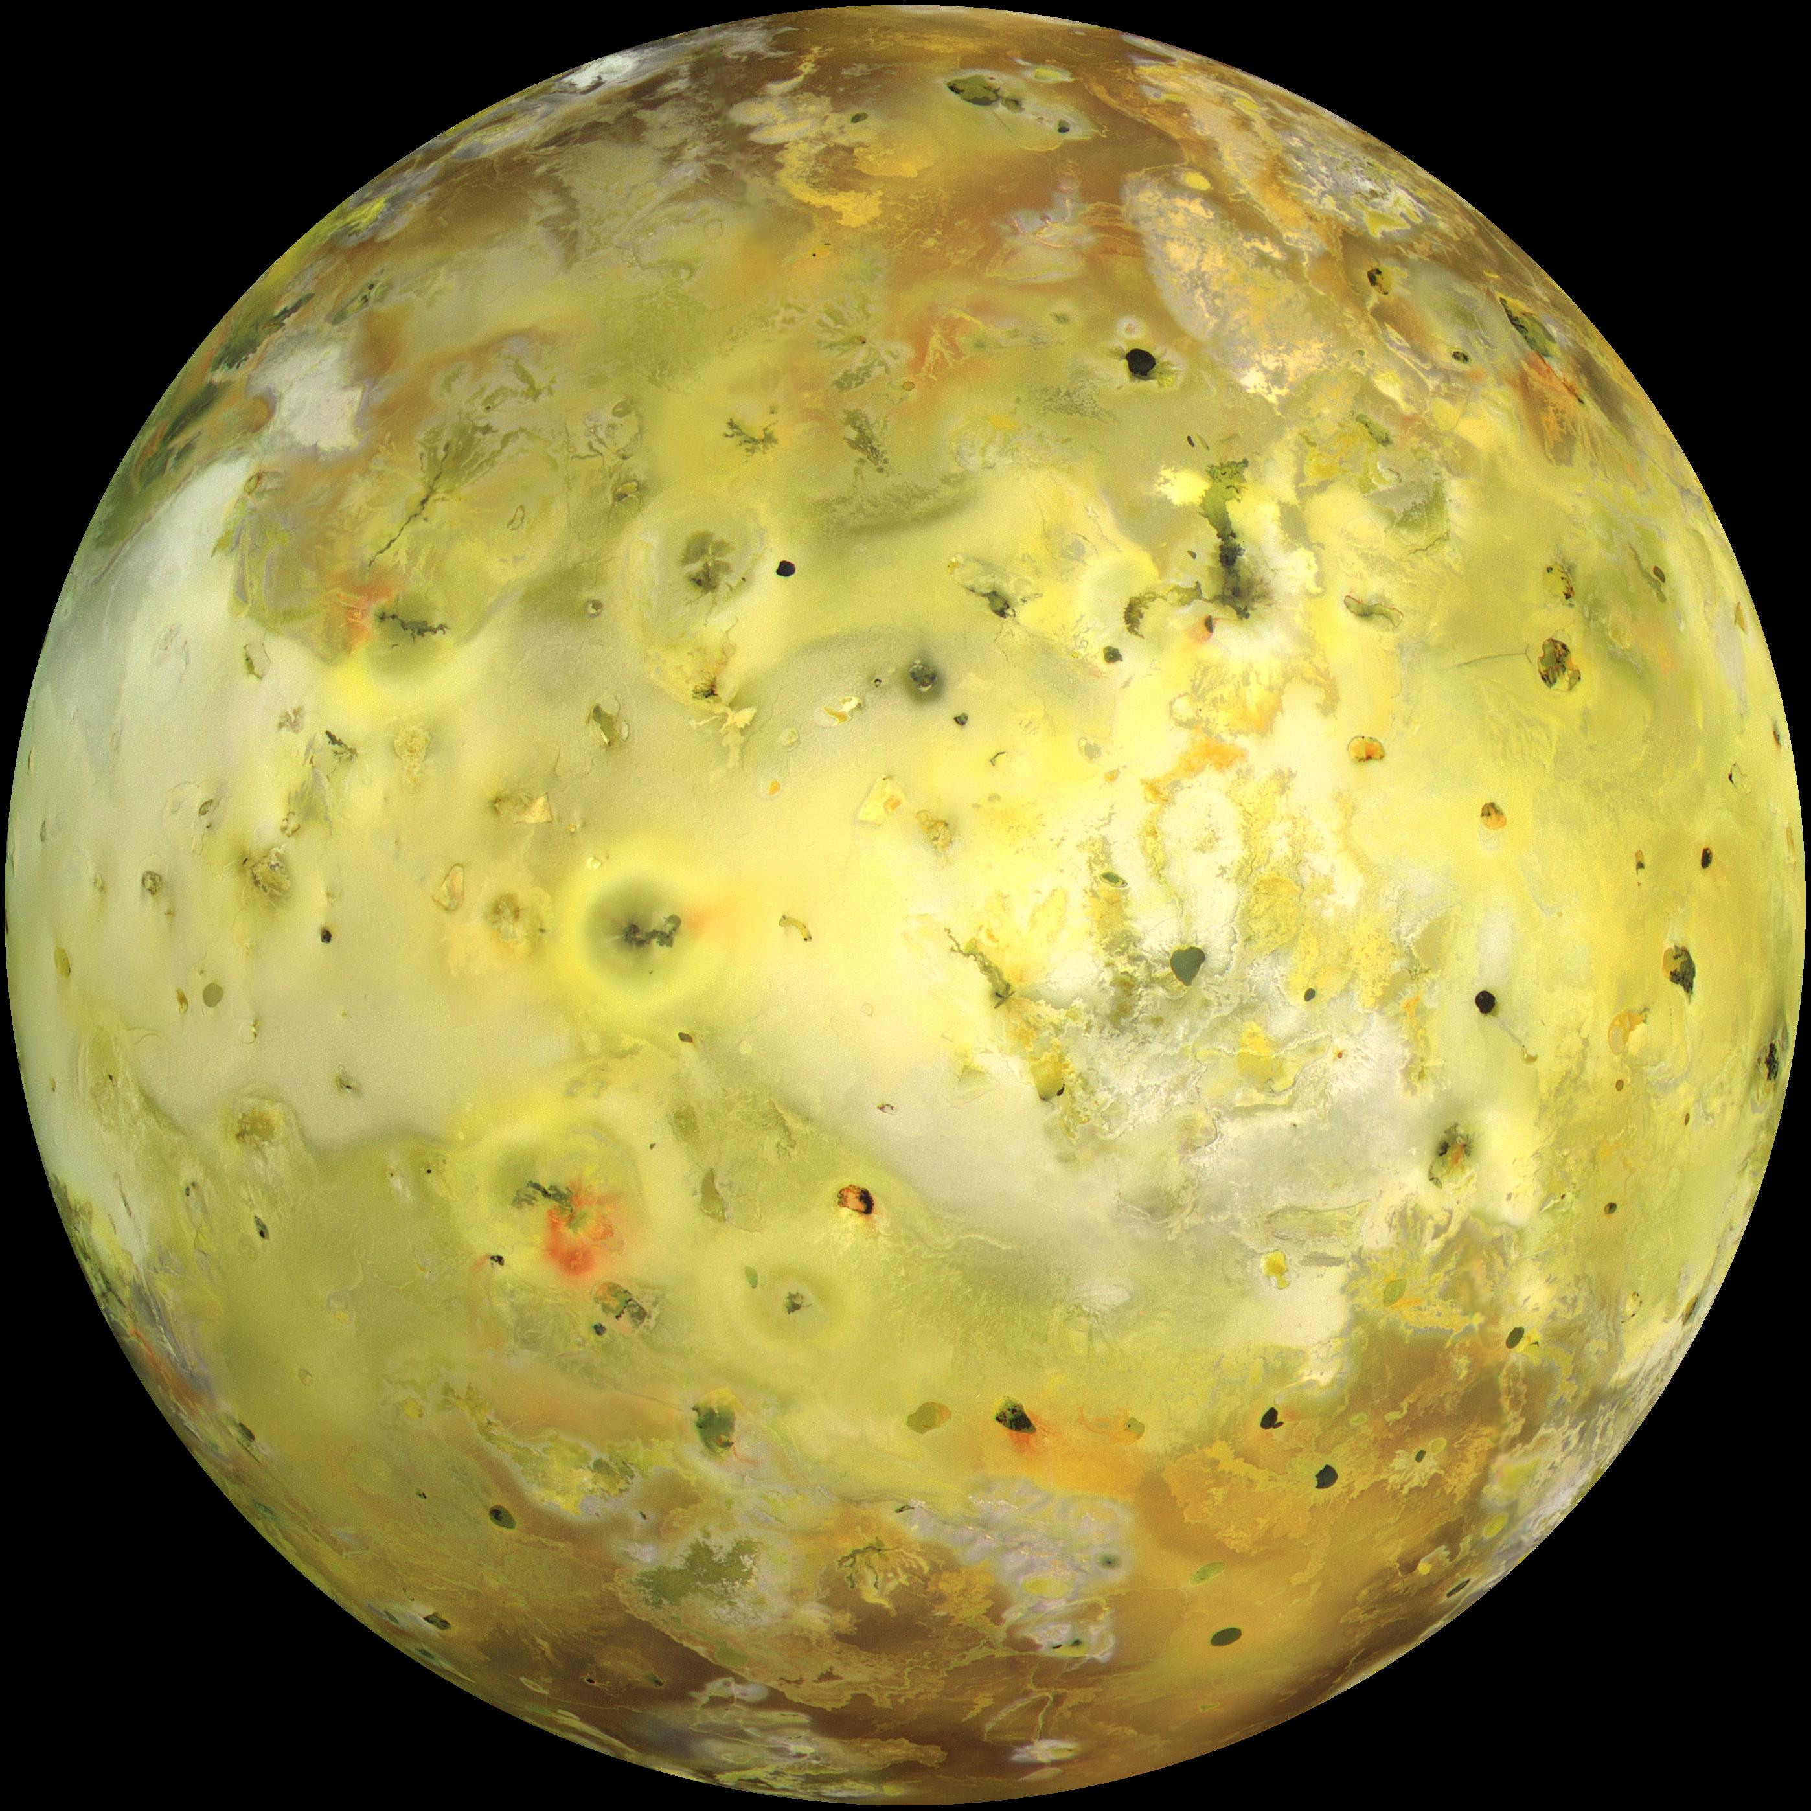
Io
Io true colour PIA02308 NASA/JPL/University of Arizona
Notes:
All images in this ppt were taken from the NASA Photojournal service and the moons were all imaged by the Galileo Orbiter.

Slide 3
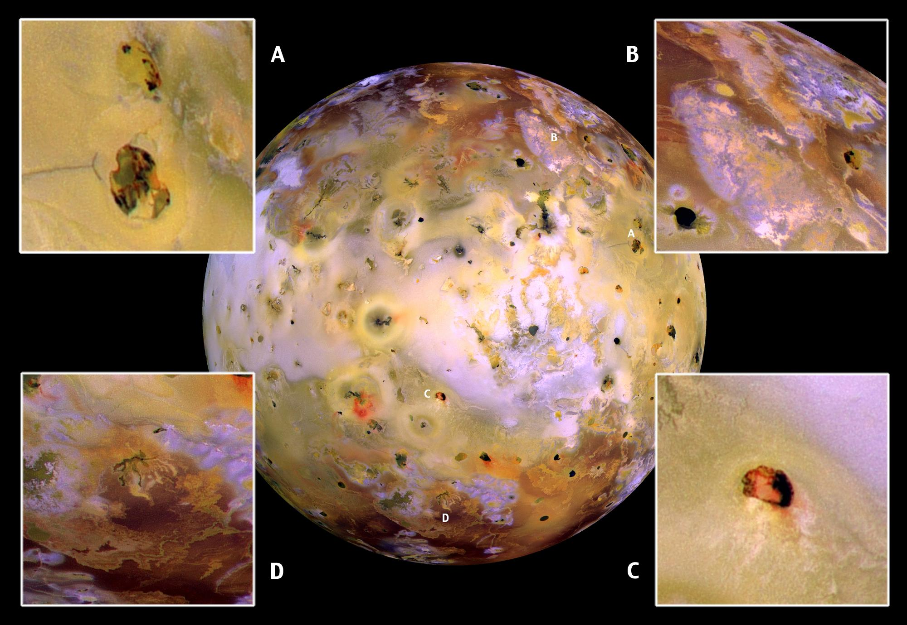
Io
Io PIA02319 NASA/JPL/University of Arizona
Notes:
https://photojournal.jpl.nasa.gov/catalog/PIA02319

Slide 4
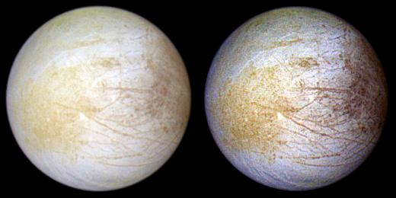
Europa
Europa enhanced colour PIA01295 NASA/JPL/University of Arizona

Slide 5
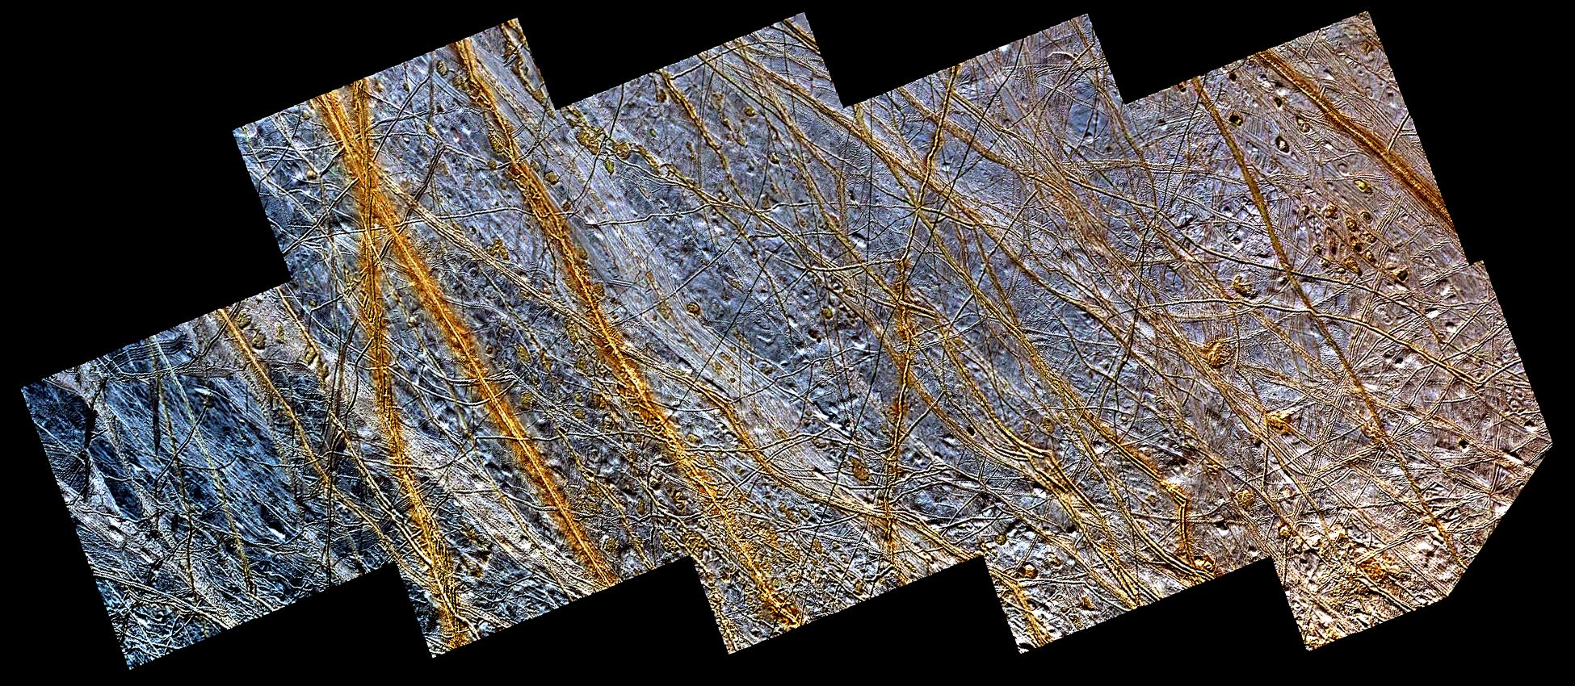
Europa
Europa PIA01641 NASA/JPL/University of Arizona
Notes:
https://photojournal.jpl.nasa.gov/catalog/PIA01641

Slide 6
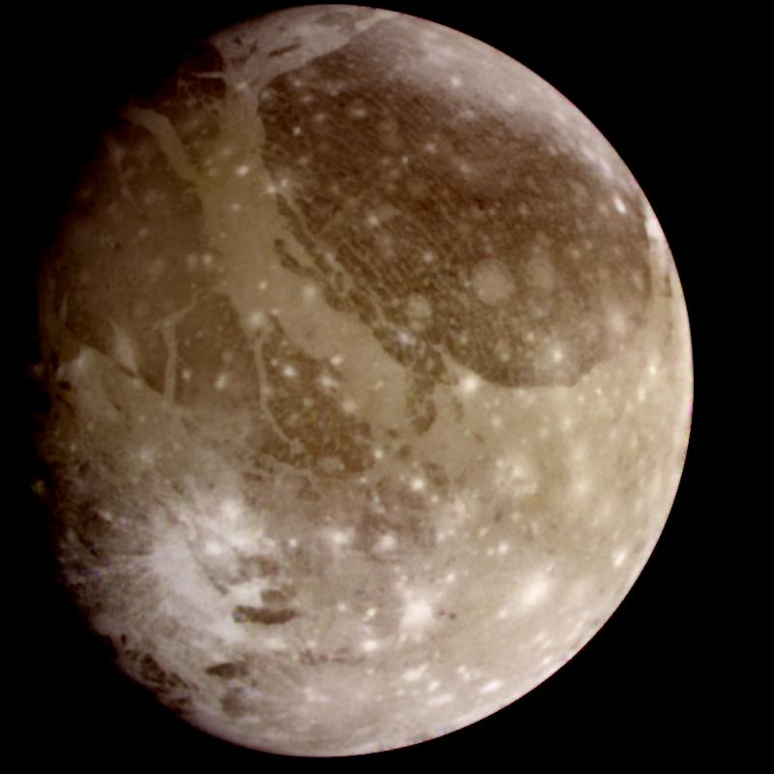
Ganymede
Ganymede true colour PIA00716 NASA/JPL

Slide 7
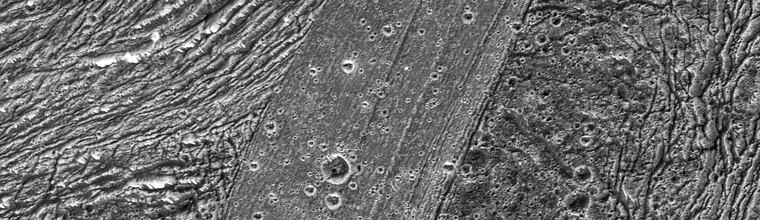
Ganymede
^{Ganymede PIA02572 NASA/JPL}
Notes:
https://photojournal.jpl.nasa.gov/catalog/PIA02572

Slide 8
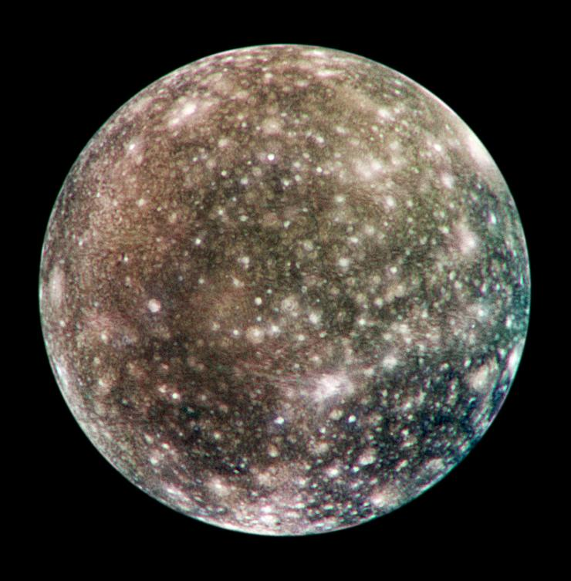
Callisto
Callisto true colour PIA03456 NASA/JPL/DLR

Slide 9
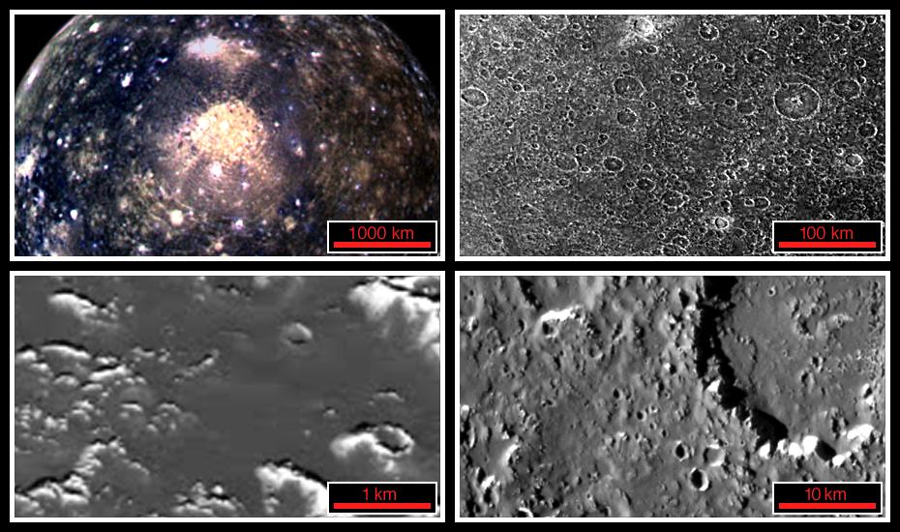
Callisto
^{Callisto PIA01297 NASA/JPL/DLR}
Notes:
https://photojournal.jpl.nasa.gov/catalog/PIA01297

