Slide 1


Bank of Baroda Hackathon - 2022
Technology Partner
Your Team Name : Sardhaka
Your team bio : Sardhaka is the team with the moto of achieving something which indeed results in helping the problem in the society with team members :
1.Sai Praneeth
2.Chethan Sai Akash
3. Vasista vempati
4. Nithin Chiguru
Date : 19-09-22

Slide 2
Problem Statement?
Problem Statement: Banks are using video cameras for the purpose of surveillance at many branches, ATMs and digital lobbies. Getting video analytics of different parameters from the video recording will help the bank to resolve many operational issues at the branches. The bank wants to explore video analytics to understand the customer sentiments, understand the patterns /behaviors/actions in certain branches for proactive surveillance and provide better services to customers.
Why did you decide to solve this Problem statement?
The issue statement provided relates to the security of banks and ATMs, a topic for which a solution is urgently required today. Additionally, employing a video analysis to solve the problem is more closely related to our area of interest, artificial intelligence. Therefore, working on the various video analysis scenarios and attempting to protect ATMs are fairly difficult activities that significantly strengthen our philosophy and the abilities we currently possess.

Slide 3
User Segment & Pain Points
Which user /advertiser segment would be early adopter of your product & why?
The survival department and those that provide survival cameras to banks and other locations that require security are the primary users who will be interested in our idea. because the design we've come up with ought to be put into the cameras that are utilised for survival. Therefore, the following finished product is helpful to the aforementioned individuals.
List of advertiser segments would be early adopter :
1.Security cameras provider
2. Survivalnce department of banks

Slide 4
Pre-Requisite
What are the alternatives/competitive products for the problem you are solving?
There are no similar alternatives to the products for the issue we are resolving, but the hardest part of developing a solution is integrating artificial intelligence models into the hardware or software, for example, the CC camera we used as part of our solution. We also need to ensure that the product we develop is flawlessly okay and precisely functions for the security system. the development of a lightweight, adaptable, and feasibly priced solution, both in terms of hardware and software, is the second major challenge.

Slide 5
Azure tools or resources
Azure tools or resources which are likely to be used by you for the prototype, if your idea gets selected Tools such as Azure video indexer : Tools such as Azure video indexer : which is used to m access media from existing content by using the media AI-based video editor. Find the right media content in your library, locate the pieces you want to use, and stitch them together into a new video. When you're happy with the result, render and download the video and use it in your own editing applications or downstream workflow. Azure Cognitive Services-Computer vision : Based on the items or live beings found in the image, the Detect API assigns tags. The object detection taxonomy and the tagging taxonomy do not presently have a formal link. Conceptually, the Tag API may also contain contextual phrases like "indoor," which cannot be localised with bounding boxes, but the Detect API can only detect objects and living creatures. These are the example tools/Services of azure we wish to use if our idea gets selected

Slide 6
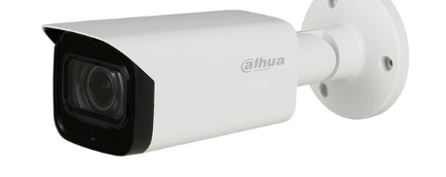
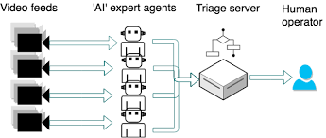


Any Supporting Functional Documents
Present your solution, talk about methodology, architecture & scalability
AI CCTV is the idea of adding a layer of Artificial Intelligence to security camera technology, allowing users to get more out of their CCTV imagery. The ‘AI layer’ can be added at various points of the technology stack - at camera-level, NVR-level or at a cloud-level.
Web-based monitoring dashboard that is compatible with any laptop or desktop computercompatibility—the device instantly transcodes a variety of video codecsOperator receives the most crucial messages because to triage logicvisible and audible notifications. Autofocus and zoomMonitors variations in Fluidity and Occupancy levels using the Pattern of Life Detector.Object detector for explosives, assault rifles, and other small armsScene abnormalities include flames, explosions, rapid crowd movement, etc.

Slide 7
Key Differentiators & Adoption Plan
How is your solution better than alternatives and how do you plan to build adoption?
AI CCTV is the idea of adding a layer of Artificial Intelligence to security camera technology, allowing users to get more out of their CCTV imagery. The ‘AI layer’ can be added at various points of the technology stack - at camera-level, NVR-level or at a cloud-level.
As opposed to many other options, we believe that our proposal is one of the considerably superior ones. The model is inexpensive since it is lightweight and doesn't require any additional tools to assemble. Additionally, the system is lightweight from both a hardware and software viewpoint.

Slide 8
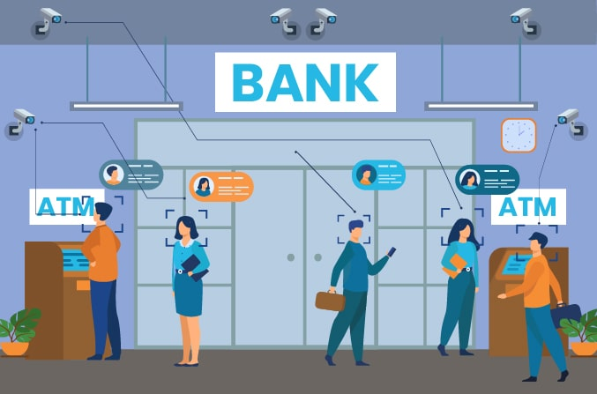
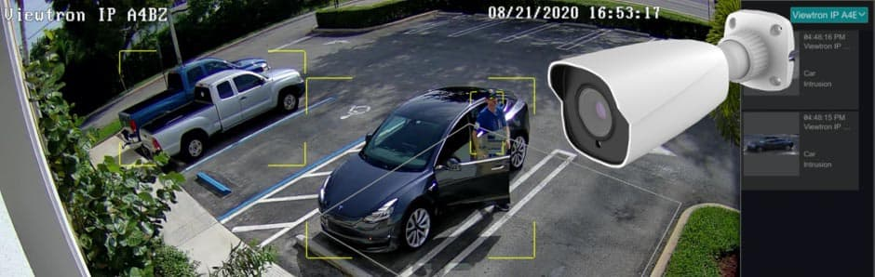
GitHub Repository Link & supporting diagrams, screenshots, if any
How far it can go?
https://github.com/SharpAI/DeepCamera

Slide 9
Thank You
Team member names

