Slide 1
Credit Card Fraud Detection using Deep ANN
TEAM MEMBERS
2000030740 PANTANGI LOKESH
2000030886 HARSH VARDHAN REDDY SADI
2000030914 SASI PRIYANKA JAMPANI

Slide 2
ABSTRACT
The abstract focuses on developing a credit card fraud detection system using Deep Artificial Neural Networks (ANNs). The project aims to utilize historical transaction data to train the deep ANNs to identify patterns indicative of fraudulent transactions. The goal is to build an accurate and efficient system that can help banks, merchants, and consumers detect and prevent fraudulent credit card transactions.

Slide 3
Dataset
Credit Card Fraud Detection: https://www.kaggle.com/datasets/mlg-ulb/creditcardfraud?resource=download
ABOUT DATASET:
The dataset contains transactions made by credit cards in September 2013 by European cardholders.
This dataset presents transactions that occurred in two days, where we have 492 frauds out of 284,807 transactions. The dataset is highly unbalanced, the positive class (frauds) account for 0.172% of all transactions.

Slide 4
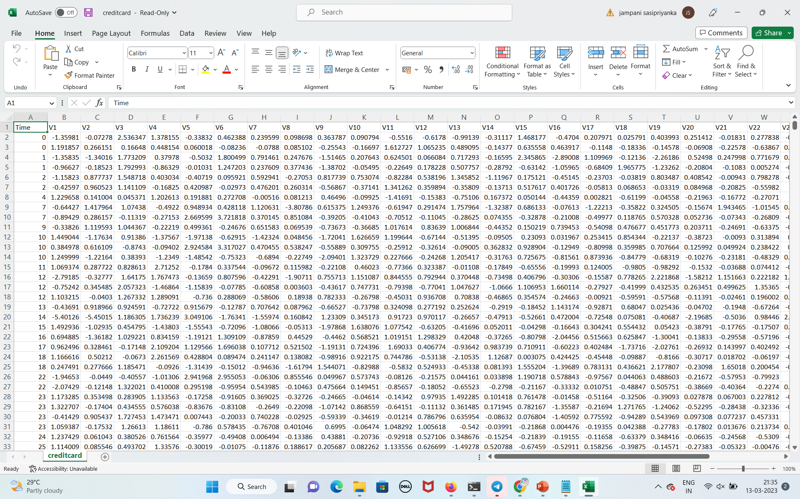

Slide 5
algorithm for Credit Card Fraud Detection using a Deep Artificial Neural Network (Deep ANN):
1. Load and pre-process the data:
Load the credit card transaction data set
Split the data into training and testing sets
Normalize the data to have zero mean and unit variance
2.Define the architecture of the Deep ANN model with 2 hidden layers and an output layer with a sigmoid activation function.
3.Compile the model with binary cross-entropy loss and accuracy metric.

Slide 6
4.Train the Deep ANN model for 20 epochs on the training data.
5.Evaluate the model on the test data using confusion matrix, F1 score, precision, and recall.
6.Plot the training and validation accuracy and loss curves over time.
7.Improve the model performance by adding a dropout layer.
8.Define multiple Deep ANN models with different optimizers and losses.
9.Train each model for 10 epochs and evaluate them on the test data.

Slide 7
10.Print and plot the accuracy of each model.
11. Compare the best accurate model from the plot.

Slide 8
IMPLEMENTATION
import pandas as pd
import numpy as np
import tensorflow as tf
from sklearn.model_selection import train_test_split
from sklearn.metrics import confusion_matrix, f1_score, precision_score, recall_score
from sklearn.preprocessing import StandardScaler
from tensorflow.keras.models import Sequential
from tensorflow.keras.layers import Dense, Dropout
from tensorflow.keras.optimizers import Adam, SGD, RMSprop, Adagrad, Adadelta
from tensorflow.keras.losses import BinaryCrossentropy, Hinge, SquaredHinge,
CategoricalCrossentropy, MeanSquaredError, Poisson
# Load the creditcard.csv file
data = pd.read_csv('creditcard.csv')
X = df.drop('Class', axis=1)
y = df['Class']
X_train, X_test, y_train, y_test = train_test_split(X, y, test_size=0.2, stratify=y,
random_state=42)
# Scale the data
scaler = StandardScaler()
X_train = scaler.fit_transform(X_train)
X_test = scaler.transform(X_test)
# Define architecture the Deep ANN
model = tf.keras.models.Sequential([
tf.keras.layers.Dense(64, activation='relu'),
tf.keras.layers.Dense(32, activation='relu'),
tf.keras.layers.Dense(1, activation='sigmoid')
])
# Compile the Deep ANN
model.compile(optimizer='adam', loss='binary_crossentropy', metrics=['accuracy'])
# Improve the Deep ANN
model.add(tf.keras.layers.Dropout(0.2))
model.fit(X_train, y_train, epochs=20, batch_size=32, validation_data=(X_test, y_test))
# Define the models
models = []
models.append(('Adam', Sequential([Dense(32, activation='relu', input_shape=(30,)),
Dropout(0.5), Dense(16, activation='relu'), Dropout(0.5), Dense(1, activation='sigmoid')])))
models.append(('SGD', Sequential([Dense(32, activation='relu', input_shape=(30,)),
Dropout(0.5), Dense(16, activation='relu'), Dropout(0.5), Dense(1, activation='sigmoid')])))
models.append(('RMSprop', Sequential([Dense(32, activation='relu', input_shape=(30,)),
Dropout(0.5), Dense(16, activation='relu'), Dropout(0.5), Dense(1, activation='sigmoid')])))
models.append(('Adagrad', Sequential([Dense(64, activation='relu', input_shape=(30,)),
Dropout(0.2), Dense(32, activation='relu'), Dropout(0.2), Dense(1, activation='sigmoid')])))
models.append(('Adadelta', Sequential([Dense(64, activation='relu', input_shape=(30,)),
Dropout(0.2), Dense(32, activation='relu'), Dropout(0.2), Dense(1, activation='sigmoid')])))

Slide 9
# Train the models
results = []
for name, model in models:
if name == 'Adam':
optimizer = Adam(lr=0.001)
loss = BinaryCrossentropy()
elif name == 'SGD':
optimizer = SGD(lr=0.001)
loss = Hinge()
elif name == 'RMSprop':
optimizer = RMSprop(lr=0.001)
loss = SquaredHinge()
elif name == 'Adagrad':
optimizer = Adagrad(lr=0.01)
loss = CategoricalCrossentropy()
elif name == 'Adadelta':
optimizer = Adadelta(lr=0.001)
loss = MeanSquaredError()
else:
continue
model.compile(optimizer=optimizer, loss=loss, metrics=['accuracy'])
history = model.fit(X_train, y_train, validation_split=0.2, epochs=10, batch_size=64,
verbose=0)
result = model.evaluate(X_test, y_test, verbose=0)
results.append((name, result[1] * 100.0))
# Print the results
for name, acc in results:
print("%s: %.2f%%" % (name, acc))
import matplotlib.pyplot as plt
# Plot the results
names = [name for name, _ in results]
accuracies = [acc for _, acc in results]
plt.bar(names, accuracies)
plt.ylim([90, 100])
plt.title('Accuracy of Different Optimizers')
plt.xlabel('Optimizer')
plt.ylabel('Accuracy')
plt.show(
IMPLEMENTATION

Slide 10
ADVANTAGES FOR CREDIT CARD FRAUD DETECTION USING DEEP ANN
Improved Accuracy: Deep ANNs can analyze large volumes of transaction data with a high degree of accuracy. They can detect complex patterns and anomalies that might be difficult for traditional methods to identify.
Real-Time Detection: Deep ANNs can analyze transactions in real-time, allowing for immediate detection and prevention of fraudulent activity. This can help prevent financial losses from accumulating and minimize the impact on customers.
Scalability: Deep ANNs can scale to handle large datasets, making them well-suited for financial institutions that process a high volume of transactions. They can analyze data quickly and efficiently, allowing for faster fraud detection.
Adaptability: Deep ANNs can adapt to changes in the patterns of fraudulent activity over time. As fraudsters develop new techniques and strategies, deep ANNs can continue to learn and improve their ability to detect fraudulent transactions.

