Slide 1
A DATA FAIRNESS CASE STUDY
Examining Adult Income
Dataset Bias
Exploratory data analysis of demographic and socioeconomic bias in the UCI Adult Income Dataset
Python • Pandas • NumPy • Matplotlib
VALABOJU SHIVA KUMAR CHARY
DIVYA SAI SUKANYA INDALA

Slide 2
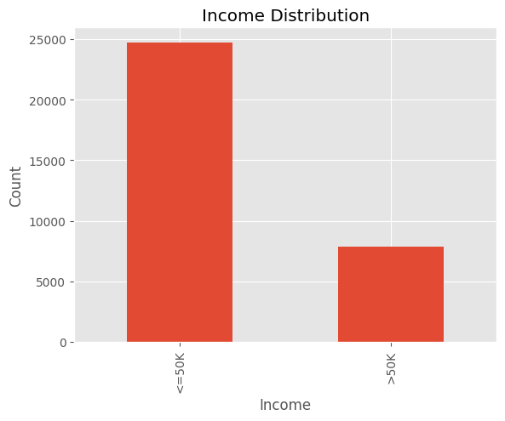
Project Overview
Machine learning models learn patterns directly from training data. When that data carries demographic imbalance, the resulting predictions can too. This project applies exploratory data analysis (EDA) to the Adult Income Dataset to surface bias before it reaches a model.
1
Gender Compare income outcomes across male and female records
2
Race Assess representation and income gaps across racial groups
3
Age & Education Examine how age and education levels shape the sample
Figure 1 · Income Distribution
4
Income Map how income splits across every demographic slice
~ 32,561 records, split into ≤ $50K and > $50K income bands
ADULT INCOME DATASET BIAS
2

Slide 3
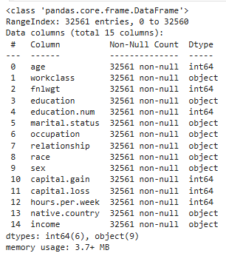
The Dataset
The UCI Adult Income Dataset (1994 U.S. Census) captures demographic and work-related attributes used to predict whether an individual earns above or below $50,000 a year.
32,561
15
38.6 yrs
40.4 hrs
Records
Variables
Average age
Avg. hours / week
Includes: age, workclass, education, marital status, occupation, relationship, race, sex, capital gain/loss, hours per week, native country, and income class.
Figure 2 · Dataset Overview (df.info())
No missing values across all 15 columns
ADULT INCOME DATASET BIAS
3

Slide 4
Methodology
1
2
3
4
Load & Validate
Explore Demographics
Visualize
Identify Bias
Load the dataset with Pandas and confirm there are no missing values across records.
Profile gender, race, age, and education distributions using descriptive statistics.
Build bar charts, histograms, and cross-tabulations with Matplotlib and NumPy.
Compare income outcomes across groups to flag representation and outcome gaps.
Tooling: Python · Pandas · NumPy · Matplotlib
ADULT INCOME DATASET BIAS
4

Slide 5
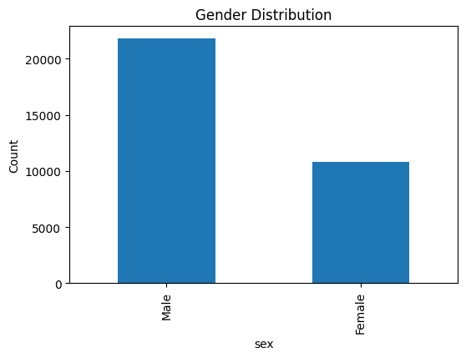
Gender Distribution
A clear sample imbalance
The dataset contains noticeably more male than female records. Any model trained on this sample inherits that imbalance — with fewer female examples to learn from, predictions for women are more likely to be less reliable.
Sample skew observed in
Male vs. Female records
Fewer women in the sample means less data richness for that group.
Figure 3 · Distribution of Gender
ADULT INCOME DATASET BIAS
5

Slide 6
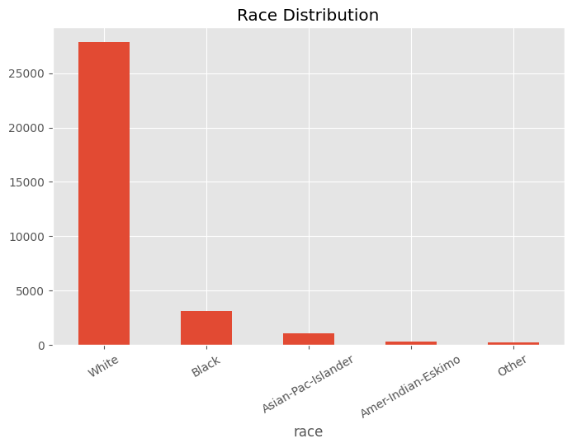
Race Distribution
White
85.43%
Black
9.59%
Asian-Pacific Islander
3.19%
Amer-Indian-Eskimo
0.96%
Other
0.83%
White individuals dominate the sample, while Black, Asian-Pacific Islander, Amer-Indian-Eskimo, and Other groups together make up less than 15%.
Figure 4 · Distribution of Races
ADULT INCOME DATASET BIAS
6

Slide 7
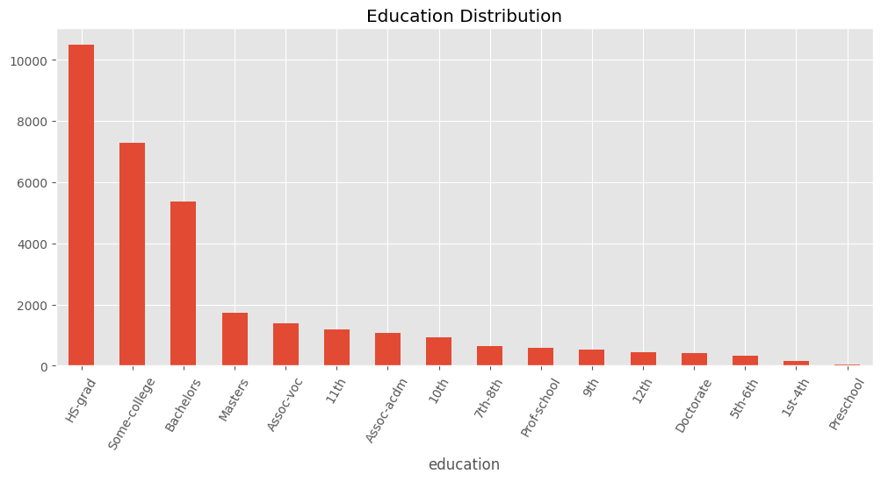
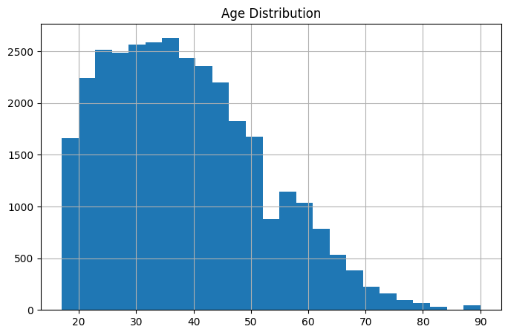
Age & Education Distribution
Figure 5 · Distribution of Ages
Most individuals fall between ages 28 and 48, tapering off sharply after 60.
Figure 6 · Distribution of Education
Some-college and high-school completion dominate; advanced degrees are rare.
ADULT INCOME DATASET BIAS
7

Slide 8
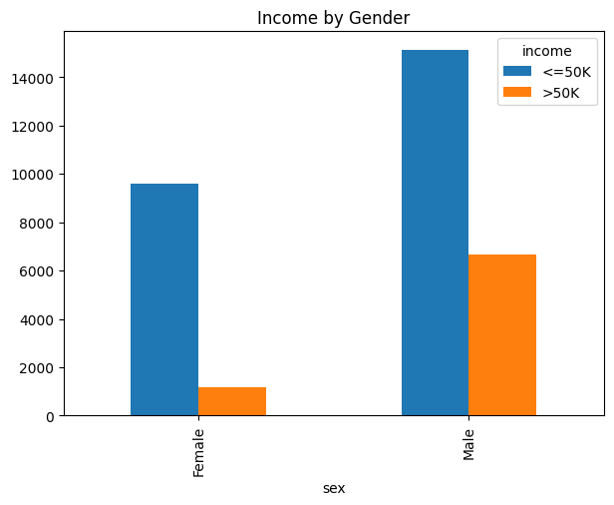
Income by Gender
10.95%
of women earn > $50K
89.05% earn ≤ $50K
30.57%
of men earn > $50K
69.43% earn ≤ $50K
Figure 7 · Gender-specific Income
ADULT INCOME DATASET BIAS
8

Slide 9
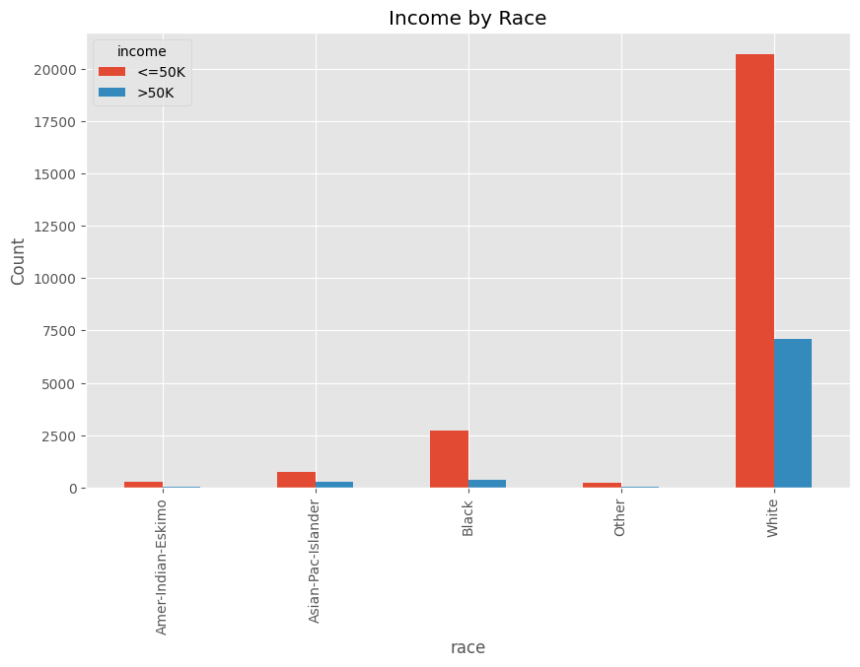
Income by Race
Minority groups see far fewer high-income outcomes
The White group dominates both income bands simply because it dominates the sample. But even accounting for scale, high-income outcomes (> $50K) are disproportionately lower for minority populations.
Figure 8 · Income by Race
ADULT INCOME DATASET BIAS
9

Slide 10
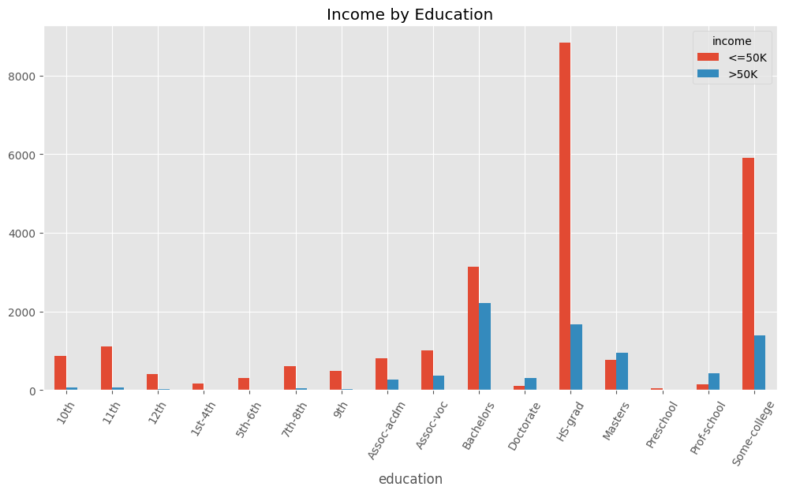
Income by Education
Education tracks strongly with income
Bachelor's, Master's, Professional-school, and PhD holders earn above $50K at noticeably higher rates than those with less education — the clearest, most consistent signal in the dataset.
Higher education
→ higher likelihood of > $50K income
Figure 9 · Education and Income
ADULT INCOME DATASET BIAS
10

Slide 11
Biases Found
1
Gender Bias
2
Race Bias
3
Education Bias
Men are more likely than women to earn more than $50,000.
Minority groups are underrepresented while White individuals dominate the sample.
Higher income is strongly associated with higher levels of education.
4
Representation Bias
5
Historical Bias
The dataset is unevenly distributed across demographic groups.
The data reflects the 1994 U.S. Census's socioeconomic conditions of that era.
11

Slide 12
Conclusion
The Adult Income Dataset carries clear socioeconomic and demographic biases. Income distribution varies meaningfully by gender, race, and education, and several groups are conspicuously underrepresented in the sample.
Key Takeaway
Audit before you train.
These findings underscore why datasets need a fairness audit before they're used to train machine learning models. Fairness-aware techniques and more representative data collection can help reduce prejudice and support responsible AI development.
Detecting demographic imbalance in training data is a prerequisite for building equitable, responsible AI systems — not an afterthought.
ADULT INCOME DATASET BIAS
12

Slide 13
References
UCI Machine Learning Repository. Adult Dataset.
Dua, D., & Graff, C. UCI Machine Learning Repository.
Barocas, S., Hardt, M., & Narayanan, A. Fairness and Machine Learning.
Mehrabi, N., et al. (2021). A Survey on Bias and Fairness in Machine Learning.
IBM AI Fairness 360 Documentation.
ADULT INCOME DATASET BIAS
13

