Slide 1
Neural Networks in Genetic Epidemiology ——Statistical Learning for Complex Diseases
Yifan Wang
2024.10.16

Slide 2
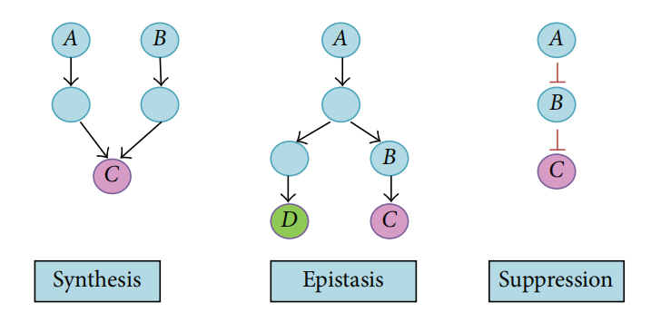
Understanding Complex Diseases
Complex diseases involve multiple genetic and environmental factors
Genetic epidemiology identifies gene-environment and gene-gene interactions.
Challenge: Interactions are non-linear, making traditional models insufficient.

Slide 3
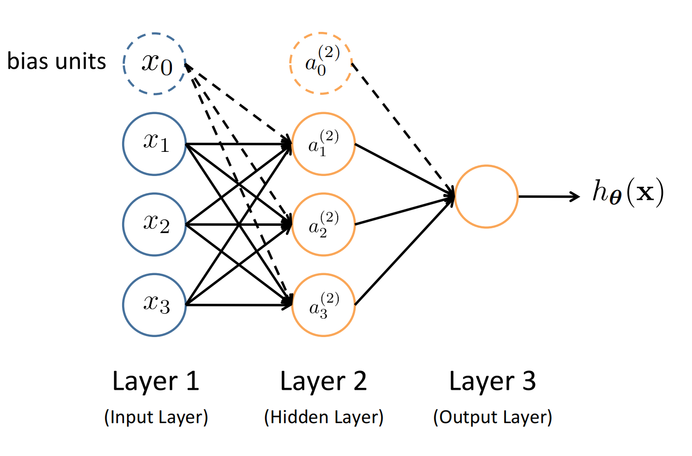
Why Neural Networks for Genetic Epidemiology?
Analyzing non-linear relationships
Adaptability to High-dimensional data
Flexibility

Slide 4
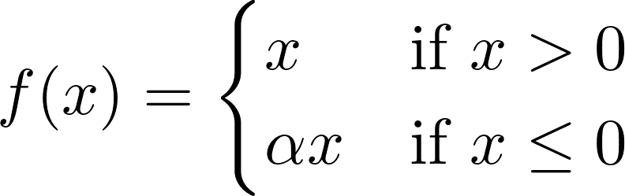
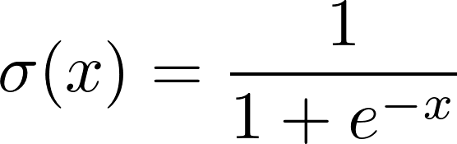
Deep Neural Network Techniques
Activation Functions
Leaky ReLU (Rectified Linear Unit) ( hidden layers )
Sigmoid ( binary classification output layers )
Optimization
Cross-entropy loss function to maximize prediction accuracy.

Slide 5

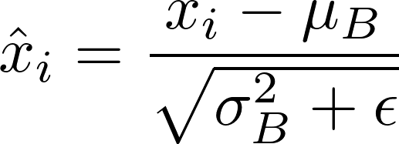
Regularization Techniques
Objective: Preventing Overfitting
Dropout: Prevents over-reliance on specific neurons by randomly dropping units during training
Batch Normalization: Normalizes activations to stabilize and accelerate training

Slide 6
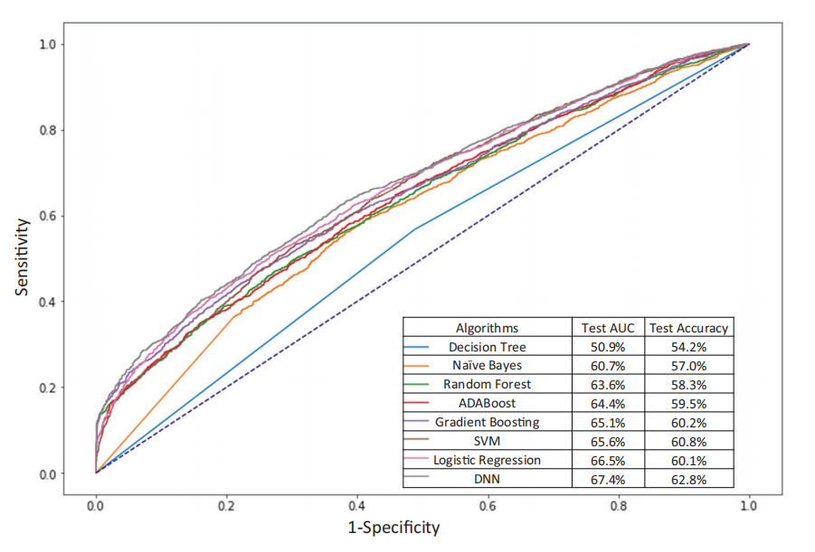
Deep Neural Networks (DNN) for Polygenic Risk Scores (PRS)
Methodology
Detect subtle genetic variant missed in other models
Non-linear interactions
Model Performance
Highest Test AUC (67.4%)
Highest Test Accuracy (62.8%)

Slide 7
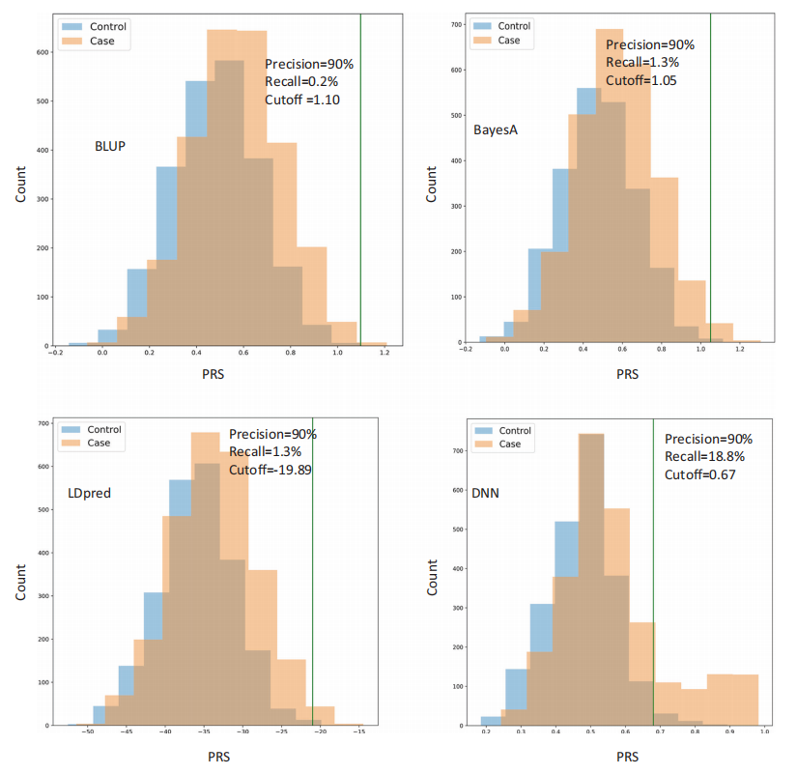
DNN Insights – Bimodal Distribution and Risk Stratification
Interpretation: Indicates DNN can effectively
separate the population into high-risk and
normal-risk subgroups.
Implication: Captures non-linear relationships
missed by traditional models.

Slide 8
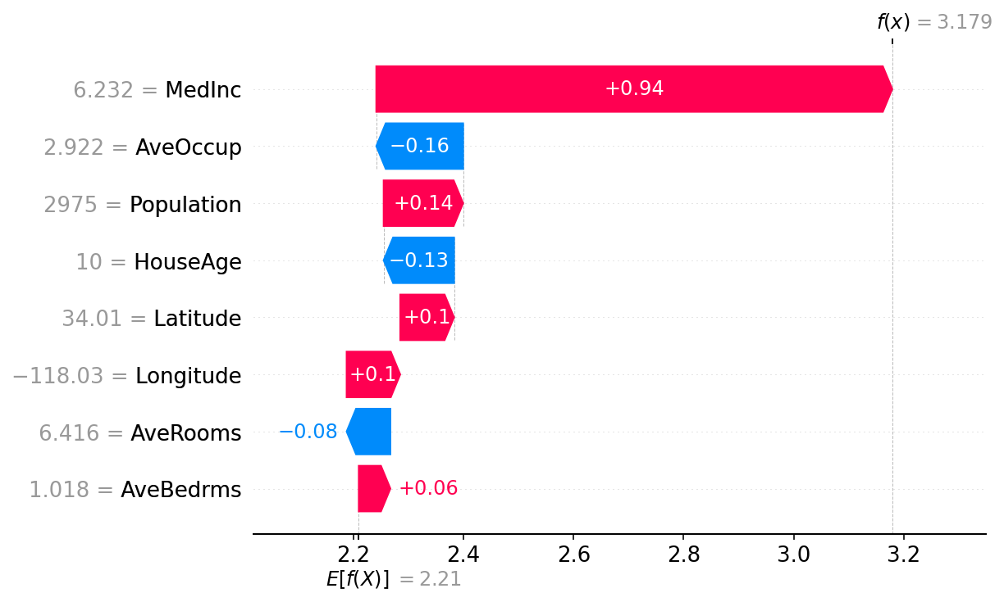
Challenges in Neural Network Interpretability
Black-box nature: Difficult to interpret
Tools: Explainable AI ( SHAP / LIME )
Impact on clinical use: Lack of transparency limits adoption in healthcare settings​​.

Slide 9
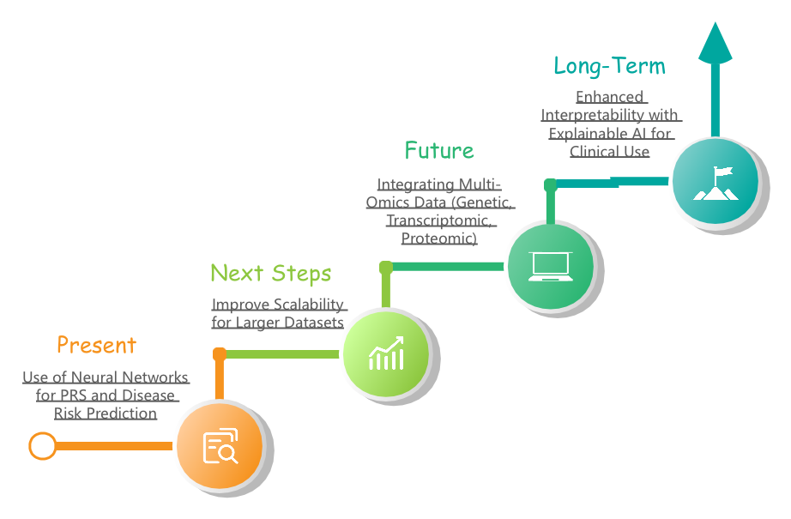
Future Directions in Neural Networks

Slide 10
Conclusion
Neural networks are effective for detecting complex, non-linear gene interactions.
Challenges: Interpretability and overfitting require attention.
Future: Focus on integrating more data types and improving transparency for broader clinical application​​.

