Slide 1
C355 ESE Dashboard
File created on: 07/02/2022 20:36:07

Slide 2
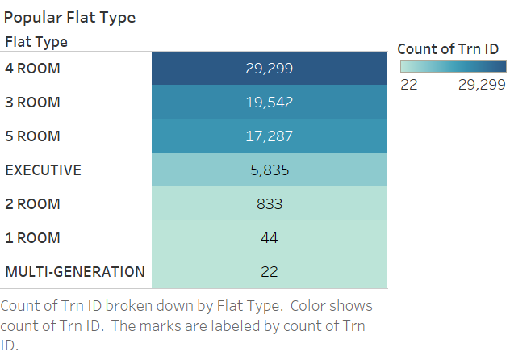

Slide 3
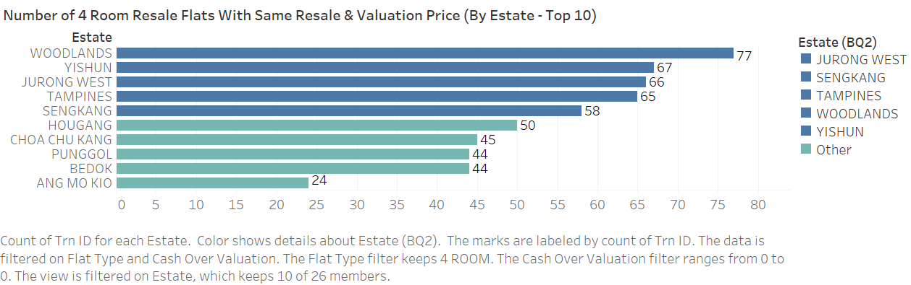

Slide 4
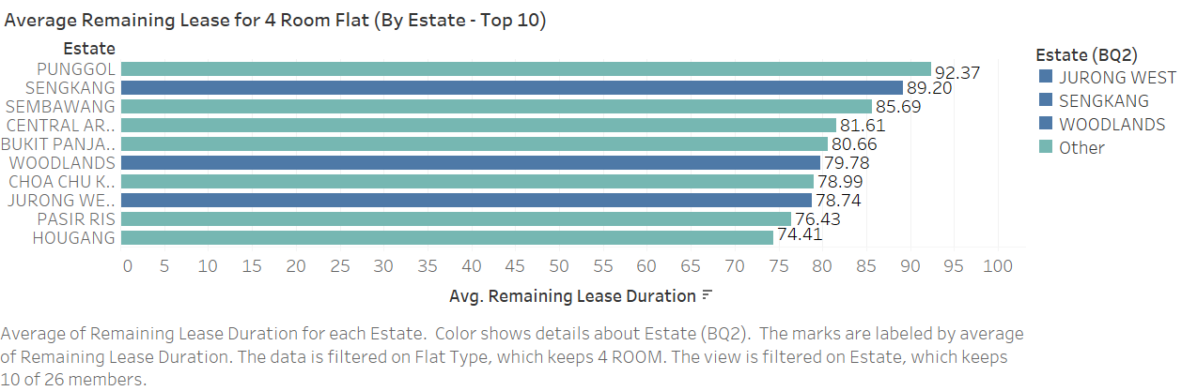

Slide 5
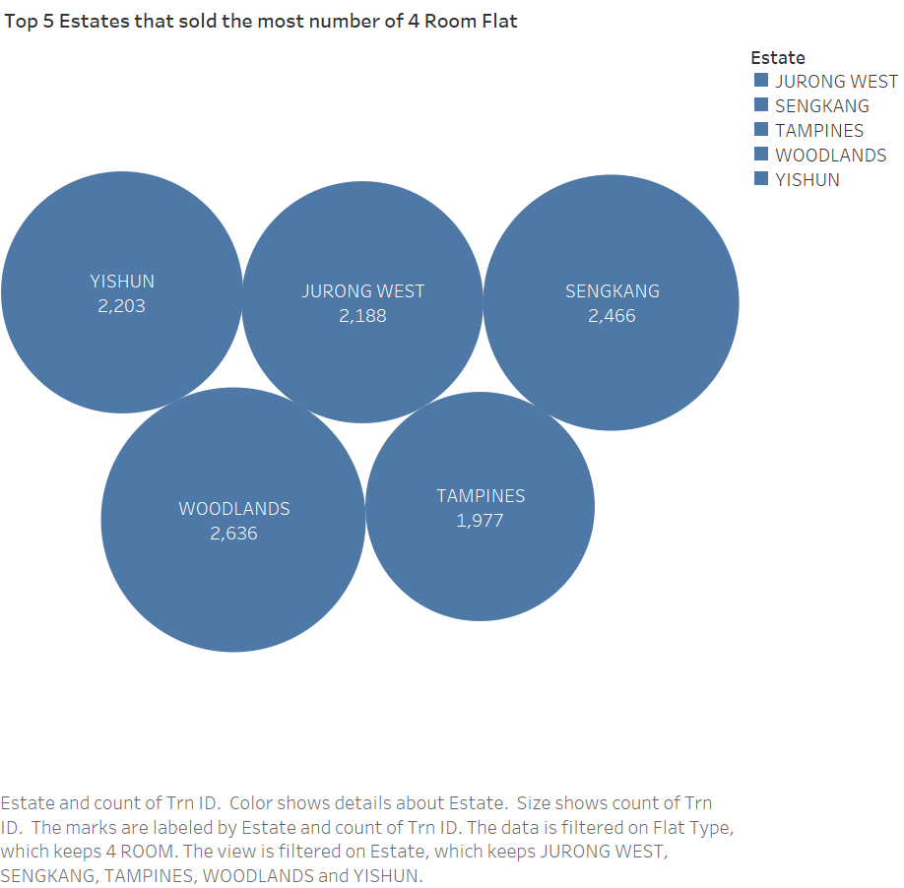

Slide 6
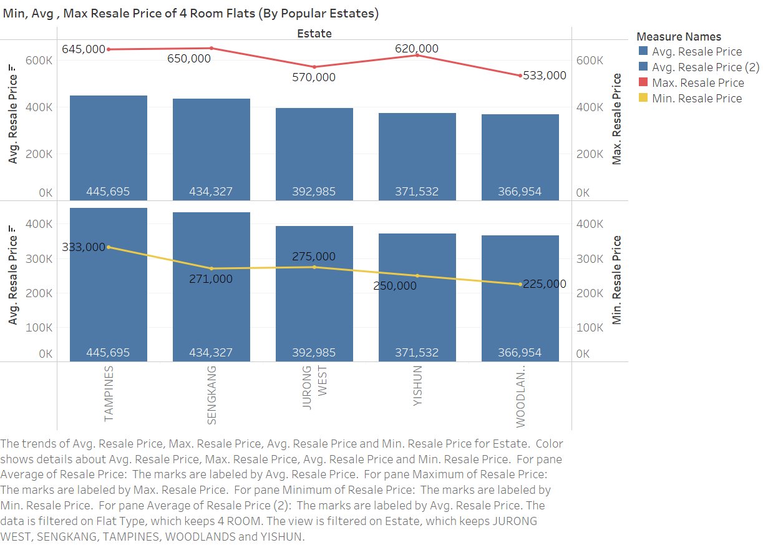

Slide 7
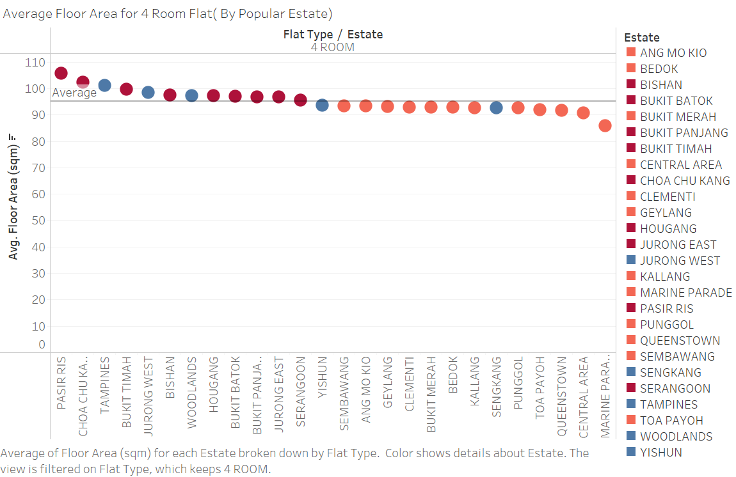

Slide 8
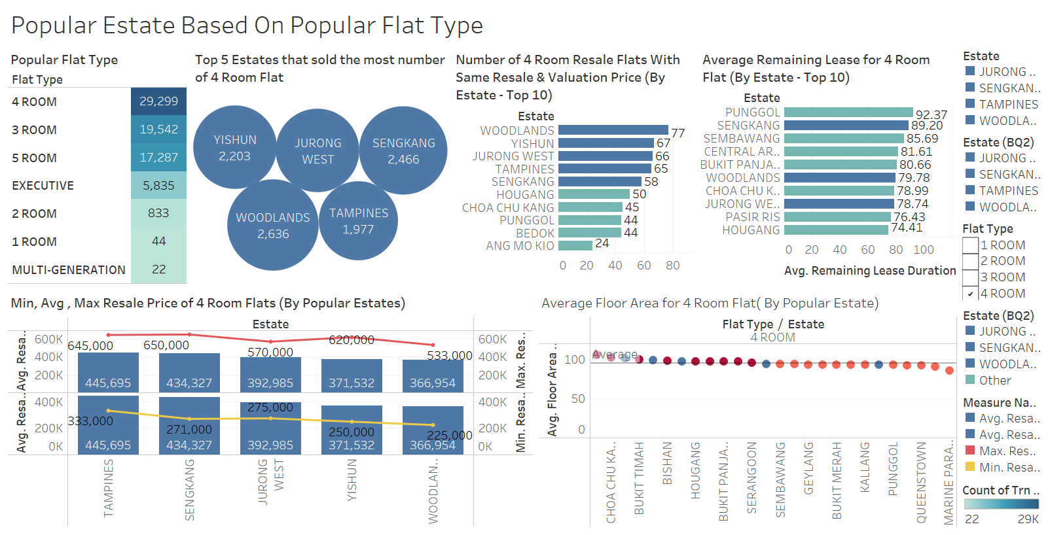

Slide 9
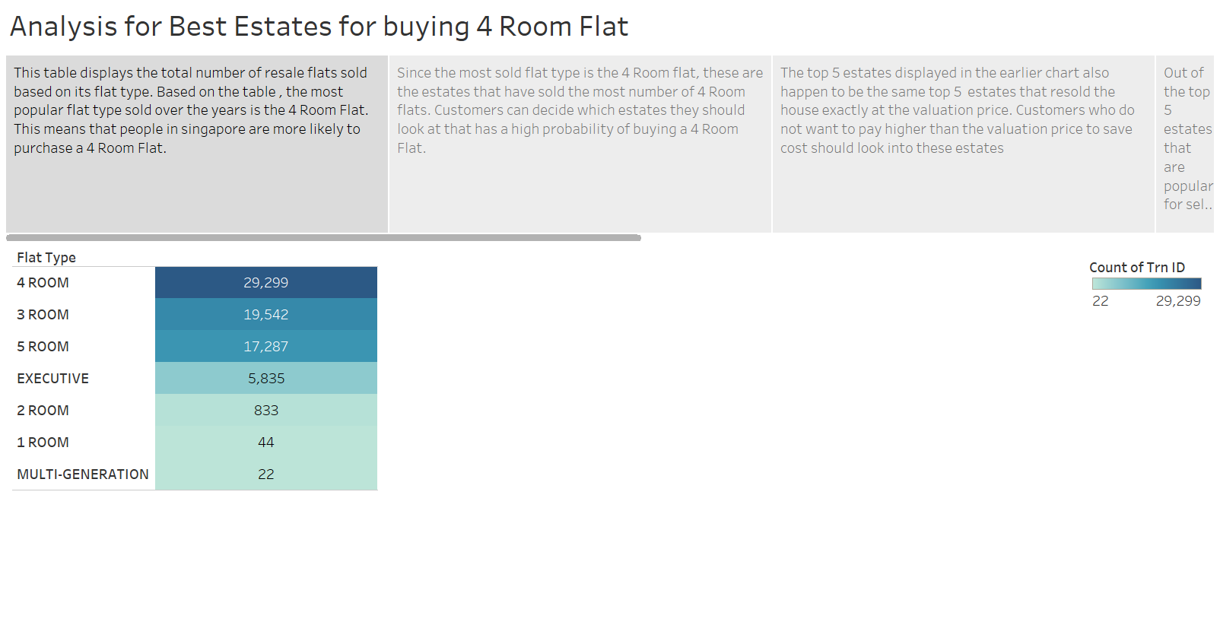

Slide 10
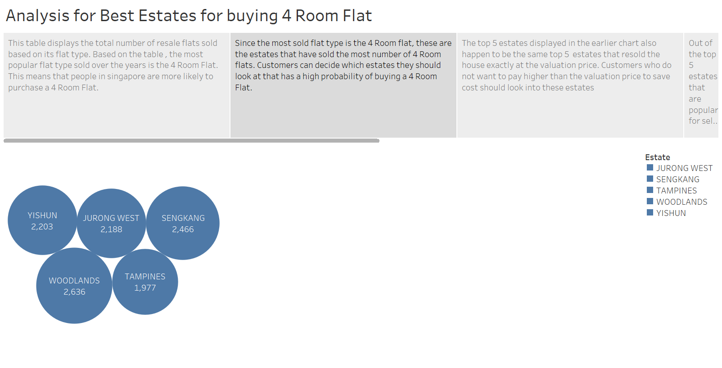

Slide 11
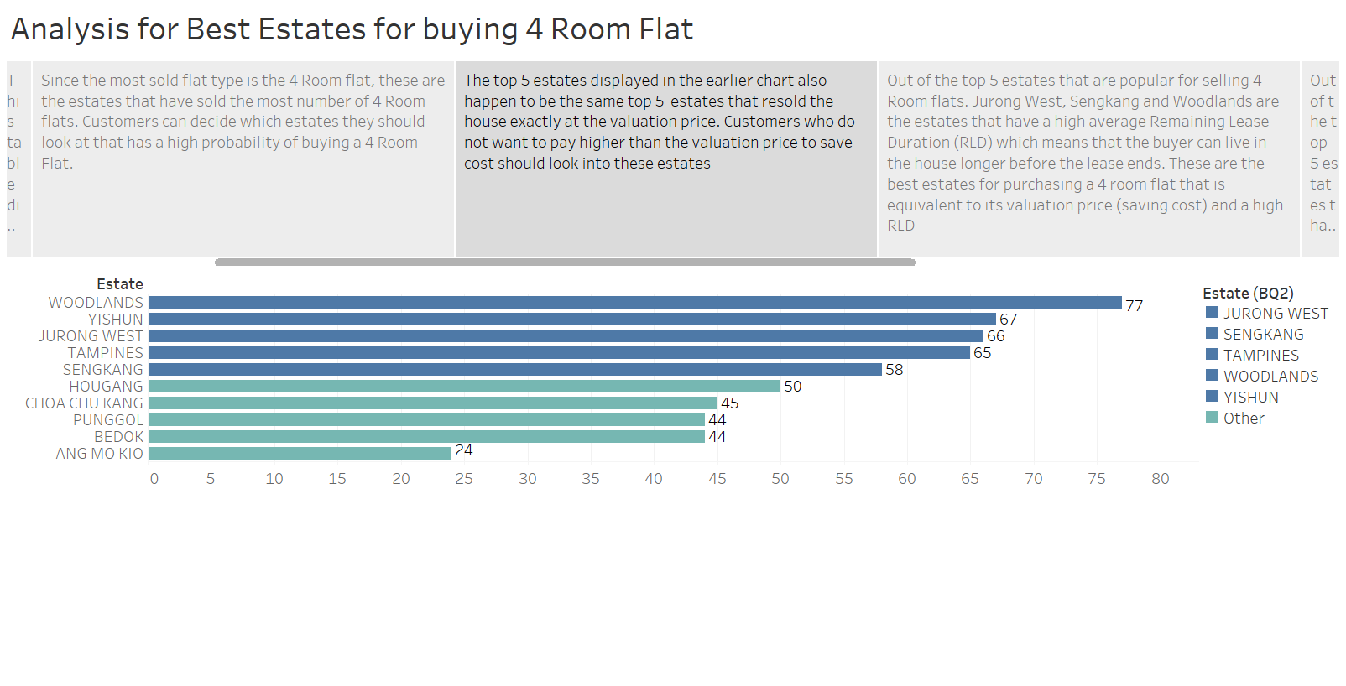

Slide 12
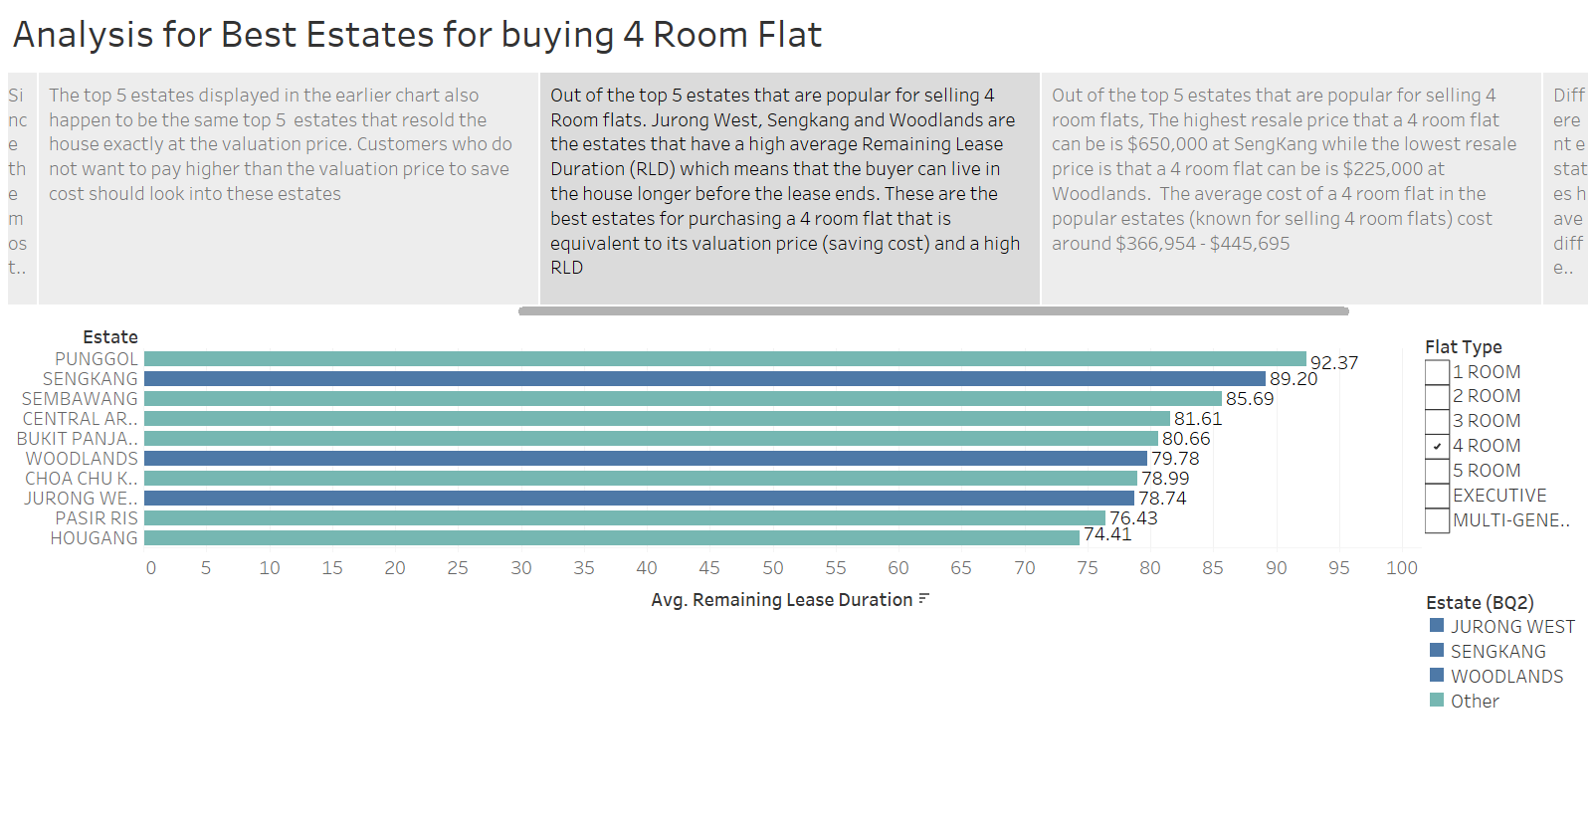

Slide 13
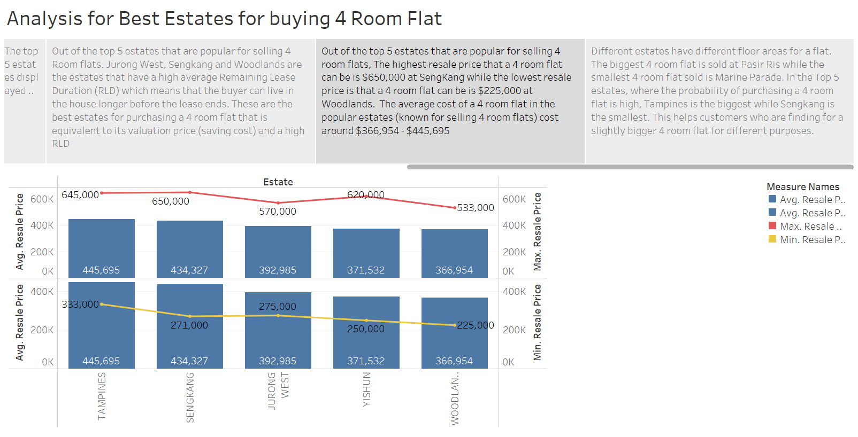

Slide 14
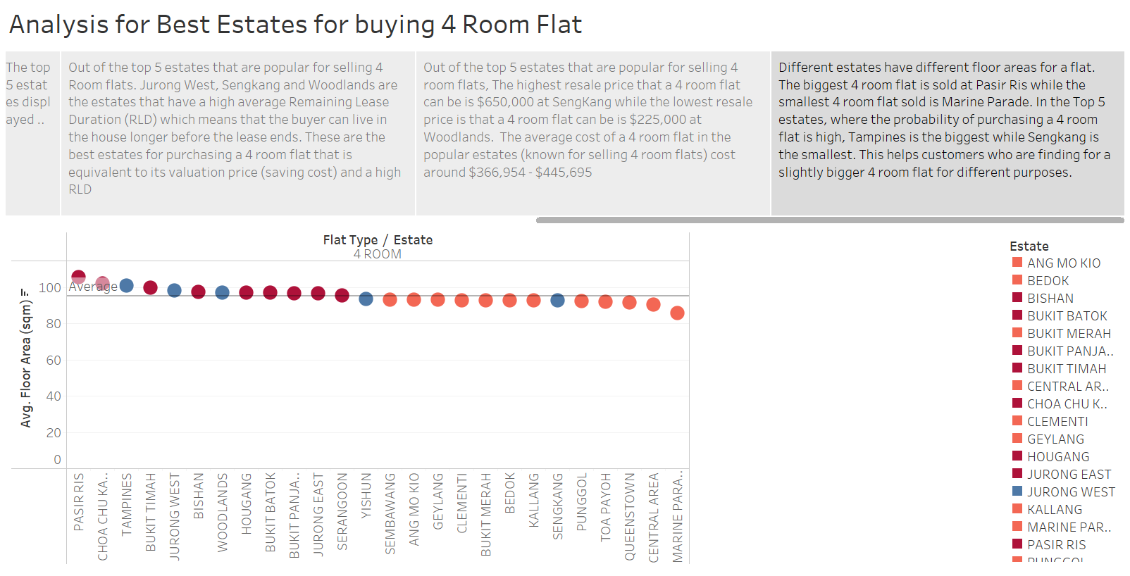

Slide 15
Conclusion
In conclusion , the best option for prospective homeowners who would like to buy a 4-room flat is at Woodlands. This is because, the probability of finding a 4-room flat is the highest , most of the 4 room flats are resold at the same price as its valuation price , the average remaining lease duration is 79.78 out of 99 years which is still relatively high , the cost of the flats is cheapest, and the floor area aligns closely with the higher average.

