Slide 2
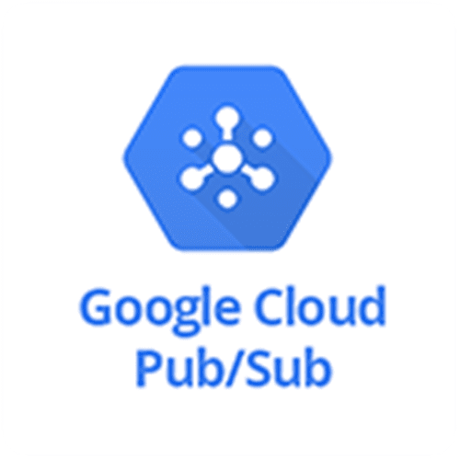
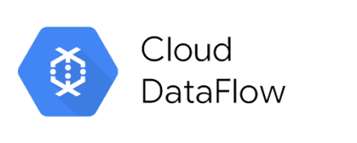
+

Slide 3


Data source
Simulated app for generating data.
Data source
Data source
Simulated app for generating data

Slide 4

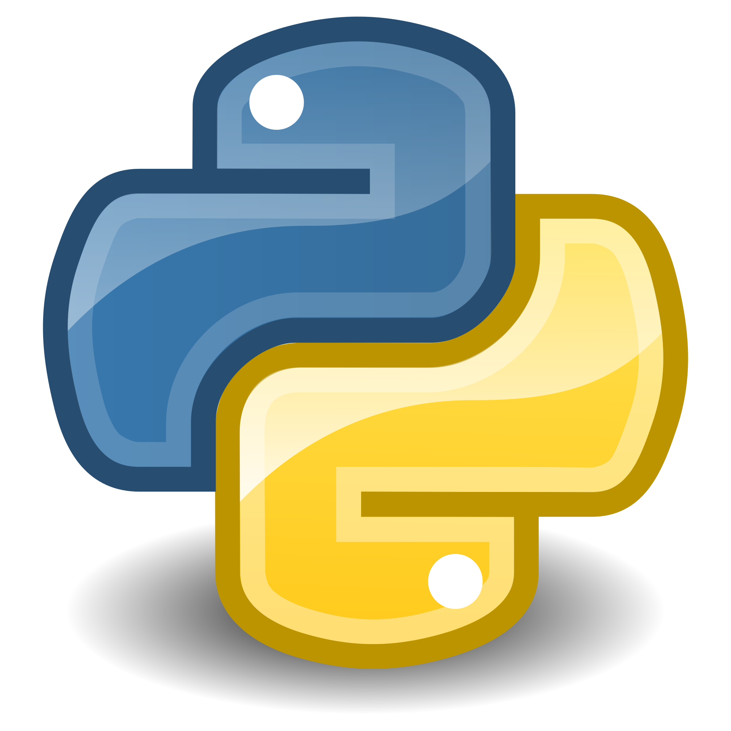

Ingestion
Data source
Simulated app for generating data
Stream Processing
in local

