Slide 1
Docker
Team FridgeThings: John Filak, Rodney Canlas, Matthew Liner

Slide 2
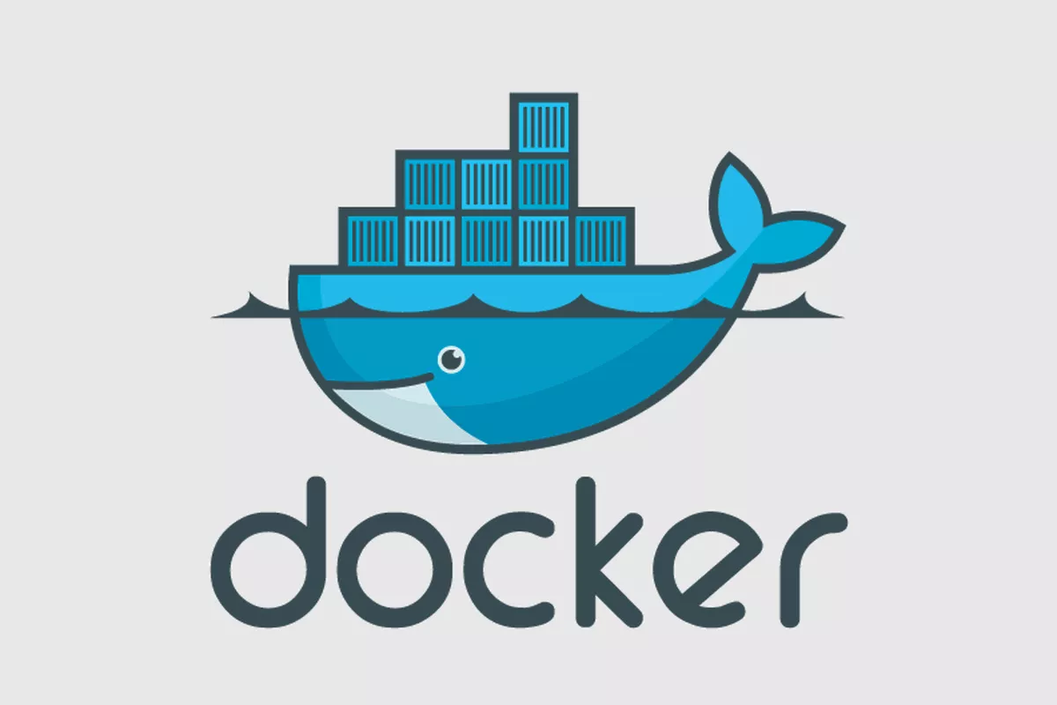
What is Docker?

Slide 3

But, first! Let’s talk about images and Docker containers.
Image
Container
- template with instructions for creating a Docker container
- built by creating a Dockerfile
- a standard unit of software that packages up code and all its dependencies
- manipulated with Docker API or CLI
Source: https://docs.docker.com/engine/docker-overview/
Notes:
An image is a read-only template with instructions for creating a Docker container. To build your own image, you create a Dockerfile with simple syntax for defining the steps needed to create the image and run it. A container is a runnable instance of an image. A container is a standard unit of software that packages up code and all its dependencies. Containerized software will always run the same, regardless of infrastructure. You can create, start, stop, move or delete a container using the Docker API or CLI.

Slide 4
Now going back to Docker, what is it?
A platform that provides tooling and a platform to manage the lifecycle of your containers.
Develop your application and its supporting components using containers.
The container becomes the unit for distributing and testing your application.
When you’re ready, deploy your application into your production environment.
Source: https://docs.docker.com/engine/docker-overview/

Slide 5
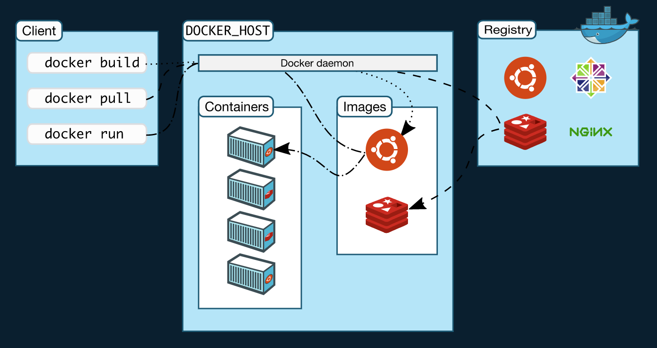
Overview of Docker architecture
Docker client: primary way for users to interact with Docker, sends commands to Docker daemon using the Docker API
Docker daemon: listens for Docker API requests, manages Docker objects
Docker registries: stores Docker images, Docker looks for images on Docker Hub by default
Source: https://docs.docker.com/engine/docker-overview/

Slide 6
Why do we need/use Docker?

Slide 7
Advantages of Docker
Standardized development environment
Application will be the same on all machines/environments
Compatible with DevOps applications
Security
A compromised container is easily replaced
Dependency management

Slide 8
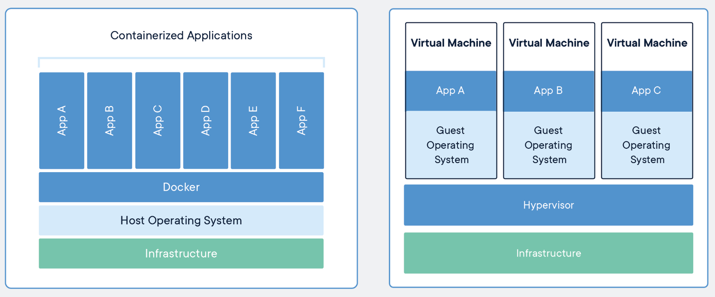
Docker vs Virtual Machines
Requires less memory
Quicker booting
More Scalability
Data sharing
More Secure
Easier portability
Run into less compatibility issues than with VMs
Better performance
Single Docker engine vs multiple virtual machines

Slide 9
How does Docker work?

Slide 10
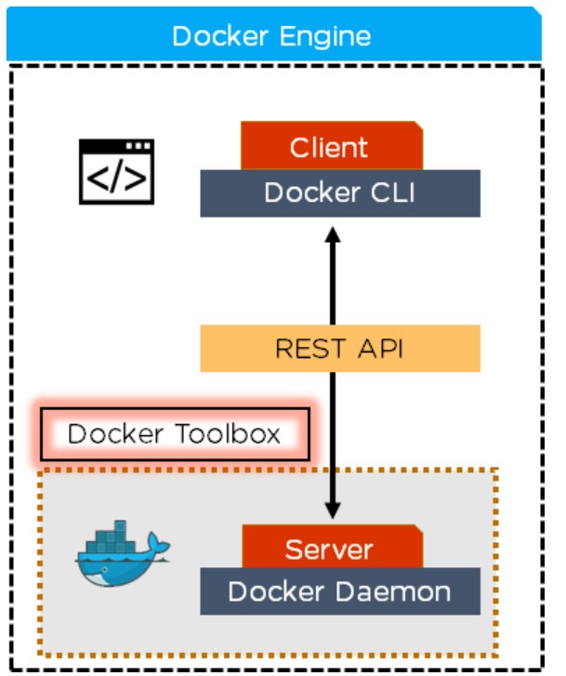
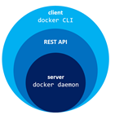
Under The Hood
Docker Architecture

Slide 11
Docker Daemon
Docker Daemon checks the client request and communicates with the docker components in order to perform a service.
The Docker Daemon listens for the Docker API requests and manages Docker objects such as images , containers , networks and volumes.

Slide 12
Docker REST API
The Docker REST API is used for the client to communicate and interact with the Docker daemon through scripting or the CLI commands.

Slide 13
Docker CLI
This is the command line tool that lets you talk to the Docker Daemon.
When Docker is installed , you get both the Docker Daemon and CLI tools.
$ docker build
$ docker run
$ docker kill
Notes:
The Docker client (docker) is the primary way that many Docker users interact with Docker. When you use commands such as docker run, the client sends these commands to dockerd, which carries them out. The docker command uses the Docker API. The Docker client can communicate with more than one daemon.

Slide 14
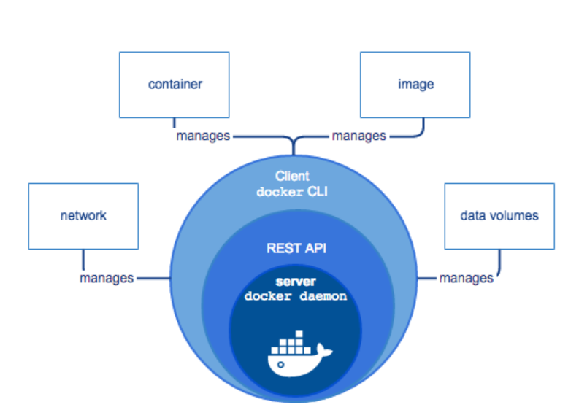
Docker is a Client - Server Application

Slide 15
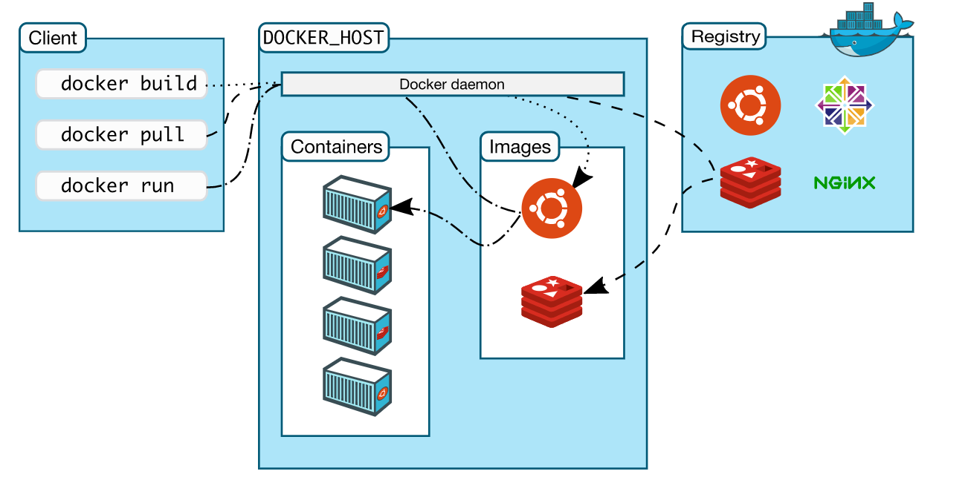
Client Server Architecture Continued
Notes:
Docker uses a client-server architecture. The Docker client talks to the Docker Daemon, which does the heavy lifting of building, running and distributing your docker contatiners. The docker client and daemon can run on the same system , or you can use the docker client to conntect to a remote Docker Dontainer. The Docker client and daemon communicate using a REST API over unix sockets or a network interface.
First we have the client on the left, this is where we’re running various Docker commands. The client could be installed on your laptop running Windows, MacOS or a server running Linux, it doesn’t matter.
Next up, we have the Docker host. This is typically referred to as the server running the Docker daemon. That makes sense right? It’s the host that happens to be running the Docker daemon.
It’s very simple to configure the Docker client to connect to a remote Docker host. This is one way you’re able to run Docker on MacOS and Windows.
In that case, the Docker daemon ends up running in a virtual machine that uses Linux, and the Docker client is configured to connect to that remote Docker host.
The key take away here is, the client and daemon does not need to be on the same box.

Slide 16
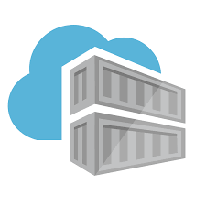
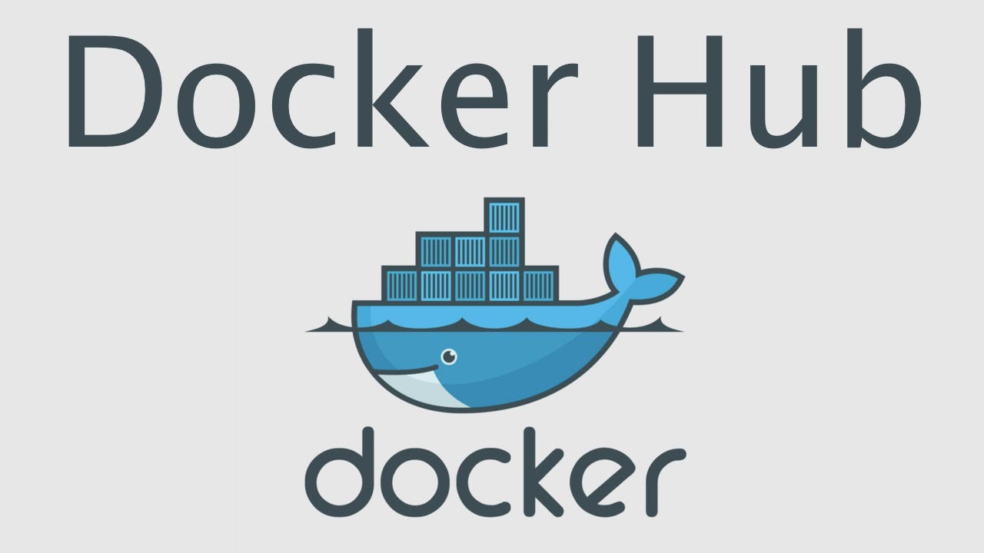
Registries
Azure Container Registry
Notes:
A Docker registry stores Docker images. Docker Hub is a public registry that anyone can use, and Docker is configured to look for images on Docker Hub by default. You can even run your own private registry. If you use Docker Datacenter (DDC), it includes Docker Trusted Registry (DTR).
When you use the docker pull or docker run commands, the required images are pulled from your configured registry. When you use the docker push command, your image is pushed to your configured registry.

Slide 17
Configuration - Dockerfile
Dockerfile - used to build Docker images to your specifics.
Commands
ADD - copies the files from a source on the host into the container's own filesystem at the set destination
CMD - can be used for executing a specific command within the container
ENTRYPOINT - sets a default application to be used every time a container is created with the image
ENV - sets environment variables
EXPOSE - associates a specific port to enable networking between the container and the outside world
Notes:
A Dockerfile is a file used to build a Docker image to your specifics. With a Dockerfile constructed, you could then easily build the same image over and over, without having to walk through the process manually.

Slide 18
Docker File Continued
FROM - defines the base image used to start the build process
MAINTAINER - defines a full name and email address of the image creator
RUN - central executing directive for Dockerfiles
USER - sets the UID (or username) which is to run the container
VOLUME - is used to enable access from the container to a directory on the host machine
WORKDIR - sets the path where the command, defined with CMD, is to be executed
Notes:
You do not have to use every command. In fact, I am going to demonstrate a Dockerfile using only FROM, MAINTAINER, and RUN.
FROM ubuntu:latest
MAINTAINER NAME EMAIL
RUN apt-get -y update && apt-get -y upgrade && apt-get install -y build-essential
Where NAME is the name to be used as the maintainer and EMAIL is the maintainer's email address.
Save and close that file.
docker build -t "NAME:Dockerfile" .

Slide 19
Docker Compose
A tool for defining and running multi-container Docker applications
Use a YAML file to configure your applications services.
Then you are able to start all your services from a single command

Slide 20
Compose Steps
Define your app’s environment with a Dockerfile
Define the services that make up your app in a a file : docker-compose.yml
(Allows services to be run together in an isolated enviornment
$ docker-compose up - Compose starts and runs your entire application

Slide 21
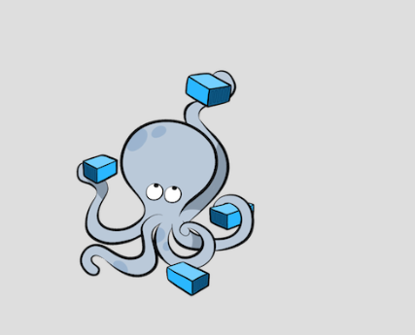
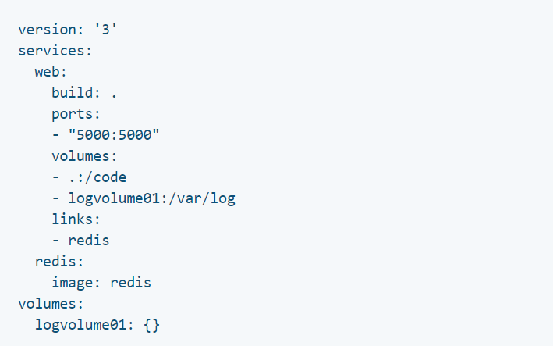
Compose Example

