Slide 1
KUBERNETES
Jacob Fisher | Bryant Reynoso | Shaanan Curtis

Slide 2
What is Kubernetes?
Open source
Container orchestration software
Creates, monitors, manages, and scales workloads
Notes:
Kubernetes is an open source container orchestration software, which is different from a container platform like Docker.
Container orchestration - a way of automating the managing and scheduling of work for individual containers in conjunction with others in a container environment.
Basically, we want to run containers packed in large scales within a given environment.
Overall, Kubernetes automatically creates, monitors, manages and scales workloads for you.

Slide 3
Basic Kubernetes Objects
Pod
Service
Volume
Namespace
Notes:
I will be going over some basic objects that are fundamental to the Kubernetes architecture
Pod, Service, Volume, and Namespace
Managed by Kubernetes Control Plane

Slide 4
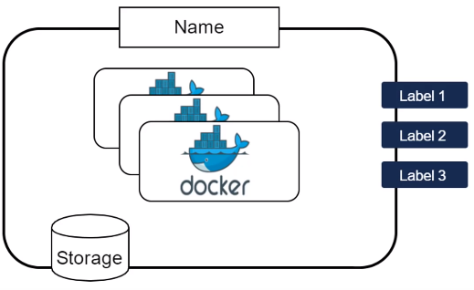
Pod
Most basic unit
Wrapper around container(s)
Shares resources
Taxonomy
Notes:
Pods are the most basic unit of the Kubernetes architecture which contain at least one or more containers.
Provides a wrapper around a container/containers to provide the abstraction that K needs to scale out or know how to use the set of containers.
Allows us to make assumptions about the pod and then adapt the pod to the container (advantage)
Network resources are connected to the pod itself
The containers in a pod share resources like secondary storage, CPU, and RAM.
Another advantage - Pod enables you to deploy related containers side-by-side that need to be in the same environment in order to run proficiently
Provides a way to label things such as by layers or type of application or version, etc.
Can name each pod as well.
Something to also note is the difference between Nodes and Clusters how they are related to Pods
(Node contains 1+ pods, Cluster contains 1+ nodes)
Node - The physical machine (VMs, physical server, etc.) that runs your applications and cloud workflows from the pods it contains.
Cluster - A set of multiple nodes collectively pursuing a common goal

Slide 5
Pod - Controllers
Manage use cases of Pods
Used to create replica sets
Replica Set Controllers
Job Controllers
Notes:
A Controller is what drives the process of pod containment
Pods are used in different ways on a cluster. The use cases are managed by controllers. In other words, the controllers provide the logic.for pods to use the cluster.
Controllers are often used to create replica sets
However, there are different types of controllers in Kubernetes:
So there’s the Replica Set Controller which is used to manage a set of pods in an overall Cluster
Job controllers manage pods by automating start, running and termination based on schedules/triggers
These are what specifically control the use case.
There are also Schedulers which are a type of controller we will talk about later...

Slide 6
Service
Abstraction defining a set of pods and a policy by which to access them
Enable loose coupling between dependent pods
Defined using a YAML or JSON
Notes:
A service is an abstraction which defines a logical set of pods and a policy by which to access those pods.
It does this through port exposure, which is an exposure of anything from Pods to replica sets and controllers on a port through the Kube Proxy to an endpoint accessible by users.
So anytime you map an external port to one of these things through a load balance scenario, that is a Kubernetes Service.
A service enables loose coupling between dependent pods and is defined, like all Kubernetes objects, by a YAML or JSON.

Slide 7
Exposing a Service
ClusterIP (default) - Service only reachable from within the cluster.
NodePort - Service accessible from outside the cluster using <NodeIP>:<NodePort>.
LoadBalancer - Assigns a fixed, external IP to the Service.
ExternalName - Exposes Service using an arbitrary name, specified by externalName in the spec.
Notes:
Something interesting about Kubernetes is that it gives Pods their own IP addresses and a single DNS name for a set of Pods, and can load-balance across them. This allows Pods to communicate across a network for better orchestration between dependent containers.
Although each Pod has a unique IP address, those IPs are not exposed outside the cluster without a Service. Services allow your applications to receive traffic. Services can be exposed in different ways by specifying a type in the ServiceSpec:
ClusterIP (default) - Exposes the Service on an internal IP in the cluster. This type makes the Service only reachable from within the cluster.
NodePort - Exposes the Service on the same port of each selected Node in the cluster using NAT. Makes a Service accessible from outside the cluster using <NodeIP>:<NodePort>. Superset of ClusterIP.
LoadBalancer - Creates an external load balancer in the current cloud (if supported) and assigns a fixed, external IP to the Service. Superset of NodePort.
ExternalName - Exposes the Service using an arbitrary name (specified by externalName in the spec) by returning a CNAME record with the name. No proxy is used. This type requires v1.7 or higher of kube-dns.

Slide 8
Service - Kube Proxy
Determines which Pod receives incoming request
Port forwarding
Notes:
The proxy determines which pod (thus, container) will receive the incoming request
The proxy does port forwarding from the external to internal port running on the pod
From here you can do reverse proxies and load balancing.

Slide 9
Volume
Directory accessible to all containers in a Pod
Abstraction that preserves data across container restarts
Notes:
So there are two problems that exist when dealing with data inside containers:
For one, the Container always starts with a clean state, meaning that when a Container crashes, kubelet will restart it and the files will be lost.
Second, when running Containers together in a Pod it is often necessary to share files between those Containers.
The Kubernetes Volume abstraction solves both of these problems by preserving data across container restarts.
A volume is essentially a directory accessible to all containers running in a Pod.

Slide 10
Namespace
Virtual clusters backed by the same physical cluster
A way to divide cluster resources between users
Notes:
Kubernetes supports multiple virtual clusters backed by the same physical cluster. These virtual clusters are called namespaces.
Namespaces are a way to divide cluster resources between multiple users (via resource quota). According to Cloud Native Foundation, in future versions of Kubernetes, objects in the same namespace will have the same access control policies by default.

Slide 11
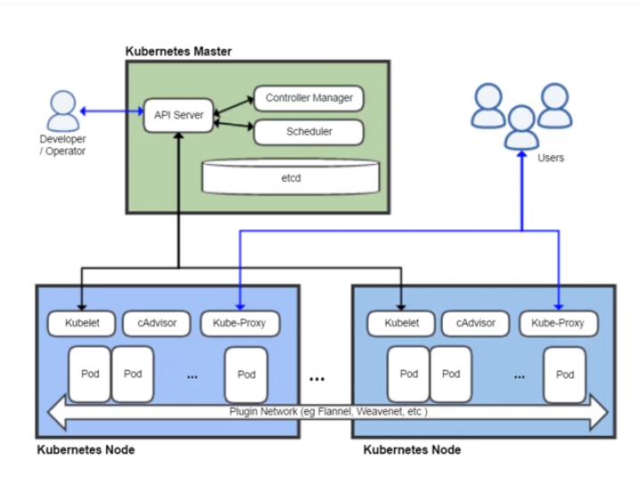
Kubernetes Architecture
Notes:
So here you can see a cluster of nodes tied to a master node.
A cluster needs 1 or more Masters to run. This is because the Kubernetes Masters act as the control unit for clusters
Typically have at least 3 Masters and 2 or more nodes
If Master fails you don’t lose the cluster
2 Masters may compete on failure, so third is there to make sure that doesn’t happen
If one node fails you can shift the work to another
This provides both redundancy and resiliency
Kubernetes Nodes run the actual workloads and that is through the Kubelet
Kubernetes needs at least 1 node to run
The node and master can be the same in small setups
So let’s talk about the components of each node type...

Slide 12
Kubernetes Master
Notes:
Components of the Kubernetes Master
API Server - provides the endpoints for developers/operators to interact with each cluster tied to the Master node. So operators can do this by way of the kubectl which is a CLI used to create Kubernetes API objects and communicate directly with the Master.
And so what the Kubernetes API does is it either sets the cluster state or modifies it.
The Cluster State identifies 4 things:
Applications/workloads to run
Container images to use
Number of replicas that exist
Network and disk resources
Another important concept is the Kubernetes Control Plane which I mentioned earlier
Maintains a record of all objects in system
Collection of processes that run on the cluster ( contained in nodes )
This is what updates current state to what the desired state was set to
An example of how the Control Plane works is say you...
Use a Kubernetes API object to create a Deployment ( which creates a new desired state for the system)
The Control Plane records the objects created, carries out instructions by initiating the required applications/workloads, and schedules them to nodes within a cluster (thus, making the current state match the desired state).
Now let’s continue…
communication happens between the API Server and the Scheduler and Controller Manager which work together to deliver pods to a running node/cluster of nodes.
Controller Manager - manages all the controllers, including scheduling and replica controllers, that work to deliver the desired state for purposes of setting the current state.
Scheduler - responsible for the actual orchestration and resource management of pods
Finally...
Etcd - database that provides a persistent key-value store for configuration data on Kubernetes. You’re going to need this for replicating your Master node so that Kubernetes can seamlessly transfer operations in case of error such as a restart on the original Master which is running a particular cluster.
The Controller Manager talks to the API Server which sends something to the Scheduler which looks at the environment to determine the best resources for delegation to various nodes running on a cluster.
Whenever replication of information happens across Masters for them to operate in sync, data like labels, names, controller configurations, etc. are stored in the etcd.
Now just to summarize what the Master does:
Maintains cluster’s desired state
Can be replicated for availability and redundancy
Interacts with and controls each node
Collection of 3 running processes which we won’t be discussing today
kube-apiserver
kube-controller-manager
Kube-scheduler

Slide 13
Kubernetes Node
Notes:
And now for the Components of the Kubernetes Node
Kubelet - agent running on each node that receives instructions from the Master’s Scheduler and Controller by way of the API Server on what to do with the node (for example, you can pull images to the local node, start a pod, or configure port mappings, etc.)
cAdvisor - collects telemetry about pods running on the nodes such as Network, CPU, and RAM usage, then sends that data back up to the Scheduler so that the Scheduler knows what’s going on in the node (behind the scenes)
Kube-Proxy - network proxy and load balancer for pods running on the node.
Stands between the internet and the network that the clusters are attached to.
So when noting one of the differences between Kubernetes and Docker Swarm...
Docker Swarm doesn’t have as sophisticated a proxy as this.
Pods - which I’ve mentioned earlier. Again these contain containers and are able to communicate to one another and run what is inside these containers.
How they do this is through the ...
Plugin Network - which uses a driver to create an overlay network between Kubernetes Nodes.
Allows pods to communicate seamlessly between nodes on a Kubernetes Cluster. The most popular of the various plugin networks one may use is called Flannel but there’s really not much of a difference that proves significant enough when deciding which to use.
And now just to summarize what a general Kubernetes Node is...
The machines (VMs, physical servers, etc.) that run your applications and cloud workflows.
And each is a collection of 2 running processes
kubelet - communicates with the Kubernetes Master
kube-proxy - network proxy which reflects Kubernetes network services on each node

Slide 14
Why Kubernetes?

Slide 15
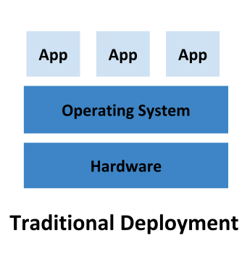
Traditional Deployment
Applications ran on physical servers
No way to define resource boundaries
One application may eat the resources for another
May run an application per server to ensure best application performance
Underutilized resources
Expensive to add more physical servers

Slide 16
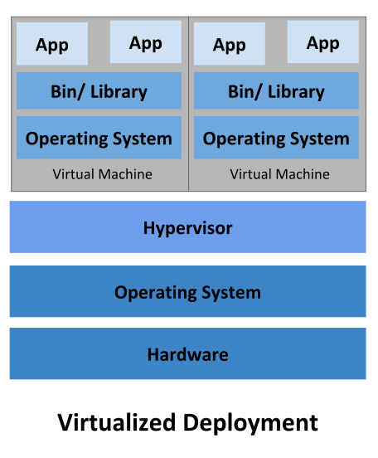
Virtualized Deployment
•Run multiple Virtual Machines (VMs) on a single physical server’s CPU
•Allows isolation and security
•Reduced hardware costs
•Came with entire OS
•Not very lightweight

Slide 17
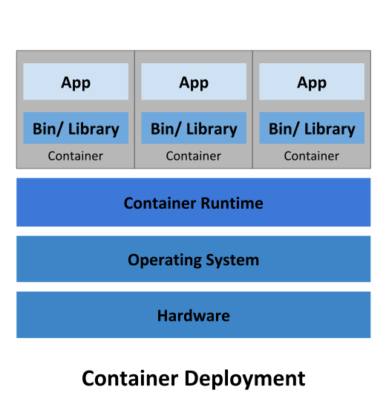
Containerized Deployment
•Like VM, but more lightweight
•Faster than VMs, easier to move to cloud
•Continuous development, integration, and deployment
•Environmentally consistent across development, testing, and production
•Efficient resource utilization and isolation

Slide 18
Manual Container Management
•Running Docker commands to create images
•Monitoring the health of each of your containers
•Running commands to replace failed containers with new ones
•Monitoring network traffic to each container
•Requires more man-hours to maintain
•Takes longer to scale

Slide 19
Self-Healing and Load Balancing
•Self-healing means that when a container goes down there is a replacement
•applications are available to users 24/7
•no need for manual replacements
•Load balancing manages oncoming traffic to your application
•exposes containers using DNS name or IP address
•container doesn’t receive too much traffic
•makes applications highly available
•balanced resource usage
•better application performance

Slide 20
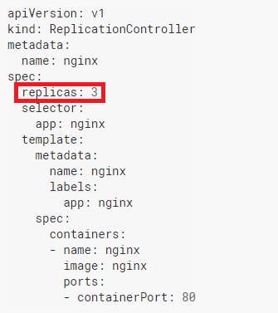
Easy Scalability
•With a simple command you can set an N number of replicas to suit your needs
•kubectl scale deployment.v1.apps/nginx-deployment --replicas=10
•ReplicationControllers allow you to define how many pods you want to be run
•Kubernetes will ensure that the amount you want is maintained

Slide 21
Automatic Bin Packing
•You can give Kubernetes a cluster of nodes that it can use to run containerized tasks
•Tell Kubernetes how much CPU and memory (RAM) each container needs
•Kubernetes will fit containers onto your nodes to make the best use of your resources.

Slide 22
Automated Rollouts and Rollbacks
•You can describe the desired states for deployed containers, and it will change the actual state to the desired state at a controlled rate.
•For example, you can automate Kubernetes to create new, upgraded containers for your deployment, remove the existing containers and adopt all their resources into the new container.
•Automated rollouts allows you to upgrade your containers without users noticing
•Automated rollbacks happen when your error-rate goes beyond a certain threshold, Kubernetes will revert your deployment to a previous version

Slide 23
Secret and Configuration Management
•Kubernetes allows you to store and manage sensitive data
•Passwords
• OAuth tokens
•SSH(Secure shell) keys
•You can deploy and update secrets and application configuration without having to rebuild container images, or without exposing your secrets in your stack configuration

Slide 24
Kubernetes is a Google Product
•Kubernetes was originally designed by Google
•Google has years of accumulated experience in working with container orchestration at a grand scale
•Kubernetes is now maintained by Cloud Native Computing Foundation(CNCF)
•Linux Foundation project created with the intent to advance container technology
•Founders: Google, Twitter, Intel, Cisco, IBM, Docker, Vmware, and more

Slide 25
Vendor Agnostic
•Does not limit the types of applications supported
•Supports an extreme variety of workloads, such as stateless, stateful, and data-processing workloads
•Does not mandate a configuration language/system
•Does not dictate logging, monitoring, or alerting solutions
•Can mount a storage system of your choice, such as local storages, public cloud providers, and more
•Provides the foundation for building developer platforms, but preserves user choice and flexibility

Slide 26
How would we implement this?
Cloud providers
Set up yourself with kubeadm
Requires Linux machines
Training environments
Minikube
Limitations: Only one Node
Kind (K8s in Docker)
Limitations: Can’t seem to connect to exposed services
Online tutorial
Limitations: Locked into certain commands, doesn’t preserve state

