Slide 1
https://www.youtube.com/watch?v=zYSMn6_-eFw

Slide 2
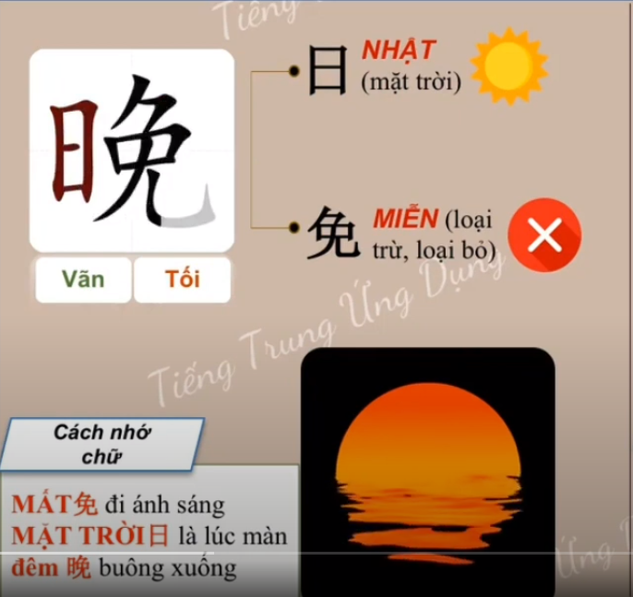
CƠM TỐI : 晚饭 /Wǎnfàn/: dinner

