Slide 1
TravClan Hotel Booking Analysis
Business Analyst Internship Assignment
Prepared By: Surbhi Jain

Slide 2
Executive Summary
30K bookings generated ₹752.42M revenue and ₹209M profit.
Overall cancellation rate: 20.23%.
Average stay length: 4 days.

Slide 3
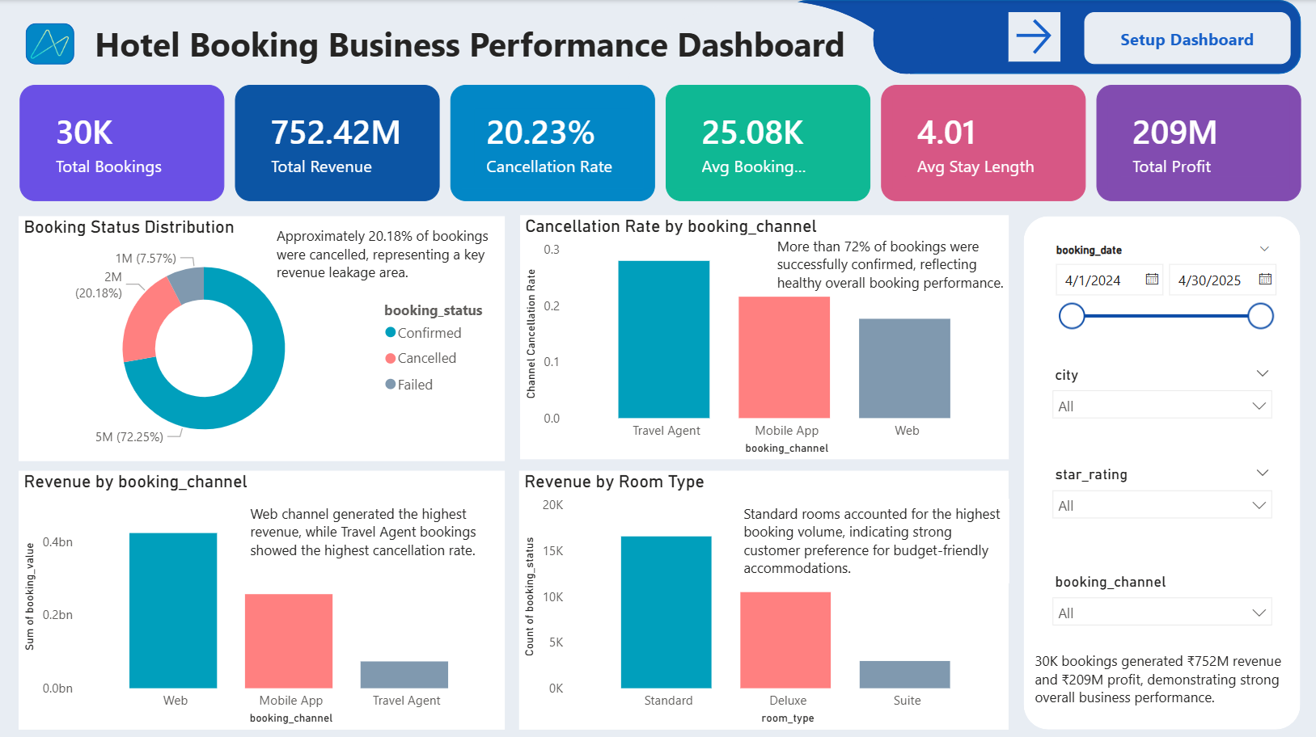

Slide 4
Key Observations
• Web channel generated the highest revenue.
• Travel Agent channel had the highest cancellation rate.
• Standard rooms drove the highest booking volume.
• 4-star hotels generated the highest revenue.

Slide 5
Cancellation Analysis
• Overall cancellation rate: 20.23%.
• Travel Agent bookings were most prone to cancellation.
• Standard rooms recorded the highest cancellation volume.

Slide 6
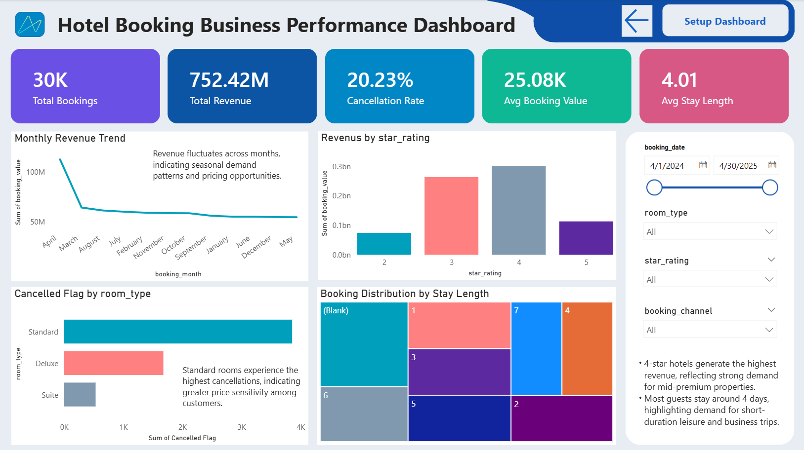

Slide 7
Root Cause Analysis
• Price-sensitive customers are more likely to cancel.
• Seasonal demand impacts revenue patterns.
• Mid-premium hotels attract the strongest demand.

Slide 8
Business Recommendations
• Promote direct website bookings.
• Offer prepaid/non-refundable plans.
• Upsell premium room categories.
• Implement dynamic pricing.
• Launch loyalty programs.

Slide 9
Conclusion
Reducing cancellations and increasing direct bookings can improve profitability and customer retention.

