Slide 1
Movie Rental Analytics Dashboard
Power BI Business Performance Analysis
Prepared by: Surbhi Jain
Date: August 2025

Slide 2
Introduction
The dashboard provides insights into customer behavior, film inventory, staff efficiency, and store performance.
It uses the MECE framework to structure the analysis and ensure comprehensive coverage of business questions.

Slide 3
Exploratory Data Analysis (EDA)
What are the purchasing patterns of new customers versus repeat customers?
Which films have the highest rental rates and are most in demand?
Are there correlations between staff performance and customer satisfaction?
Are there seasonal trends in customer behavior across different locations?
Are certain language films more popular among specific customer segments?
How does customer loyalty impact sales revenue over time?
Are certain film categories more popular in specific locations?
How does the availability and knowledge of staff affect customer ratings?

Slide 4
Key Insights (Summary)
Repeat customers = majority of revenue
Action & Animation films drive demand
Peak rentals during summer & holiday season
Staffing impacts satisfaction → optimize scheduling
Localized language films improve rentals & retention

Slide 5
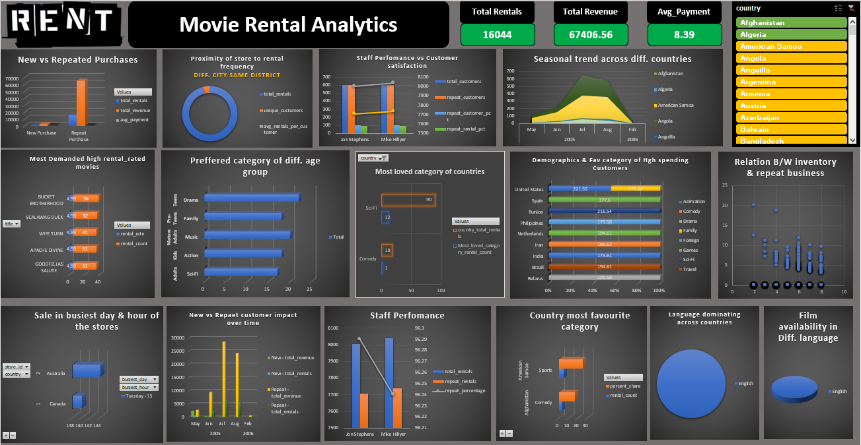

Slide 6
Methodology – MECE Framework
A. Time-based Analysis (When?)
B. Customer Analysis (Who?)
C. Product/Inventory Analysis (What?)
D. Staff/Store Analysis (Where/By Whom?)

Slide 7
Data Model
Fact Tables:
- fact_rentals (rental transactions)
- fact_sales (payment transactions)
Dimension Tables:
- dim_customer (customer demographics)
- dim_staff (staff details)
- dim_store (store details)
- dim_film (film details)
- dim_date (calendar)
Built as a star schema for optimized querying.

Slide 8
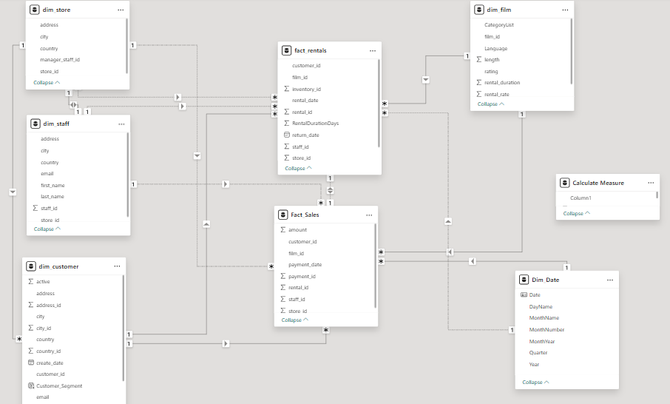

Slide 9
Page 1: Executive Overview
KPIs: Revenue, Rentals, Customers, On-time %
Visuals: Revenue by Month, Store, Country
Purpose: Provide high-level business performance snapshot.

Slide 10
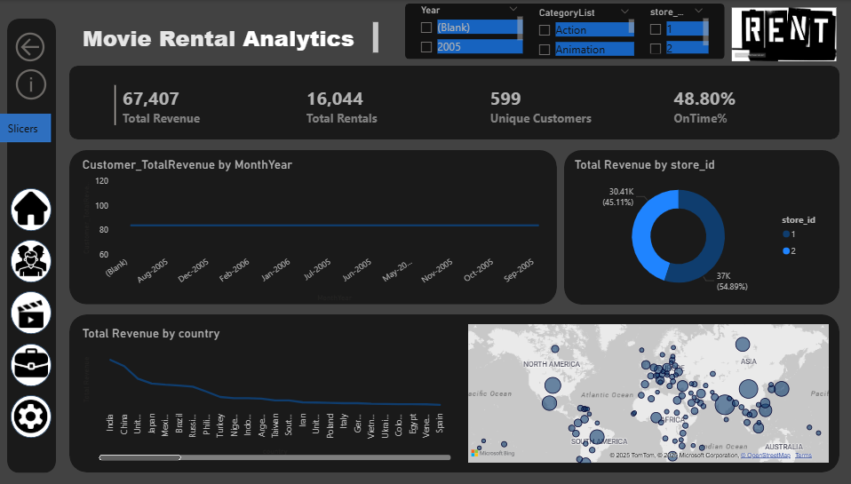

Slide 11
Page 2: Customers & Segments
KPIs: Active Customers, Avg Revenue/Customer, Top Customer
Visuals: Segmentation, City Distribution, Top Customers Table
Purpose: Identify valuable customers and retention opportunities.

Slide 12
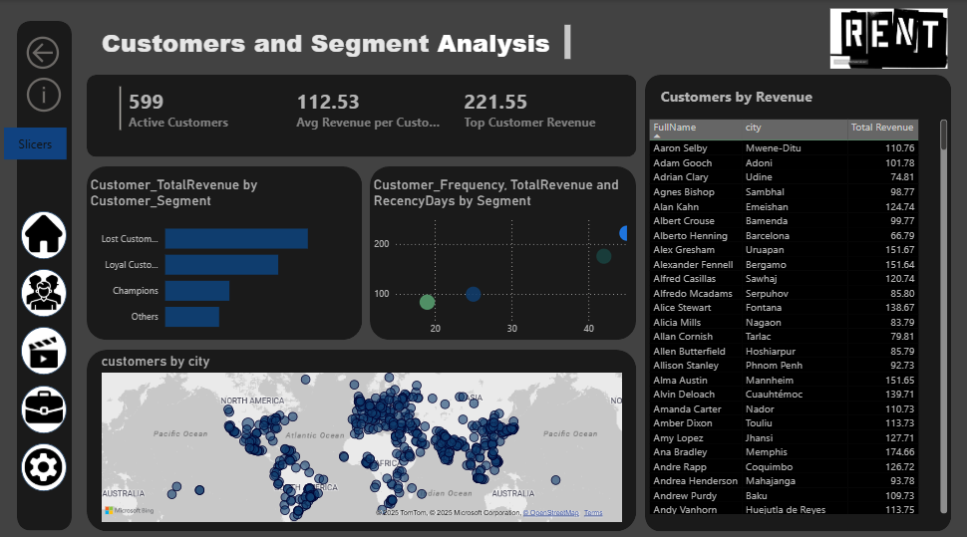

Slide 13
Page 3: Films & Inventory
KPIs: Films in Catalog, Copies in Stock, Rentals per Copy
Visuals: Rentals by Category, Film × Store Matrix, Rental Duration Histogram
Purpose: Optimize film stock and category demand.

Slide 14
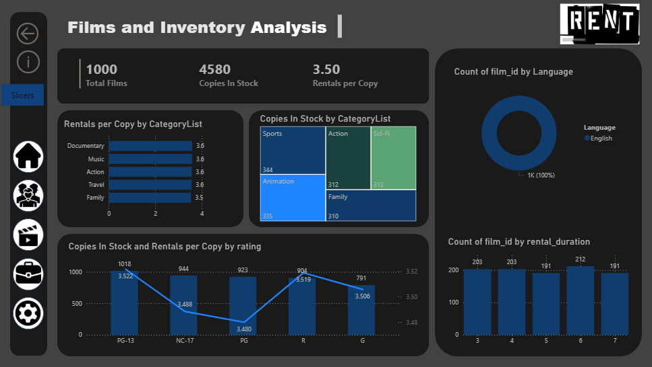

Slide 15
Page 4: Staff & Store Operations
KPIs: Revenue per Store, Avg Rentals per Staff, On-time % by Store
Visuals: Store Comparison, Staff Performance Table
Purpose: Benchmark stores and staff efficiency.

Slide 16
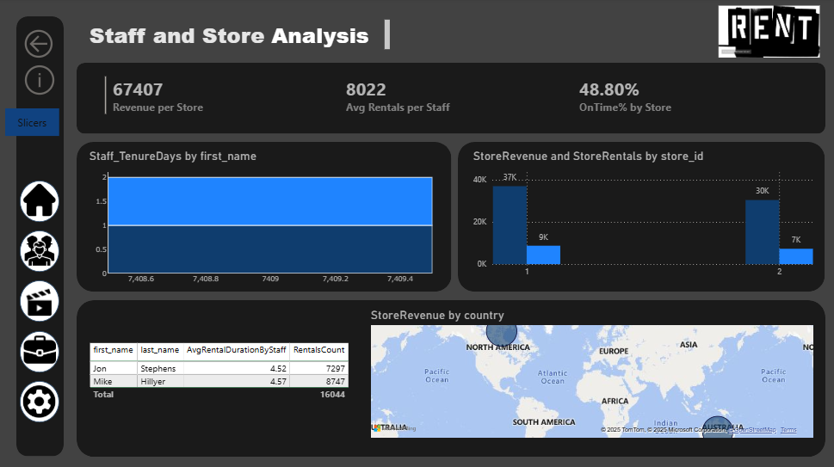

Slide 17
Recommendations
- Improve customer retention by targeting 'Lost customers'
- Restock high-demand categories (Sports, Action, Animation)
- Train staff for on-time returns
- Balance inventory across stores

Slide 18
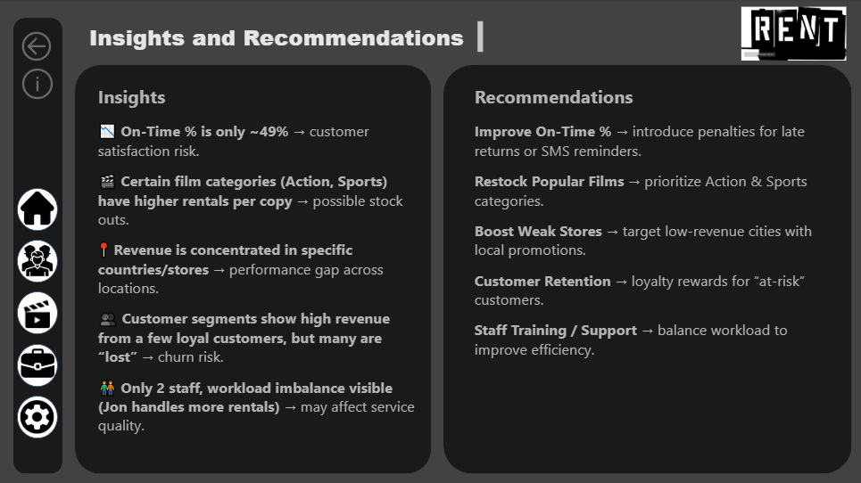

Slide 19
Conclusion
• Star schema ensures clean and optimized data modeling.
• MECE framework ensures structured analysis without overlap.
• Dashboard answers key business questions.
• Helps improve retention, inventory, staff efficiency, and profitability.

