Slide 1

Boxing, and Unboxing
.net / Microsoft dynamics 365

Slide 2
Variance refers to how subtyping between more complex types relates to subtyping between their components. For instance, if the type Cat is a subtype of Animal , then an expression of type Cat should be substitutable wherever an expression of type Animal is used.

Slide 3
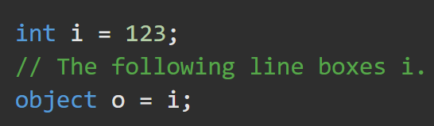
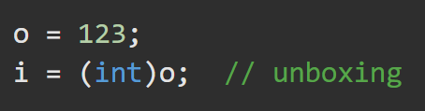
Boxing Unboxing https://docs.microsoft.com/en-us/dotnet/csharp/programming-guide/types/boxing-and-unboxing#boxing https://docs.microsoft.com/en-us/dotnet/csharp/programming-guide/types/boxing-and-unboxing#unboxing
The concept of boxing and unboxing underlies the C# unified view of the type system in which a value of any type can be treated as an object.
https://docs.microsoft.com/en-us/dotnet/csharp/programming-guide/types/boxing-and-unboxing
Boxing happens when any value type is cast to an object. The value is wrapped to give it reference type behavior.
BOXING is implicit
Unboxing extracts the value type from the object.
UNBOXING is explicit

Slide 4
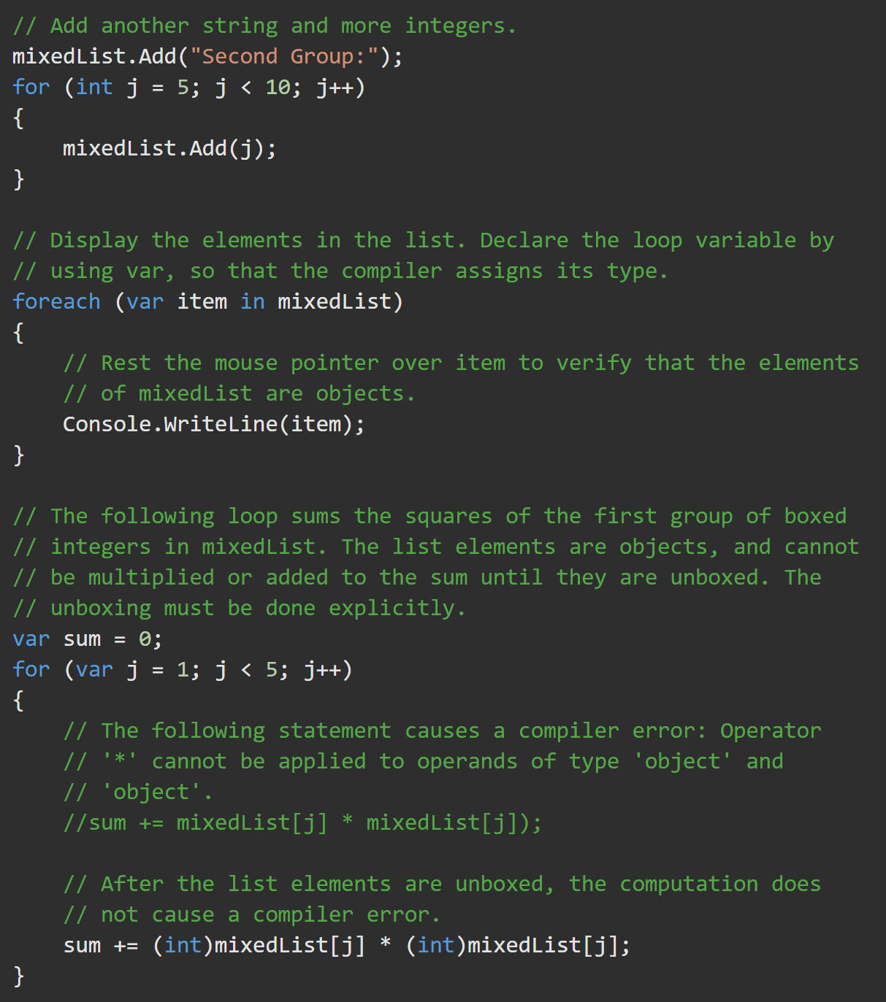
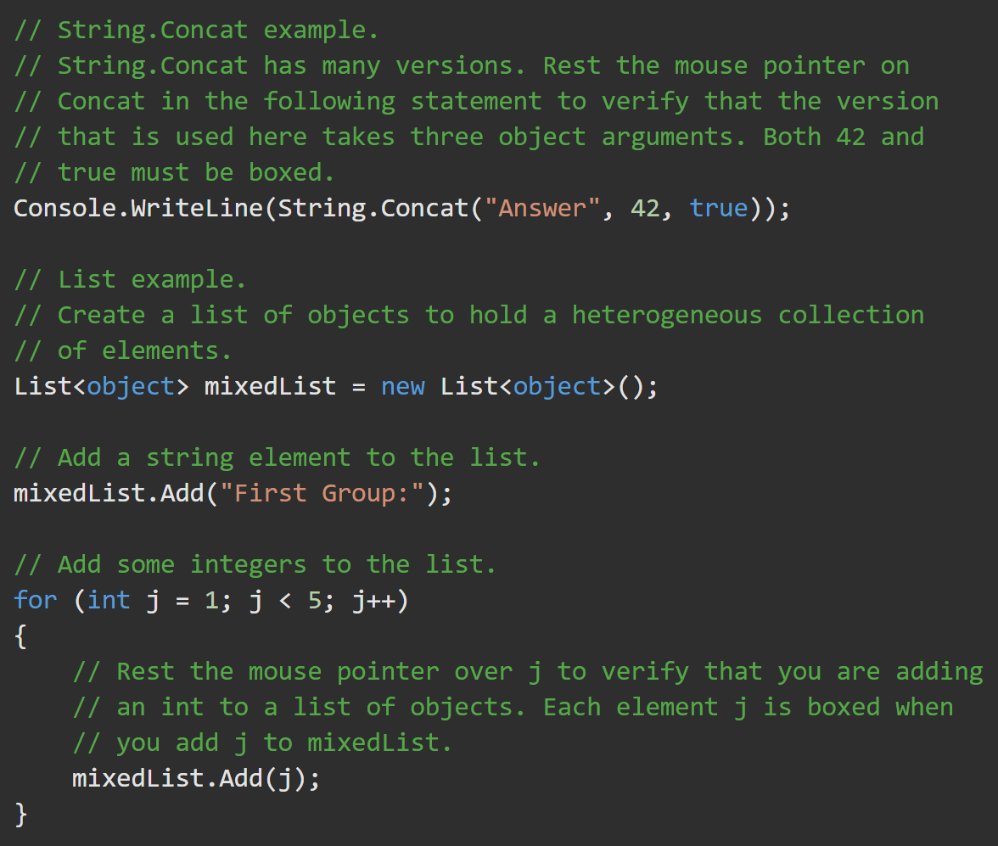
Boxing Activity - Boxing to the object type allows different types to inhabit the same array.
https://docs.microsoft.com/en-us/dotnet/csharp/programming-guide/types/boxing-and-unboxing
Assignment:
Replace the List<object> with non-generic ArrayList

Slide 5
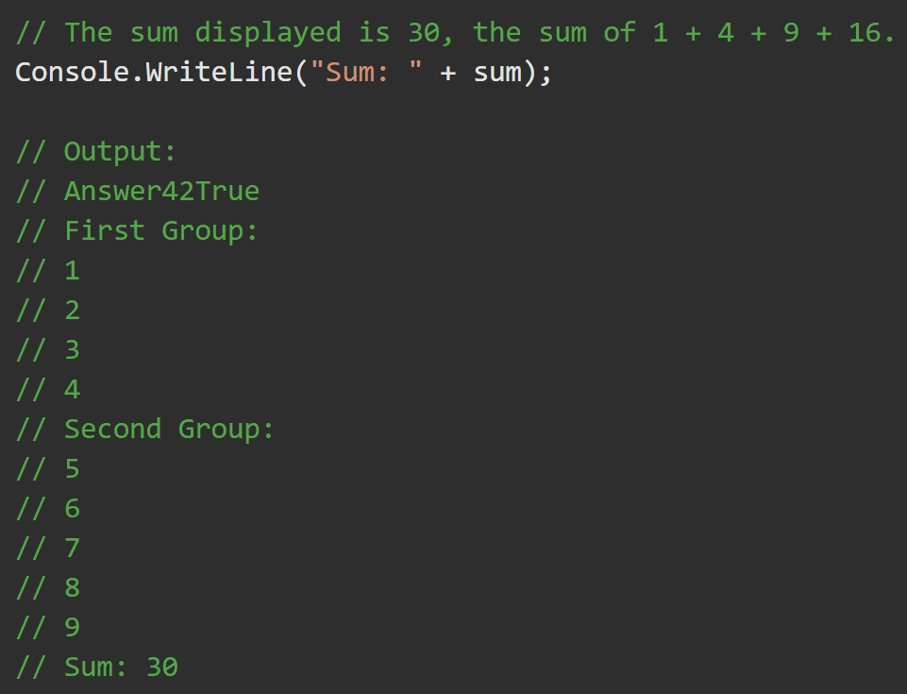
Activity Output

Slide 6
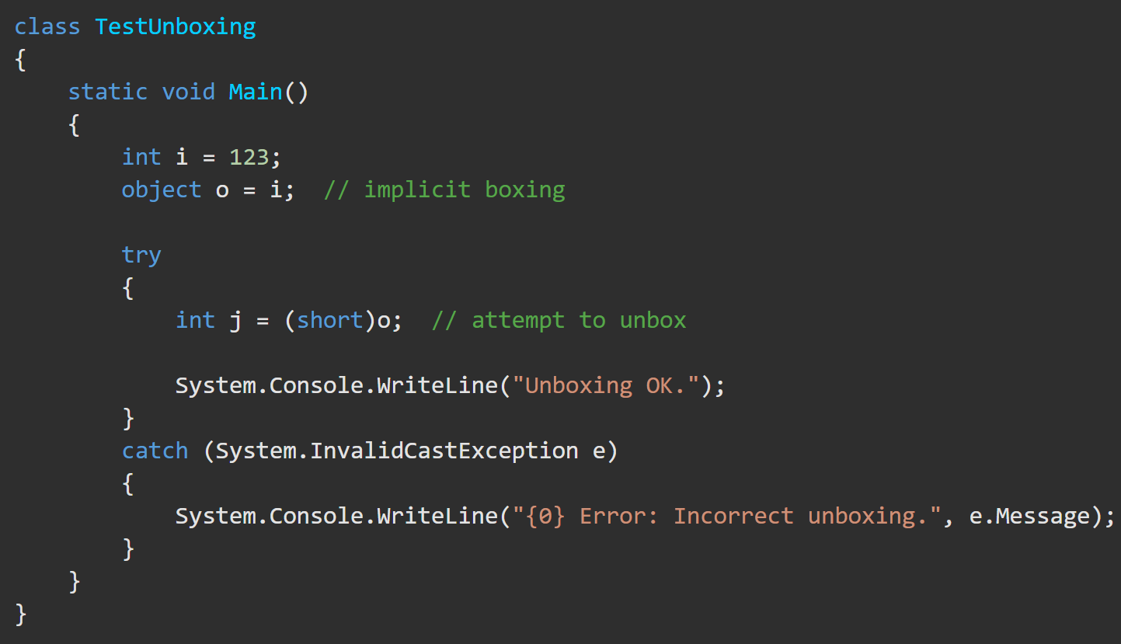
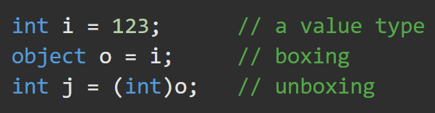
Unboxing https://docs.microsoft.com/en-us/dotnet/csharp/programming-guide/types/boxing-and-unboxing#unboxing
Unboxing is an explicit conversion from the type object to a value type or from an interface type to a value type that implements the interface. An unboxing operation consists of:
Checking the object instance to make sure that it is a boxed value of the given value type.
Copying the value from the instance into the value-type variable.

