Slide 1

Lambda Expressions
.net / Microsoft dynamics 365

Slide 2
Lambda expressions are anonymous functions that contain expressions or a sequence of operators. All lambda expressions use the lambda operator =>, that can be read as “goes to” or “becomes”. The left side of the lambda operator specifies the input parameters and the right side holds an expression or a code block that works with the input parameters.
https://www.c-sharpcorner.com/UploadFile/bd6c67/lambda-expressions-in-C-Sharp/

Slide 3

Lambda Expression https://docs.microsoft.com/en-us/dotnet/csharp/programming-guide/statements-expressions-operators/lambda-expressions
There are two Lambda expression forms
Expression Lambda -
Statement Lambda -
Use the lambda declaration operator ‘=>’ to separate the parameter list from the body.
Specify input parameters (if any) to the left of the => and an expression/statement block to the right.

Slide 4
Lambda Conversions https://docs.microsoft.com/en-us/dotnet/csharp/programming-guide/statements-expressions-operators/lambda-expressions
Any lambda expression can be converted to a delegate type.
The delegate type to which a lambda expression can be converted is defined by the types of its parameters and return value.
If a lambda expression doesn't return a value,
it can be converted to one of the Action delegate types.
it can be converted to a Func delegate type.
A lambda expression that has two parameters and returns no value can be converted to an Action<T1,T2> delegate.
A lambda expression that has one parameter and returns a value can be converted to a Func<T,TResult> delegate.

Slide 5
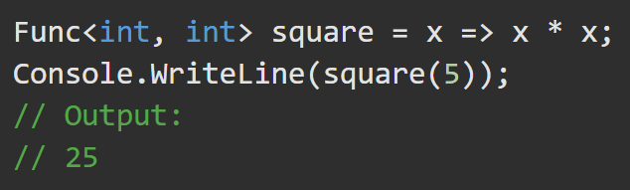
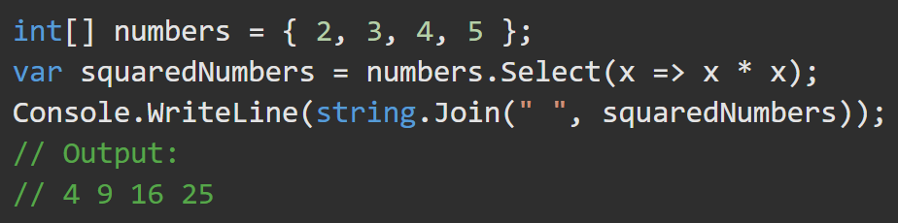
Lambda Conversions - Examples https://docs.microsoft.com/en-us/dotnet/csharp/programming-guide/statements-expressions-operators/lambda-expressions
The lambda expression x => x * x, which specifies a parameter that’s named x and returns the value of x squared, is assigned to a variable of a delegate type.
You can use lambda expressions when you write LINQ.

Slide 6
Lambda Expression Form https://docs.microsoft.com/en-us/dotnet/csharp/programming-guide/statements-expressions-operators/lambda-expressions#expression-lambdas
Expression lambdas are used extensively in the construction of expression trees. An expression lambda returns the result of the expression.
Zero input parameters have empty ( ).
>2 input parameters are separated by commas enclosed in ( ).
You can optionally specify the types explicitly.
Input parameter types must be all explicit or all implicit.

Slide 7
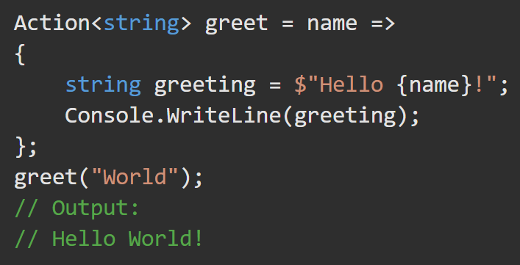
Lambda Statement Form https://docs.microsoft.com/en-us/dotnet/csharp/programming-guide/statements-expressions-operators/lambda-expressions#statement-lambdas
The body of a statement lambda can consist of any number of statements
Statement lambdas cannot be used to create expression trees.

Slide 8
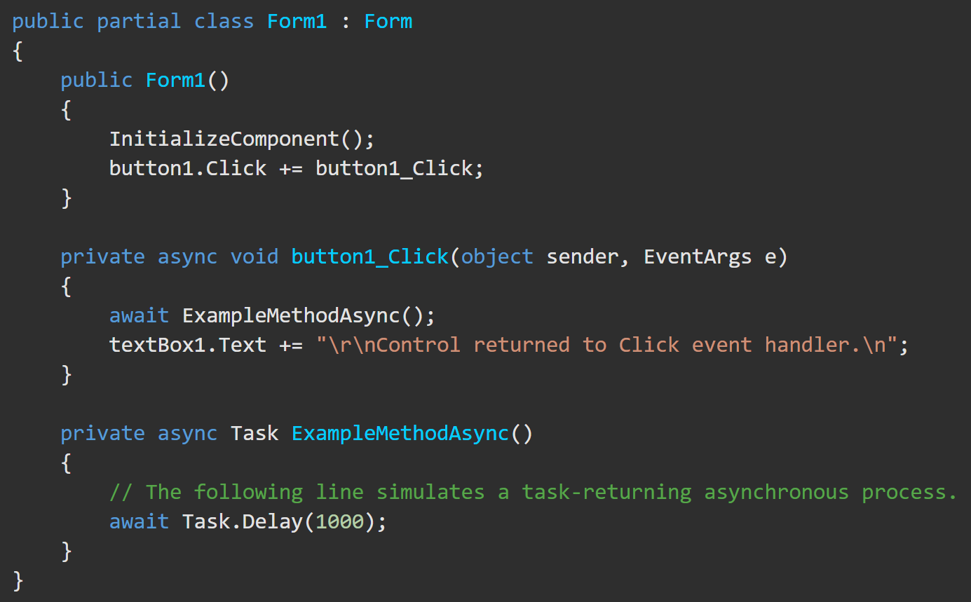
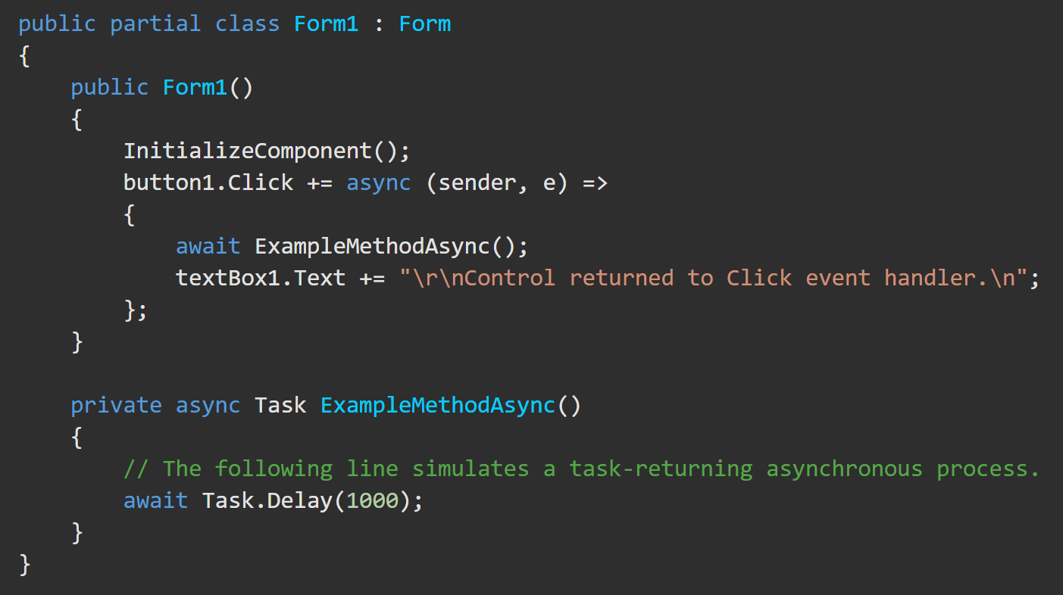
Lambda Async Form https://docs.microsoft.com/en-us/dotnet/csharp/programming-guide/statements-expressions-operators/lambda-expressions#async-lambdas
You can easily create lambda expressions and statements that incorporate asynchronous processing by using the async and await keywords.

Slide 9
Predicate<T> Delegate https://docs.microsoft.com/en-us/dotnet/api/system.predicate-1?view=netframework-4.8
Represents the method that defines a set of criteria and determines whether the specified object meets those criteria. This type parameter is contravariant (type specified or less derived).
Returns true if obj meets the criteria defined within the method represented by this delegate; otherwise, false. It’s customary to use a lambda expression rather than to explicitly define a delegate of type Predicate<T>,

Slide 10
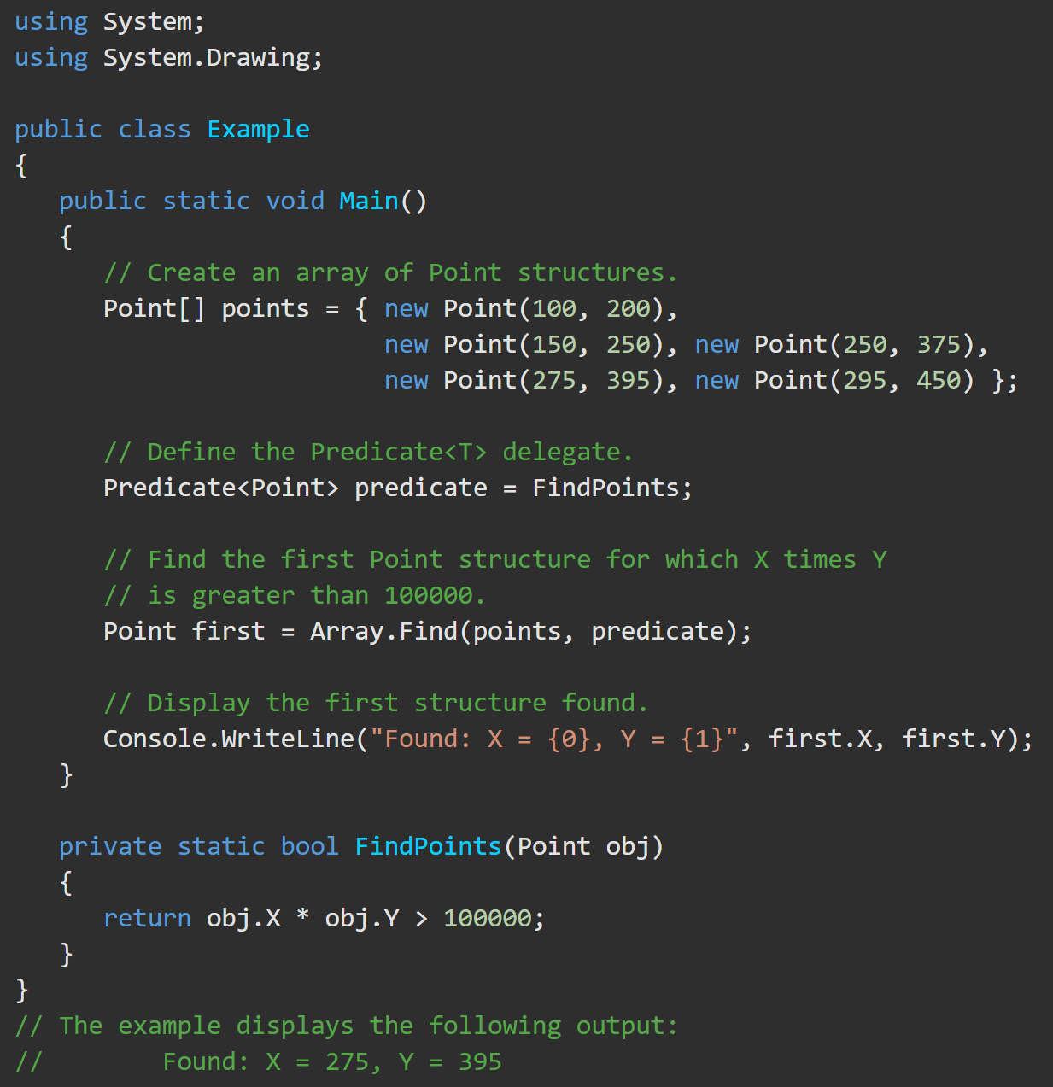
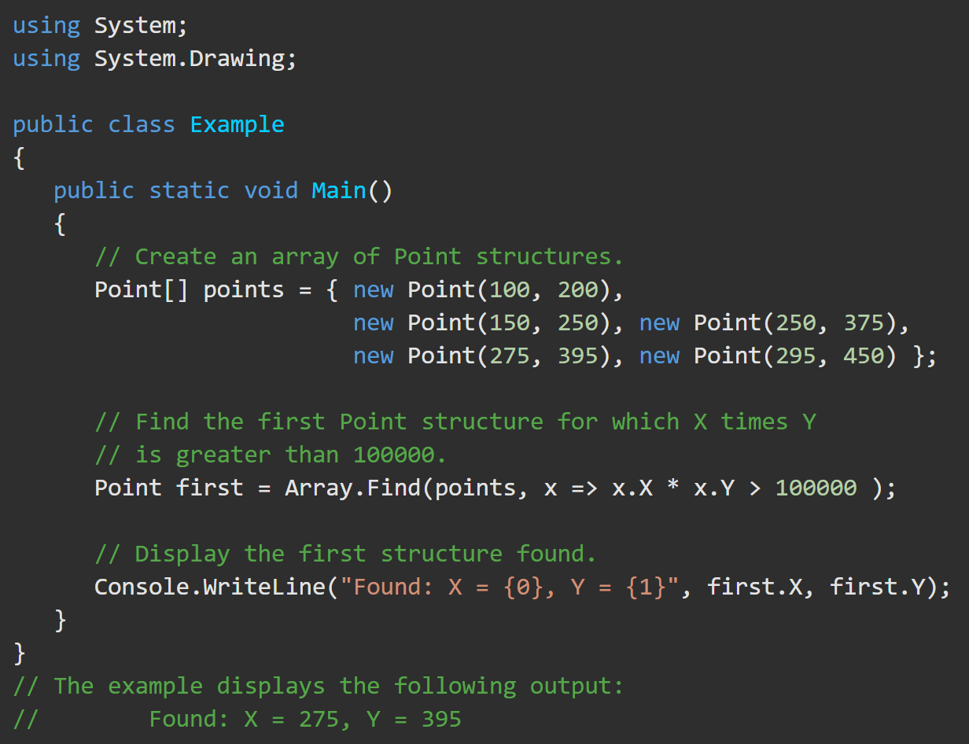
Predicate<T> Delegate https://docs.microsoft.com/en-us/dotnet/api/system.predicate-1?view=netframework-4.8
Below, each element of the points array is passed to the lambda expression until the expression finds an element that meets the search criteria. The lambda expression returns true if the product of the X and Y fields is greater than 100,000.

Slide 11
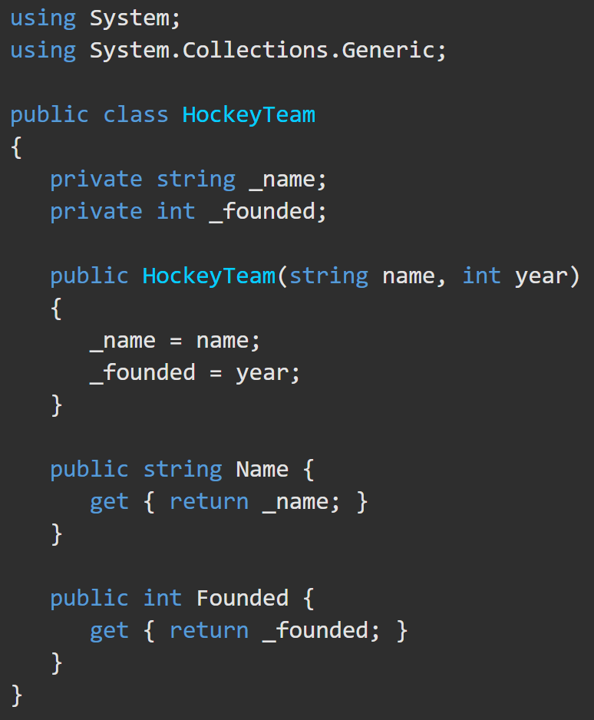
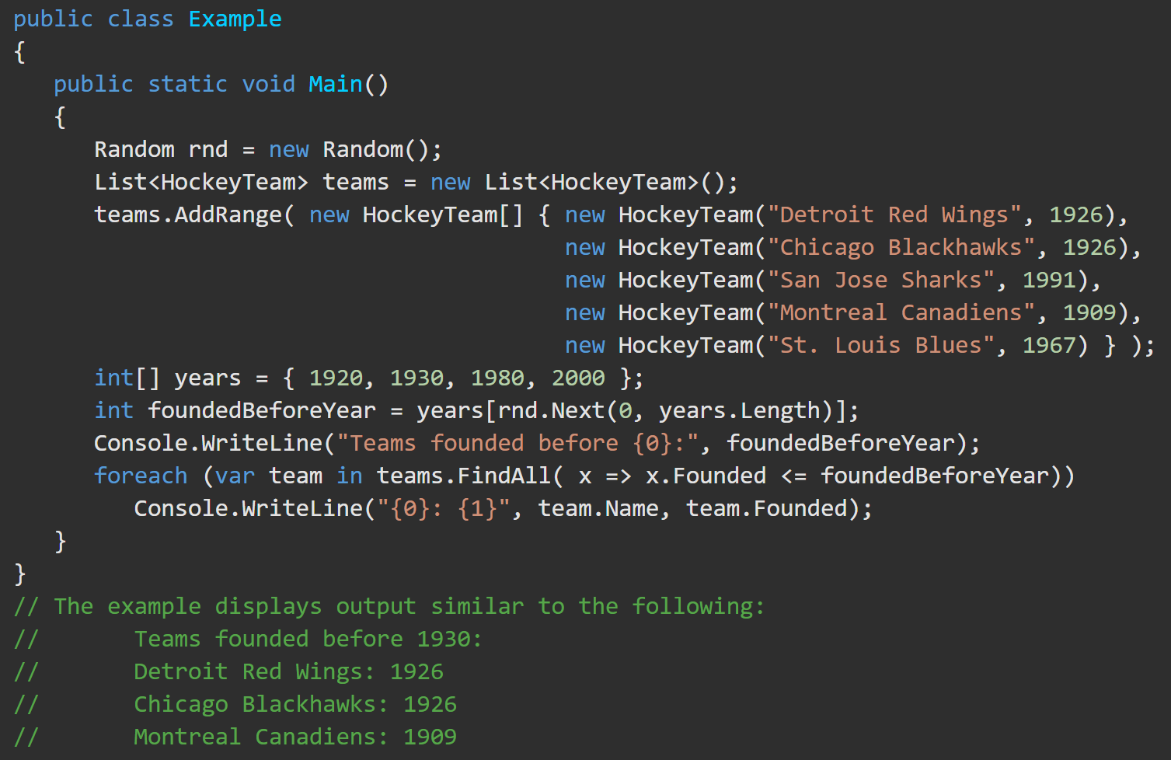
Predicate<T> Delegate https://docs.microsoft.com/en-us/dotnet/api/system.predicate-1?view=netframework-4.8#remarks
Predicate<T> is used by several methods of the Array and List<T> classes to search for elements in the collection. Predicate<T> delegate is typically represented by a lambda expression because locally scoped variables are available to it and it is easy to test for a condition that is not precisely known at compile time.

