Slide 1

Collections
.net / Microsoft dynamics 365

Slide 2
Collections are ready-made classes that provide a more flexible way to work with groups of objects. This group of objects can grow and shrink dynamically as the needs of the application change.
https://docs.microsoft.com/en-us/dotnet/csharp/programming-guide/concepts/collections

Slide 3
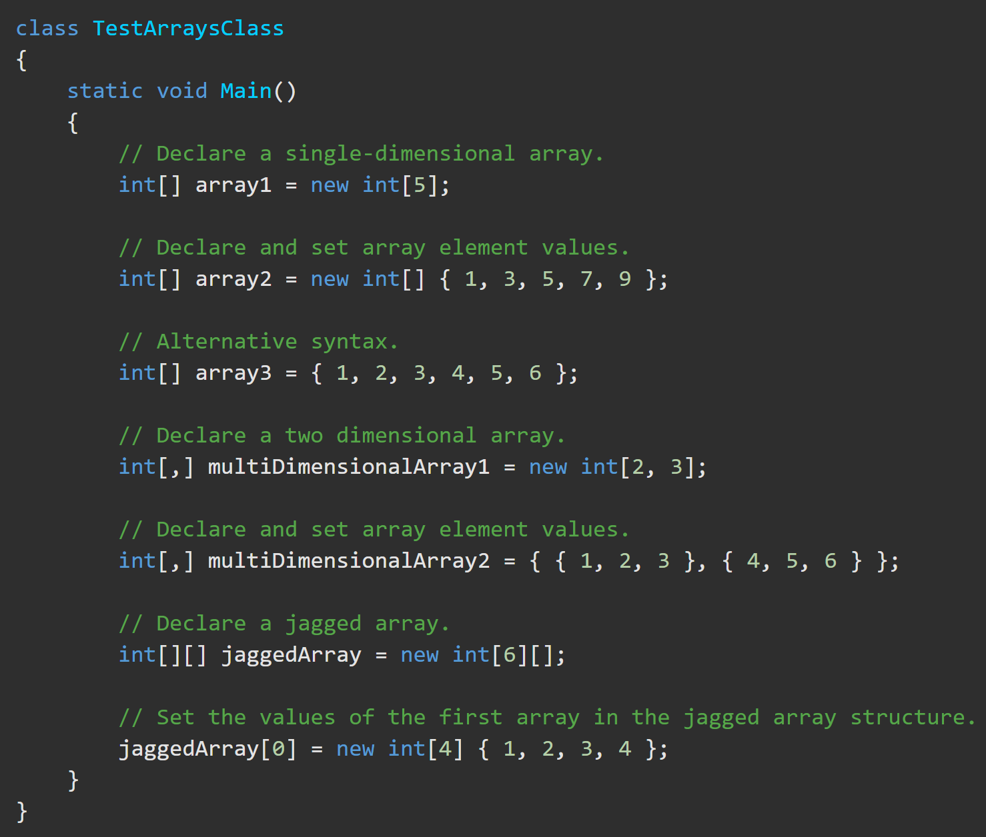
C# Array Class https://docs.microsoft.com/en-us/dotnet/csharp/programming-guide/arrays/ https://docs.microsoft.com/en-us/dotnet/api/system.array?view=netframework-4.8
The Array class is considered a collection because it is based on the IList interface.
Has methods for creating, manipulating, searching, and sorting arrays,
length, and data type are set when the array instance is created. Cannot be changed.
An array can be Single-Dimensional, Multidimensional or Jagged.
Numeric default values are zero (0).
Reference default values are ‘null’.
Arrays are ‘zero indexed’ (They start at 0).

Slide 4

Generics https://docs.microsoft.com/en-us/dotnet/api/system.collections.generic?view=netframework-4.8 https://docs.microsoft.com/en-us/dotnet/csharp/programming-guide/generics/ https://docs.microsoft.com/en-us/dotnet/standard/generics/?view=netframework-4.8
Generic classes, structs, interfaces, and methods
have placeholders (type parameters), instead of specified types, for the types that they use.
generic collection class
use a type (T) parameter as a placeholder for the type of objects that it stores; the type parameters appear as the types of its fields and the parameter types of its methods.
generic method
use its type parameter as the type of its return value or as the type of one of its formal parameters.

Slide 5
Generics - Terminology https://docs.microsoft.com/en-us/dotnet/standard/generics/?view=netframework-4.8
generic type definition - a class, structure, or interface declaration that functions as a template with placeholders for its types.
generic type parameters - type parameters. Placeholders in a generic type or method definition.
constructed generic type - constructed type. The result of specifying types for the generic type parameters of a generic type definition.
generic type argument - any type that is substituted for a generic type parameter.
generic type - constructed types and generic type definitions.
variance
Covariance – constructed generic types whose type arguments are more derived than a target constructed type.
contravariance – constructed generic types whose type arguments are less derived than a target constructed type.
constraints - limits placed on generic type parameters. Arguments that do not satisfy the constraints cannot be used.
generic method definition - a method with two parameter lists: a list of generic type parameters and a list of formal parameters. Type parameters can appear as the return type or as the types of the formal parameters.

Slide 6
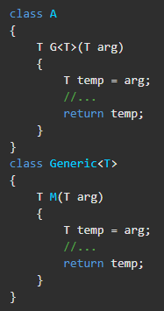
Generics – What qualifies as a generic method? https://docs.microsoft.com/en-us/dotnet/standard/generics/?view=netframework-4.8
A method is generic only if it has its own list of type parameters.
Generic methods can appear on generic or nongeneric types.
A method is not generic just because it belongs to a generic type, or even because it has formal parameters whose types are the generic parameters of the enclosing type.
In the following code, only method G is generic.

Slide 7
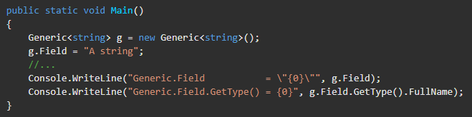
Generics - Instantiation https://docs.microsoft.com/en-us/dotnet/api/system.collections.generic?view=netframework-4.8 https://docs.microsoft.com/en-us/dotnet/csharp/programming-guide/generics/ https://docs.microsoft.com/en-us/dotnet/standard/generics/?view=netframework-4.8
On instantiation of a generic class, specify the actual types to substitute for the type parameters. This establishes a ‘constructed generic class’, with your chosen types substituted everywhere that the type parameters appear. The result is a type-safe class that is tailored to your choice of types.

Slide 8
Generics https://docs.microsoft.com/en-us/dotnet/api/system.collections.generic?view=netframework-4.8 https://docs.microsoft.com/en-us/dotnet/csharp/programming-guide/generics/ https://docs.microsoft.com/en-us/dotnet/standard/generics/?view=netframework-4.8
The System.Collections.Generic namespace contains interfaces and classes that define generic collections. Users can create strongly typed collections that provide better type safety and performance.
Many generic collection types are direct analogs of nongeneric types.
Dictionary<TKey,TValue> is a generic version of Hashtable.
List<T> is a generic version of ArrayList.
Queue<T> and Stack<T> classes that correspond to the nongeneric versions.
There are generic and nongeneric versions of SortedList<TKey,TValue>. Both versions are hybrids of a dictionary and a list.
Unique Generic Structures
The SortedDictionary<TKey,TValue> generic class is a pure dictionary and has no nongeneric counterpart.
The LinkedList<T> generic class is a true linked list and has no nongeneric counterpart.

Slide 9
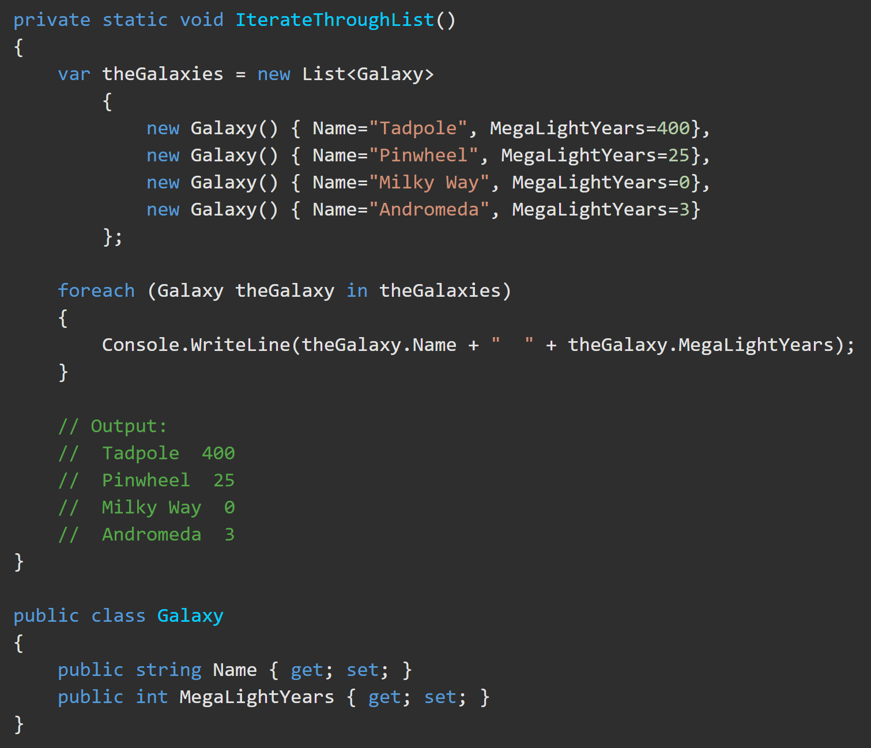
List<T> https://docs.microsoft.com/en-us/dotnet/csharp/programming-guide/concepts/collections https://docs.microsoft.com/en-us/dotnet/api/system.collections.generic.list-1?view=netframework-4.8
List<T> represents a strongly typed list of objects
Elements can be accessed by (zero-based) index[].
Provides methods to search, sort, and manipulate lists.
The List<T> class is the generic equivalent of the (Deprecated) ArrayList class.
It implements the IList<T> generic interface by using an array whose size is dynamically increased as required.
The List<T> is not guaranteed to be sorted.

Slide 10
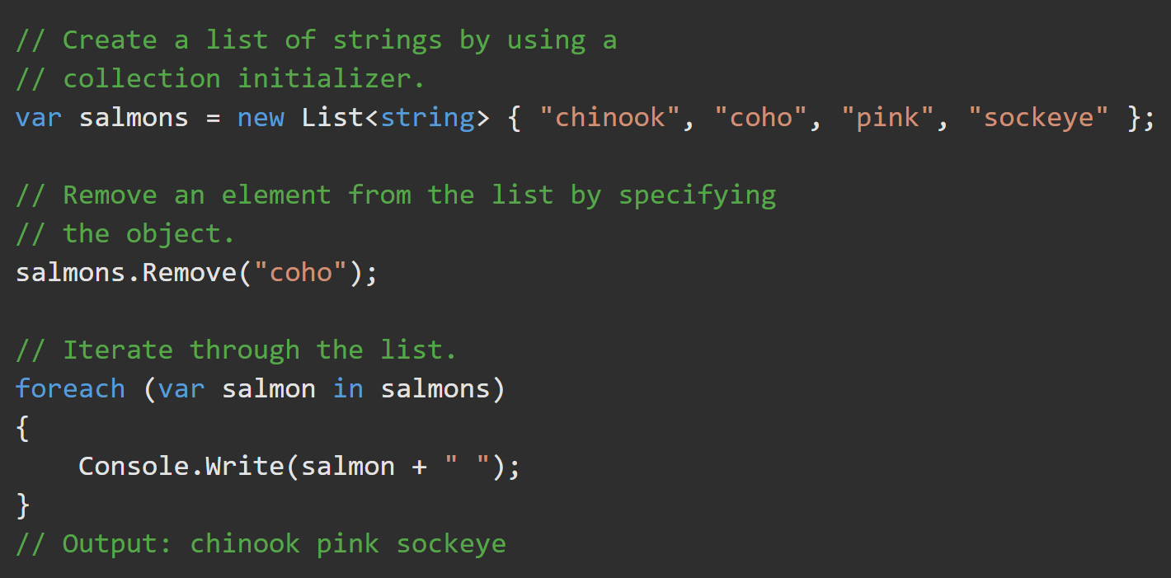
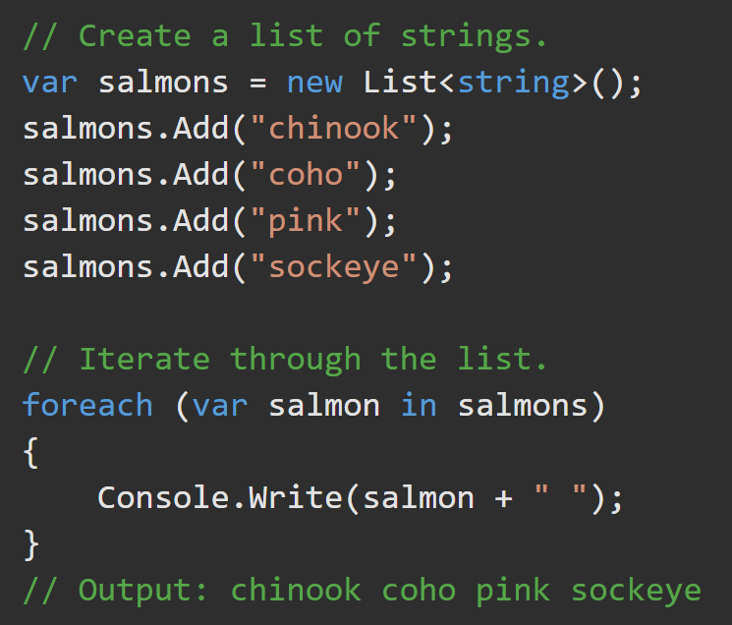
List<T> https://docs.microsoft.com/en-us/dotnet/csharp/programming-guide/concepts/collections
A List<T>() represents a list of objects that can be accessed by index. Methods to search, sort, and modify lists are provided.
Add content using .Add().
Use ‘foreach’ to iterate through the List.
Use a ‘content initializer’ to add content of the specified type.
Use ‘foreach’ to iterate through the List.

Slide 11
Dictionary<TKey,TValue> https://docs.microsoft.com/en-us/dotnet/api/system.collections.generic.dictionary-2?view=netframework-4.8
Represents a collection of key/value pairs.
The Dictionary<TKey,TValue> generic class provides a mapping from a set of keys to a set of values. A key and its value must be added at the same time.
A key cannot be null, but a value can be, if its type TValue is a reference type.
As elements are added to a Dictionary<TKey,TValue>, the capacity is automatically increased as required by reallocating the internal array.

Slide 12
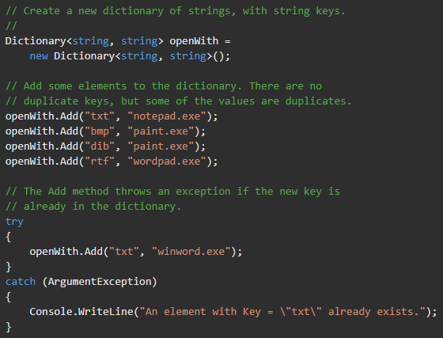
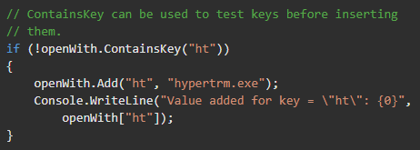
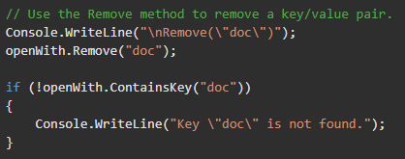
Dictionary<TKey,TValue> – Usage https://docs.microsoft.com/en-us/dotnet/api/system.collections.generic.dictionary-2?view=netframework-4.8

Slide 13

Dictionary< TKey,TValue > https://docs.microsoft.com/en-us/dotnet/api/system.collections.generic.dictionary-2?view=netframework-4.8
The foreach statement returns an object representing the key/value pair in the collection. Since the Dictionary<TKey,TValue> is a collection of keys and values, the element type is not the type of the key or the type of the value. Instead, the element type is a KeyValuePair<TKey,TValue> of the key type and the value type. The foreach statement is a wrapper around the enumerator, which allows only reading from the collection, not writing to it.

Slide 14
SortedList<TKey,TValue> https://docs.microsoft.com/en-us/dotnet/api/system.collections.generic.sortedset-1?view=netframework-4.8
Represents a collection of key/value pairs that are sorted by key based on the associated IComparer<T> implementation.
SortedList<TKey,TValue> is implemented as an array of key/value pairs, sorted by the key.
SortedList<TKey, TValue>is similar to the SortedDictionary<TKey,TValue> generic class
SortedList<TKey,TValue> uses less memory than SortedDictionary<TKey,TValue>.
SortedDictionary<TKey,TValue> has faster insertion and removal operations for unsorted data.
If the list is populated all at once from sorted data, SortedList<TKey,TValue> is faster than SortedDictionary<TKey,TValue>.
SortedList<TKey,TValue> supports efficient indexed retrieval of keys and values
The capacity can be decreased by calling .TrimExcess() or by setting the Capacity property explicitly.
The ‘foreach’ statement is a wrapper around the enumerator. It is readonly.

Slide 15
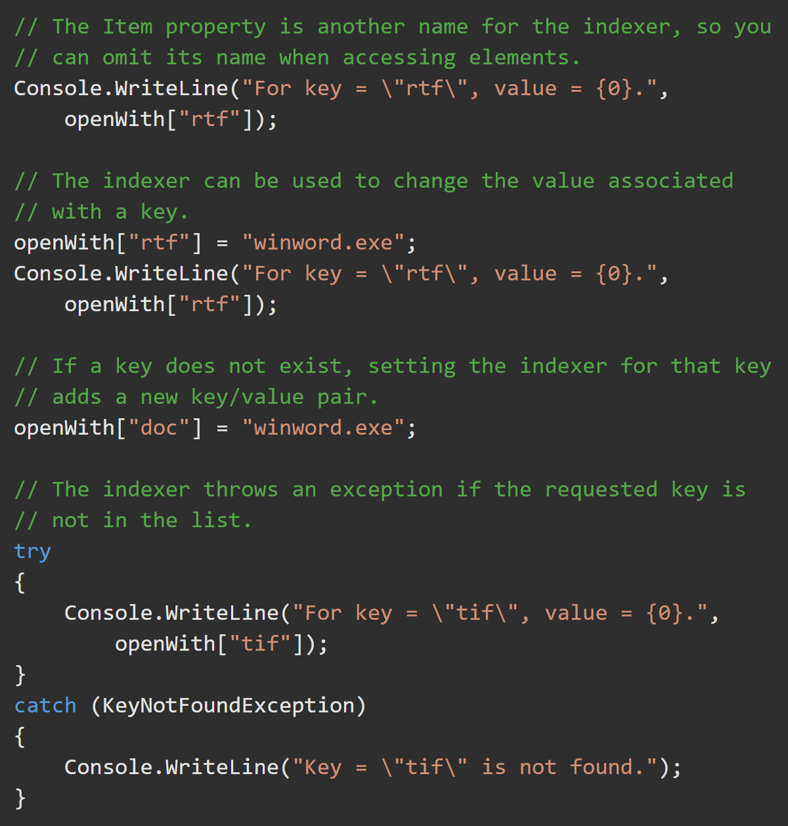
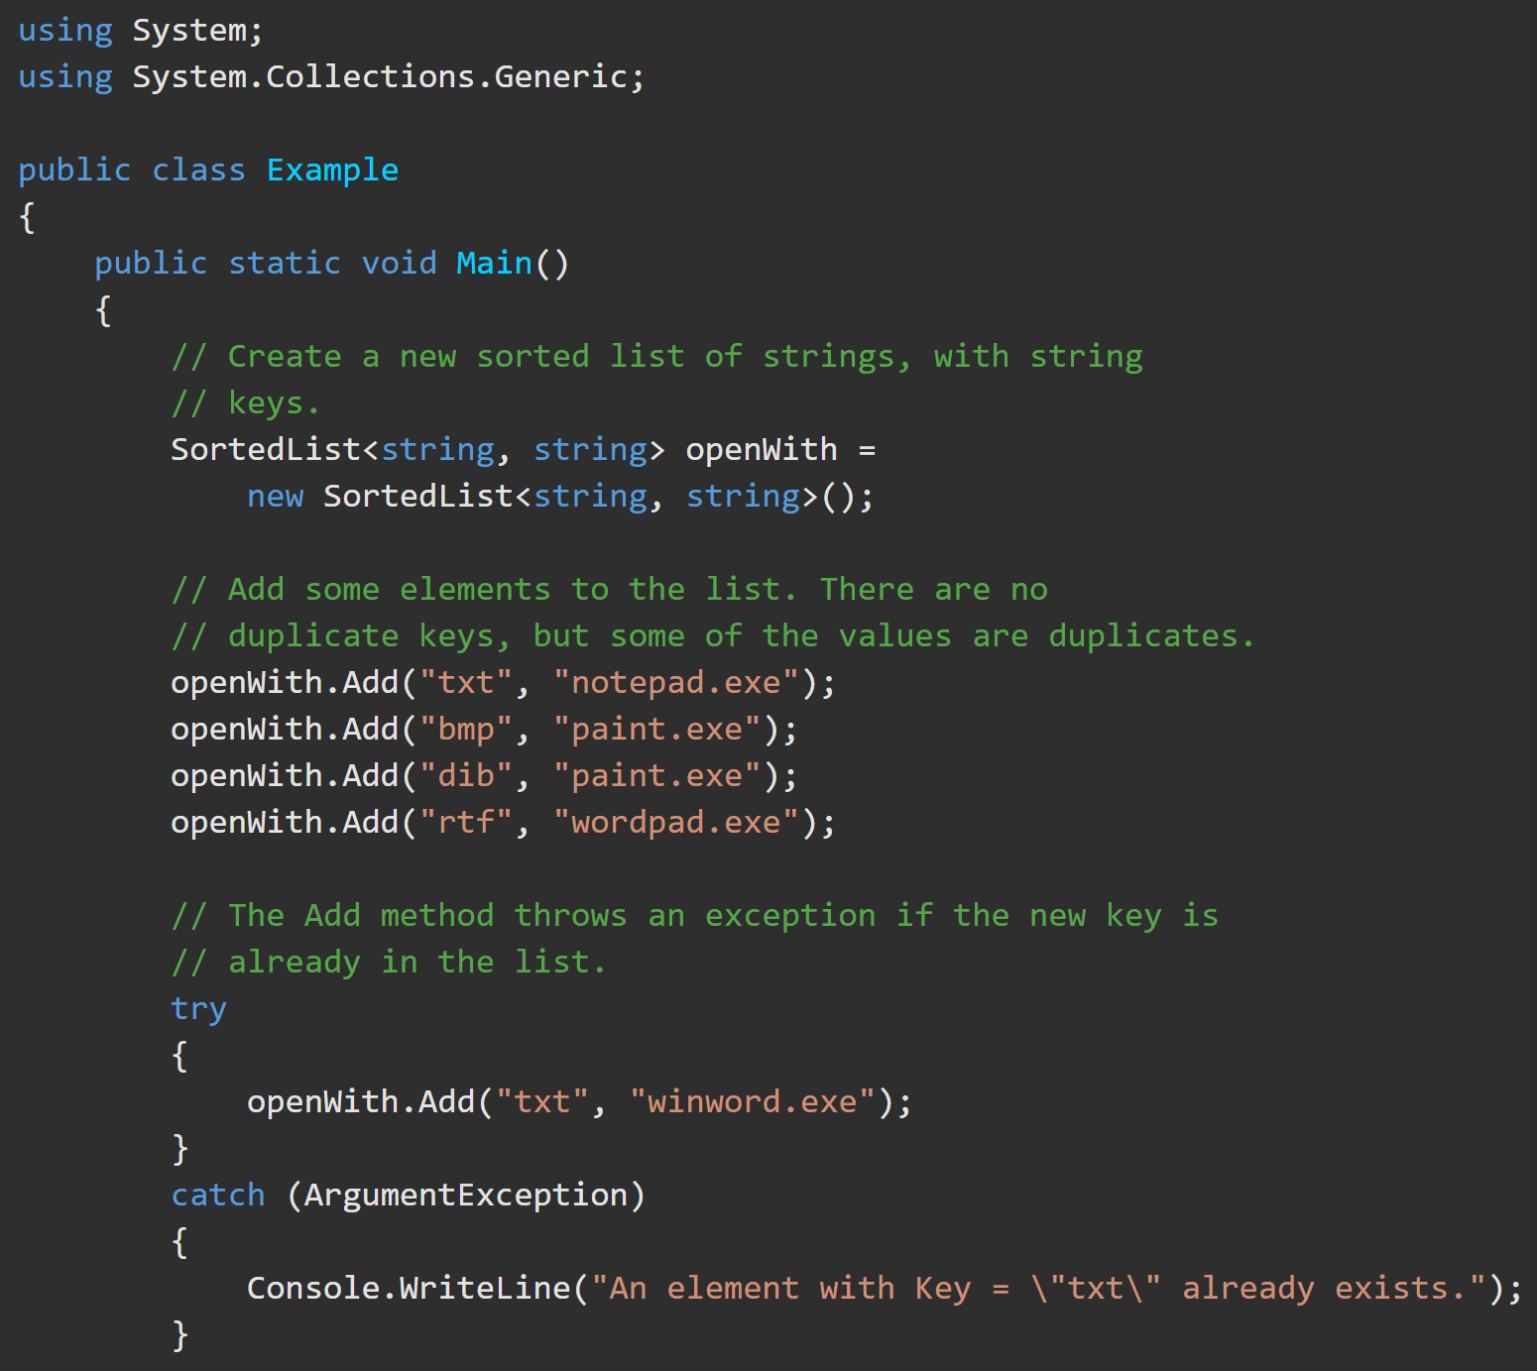
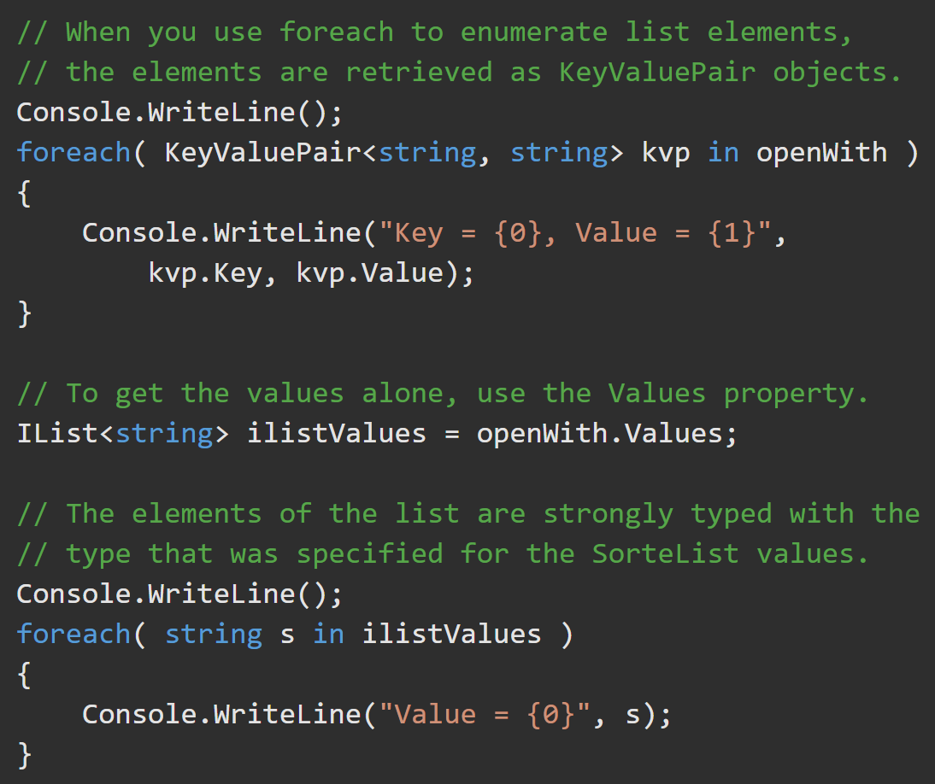
SortedList<TKey,TValue> https://docs.microsoft.com/en-us/dotnet/api/system.collections.generic.sortedlist-2?view=netframework-4.8

Slide 16
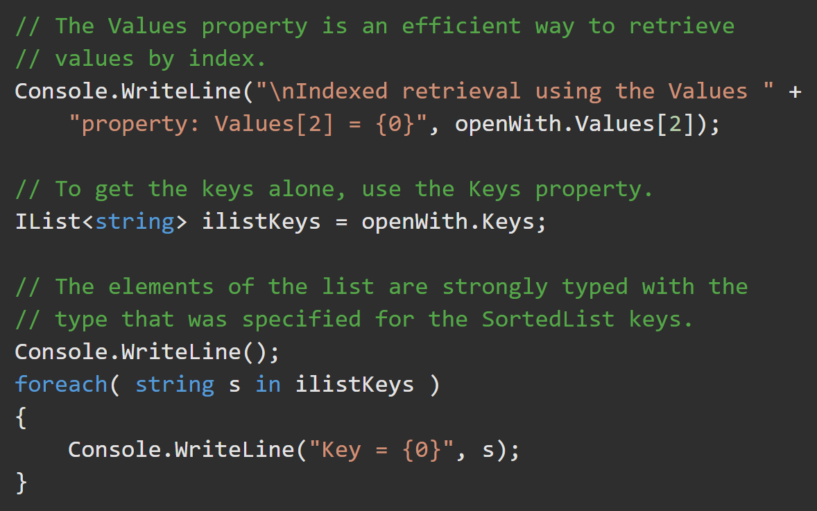
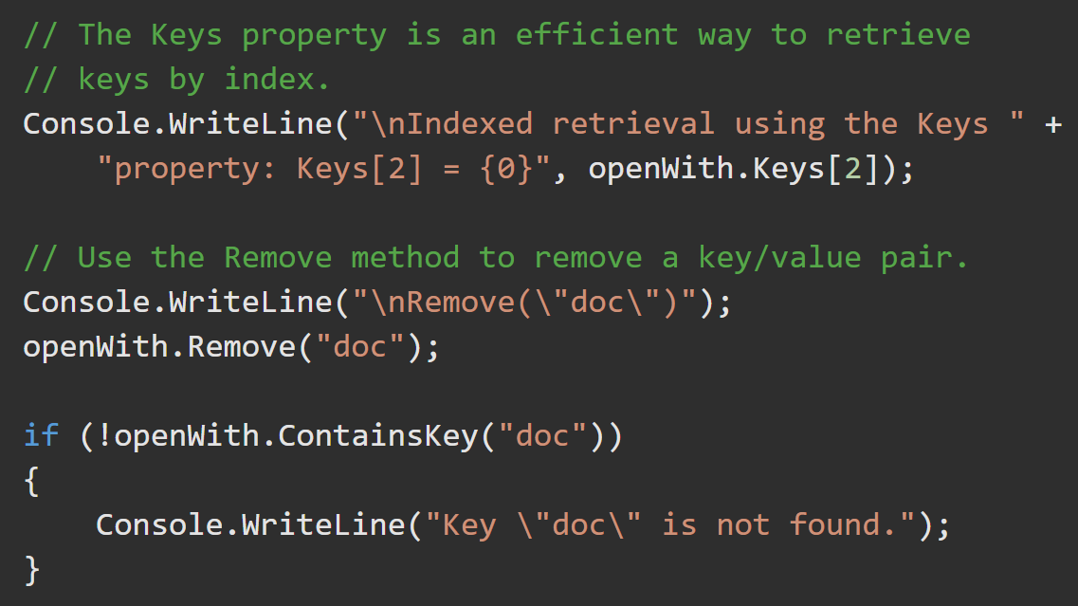
SortedList<TKey,TValue> https://docs.microsoft.com/en-us/dotnet/api/system.collections.generic.sortedset-1?view=netframework-4.8

Slide 17
Queue<T> https://docs.microsoft.com/en-us/dotnet/api/system.collections.generic.queue-1?view=netframework-4.8
FIFO - Objects stored in a Queue<T> are inserted at one end and removed from the other.
Use Queue<T> if you need to access the information in the same order that it is stored in the collection.
Use ConcurrentQueue<T> if you need to access the collection from multiple threads concurrently.
Queue<T> accepts null as a valid value for reference types and allows duplicate elements.
Queues and stacks are useful when you need temporary storage for information
Three main operations can be performed on a Queue<T> and its elements:
Enqueue adds an element to the end of the Queue<T>.
Dequeue removes the oldest element from the start of the Queue<T>.
Peek peek returns the oldest element that is at the start of the Queue<T> but does not remove it from the Queue<T>.

Slide 18
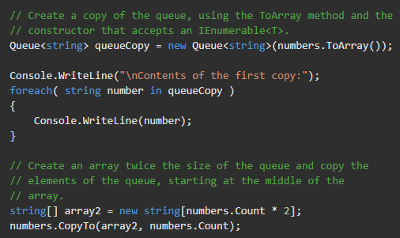
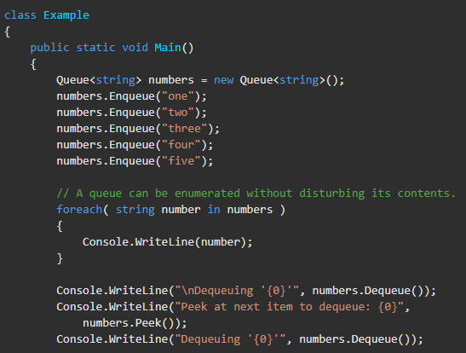
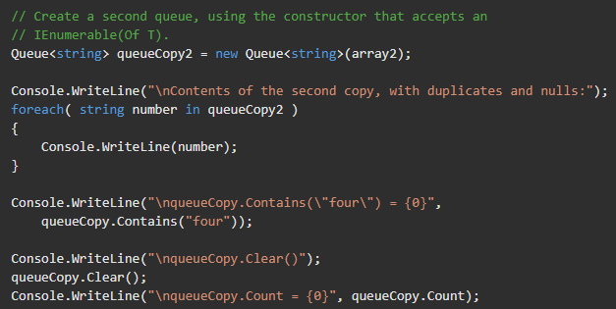
Queue<T> https://docs.microsoft.com/en-us/dotnet/api/system.collections.generic.queue-1?view=netframework-4.8

Slide 19
Stack<T> https://docs.microsoft.com/en-us/dotnet/api/system.collections.generic.stack-1.push?view=netframework-4.8
A (LIFO) collection of instances of the same specified type.
Stack<T> is implemented as an array.
Stacks (and Queues) are useful when you need temporary storage for information
Use Stack<T> if you need to access the information in reverse order.
Use System.Collections.Concurrent.ConcurrentQueue<T> when access is needed from multiple threads concurrently.
System.Collections.Generic.Stack<T> preserves variable states during calls to other procedures.
The capacity can be decreased by calling .TrimExcess().
Stack<T> accepts null as a valid value for reference types and allows duplicate elements.
Three main operations can be performed on a System.Collections.Generic.Stack<T> and its elements:
.Push() inserts an element at the top of the Stack<T>.
.Pop() removes an element from the top of the Stack<T>.
.Peek() returns an element that is at the top of the Stack<T> but does not remove it from the Stack<T>.

Slide 20
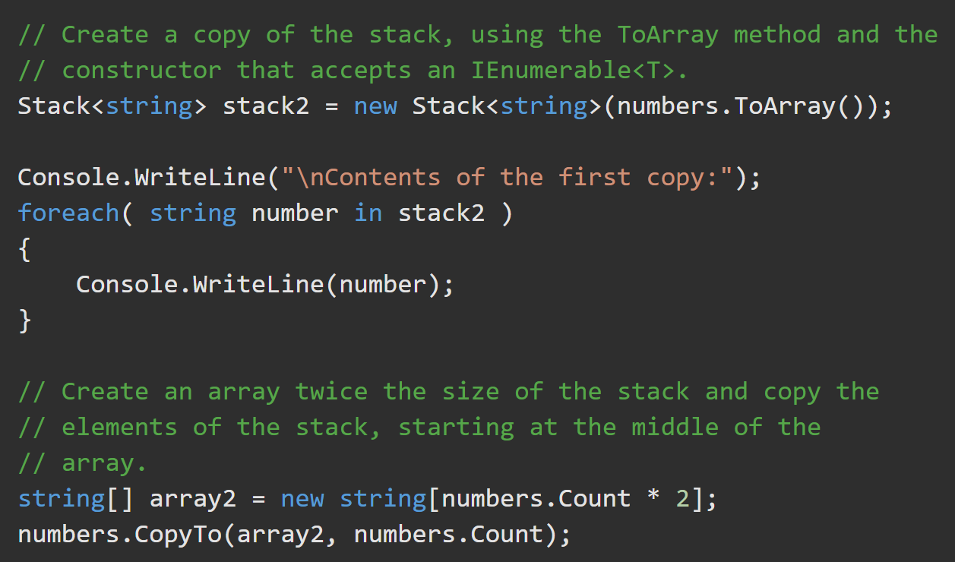
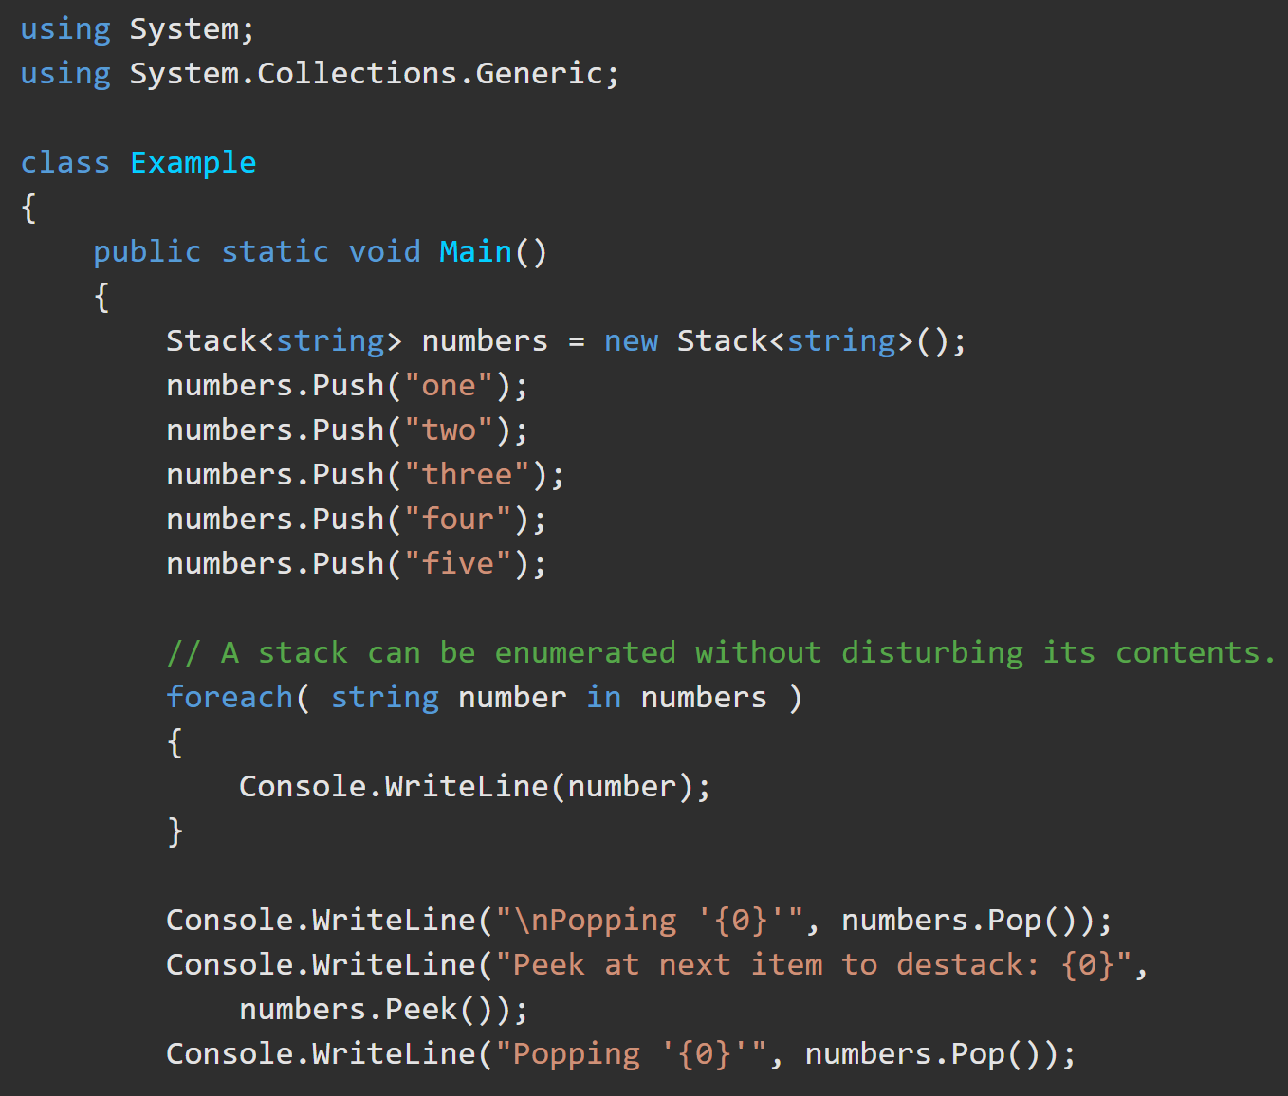
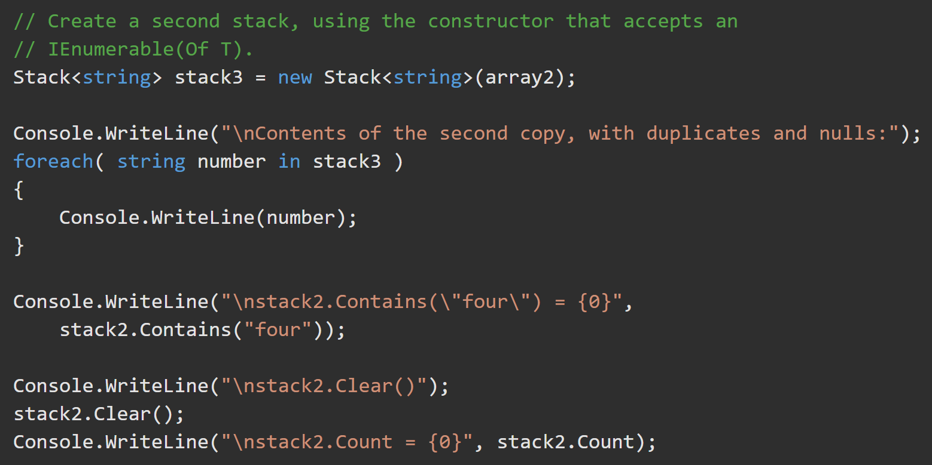
Stack<T> https://docs.microsoft.com/en-us/dotnet/api/system.collections.generic.stack-1.push?view=netframework-4.8

