Slide 1

Variance, Boxing, and Unboxing
.net / Microsoft dynamics 365

Slide 2
Variance refers to how subtyping between more complex types relates to subtyping between their components. For instance, if the type Cat is a subtype of Animal , then an expression of type Cat should be substitutable wherever an expression of type Animal is used.
https://en.wikipedia.org/wiki/Covariance_and_contravariance_(computer_science)

Slide 3
Variance https://docs.microsoft.com/en-us/dotnet/csharp/programming-guide/concepts/covariance-contravariance/
Covariance and contravariance are collectively referred to as variance. Covariance and contravariance of generic type parameters enable the use of constructed generic types whose type arguments are more derived (covariance) or less derived (contravariance) than a target constructed type.
Covariance and contravariance enable implicit reference conversion for array types, delegate types, and generic type arguments.
Covariance preserves assignment compatibility and contravariance reverses it.

Slide 4
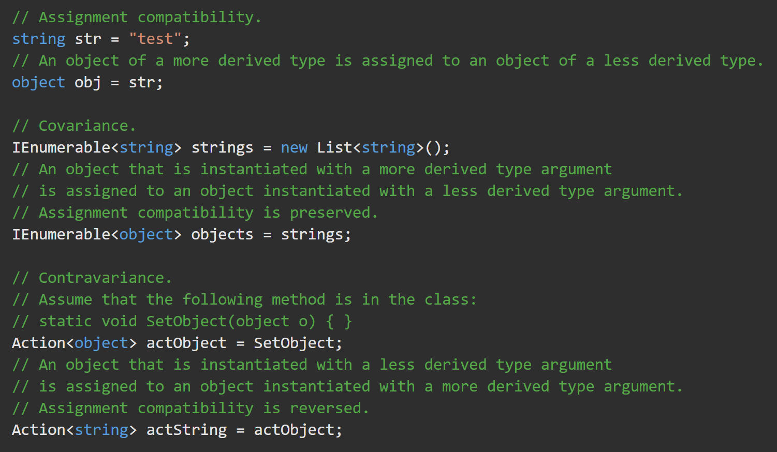
Variance https://docs.microsoft.com/en-us/dotnet/csharp/programming-guide/concepts/covariance-contravariance/
The difference between assignment compatibility, covariance, and contravariance.

Slide 5
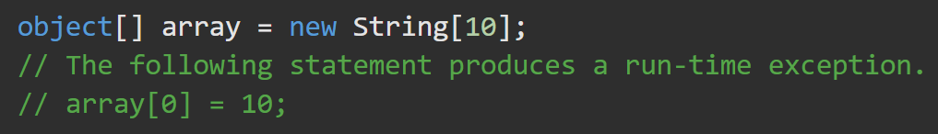
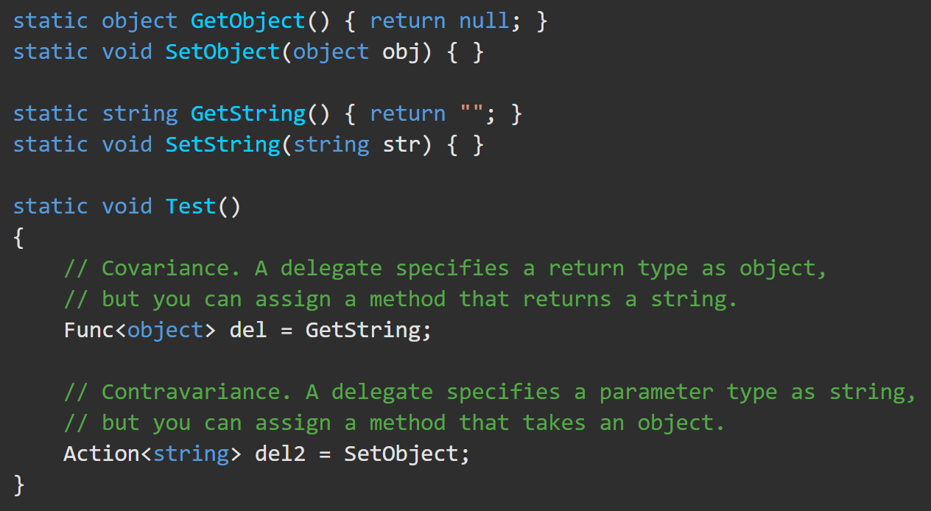
Variance https://docs.microsoft.com/en-us/dotnet/csharp/programming-guide/concepts/covariance-contravariance/
Covariance for arrays enables implicit conversion of an array of a more derived type to an array of a less derived type. But this operation is not type safe.
Covariance and contravariance support for method groups allows for matching method signatures with delegate types. This enables you to assign to delegates not only methods that have matching signatures, but also methods that return more derived types (covariance) or that accept parameters that have less derived types (contravariance) than that specified by the delegate type.

Slide 6
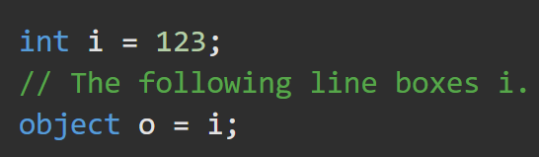
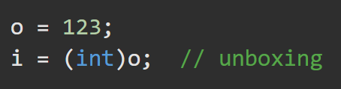
Boxing Unboxing https://docs.microsoft.com/en-us/dotnet/csharp/programming-guide/types/boxing-and-unboxing#boxing https://docs.microsoft.com/en-us/dotnet/csharp/programming-guide/types/boxing-and-unboxing#unboxing
The concept of boxing and unboxing underlies the C# unified view of the type system in which a value of any type can be treated as an object.
https://docs.microsoft.com/en-us/dotnet/csharp/programming-guide/types/boxing-and-unboxing
Boxing converts a value type to a new type object which is stored in the garbage-collected heap.
BOXING is implicit
Unboxing extracts the value type from the object.
UNBOXING is explicit

Slide 7
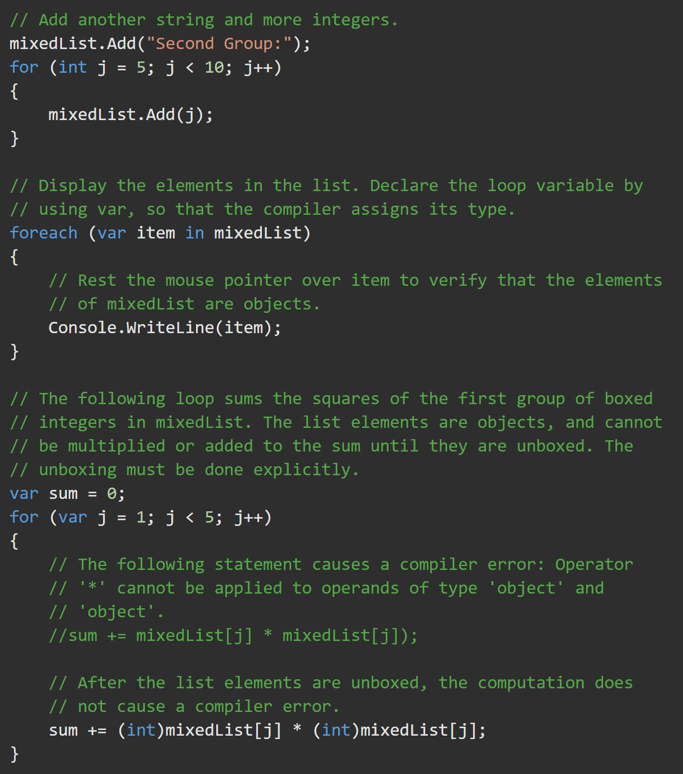
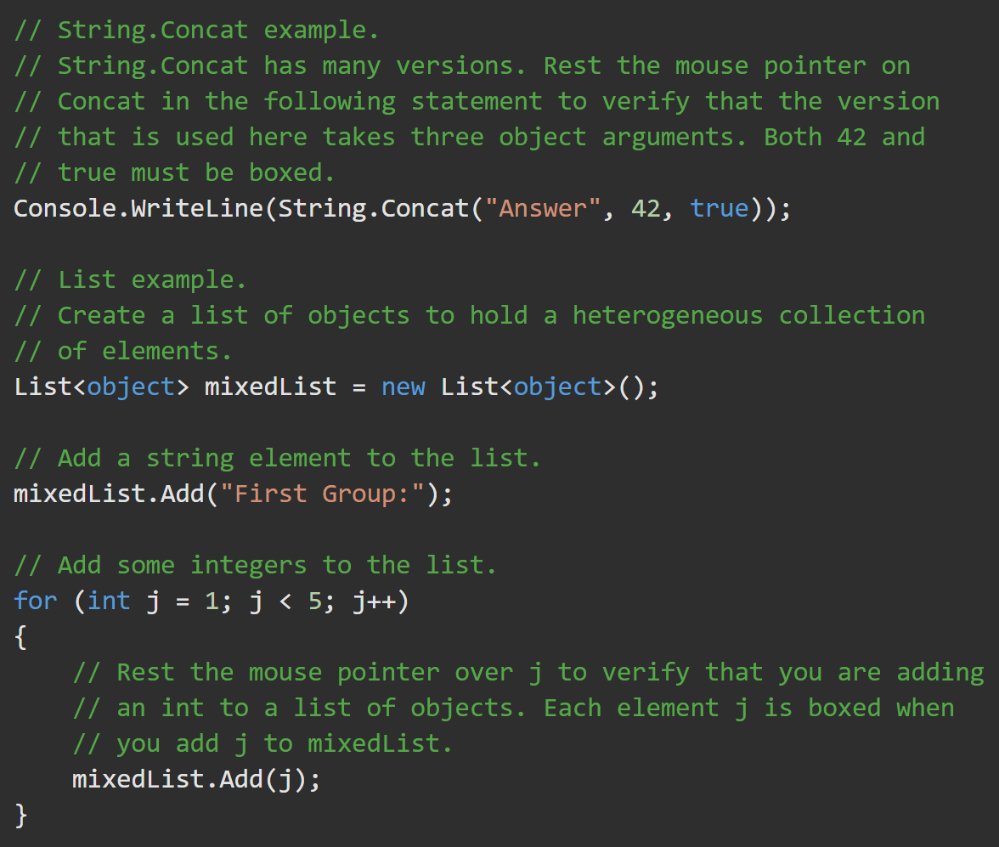
Boxing Activity - Boxing to the object type allows different types to inhabit the same array.
https://docs.microsoft.com/en-us/dotnet/csharp/programming-guide/types/boxing-and-unboxing

Slide 8
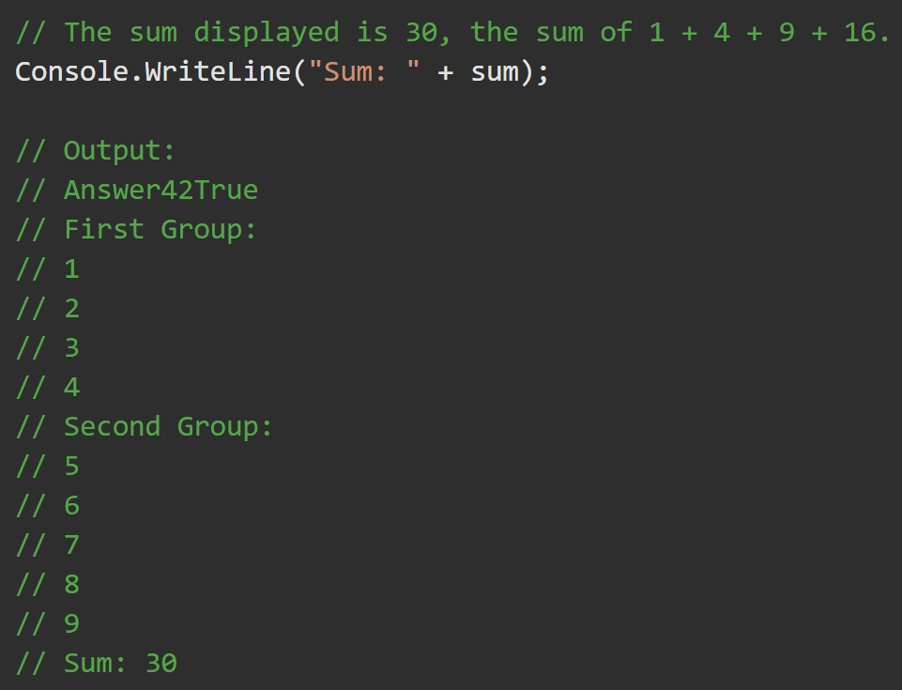
Activity Output

Slide 9
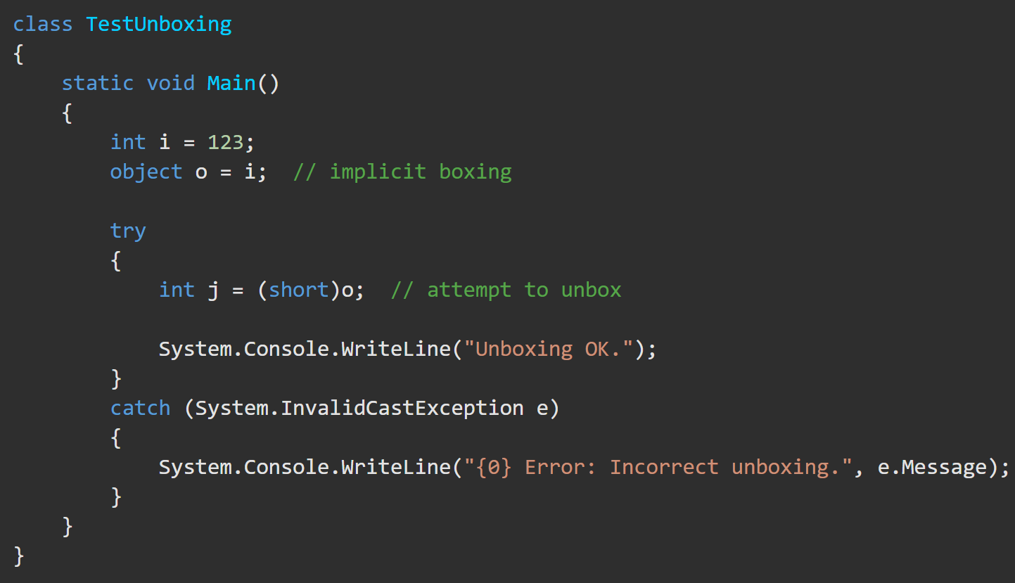
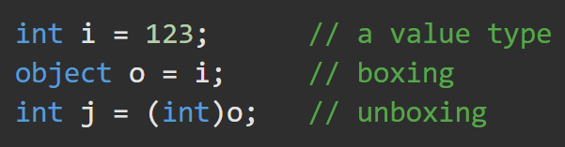
Unboxing https://docs.microsoft.com/en-us/dotnet/csharp/programming-guide/types/boxing-and-unboxing#unboxing
Unboxing is an explicit conversion from the type object to a value type or from an interface type to a value type that implements the interface. An unboxing operation consists of:
Checking the object instance to make sure that it is a boxed value of the given value type.
Copying the value from the instance into the value-type variable.

