Slide 1

Transactions and Isolation Levels
.NET

Slide 2
Transactions specify an isolation level that defines the degree to which one transaction must be isolated from a resource or from data modifications made by other transactions. Isolation levels are described in terms of which concurrency side effects are allowed.
https://docs.microsoft.com/en-us/sql/connect/jdbc/understanding-isolation-levels?view=sql-server-ver15

Slide 3
Isolation Level and Read Errors https://www.geeksforgeeks.org/transaction-isolation-levels-dbms/#:~:text=
Isolation levels define the degree to which a transaction must be isolated from other data modifications made by any other transaction. A transaction isolation level is determined by its permissiveness of the following.
Dirty Read – When a transaction reads data that is new and has not yet been committed by another transaction.
Non-Repeatable read – When a transaction reads the same row twice, and gets a different value each time.
Phantom Read – When two identical queries are executed but the rows retrieved by the two are different.

Slide 4
Isolation Levels https://docs.microsoft.com/en-us/sql/connect/jdbc/understanding-isolation-levels?view=sql-server-ver15
Transaction isolation levels control the following:
If locks, and what type, are enacted when data is read.
How long read locks are held.
If a read operation references rows modified by another transaction:
Block until the exclusive lock on the row is freed.
Retrieve the committed version of the row that existed at the time the statement or transaction started.
Read the uncommitted data modification.
Choosing a transaction isolation level doesn't affect the locks that are acquired to protect data modifications. A transaction always gets an exclusive lock on any data it modifies and holds that lock until the transaction completes, regardless of its isolation level.

Slide 5

Isolation Levels – Serializable https://sqlperformance.com/2015/04/t-sql-queries/the-read-uncommitted-isolation-level
The only transaction isolation level that provides complete isolation from concurrency effects is serializable. The SQL Server implementation of the serializable isolation level means a transaction will see the latest committed data. The set of data encountered under serializable isolation is guaranteed not to change before the transaction ends.

Slide 6
Isolation Levels – Repeatable-Read https://sqlperformance.com/2015/04/t-sql-queries/the-read-uncommitted-isolation-level
The Repeatable Read isolation level is guaranteed to read only committed data. If two identical queries are enacted simultaneously, they may return different results.

Slide 7
Isolation Levels – Read-Committed https://sqlperformance.com/2015/04/t-sql-queries/the-read-uncommitted-isolation-level
Read committed can see committed data from different points in time – even for a single row if, for example, the query plan uses techniques like index intersection.

Slide 8

Isolation Levels – Read-Uncommitted https://sqlperformance.com/2015/04/t-sql-queries/the-read-uncommitted-isolation-level
Read uncommitted is the weakest of the four transaction isolation levels. It allows all three "concurrency phenomena“; dirty reads, non-repeatable reads, and phantom reads.

Slide 9
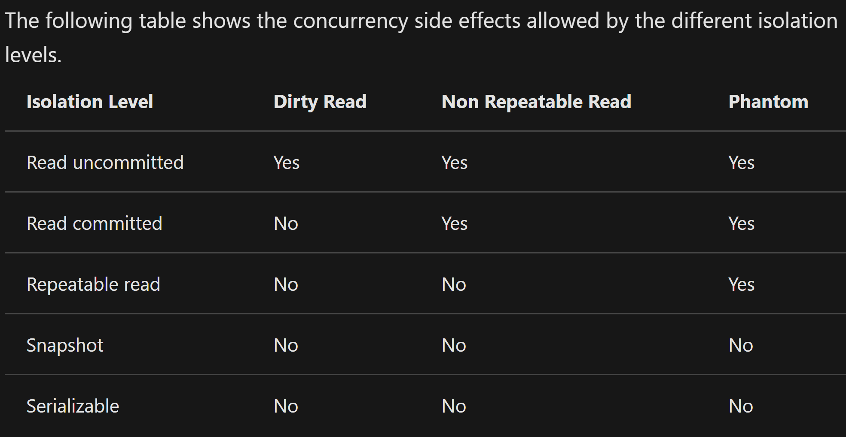
Isolation Levels – In context https://docs.microsoft.com/en-us/sql/connect/jdbc/understanding-isolation-levels?view=sql-server-ver15#remarks

Slide 10
Transactions – Commit/Rollback/Savepoint https://www.techopedia.com/definition/16/commit#:~:text=
Commit - Refers to the saving of data permanently after a set of tentative changes. A commit ends a transaction within a Relational Database and allows all other users to see the changes.
Rollback - In database technologies, a rollback is an operation which returns the database to some previous state. Rollbacks are important for database integrity, because they mean that the database can be restored to a clean copy even after erroneous operations are performed.
Savepoint - A way of implementing nested transactions within a Relational Database Management System by indicating a point within a transaction that can be "rolled back to" without affecting any work done in the transaction before the Savepoint was created. Multiple Savepoints can exist within a single transaction.

