Slide 1

Garbage Collection
.net / Microsoft dynamics 365

Slide 2
.NET's garbage collector manages the allocation and release of memory for your application. The garbage collector's optimizing engine determines the best time to perform a collection, based upon the allocations being made. It checks for objects in the managed heap that are no longer being used by the application and performs the necessary operations to reclaim their memory.
https://docs.microsoft.com/en-us/dotnet/standard/garbage-collection/

Slide 3
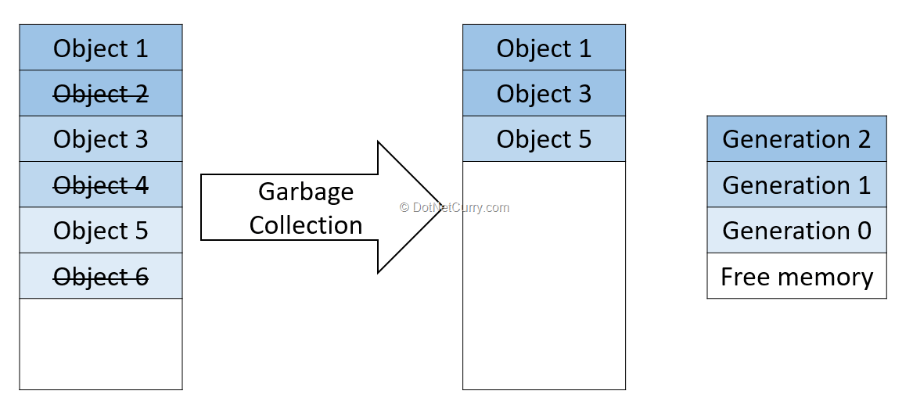
Fundamentals of memory https://docs.microsoft.com/en-us/dotnet/standard/garbage-collection/fundamentals#fundamentals-of-memory
Each process (program) has 2GB of virtual memory allocated.
In C#, you cannot decide where or how memory is allocated during the process.
The Garbage Collector allocates and frees memory.
Virtual memory has three states:
free(unallocated, available),
Reserved
available,
Unusable for other processes,
must be committed in order to store data
Committed
assigned to physical storage
The frequency of garbage collection is the result of the volume of allocations and the amount of survived memory on the managed heap.

Slide 4
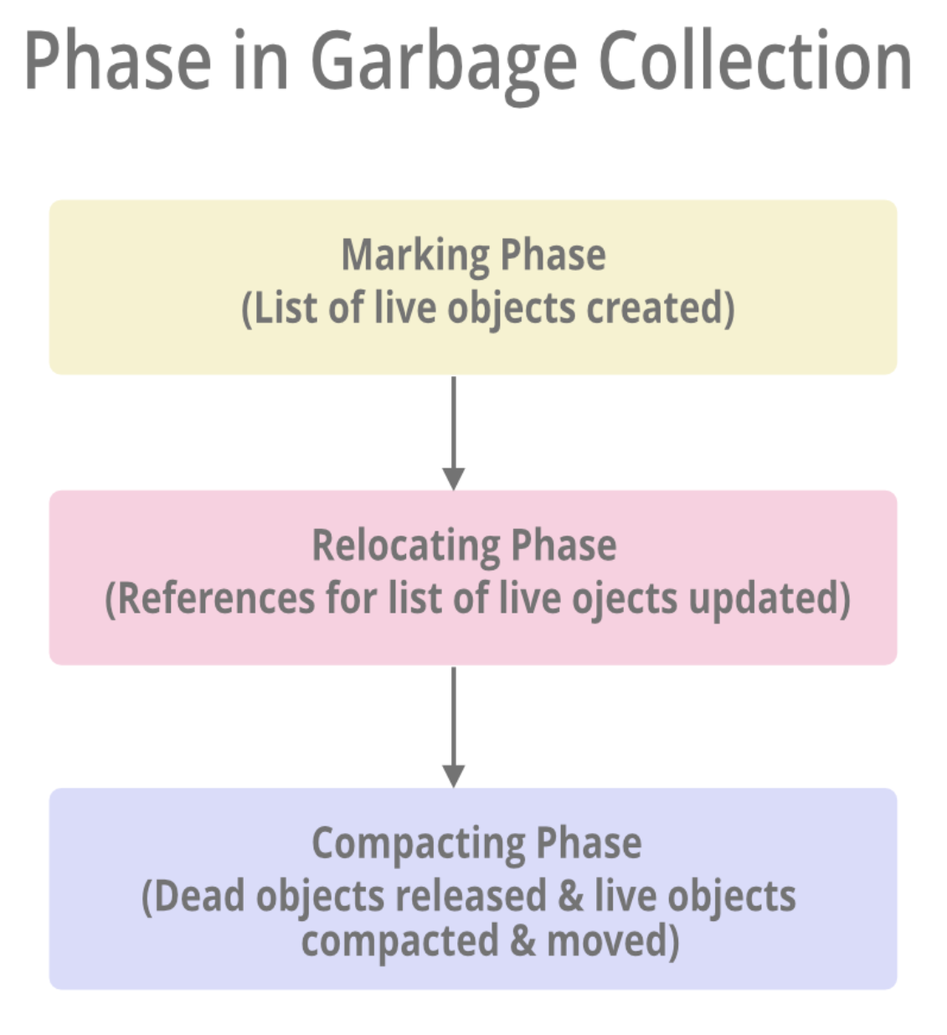
Benefits of Garbage Collection https://docs.microsoft.com/en-us/dotnet/standard/garbage-collection/fundamentals
Don’t worry about memory leaks.
Efficient memory allocation.
Automatically reclaims unused objects, clears memory, and makes memory available.
Constructors do not have to initialize every data field.
Makes sure that an object cannot use the contents of another object.

Slide 5

Managed Heap https://docs.microsoft.com/en-us/dotnet/standard/garbage-collection/fundamentals https://docs.microsoft.com/en-us/dotnet/standard/garbage-collection/large-object-heap
The GC allocates a segment of memory (Managed Heap) to store and manage objects.
There is one Managed Heap for each managed process.
The GC calls the Windows VirtualAlloc function to reserve memory and VirtualFree function to release memory.
The GC divides objects up into small and large objects. Large Objects (arrays) go on the Large Object Heap (LOH), Small objects(instances) go on the Small Object Heap (SOH).

Slide 6
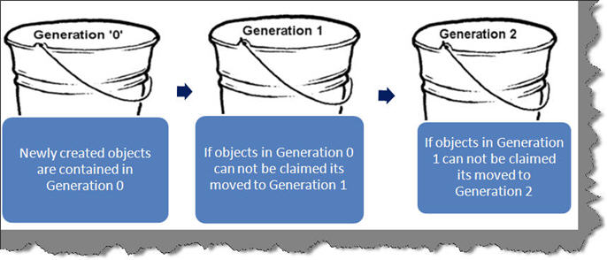
Heap Object Generations https://docs.microsoft.com/en-us/dotnet/standard/garbage-collection/fundamentals#generations
Garbage collection happens on a whole generation at once.
Objects that survive a garbage collection (‘survivors’) are promoted to the next generation.
When GC sees that survival rate is high, it allocates more memory to that generation.
After Garbage Collection, survivors are ‘compacted’ (defragmentation) to the older end of the memory segment.
Generation 0 – New objects, temp. variables, most objects live and die here.
Generation 1 – Short-Lived objects, this serves as a buffer between G0 and G2.
Generation 2 – Long-Lived objects.

Slide 7
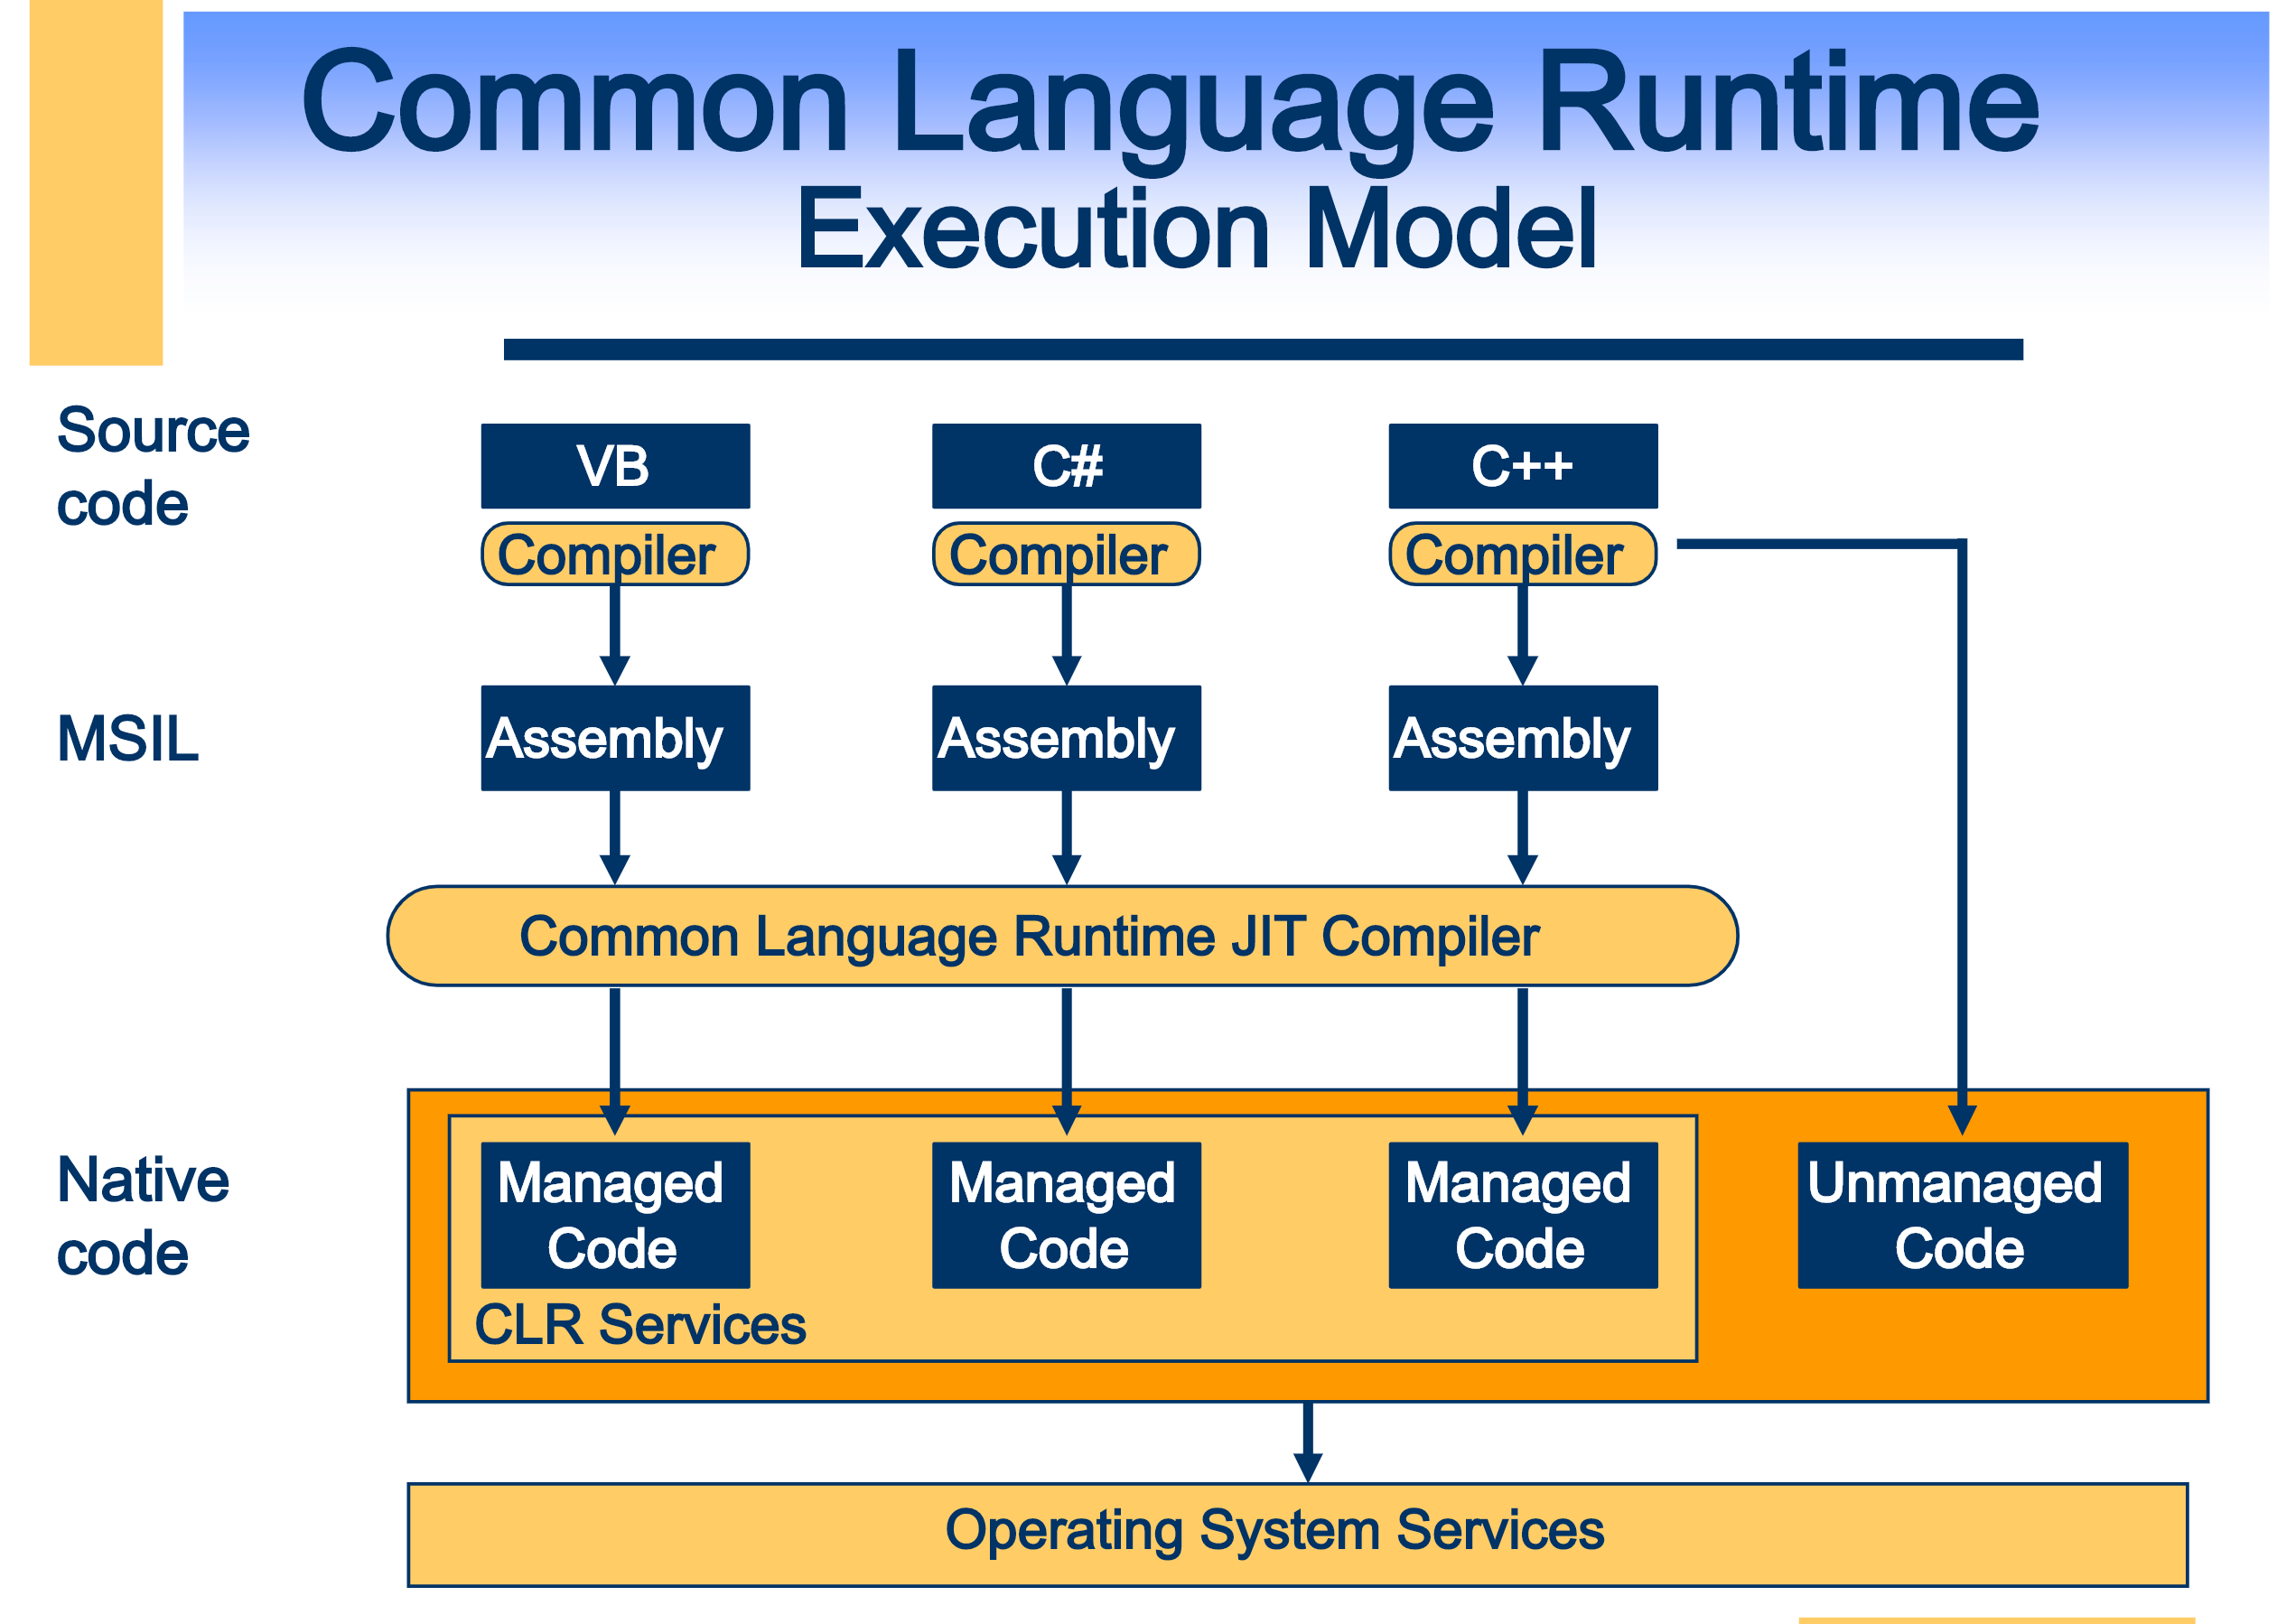
Managed Code https://docs.microsoft.com/en-us/dotnet/standard/managed-code
Managed code managed by the Common Language Runtime (CLR) at runtime.
The CLR provides memory management (GC), security boundaries, type safety, etc.
Managed code is written in a high-level language that can be run on top of .NET.
Code is compiled into Intermediate Language (IL [AKA, MISL, AKA CIL]) code, which the CLR compiles and executes.
The CLR manages the Just-In-Time compiling code from IL to machine code that can be run on a CPU.
The CLR knows what your code is doing and can manage it.

Slide 8
Unmanaged Code https://docs.microsoft.com/en-us/dotnet/framework/interop/
Code that runs outside the CLR is called Unmanaged Code.
The .NET Framework promotes interaction with COM components, COM+ services, external type libraries, and many operating system services. Data types, method signatures, and error-handling mechanisms vary between managed and unmanaged object models.
Examples of Unmanaged Code:
COM components,
ActiveX interfaces,
Windows API functions.

Slide 9
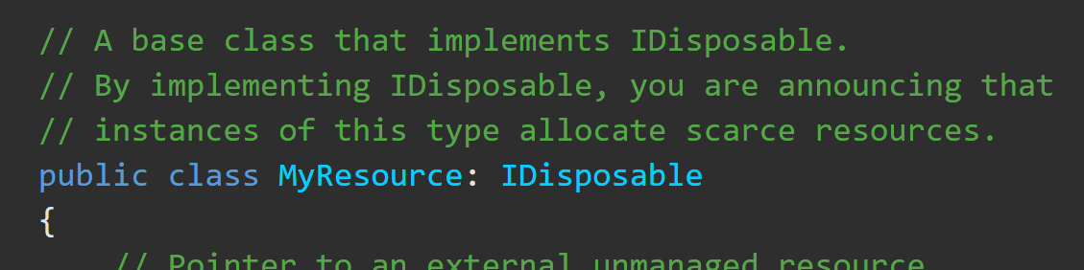
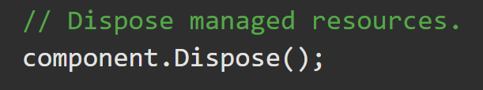
Idisposable Interface https://docs.microsoft.com/en-us/dotnet/api/system.idisposable?view=netframework-4.8
The Garbage Collector (GC) has no knowledge of unmanaged resources (window handles, or open files and streams).
Idisposable provides a method for releasing unmanaged resources.
If your app uses an object that implements the Idisposable interface, call the object’s IDisposable.Dispose implementation when finished using it.

Slide 10
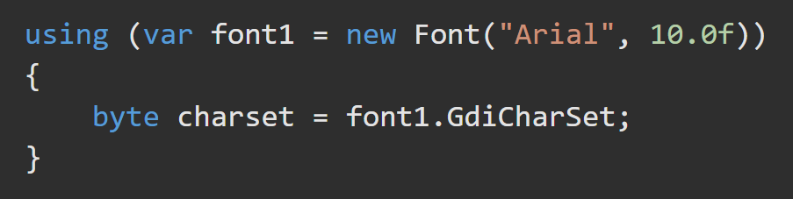
Using Block https://docs.microsoft.com/en-us/dotnet/csharp/language-reference/keywords/using-statement
Provides a convenient syntax that ensures the correct use of IDisposable objects.
When the lifetime of an IDisposable object is limited to a single method, you should declare and instantiate it in the using statement. The using statement calls the Dispose method on the object in the correct way, and (when you use it as shown earlier) it also causes the object itself to go out of scope as soon as Dispose is called. Within the using block, the object is read-only and cannot be modified or reassigned.

Slide 11
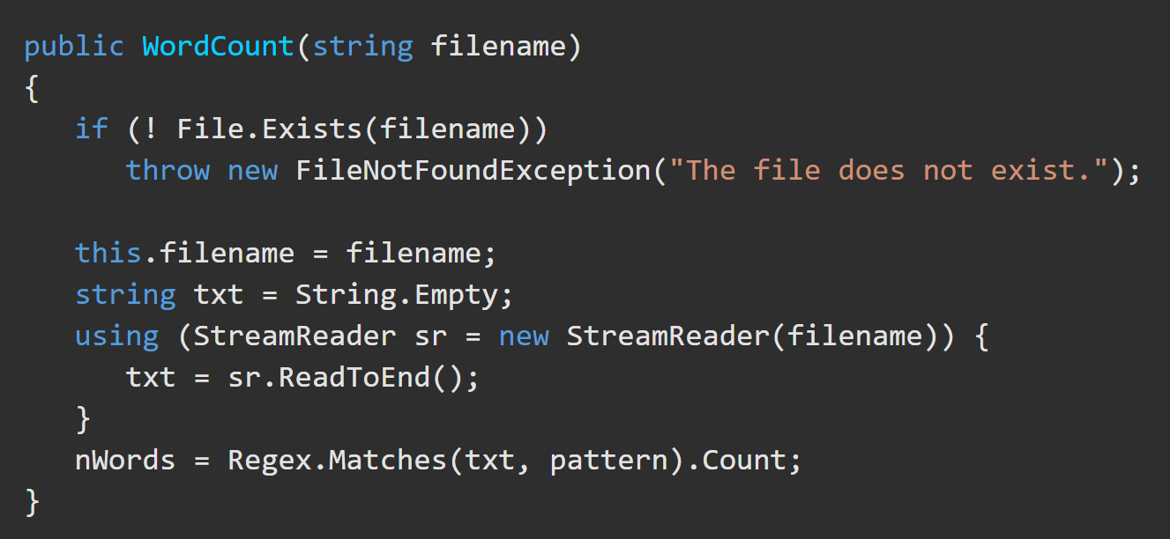
Using Block https://docs.microsoft.com/en-us/dotnet/api/system.idisposable?view=netframework-4.8
If your language supports a construct such as the using statement in C#, you can use it instead of explicitly calling IDisposable.Dispose yourself.
The using statement is a syntactic convenience. At compile time, the language compiler implements the intermediate language (IL) for a try/finally block.

Slide 12
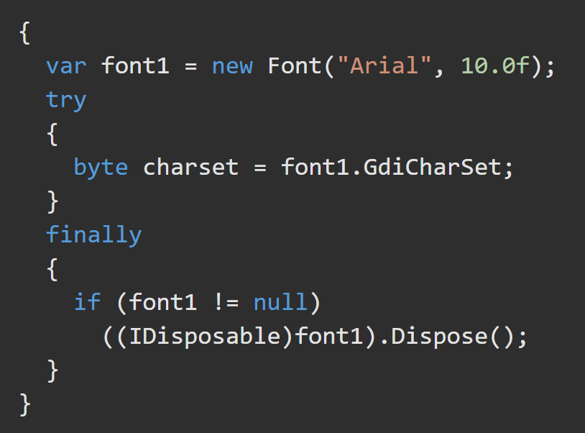
Using Block https://docs.microsoft.com/en-us/dotnet/csharp/language-reference/keywords/using-statement
The using statement ensures that .Dispose is called even if an exception occurs within the using block. You can achieve the same result by putting the object inside a try block and then calling Dispose in a finally block.
A using block is expanded to a try/catch block at compile time (note the extra curly braces to create the limited scope for the object).

