Slide 1

Access Modifiers
.net / Microsoft dynamics 365

Slide 2
Access modifiers are keywords used to specify the declared accessibility of a member or type.
https://docs.microsoft.com/en-us/dotnet/csharp/language-reference/keywords/access-modifiers

Slide 3
Access Modifiers - Class Accessibility https://docs.microsoft.com/en-us/dotnet/csharp/programming-guide/classes-and-structs/access-modifiers
Classes and structs declared directly within a namespace (not nested within other classes or structs) can be either public or internal. Internal is the default if no access modifier is specified.
Derived classes can't have greater accessibility than their base types.

Slide 4
Access Modifiers - Class Member Accessibility https://docs.microsoft.com/en-us/dotnet/csharp/tour-of-csharp/classes-and-objects#accessibility
Access Modifiers control which regions of program text can access the member.
public - Access isn't limited.
private (default)- This class only.
internal - current assembly (.exe, .dll).
protected internal - Child classes, or classes within the same assembly.
protected - Derived classes only.
private protected - This class or derived classes only.

Slide 5
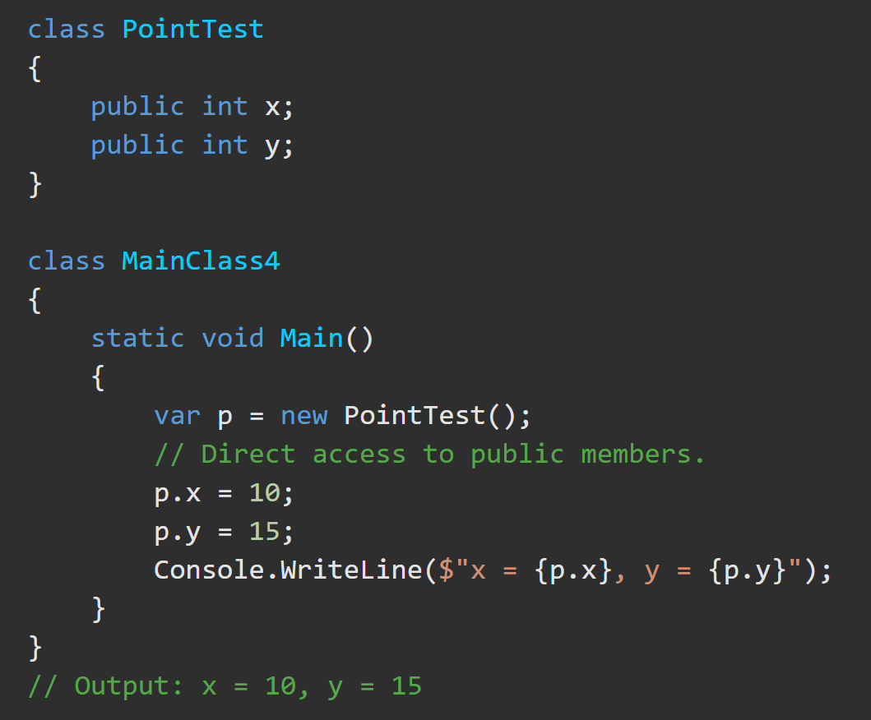
Access Modifiers – Public https://docs.microsoft.com/en-us/dotnet/csharp/language-reference/keywords/public
The public keyword is an access modifier for types and type members.
There are no restrictions on accessing public members.

Slide 6
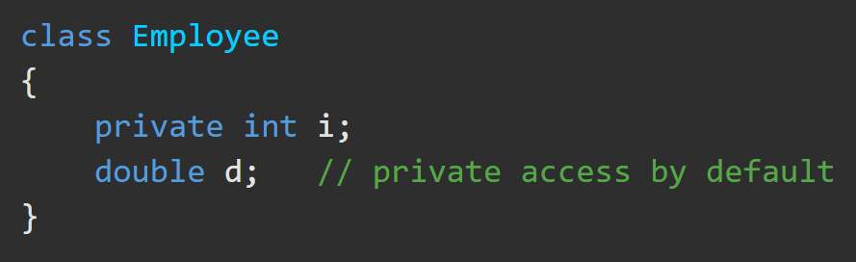
Access Modifiers – Private https://docs.microsoft.com/en-us/dotnet/csharp/language-reference/keywords/private
Private access is the least permissive access level. Private members are accessible only within the body of the class or the struct in which they are declared.
Nested types in the same body can also access those private members.

Slide 7

Access Modifiers – Private Example https://docs.microsoft.com/en-us/dotnet/csharp/language-reference/keywords/private
This Employee class contains two private data members, name and salary. As private members, they cannot be accessed except by member methods. Public methods named GetName() and Salary() are added to allow controlled access to the private members.

Slide 8
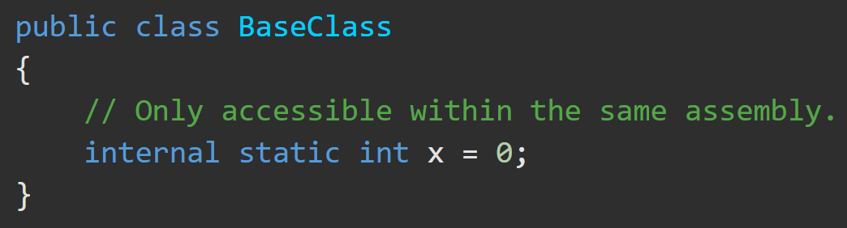
Access Modifiers – Internal https://docs.microsoft.com/en-us/dotnet/csharp/language-reference/keywords/internal
Internal types or members are accessible only within files in the same assembly.
A common use of internal access is in component-based development because it enables a group of components to cooperate in a private manner without being exposed to the rest of the application code.

Slide 9
Access Modifiers – Protected Internal https://docs.microsoft.com/en-us/dotnet/csharp/language-reference/keywords/protected-internal
A protected internal member of a base class is accessible from any type within its containing assembly.
It is also accessible in a derived class located in another assembly only if the access occurs through a variable of the derived class type.
Struct members cannot be protected internal because the struct cannot be inherited.

Slide 10
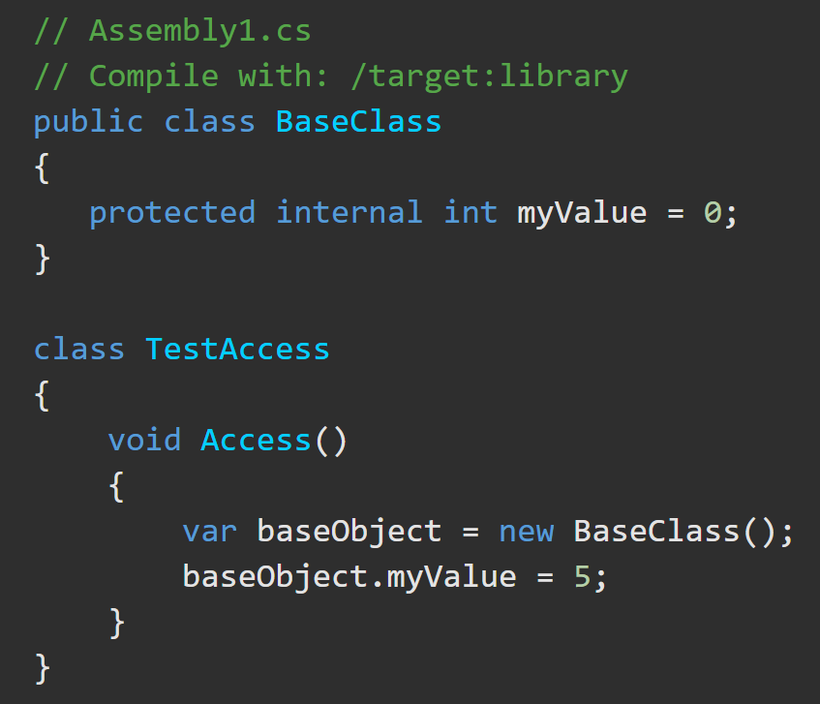
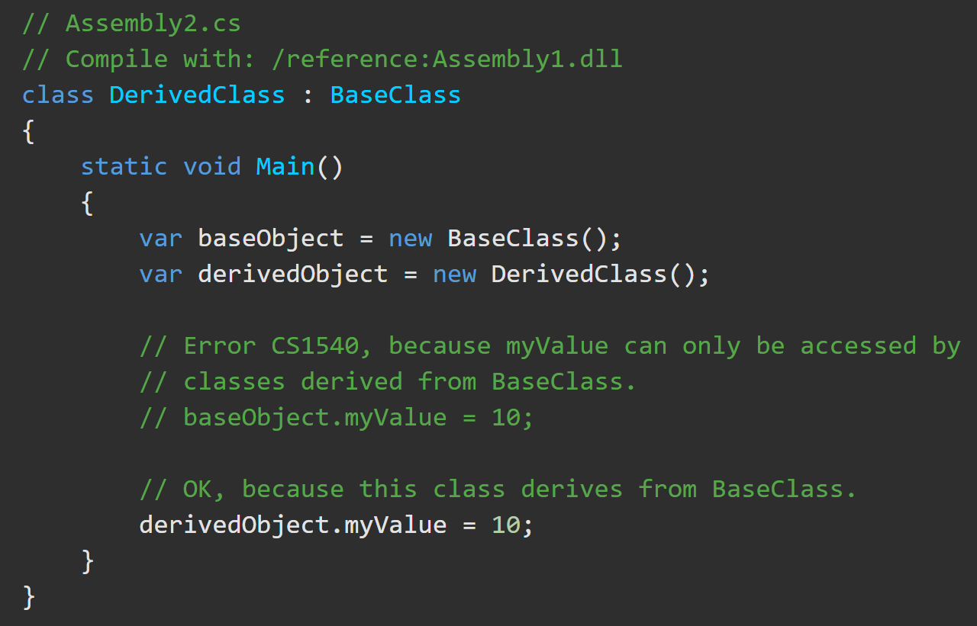
Access Modifiers – Protected Internal https://docs.microsoft.com/en-us/dotnet/csharp/language-reference/keywords/protected-internal
BaseClass and TestAccess are in the same assembly. TestAccess can access myValue. In the second file, an attempt to access myValue through an instance of BaseClass will produce an error, while an access to this member through DerivedClass succeeds.

Slide 11
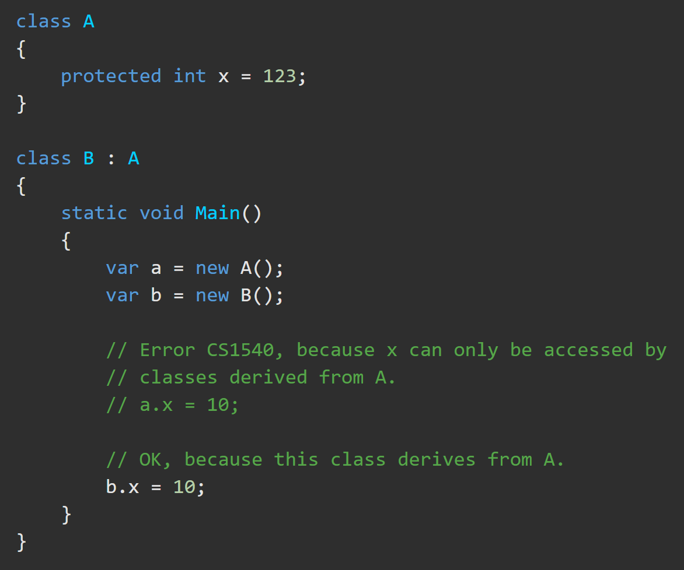
Access Modifiers – Protected https://docs.microsoft.com/en-us/dotnet/csharp/language-reference/keywords/protected
A protected member is accessible through derived class instances only.

Slide 12
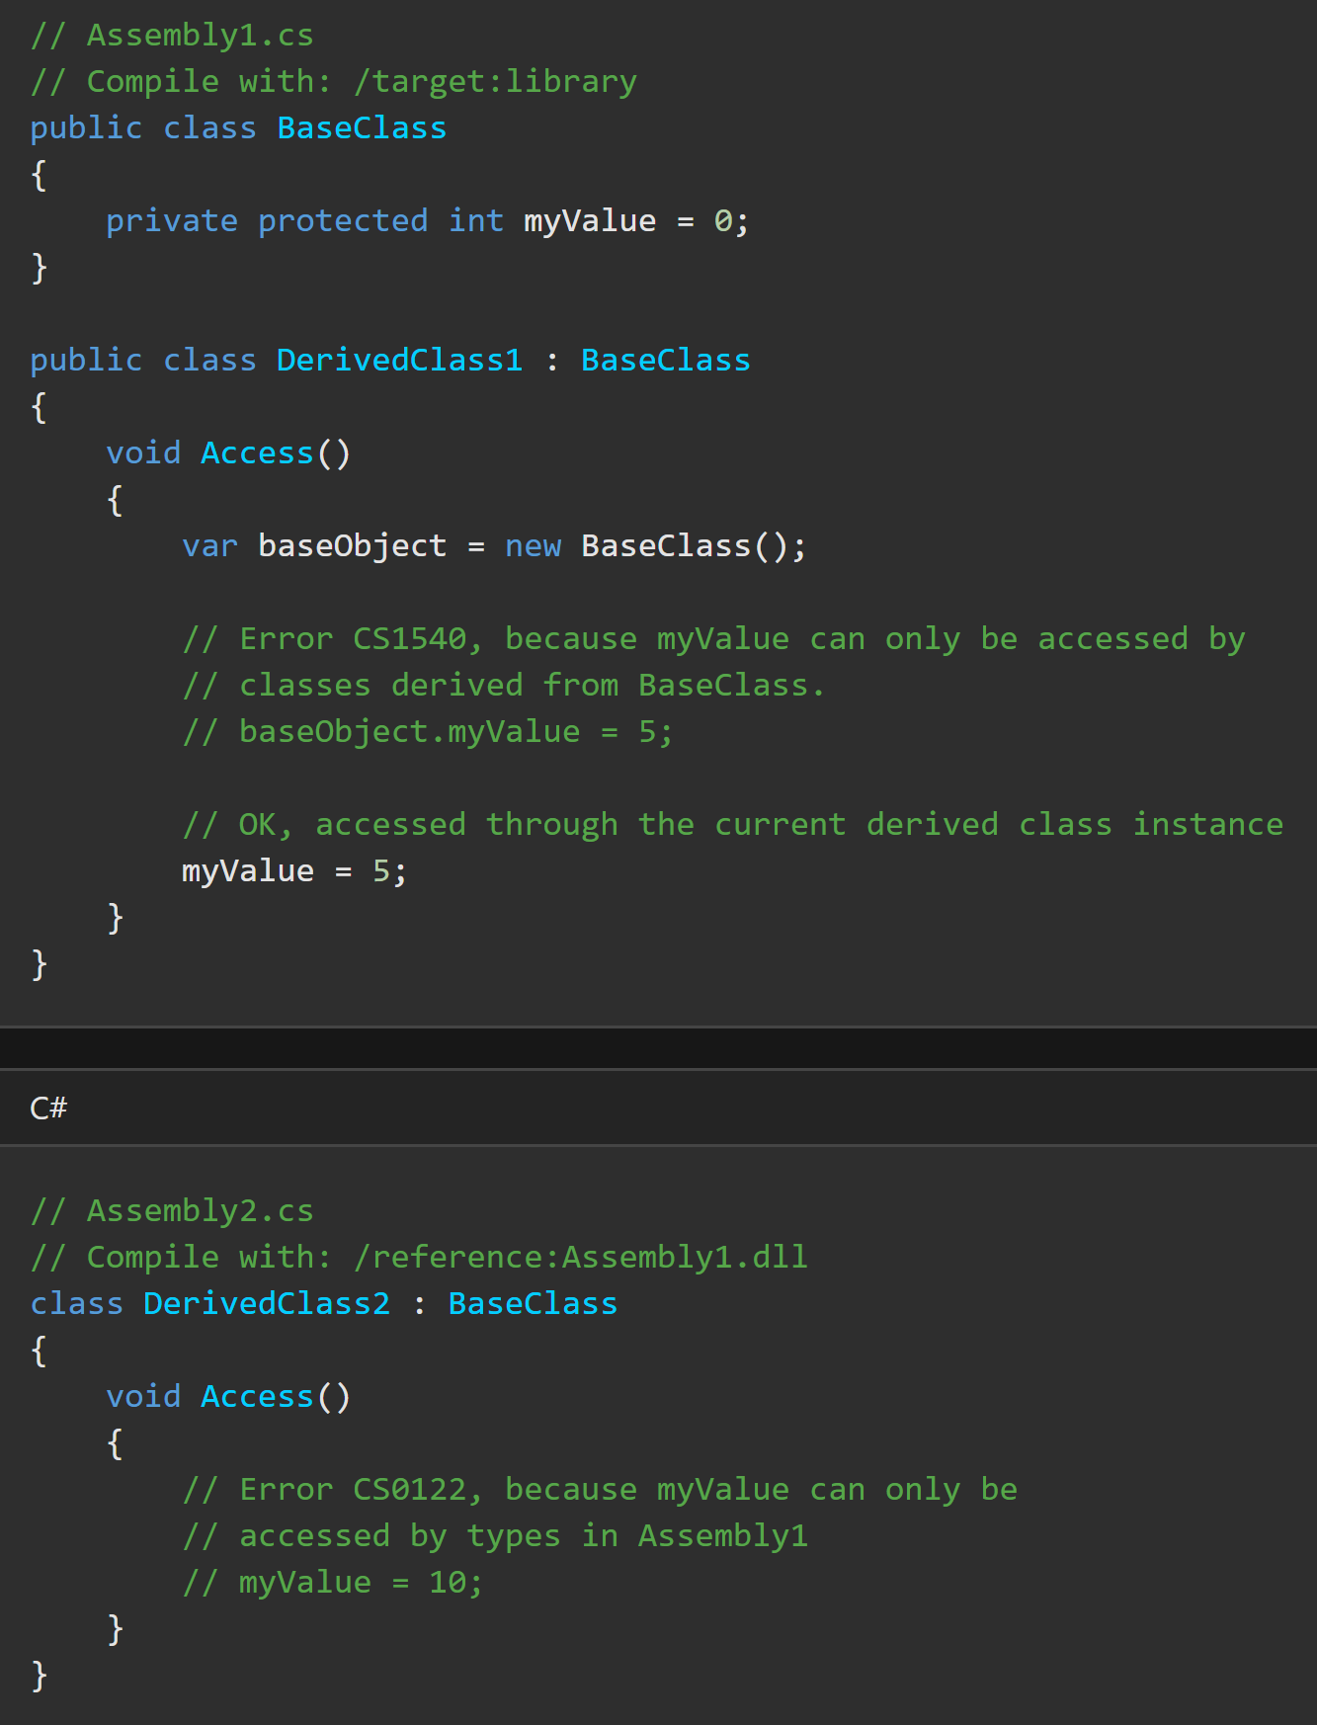
Access Modifiers – Private Protected https://docs.microsoft.com/en-us/dotnet/csharp/language-reference/keywords/private-protected
A private protected member is accessible by types derived from the containing class, but only within its containing assembly.
Assembly1.cs contains public BaseClass, and derived, DerivedClass1. BaseClass owns a private protected myValue, which DerivedClass1 tries to access in two ways. Accessing myValue through an instance of BaseClass will produce an error. Using it as an inherited member in DerivedClass1 succeeds. In Assembly2.cs, accessing myValue as an inherited member of DerivedClass2 produces an error, because it’s in a different assembly.

