Slide 1

Class and Interface
.net / Microsoft dynamics 365

Slide 2
The most fundamental of C#’s types, a class is a data structure that combines state (fields) and actions (methods and other function members) in a single unit. A class provides a definition for dynamically created instances of the class (objects). Classes support inheritance and polymorphism. Objects are created from a class blueprint, which defines the data and behavior of all instances of that type.
https://docs.microsoft.com/en-us/dotnet/csharp/tour-of-csharp/classes-and-objects

Slide 3
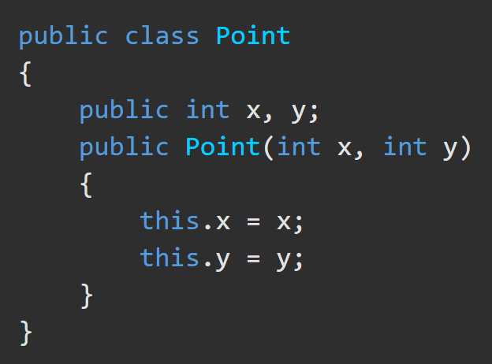
Class https://docs.microsoft.com/en-us/dotnet/csharp/tour-of-csharp/classes-and-objects
Classes are defined using class declarations.
A class declaration starts with a header that specifies
the attributes and modifiers of the class,
the name of the class,
the base class (if given), and
the interfaces implemented by the class.
The header is followed by the class body, which consists of a list of member declarations written between { }.
Header
Body

Slide 4
Class Accessibility https://docs.microsoft.com/en-us/dotnet/csharp/programming-guide/classes-and-structs/access-modifiers
Classes and structs declared directly within a namespace (not nested within other classes or structs) can be either public or internal. Internal is the default if no access modifier is specified.
*Derived classes can't have greater accessibility than their base types.

Slide 5
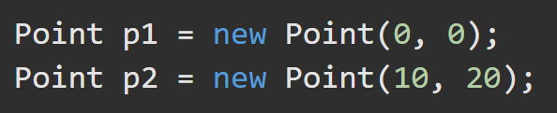
Class – Instance Instantiation https://docs.microsoft.com/en-us/dotnet/csharp/tour-of-csharp/classes-and-objects
Instances of classes are created using the new operator, which
allocates memory for a new instance,
invokes a constructor to initialize the instance, and
returns a reference to the instance.
The memory occupied by an object is automatically reclaimed when the object is no longer reachable. It’s not possible to explicitly deallocate objects in C#.

Slide 6
Class - Members https://docs.microsoft.com/en-us/dotnet/csharp/tour-of-csharp/classes-and-objects
There are two types of class members.
static - belong to classes
instance - belong to objects (instances of classes).
The kinds of members a class can contain
Constructors - To initialize instances of the class
Constants - Constant values
Fields - Variables
Methods – Computations/actions that can be performed
Properties – Actions associated with reading/writing named properties
Types - Nested types declared by the class
Indexers - Actions associated with indexing instances of the class. (i.e. arrays)
Events - Notifications generated by the class

Slide 7
Class – Member Accessibility https://docs.microsoft.com/en-us/dotnet/csharp/tour-of-csharp/classes-and-objects#accessibility
Access Modifiers control the regions of program text that can access the member.
private - This class only.
protected - derived classes.
private protected - This class or derived classes only.
internal - current assembly (.exe, .dll).
protected internal - This class, child classes, or classes within the same assembly.
public - Access isn't limited.

Slide 8
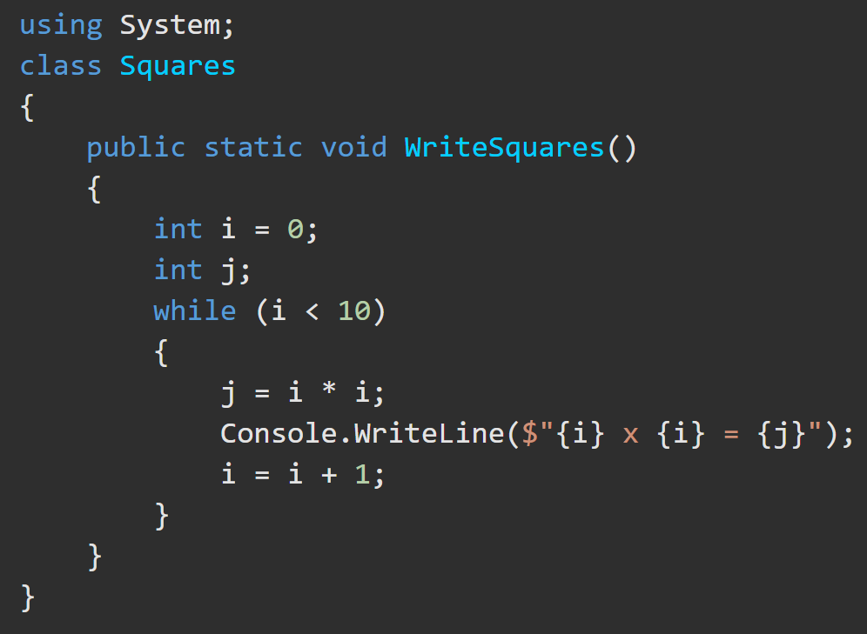
Class – Local Variables https://docs.microsoft.com/en-us/dotnet/csharp/tour-of-csharp/classes-and-objects#method-body-and-local-variables
Local variables - declared inside the body of the method. They must have a type name and a variable name. All variables get a default value.
Int == 0;
String == “”

Slide 9
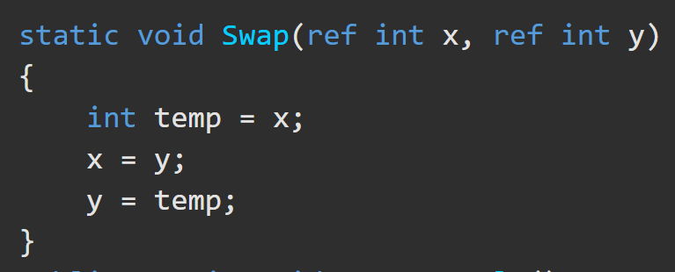
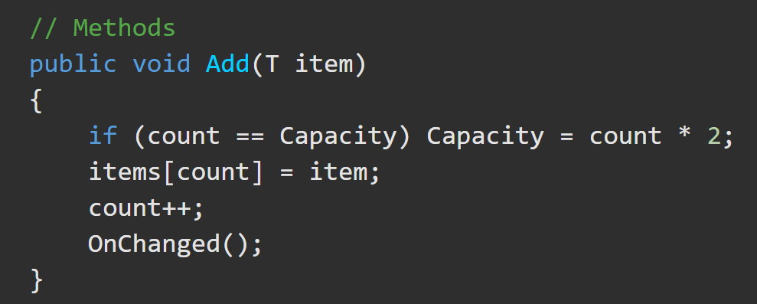
Class – Methods https://docs.microsoft.com/en-us/dotnet/csharp/tour-of-csharp/classes-and-objects#methods
Two types of methods
Static – accessed through the class
Instance – accessed though the class.
Methods have a Method Signature which consists of
the name of the method,
the number of type parameters and
the number, modifiers, and types of its parameters.
*The signature of a method doesn't include the return type.

Slide 10
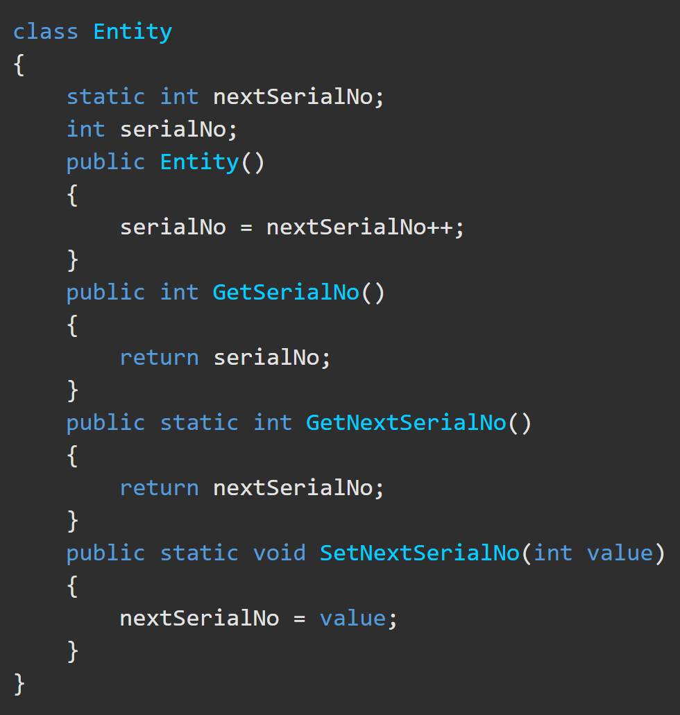
Class – Static and Instance Methods https://docs.microsoft.com/en-us/dotnet/csharp/tour-of-csharp/classes-and-objects#static-and-instance-methods
static method –
declared with a static modifier.
doesn't operate on a specific class instance.
can only directly access static members.
Cannot use ‘this’
instance method –
declared without a static modifier.
operates on a specific class instance.
can access both static and instance members.
Can use ‘this’.

Slide 11
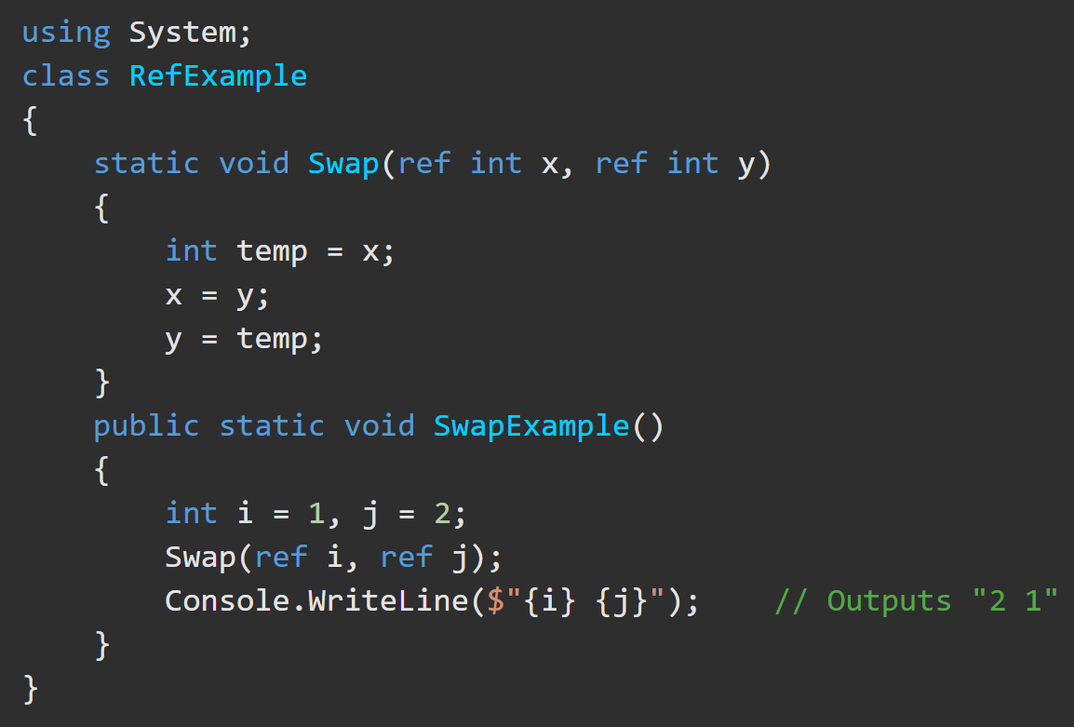
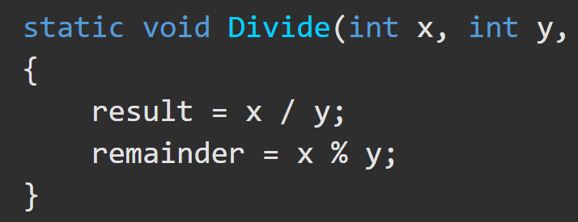
Class – Value and Reference Parameters https://docs.microsoft.com/en-us/dotnet/csharp/tour-of-csharp/classes-and-objects#parameters
Parameters are used to pass values or variable references to methods. There are four types:
1. value parameter
a copy of the argument passed. Changes don’t affect the original argument. Can be options by specifying a default value.
2. reference parameter
declared with the ‘ref’ modifier. Used for passing arguments by reference. The argument must be a variable with a definite value. Changes take place on the original value.

Slide 12
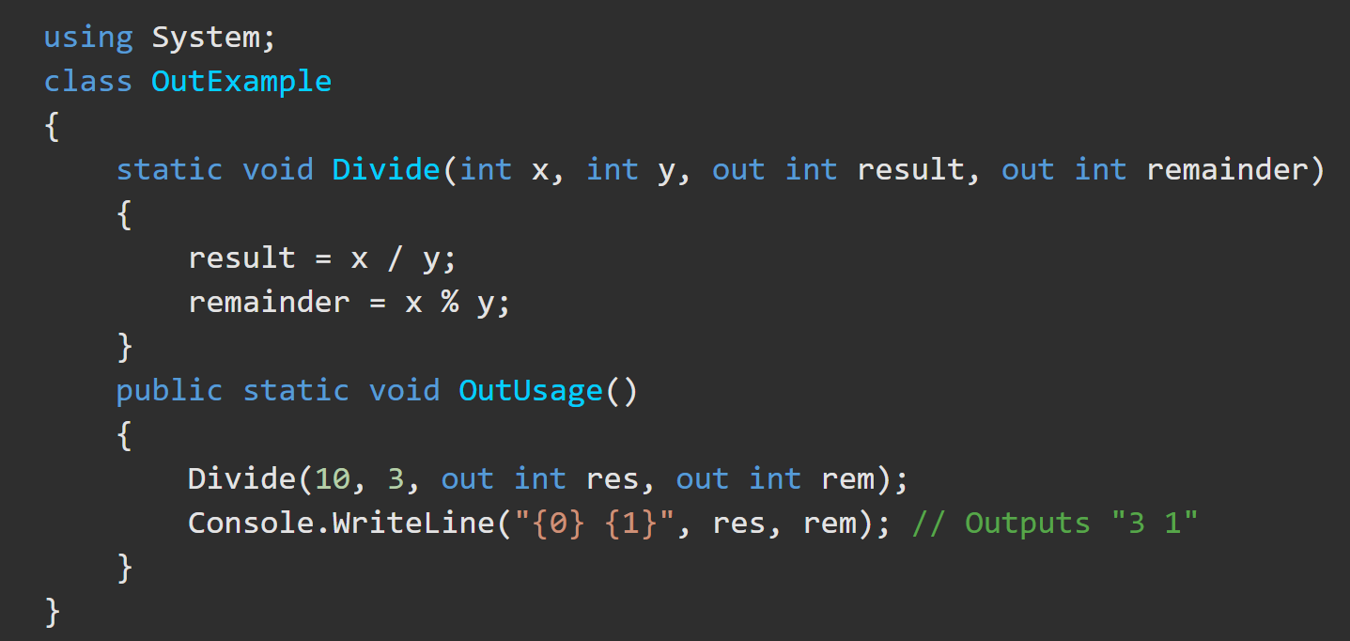
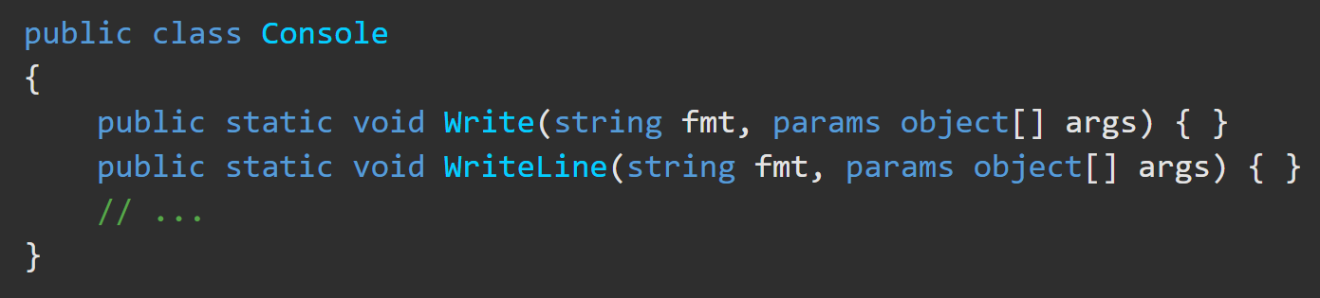
Class – Output and Parameter Array Parameters https://docs.microsoft.com/en-us/dotnet/csharp/tour-of-csharp/classes-and-objects#parameters
3. output parameter - declared with the out modifier. Used for passing arguments by reference. An explicitly assigned value is not required before the method call.
4. parameter array - permits a variable number of arguments to be passed to a method. Declared with the params modifier. Must the last parameter and be a 1-D array. See Write and WriteLine methods.

Slide 13
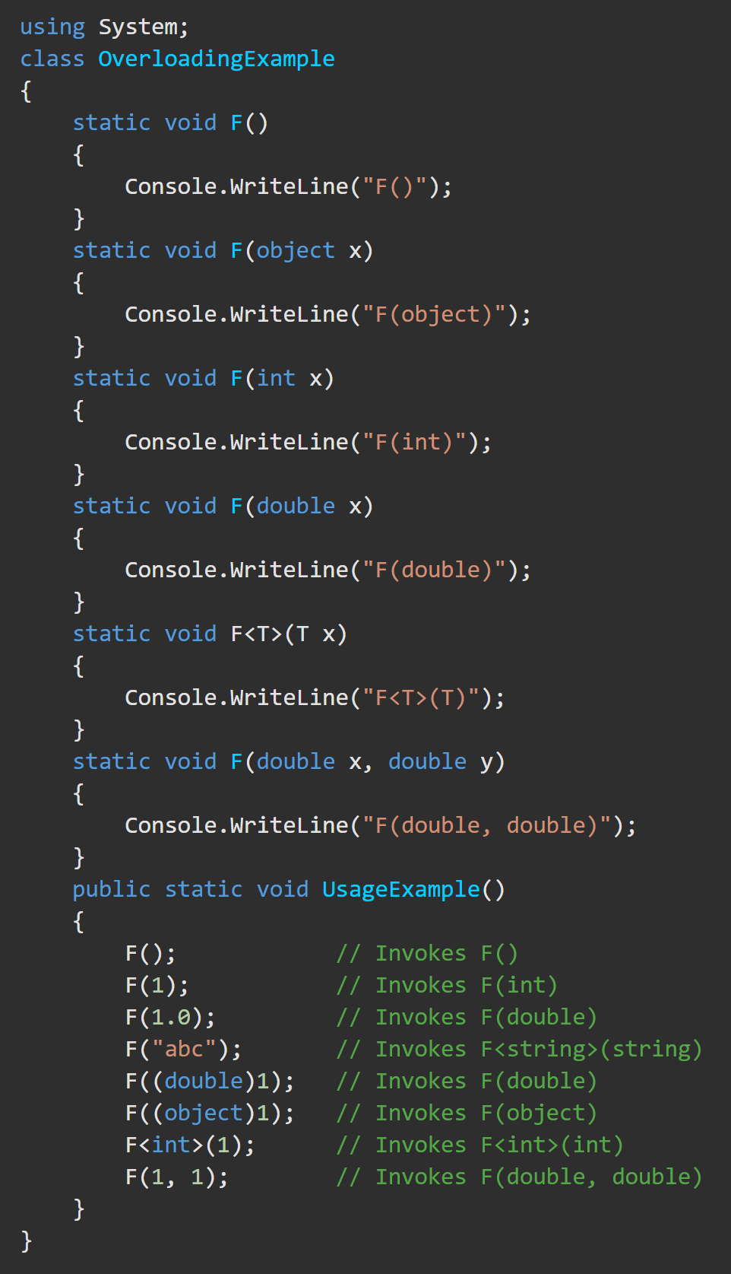
Class – Method Overloading https://docs.microsoft.com/en-us/dotnet/csharp/tour-of-csharp/classes-and-objects#method-overloading
Method overloading
permits multiple methods in the same class to have the same name
Methods must have unique parameter lists.
The compiler uses ‘overload resolution’ to determine the specific method to invoke.
‘Overload resolution’ finds the one method that best matches the arguments or reports an error if none is found.
A particular method can be selected by explicitly casting the arguments to the exact parameter types.

Slide 14
Interface https://docs.microsoft.com/en-us/dotnet/csharp/tour-of-csharp/interfaces
An interface defines a contract that can be implemented by classes and structs.
An interface can contain
methods, properties, events, indexers.
An interface does NOT provide implementations. It specifies the members that must be implemented by classes or structs that implement the interface.
Interface implementation is NOT inheritance. It is intended to express a "can do" relationship between an interface and its implementing type.
Interfaces can simulate multiple inheritance.

Slide 15
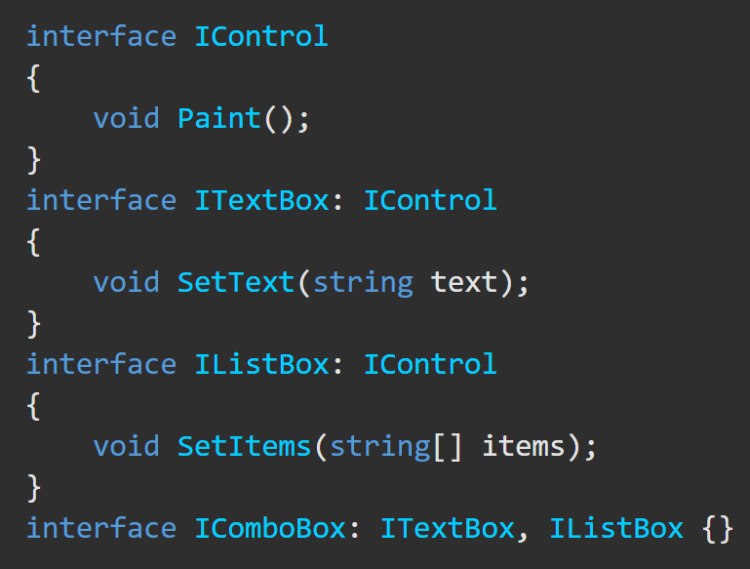
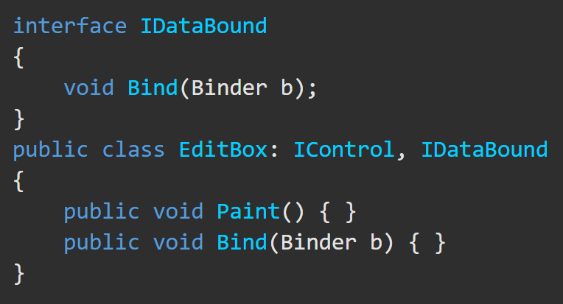
Interface https://docs.microsoft.com/en-us/dotnet/csharp/tour-of-csharp/interfaces
Interfaces may employ multiple inheritance.
Classes and structs can implement multiple interfaces.
Are Paint() and Bind() defined?

Slide 16
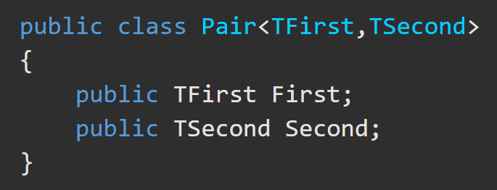
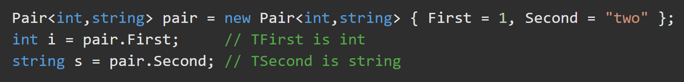
Class – Type Parameters https://docs.microsoft.com/en-us/dotnet/csharp/tour-of-csharp/classes-and-objects#type-parameters
Type Parameters
are used to define a generic class type
follow the class name and are inside < >
are used to define the members of the class

Slide 17
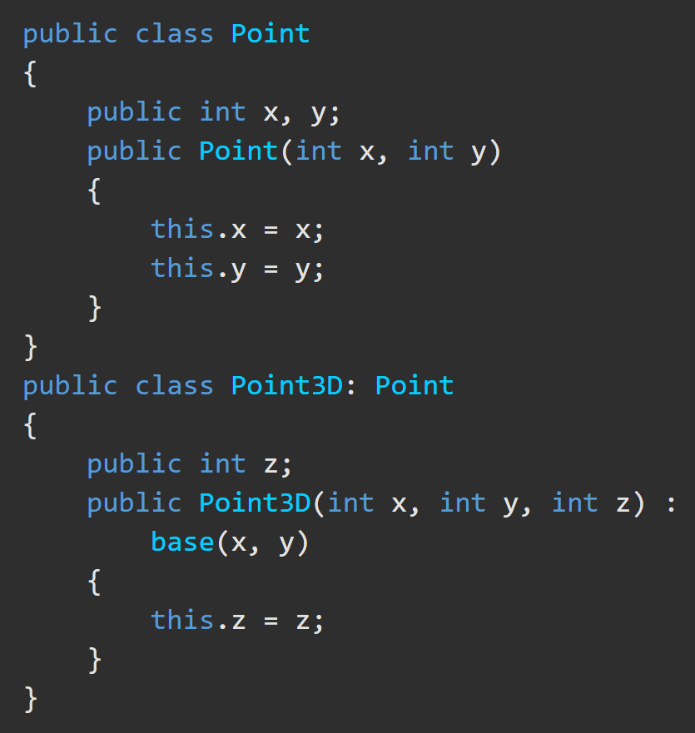
Class – Base Classes https://docs.microsoft.com/en-us/dotnet/csharp/tour-of-csharp/classes-and-objects#base-classes
A class declaration specifies an inherited base class by following the class name and type parameters with…
: baseClassName

