Slide 1

HTML Fundamentals
.NET

Slide 2
HTML is not a programming language; it is a markup language that defines the structure of your webpage. HTML consists of a series of elements, which you use to enclose, different parts of the content to make it appear or act a certain way.
https://developer.mozilla.org/en-US/docs/Learn/Getting_started_with_the_web/HTML_basics

Slide 3
HTML vs CSS

Slide 4
Philisophical differences. Html 4 vs html 5
What’s new in html 5… living standard. Browsers work together more now. Enphasis on accessibility and adding support for mjltimedia(without plugins) More structural elements.

Slide 5
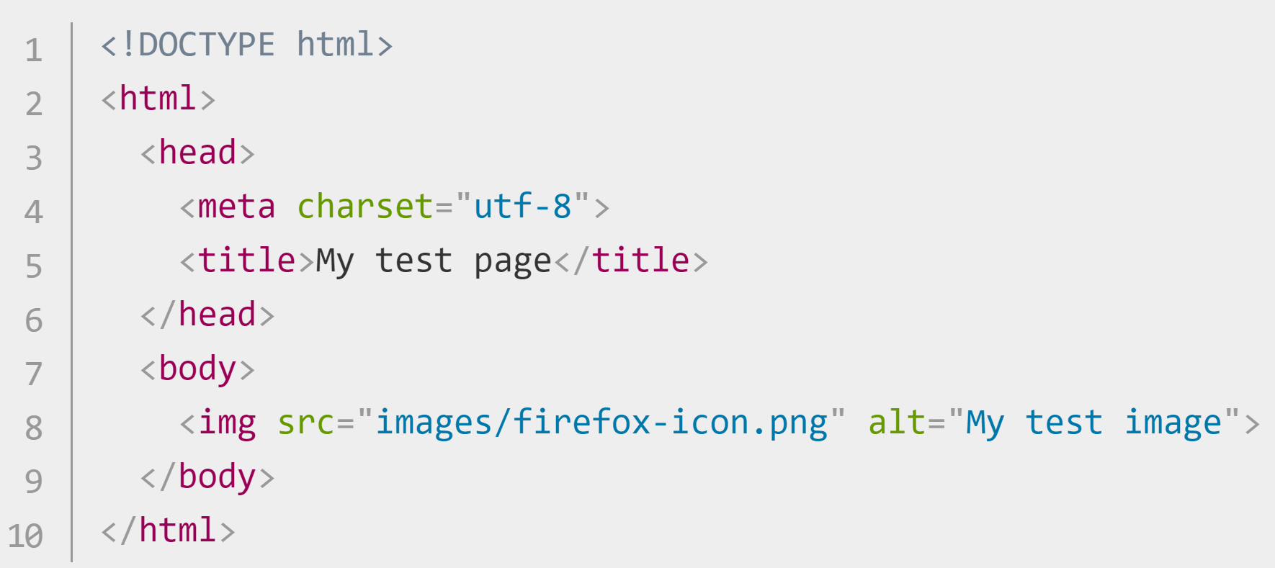
HTML – Anatomy of a Web Page https://developer.mozilla.org/en-US/docs/Learn/Getting_started_with_the_web/HTML_basics
The required HTML5 document type declaration.
Wraps all the content on the page. Sometimes known as the root element.
The head is a container for metadata (not to be displayed).
Unicode Transformation Format-8. A set of chars you’ll need for text.
The title appears in the browser tab when the page is
loaded and in bookmarks.
The body contains all the content that you want to show web users. (text, images, videos, games,etc)

Slide 6
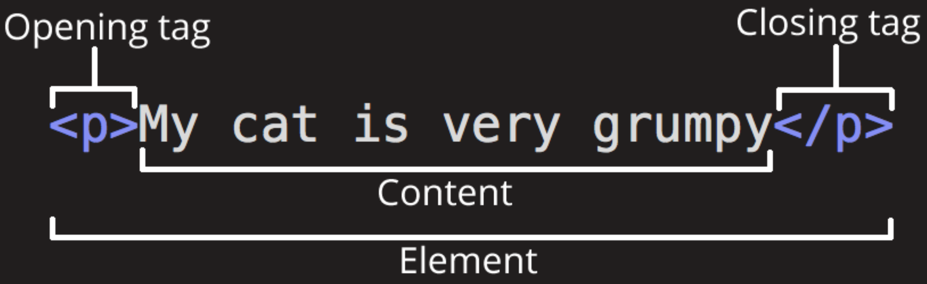
HTML - Anatomy of an Element https://developer.mozilla.org/en-US/docs/Learn/Getting_started_with_the_web/HTML_basics https://devdocs.io/html/
An Element designates a section of HTML for a specific purpose according to the tags on the element. It’s also known as the Root Element.
Text without any tag prints on the webpage. Text inside element tags will have a styling and purpose.
Between the opening and closing tags is the content. The content prints to the webpage.
p means paragraph. All tags have angle brackets on each side.
The closing tag has a ‘/’ before the closing tag type.
The opening and closing tags, along with everything between them, is the element.
* Some elements don’t have contents or a closing tag. (<img>, <br>, <input>)

Slide 7
HTML - Nested Elements
You can nest elements inside other elements.
A nested element must be closed before it’s enclosing element is closed. The below will compile but the styling will not be applied.

Slide 8
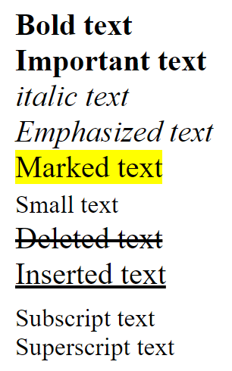
HTML – Basic Text Elements https://www.w3schools.com/html/html_formatting.asp
Here are some examples of how to format elements.
<b>Bold text </b>
<strong>Important text </strong>
<i>italic text</i>
<em> Emphasized text </em>
<mark>Marked text </mark>
<small>Small text</small>
<del>Deleted text </del>
<ins>Inserted text </ins>
<sub>Subscript text</sub>
<sup>Superscript text</sup>
*use <br> to create a line break.

Slide 9
HTML - <span> and <div> Elements https://www.w3schools.com/tags/tag_span.asp
<span> | <div>
used to group inline-elements in a document. provides no visual change by itself. CSS can hook onto that part of the HTML doc using the value of the span. | defines a division or a section in an HTML document. often used as a container for other HTML elements to style them with CSS or to perform certain tasks with JavaScript.
<p>My mother has <span style="color:blue">blue</span> eyes.</p>
<div style="background-color:lightblue"> <h3>This is a heading</h3> <p>This is a paragraph.</p> </div>

Slide 10
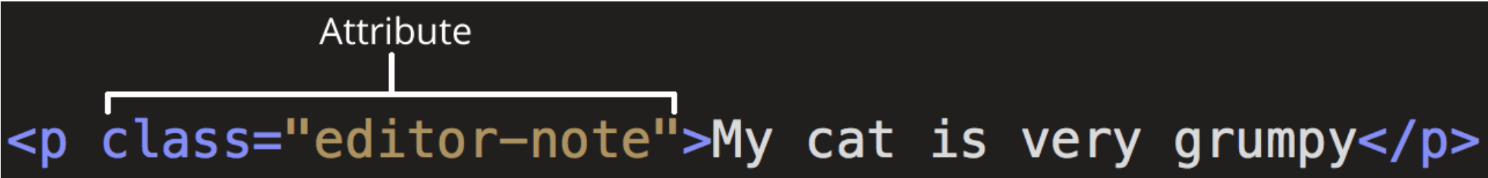
HTML – Attributes https://developer.mozilla.org/en-US/docs/Learn/Getting_started_with_the_web/HTML_basics https://en.wikipedia.org/wiki/HTML_attribute
Attributes are modifiers placed inside the opening tag of the element. The Attribute is a key-value pair. Different Tags have some specific Attributes but most share from four main attributes.

Slide 11
HTML – Global Attributes https://developer.mozilla.org/en-US/docs/Learn/Getting_started_with_the_web/HTML_basics https://en.wikipedia.org/wiki/HTML_attribute
Attribute | Meaning and usage
id | Provides a document-wide unique identifier for an element. Can be used by CSS or Web Browsers to provide additional styling. Must be a unique value on the page. <p id=“id-green”>This is an example of an id</p>
class | Provides a way of classifying similar elements. NOT unique and can be used by CSS or Web Browsers to provide additional styling. This value can be shared with other elements and in other files <p class=“class-blue”>This is an example of the ‘class=“class-blue”’ attribute</p>
style | Adds styling directly to the element. This is not recommended. It is better to use external CSS for all styling. <p style=“color:red”>This is an example of the ‘style=“color:red”’ attribute</p>
title | Used to attach subtextual explanation to an element. This is the small popup when you hover over a button. <p title="Hypertext Markup Language“>This is an example of the ‘title="Hypertext Markup Language“’ attribute</p>

Slide 12

HTML – Metadata https://itseeze.com/blog/seo-101-everything-you-need-to-know-about-metadata/
Metadata is data that describes other data.
In webpages, metadata is used for Search Engine Optimization (SEO).
Website metadata consists of a page title and <meta> description for every page.
Located in the <head> of an HTML page, <meta> elements provide search engines with information about the content and purpose of pages of a website.

Slide 13
HTML – Metadata inside <head> https://itseeze.com/blog/seo-101-everything-you-need-to-know-about-metadata/
<meta name="viewport" content="width=device-width, initial-scale=1.0"> | This has to do with mobile initial zoom stuff
<meta http-equiv="X-UA-Compatible" content="ie=edge"> | This switches off Microsoft Edge's old-IE-compatibility behaviors.
<meta name=“Tech Lead" content="Nick Escalona"> | Self Explanatory.
<meta name="description" content="description of this page"> <meta name="keywords" content="search engine keywords"> | These used to be very important for search engine results.

Slide 14
HTML – Elements inside <body> https://developer.mozilla.org/en-US/docs/Learn/Getting_started_with_the_web/HTML_basics
Element | Description
<p> | The paragraph element
<h1>, <h2>, <h3>, <h4>, <h5>, <h6> | Headers. Largest to smallest
<a href="https://revature.com/">Revature</a> | Link to another web page with the ‘anchor’ tag.
<img src=“routeToImage" width="100px” alt="My Revature image"> | Link to an image on your computer or online. ‘alt’ is for when the img is not found.
<img src=“routeToImage" width="100px” alt="My Revature image” /> | This is an alternate XML-style syntax for elements with no closing tag.

Slide 15
HTML – Lists https://developer.mozilla.org/en-US/docs/Learn/Getting_started_with_the_web/HTML_basics
HTML has special elements for lists. The most common list types are ordered and unordered lists. Items inside the lists are put inside <li> elements.
Unordered lists have no defined order (shopping list). These are wrapped in a <ul> element. | Ordered lists have a defined sequence (recipe). These are wrapped in an <ol> element.
<ul> <li>bullet 1</li> <li>bullet 2</li> </ul> | <ol> <li>number 1</li> <li>number 2</li> </ol>

Slide 16
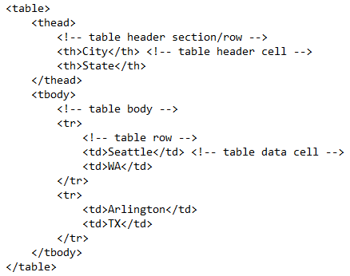
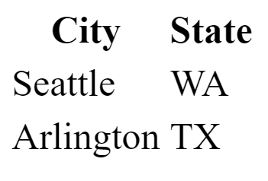
HTML - Tables

Slide 17
HTML – Entities/Character Codes https://www.w3schools.com/html/html_entities.asp https://www.w3schools.com/charsets/ref_utf_punctuation.asp
Character entities are used to display reserved characters in HTML.
HTML has a Numerical Reference, a Hexadecimal Reference and an Entity Code for these reserved characters.
Entity Code/numeric code | Symbol/Number
&lt; / &#60; | <
&gt; | >
&nbsp; | Non-breaking space
&#20B5; | ₵
&trade; | ™
&#213C; | ℼ (pi)
&#2192; / &rarr; | →
*there are many more

Slide 18
HTML – Features in HTML5 https://www.w3schools.com/html/html5_intro.asp
New element | Use
<audio> </audio> | audio & video both support multiple formats, so the browser can choose the one it knows best. No more Flash with its security holes!
<video> </video>
<canvas> </canvas> | "flash games and graphics primitives"
<nav></nav> | Nav bar on the page
<header></header> | A container for introductory content or a set of navigational links.
<footer></footer> | defines a footer for a document or section.
<article></article> | Specifies independent, self-contained content.
<section></section> | Defines sections in a document (chapters, headers, footers).

Slide 19
FORMs

Slide 20
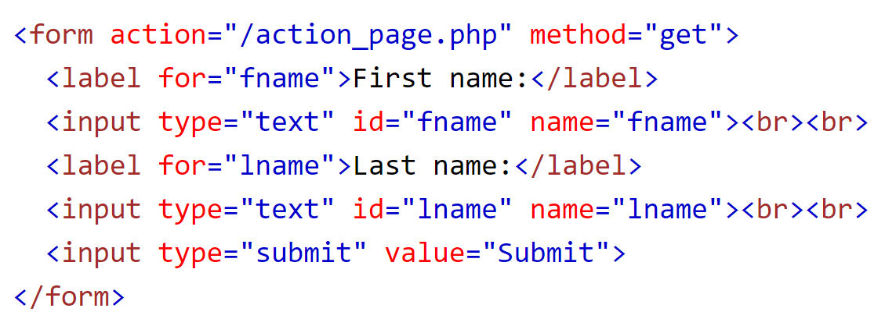
HTML – Method Attribute and Form https://www.w3schools.com/tags/att_form_method.asp
The form data can be sent as URL variables (with method="get") or as HTTP post transaction (with method="post").
The action attribute specifies where the form data is sent
The method attribute specifies how the form data is sent. GET, POST

Slide 21
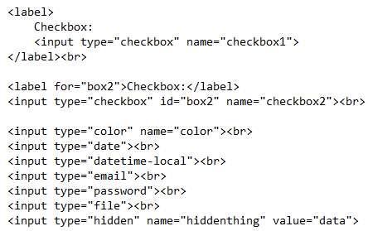
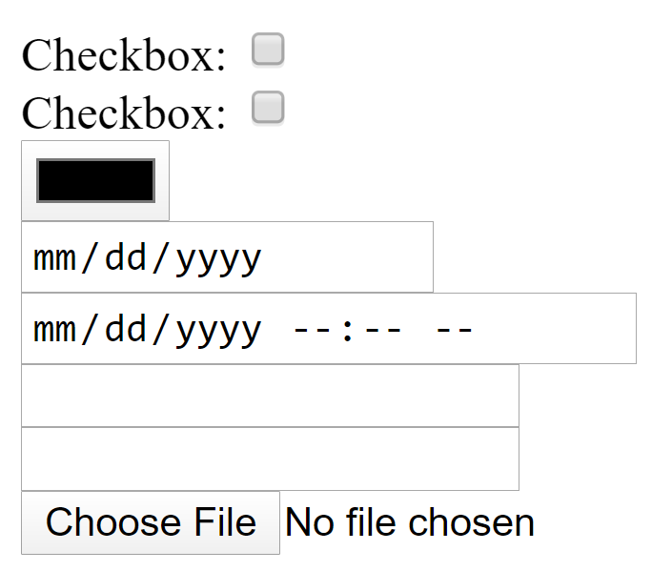
HTML - Input Types

Slide 22
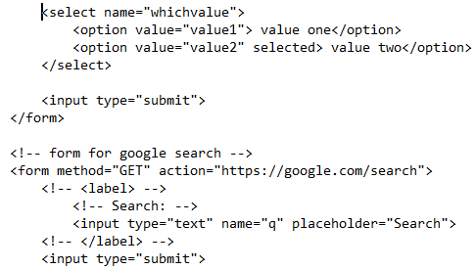
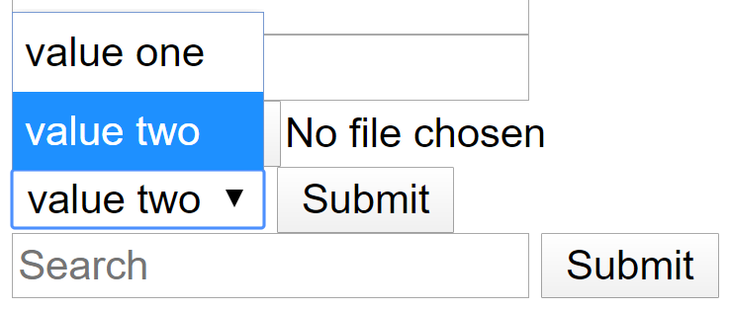
HTML – More Input Types
This is a Boolean Attribute. This is shorthand for selected = “selected”. This creates a default choice.

