Slide 1

HTML Fundamentals
.NET

Slide 2
HTML is not a programming language; it is a markup language that defines the structure of your webpage. HTML consists of a series of elements, which you use to enclose, different parts of the content to make it appear or act a certain way.
https://developer.mozilla.org/en-US/docs/Learn/Getting_started_with_the_web/HTML_basics

Slide 3


HTML vs CSS https://www.w3schools.com/html/html_intro.asp https://en.wikipedia.org/wiki/HTML https://en.wikipedia.org/wiki/Cascading_Style_Sheets https://www.w3schools.com/css/css_intro.asp
HTML (Hyper Text Markup Language) | CSS (Cascading Style Sheets)
In 1989, Tim Berners-Lee invented the Web with HTML as its publishing language. HTML (Hyper Text Markup Language) was created to help programmers describe the content on a website. HTML uses tags to help you add paragraphs, headers, pictures, bullets and other structural components. Just like you would write something on a word document, HTML helps you write something on a website. | CSS was proposed by Hakom Lie and co-created by Bert Bos around 1996. Created to compliment HTML, CSS is what makes a website look amazing. CSS more involved with changing a websites style rather than its content. Kind of like changing the font size, font color and positioning on a word document. CSS oversees the way the content looks on a page and what else goes on it to compliment that content.

Slide 4
HTML4 vs HTML5 https://html.spec.whatwg.org/multipage/introduction.html#is-this-html5?
HTML5 is the result of a collaboration between the World Wide Web Consortium, or W3C, and the Web Hypertext Application Technology Working Group, or WHATWG.
These organizations teamed up in 2006 to reduce HTML4’s reliance on plugins, improve error handling and replace scripting with more markups.
For several years, both groups worked together. In 2011, however, the groups came to the conclusion that they had different goals: the W3C wanted to publish a "finished" version of "HTML5", while the WHATWG wanted to continue working on a Living Standard for HTML, continuously maintaining the specification rather than freezing it in a state with known problems, and adding new features as needed to evolve the platform.
In 2019, the WHATWG and W3C signed an agreement to collaborate on a single version of HTML going forward.
Consequently, HTML5 has greatly simplified the process of creating web applications.
In HTML5, browsers work together and emphasis on accessibility and support for multimedia(without plugins) results in a greatly simplified the process of creating web applications and a more secure, stable user experience.

Slide 5
HTML – Features in HTML5 https://www.w3schools.com/html/html5_intro.asp
New element | Use
<audio> </audio> | audio & video both support multiple formats, so the browser can choose the one it knows best. No more Flash with its security holes!
<video> </video>
<canvas> </canvas> | "flash games and graphics primitives"
<nav></nav> | Nav bar on the page
<header></header> | A container for introductory content or a set of navigational links.
<footer></footer> | defines a footer for a document or section.
<article></article> | Specifies independent, self-contained content.
<section></section> | Defines sections in a document (chapters, headers, footers).

Slide 6
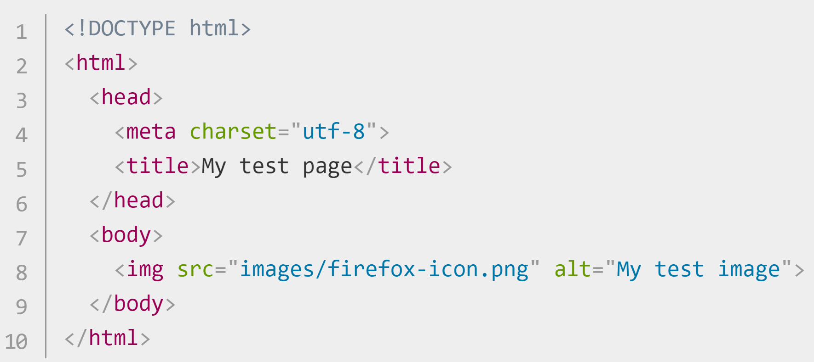
HTML – Anatomy of a Web Page https://developer.mozilla.org/en-US/docs/Learn/Getting_started_with_the_web/HTML_basics
The required HTML5 document type declaration.
Wraps all the content on the page. Sometimes known as the root element.
The head is a container for metadata (not to be displayed).
Unicode Transformation Format-8. A set of chars you’ll need for text.
The title appears in the browser tab when the page is
loaded and in bookmarks.
The body contains all the content that you want to show web users. (text, images, videos, games, etc)

Slide 7
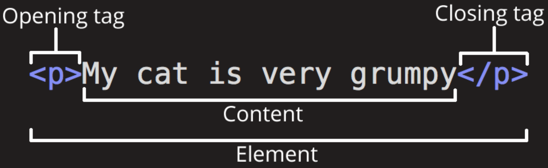
HTML - Anatomy of an Element https://developer.mozilla.org/en-US/docs/Learn/Getting_started_with_the_web/HTML_basics https://devdocs.io/html/
An Element designates a section of HTML for a specific purpose according to the tags on the element. It’s also known as the Root Element.
Text without any tag prints on the webpage. Text inside element tags will have a styling and purpose.
Between the opening and closing tags is the content. The content prints to the webpage.
p means paragraph. All tags have angle brackets on each side.
The closing tag has a ‘/’ before the closing tag type.
The opening and closing tags, along with everything between them, is the element.
* Some elements don’t have contents or a closing tag. (<img>, <br>, <input>)

Slide 8
HTML - Nested Elements
You can nest elements inside other elements.
A nested element must be closed before it’s enclosing element is closed. The below will display but the styling will not be applied.

Slide 9
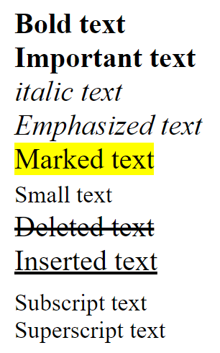
HTML – Basic Text Elements https://www.w3schools.com/html/html_formatting.asp
Here are some examples of how to format elements inline.
<b>Bold text </b>
<strong>Important text </strong>
<i>italic text</i>
<em> Emphasized text </em>
<mark>Marked text </mark>
<small>Small text</small>
<del>Deleted text </del>
<ins>Inserted text </ins>
<sub>Subscript text</sub>
<sup>Superscript text</sup>
*use <br> to create a line break.

Slide 10
HTML - <span> and <div> Elements https://www.w3schools.com/tags/tag_span.asp
<span> | <div>
used to group inline-elements in a document. provides no visual change by itself. CSS can hook onto that part of the HTML doc using the value of the span. | defines a division or a section in an HTML document. often used as a container for other HTML elements to style them with CSS or to perform certain tasks with JavaScript.
<p>My mother has <span style="color:blue">blue</span> eyes.</p>
<div style="background-color:lightblue"> <h3>This is a heading</h3> <p>This is a paragraph.</p> </div>

Slide 11
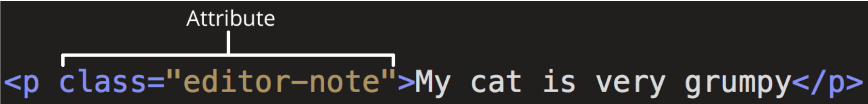
HTML – Attributes https://developer.mozilla.org/en-US/docs/Learn/Getting_started_with_the_web/HTML_basics https://en.wikipedia.org/wiki/HTML_attribute
Attributes are modifiers placed inside the opening tag of the element. The Attribute is a key-value pair. Different Tags have some specific Attributes but most share from four main attributes.

Slide 12
HTML – Global Attributes https://developer.mozilla.org/en-US/docs/Learn/Getting_started_with_the_web/HTML_basics https://en.wikipedia.org/wiki/HTML_attribute
Attribute | Meaning and usage
id | Provides a document-wide unique identifier for an element. Must be a unique value on the page. <p id=“id-green”>This is an example of an id</p>
class | Provides a way of classifying similar elements. NOT unique. Can be shared with other elements and in other files <p class=“class-blue”>This is an example of the ‘class=“class-blue”’ attribute</p>
style | Adds styling directly to the element. NOT recommended. It is better to use external CSS for all styling. <p style=“color:red”>This is an example of the ‘style=“color:red”’ attribute</p>
title | Used to attach subtextual explanation to an element. It’s the small popup when you hover over something. <p title="Hypertext Markup Language“>This is an example of the ‘title="Hypertext Markup Language“’ attribute</p>

Slide 13

HTML – Metadata https://itseeze.com/blog/seo-101-everything-you-need-to-know-about-metadata/
Metadata is data that describes other data.
In webpages, metadata is used for Search Engine Optimization (SEO).
Website metadata consists of a page title and <meta> description for every page.
Located in the <head> of an HTML page
<meta> elements provide search engines with information about the content and purpose of pages of a website.

Slide 14
HTML – Metadata inside <head> https://itseeze.com/blog/seo-101-everything-you-need-to-know-about-metadata/
<meta name="viewport" content="width=device-width, initial-scale=1.0"> | This has to do with mobile initial zoom stuff
<meta http-equiv="X-UA-Compatible" content="ie=edge"> | This switches off Microsoft Edge's old-IE-compatibility behaviors.
<meta name=“Tech Lead" content="Nick Escalona"> | Self Explanatory.
<meta name="description" content="description of this page"> <meta name="keywords" content="search engine keywords"> | These used to be very important for search engine results.

Slide 15
HTML – Elements inside <body> https://developer.mozilla.org/en-US/docs/Learn/Getting_started_with_the_web/HTML_basics
Element | Description
<p> | The paragraph element. For text.
<h1>, <h2>, <h3>, <h4>, <h5>, <h6> | Headers. Largest to smallest
<a href="https://revature.com/">Revature</a> | Link to another web page with the ‘anchor’ tag.
<img src=“routeToImage" width="100px” alt="My Revature image"> | Link to an image on your computer or online. ‘alt’ is for when the img is not found.
<img src=“routeToImage" width="100px” alt="My Revature image” /> | This is an alternate XML-style syntax for elements with no closing tag.

Slide 16
HTML – Lists https://developer.mozilla.org/en-US/docs/Learn/Getting_started_with_the_web/HTML_basics
HTML has special elements for lists. The most common list types are ordered and unordered lists. Items inside the lists are put inside <li> elements.
Unordered lists have no defined order (shopping list). These are wrapped in a <ul> element. | Ordered lists have a defined sequence (recipe). These are wrapped in an <ol> element.
<ul> <li>bullet 1</li> <li>bullet 2</li> </ul> | <ol> <li>number 1</li> <li>number 2</li> </ol>

Slide 17
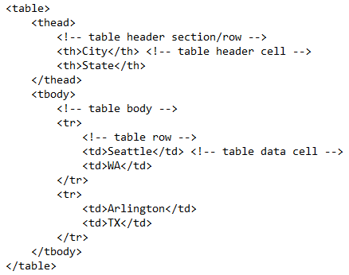
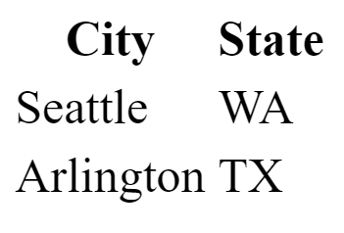
HTML - Tables

Slide 18
HTML – Entities/Character Codes https://www.w3schools.com/html/html_entities.asp https://www.w3schools.com/charsets/ref_utf_punctuation.asp
Character entities are used to display reserved characters in HTML.
HTML has a Numerical Reference, a Hexadecimal Reference and an Entity Code for these reserved characters.
Entity Code/numeric code | Symbol/Number
&lt; / &#60; | <
&gt; | >
&nbsp; | Non-breaking space
&#20B5; | ₵
&trade; | ™
&#213C; | ℼ (pi)
&#2192; / &rarr; | →
*there are many more

Slide 19
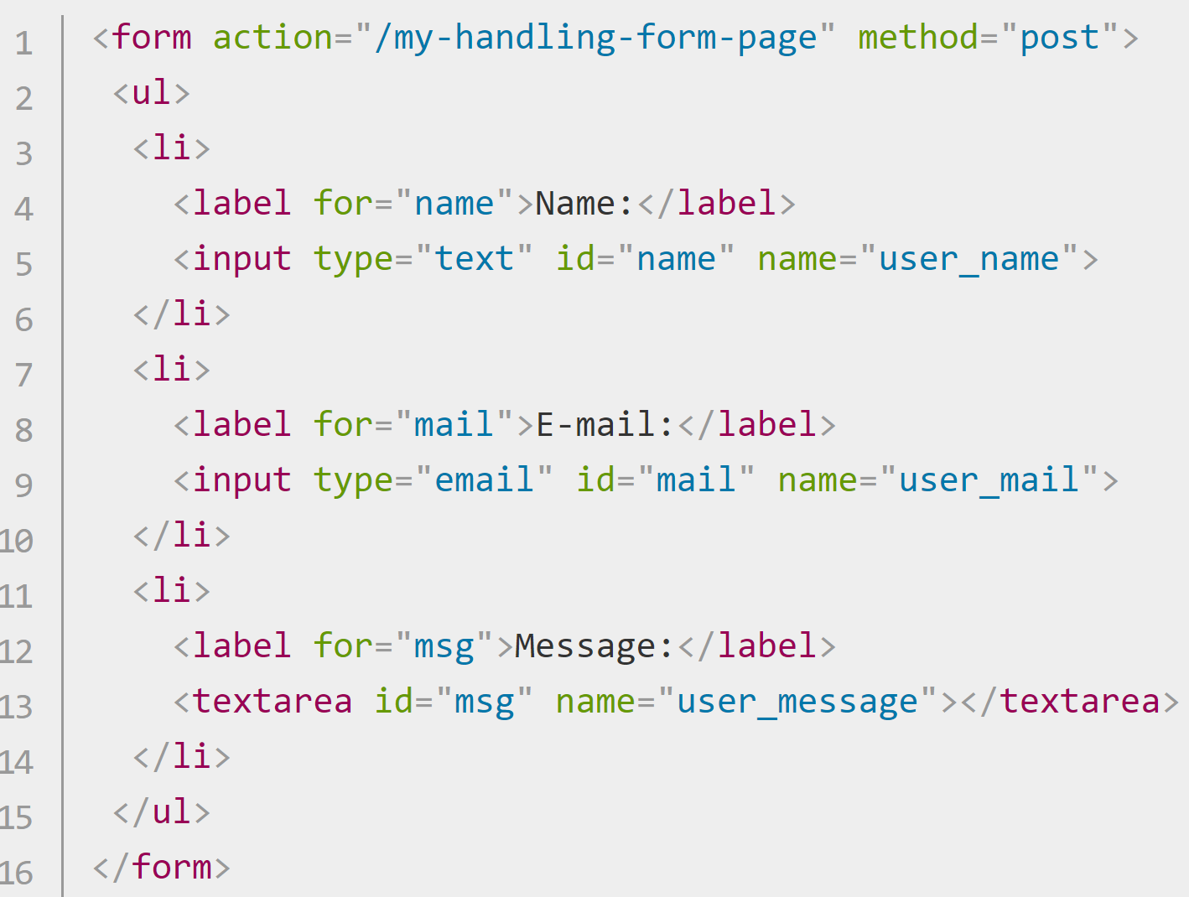
HTML – Forms https://developer.mozilla.org/en-US/docs/Learn/Forms https://developer.mozilla.org/en-US/docs/Learn/Forms/Your_first_form
Forms allow users to enter data which is sent to a web server for processing or used on the client-side to immediately update the interface in some way (add another item to a list, or show or hide a UI feature)
A form's HTML is made up of one or more form controls, plus some additional elements to help structure the overall form.
They are mostly created using the <input> element, although there are some other elements, too
Form controls can be programmed to enforce specific formats or values to be entered (form validation) and paired with text labels that describe their purpose. Controls can be:
Single text fields | multi-line text fields | dropdown boxes | buttons | checkboxes | radio buttons

Slide 20
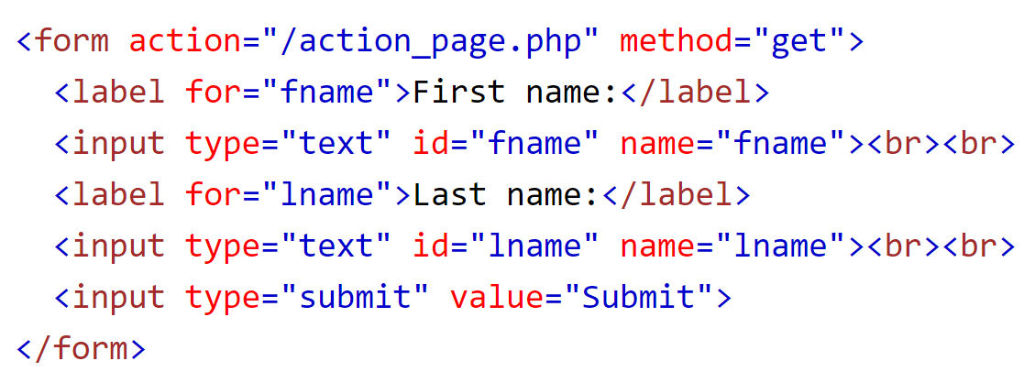
HTML – Method Attribute and Form https://www.w3schools.com/tags/att_form_method.asp
The form data can be sent as URL variables (with method="get") or as HTTP post transaction (with method="post").
The method attribute specifies how the form data is sent.
*ONLY GET and POST are valid for forms
The action attribute specifies where the form data is sent

Slide 21
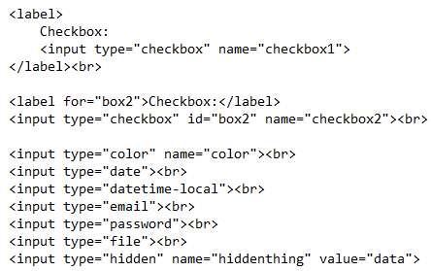
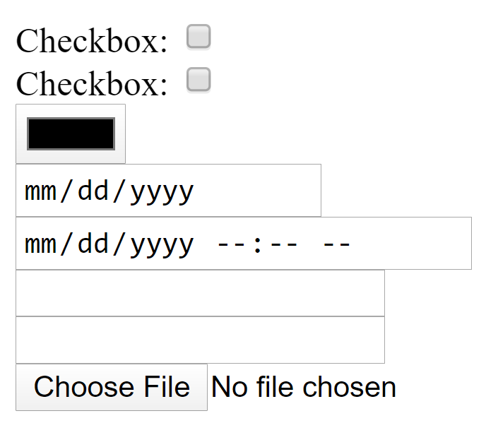
HTML - Input Types
*the name attribute is the name sent back to the server so you can access the user inputted value in the controller

Slide 22
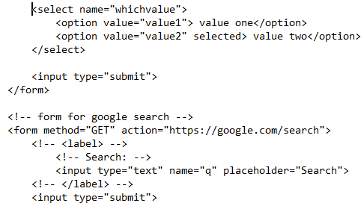
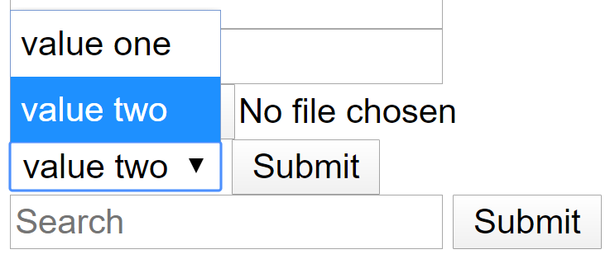
HTML – More Input Types
This is a Boolean Attribute. This is shorthand for selected = “selected”. This creates a default choice.

Slide 23
Input Attribute Purposes
id=“”
type=“”
name=“”
for=“”
placeholder=“”
value=“”

