Slide 1

JavaScript Objects and Classes
.NET

Slide 2
Classes are in fact "special functions", and just as you can define function expressions and function declarations, the class syntax has two components: class expressions and class declarations.
https://developer.mozilla.org/en-US/docs/Web/JavaScript/Reference/Classes

Slide 3
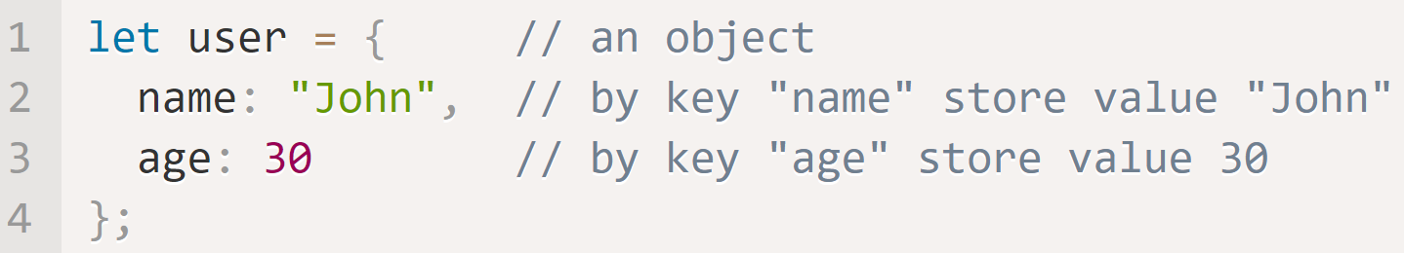
JS objects https://developer.mozilla.org/en-US/docs/Learn/JavaScript/First_steps/A_first_splash https://javascript.info/object
In JavaScript, everything is an object. An object is a collection of related functionality stored in a single grouping. You can create your own objects. Objects are used to store properties (key:value collections) of various data and more complex entities. In JavaScript, objects penetrate almost every aspect of the language. Objects are stored by reference, so the variable representing the object merely holds the memory location of the object on the heap.
An empty object can be created with figure brackets {…} with an optional list of properties in two ways.
An Object Literal is created immediately with properties. Property values are accessible using dot (.) notation.

Slide 4
JS objects – Common Commands https://developer.mozilla.org/en-US/docs/Learn/JavaScript/First_steps/A_first_splash https://javascript.info/object
Command | Usage
Delete user.age | Remove a property (age) from an object (user).

Slide 5
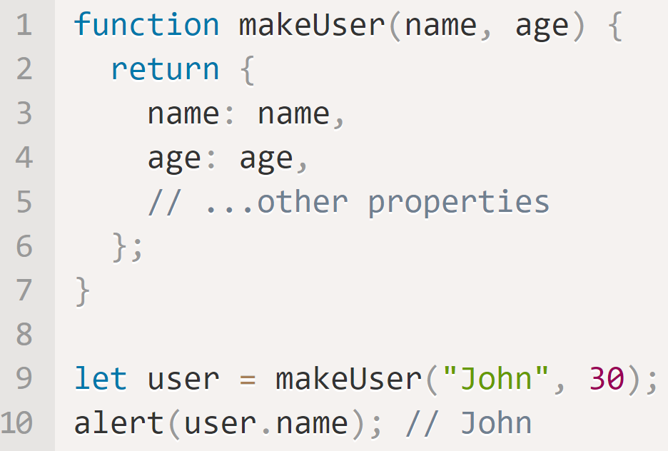
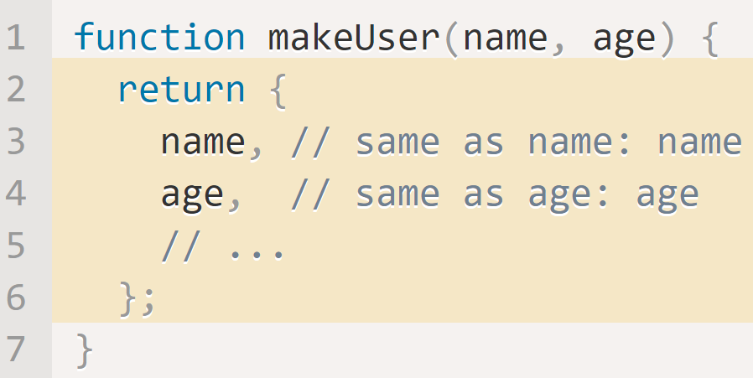
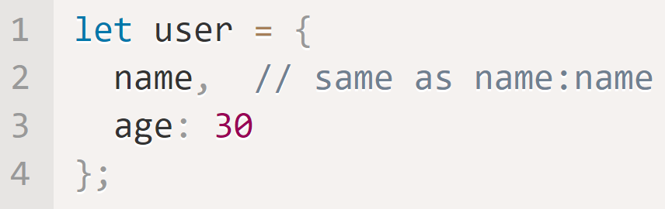
JS Objects – Property Values and Shorthand https://javascript.info/object#property-value-shorthand
JavaScript has a shorthand for declaring and setting object variables. The below examples are all equivalent objects.
This is reusable
This is reusable
This is not reusable

Slide 6
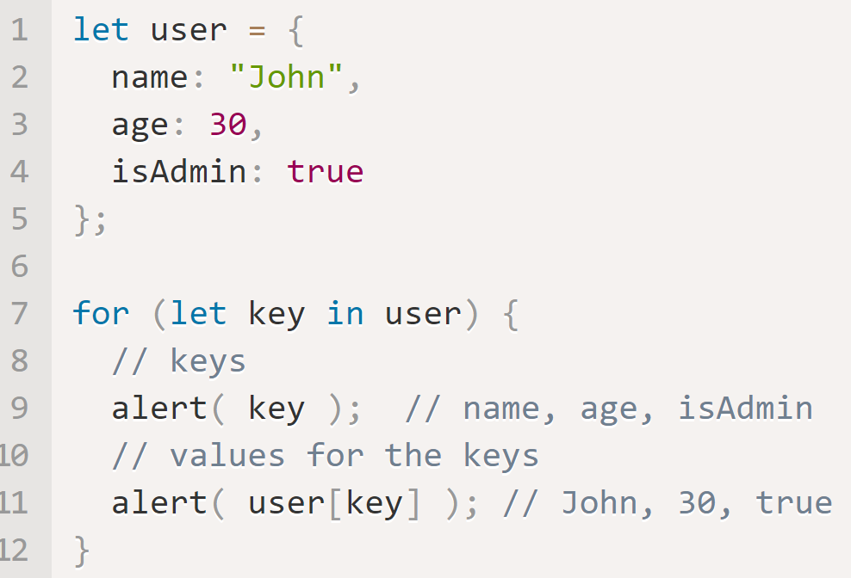
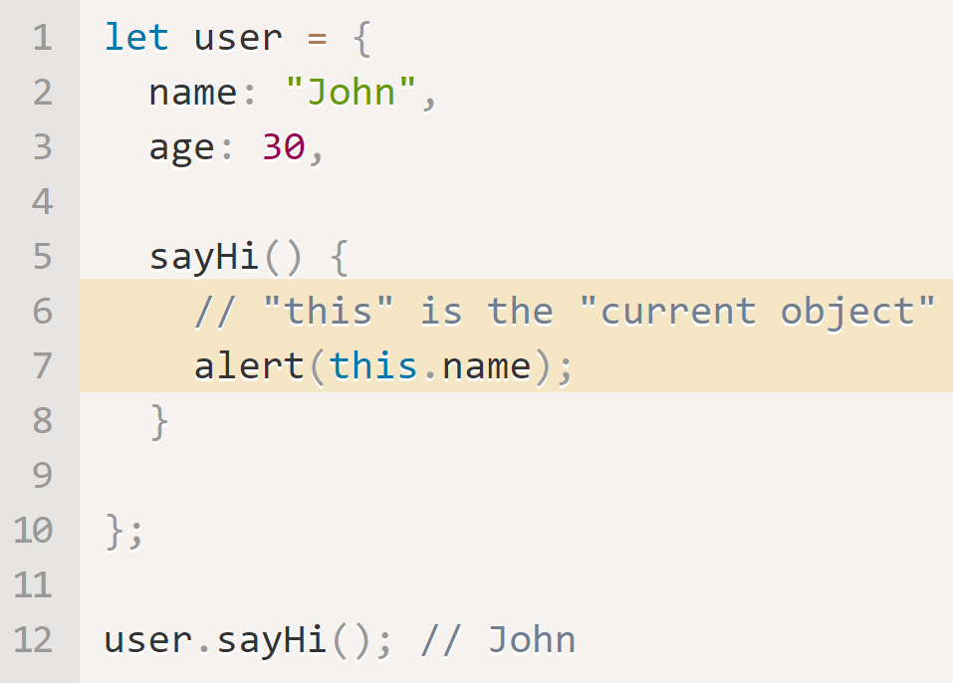
JS Objects - Accessing Properties https://javascript.info/object#property-existence-test-in-operator https://javascript.info/object#the-for-in-loop
It’s possible to access any property of an object.
user.noSuchProperty returns undefined if the property exists, true if does not exist.
The in operator can also be used. “propertyName” in objectName returns true of the property exists, false if it doesn’t.
Use the for…in loop to access each property of an object in sequence.
The this keyword can be used to specify which variable to access

Slide 7
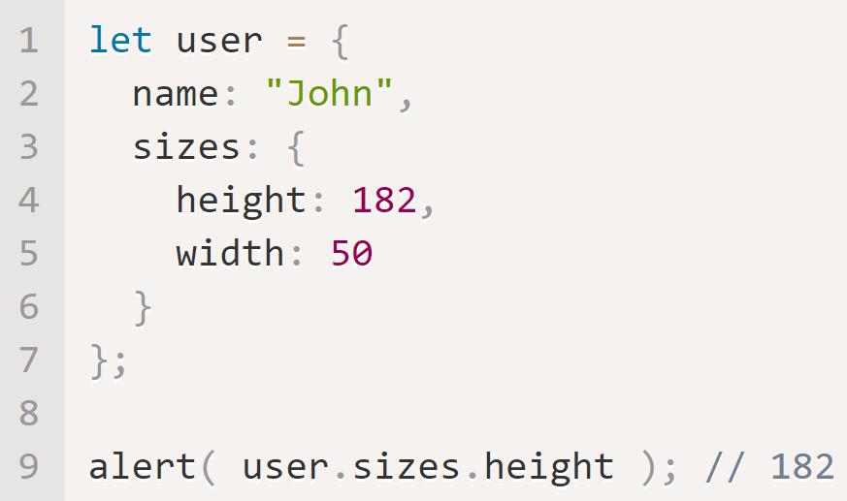
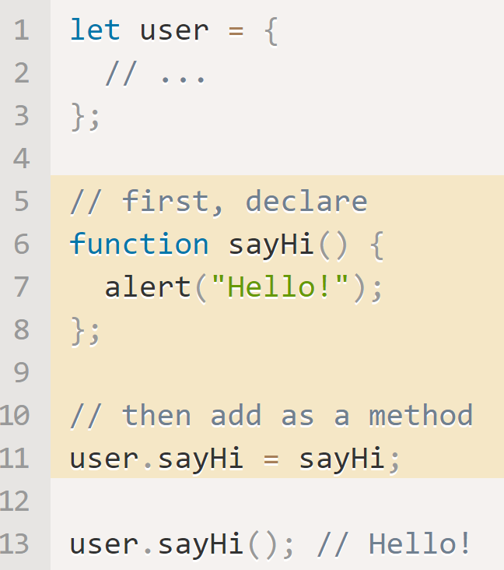
JS Objects – Objects in Objects https://javascript.info/object#cloning-and-merging-object-assign
An object can contain another object. In this example, you would access height with
let height = user.sizes.height
An object can be assigned another object or function after being created.

Slide 8
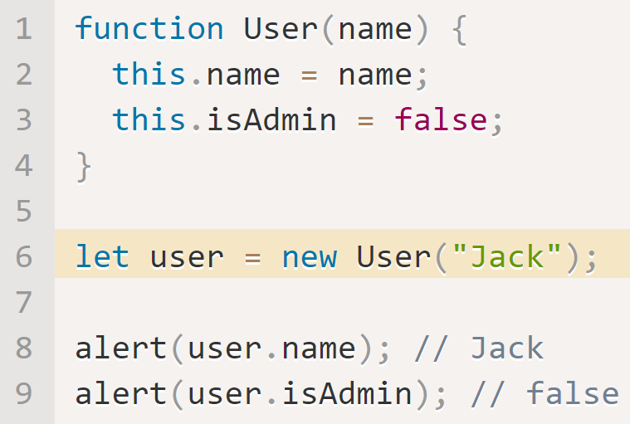
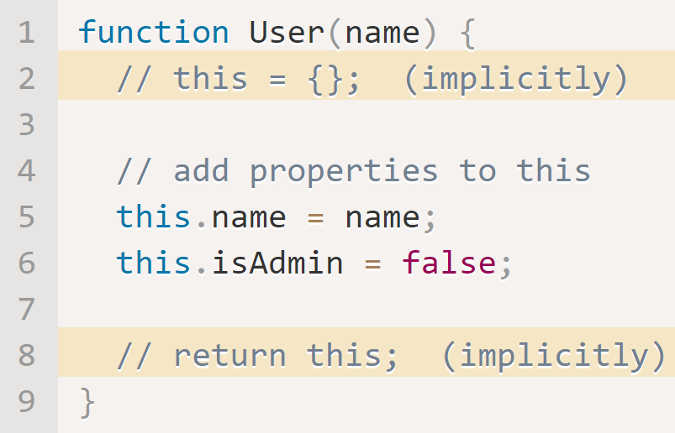
JS Objects – Constructors and new https://javascript.info/constructor-new
A constructor function in JavaScript serves the same purpose as a Class constructor in C#.
Constructor functions technically are regular functions. There are two conventions though:
They are named with capital letter first.
They should be executed only with "new" operator.
When a function is executed with new, it does the following steps
A new empty object is created and assigned to this.
The function body executes. Usually it modifies this, adds new properties to it.
The value of this is returned.
The main purpose of constructors is to implement reusable object creation code. Like for Classes!

Slide 9
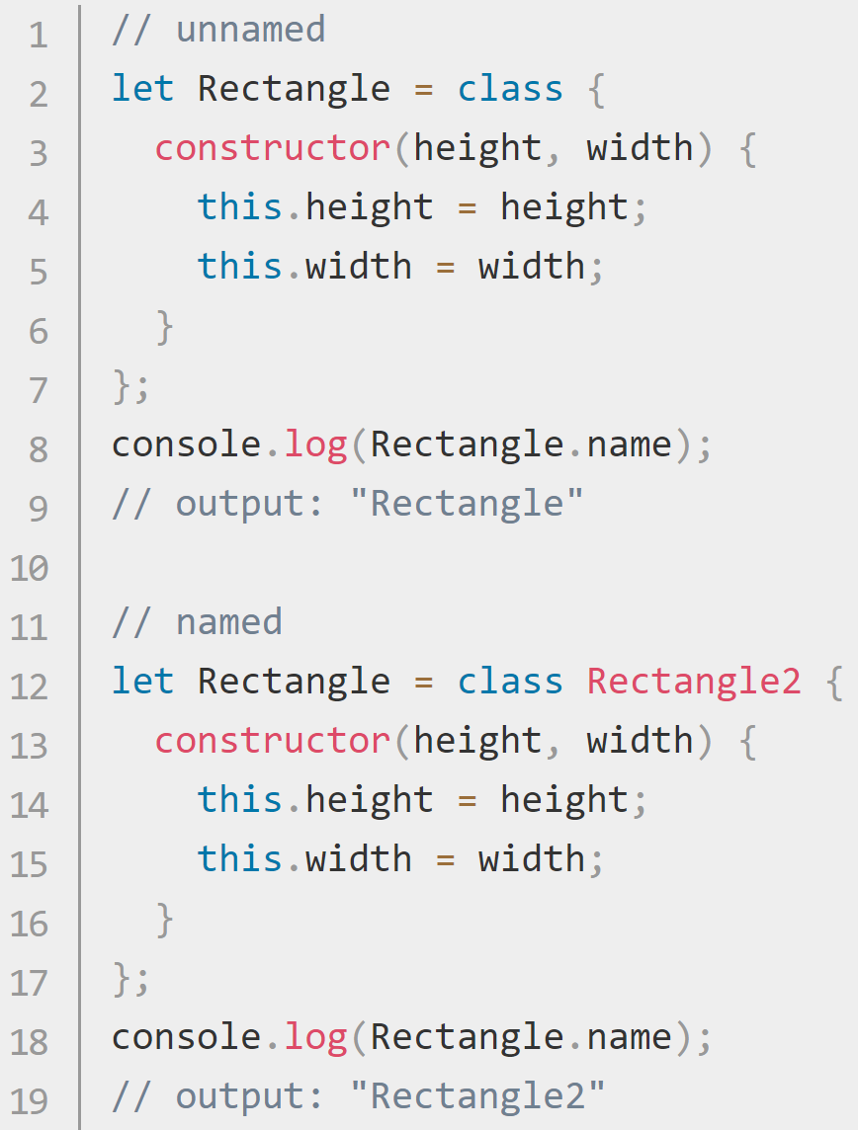
JavaScript Classes https://developer.mozilla.org/en-US/docs/Web/JavaScript/Reference/Classes
JavaScript classes are primarily syntactical sugar over JavaScript's existing prototype-based inheritance. The class syntax does not introduce a new object-oriented inheritance model to JavaScript. Classes are "special functions" and just as you can define function expressions and function declarations, the class syntax has two components: class expressions and class declarations.
Class Declaration | Class Expression
class Rectangle { constructor(height, width) { this.height = height; this.width = width; } } | Class expressions can be named or unnamed. The name given to a named class expression is local to the class's body. (it can be retrieved through the class's (not an instance's) name property.
A class must be declared before they can be accessed. (no Hoisting)

Slide 10
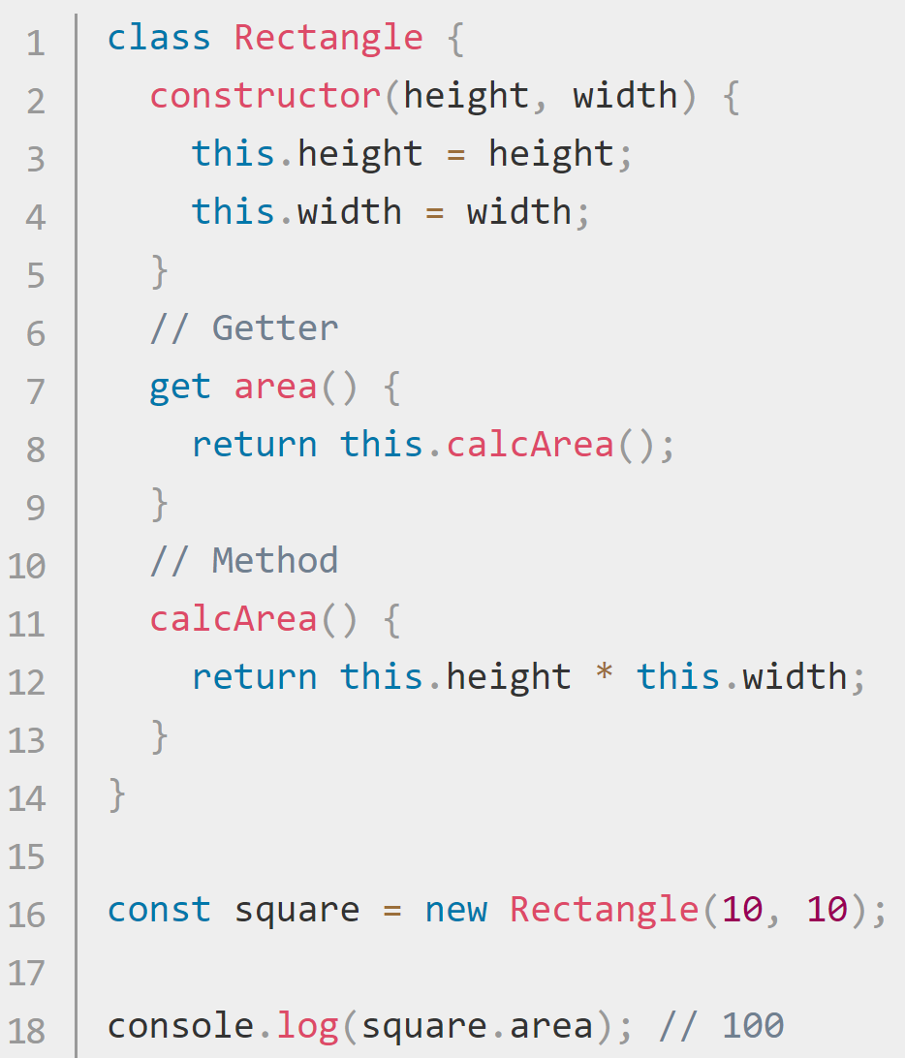
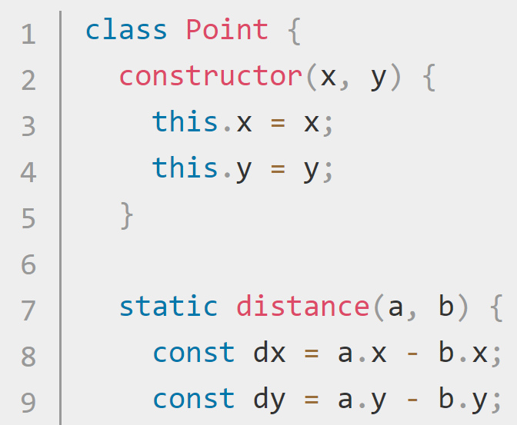
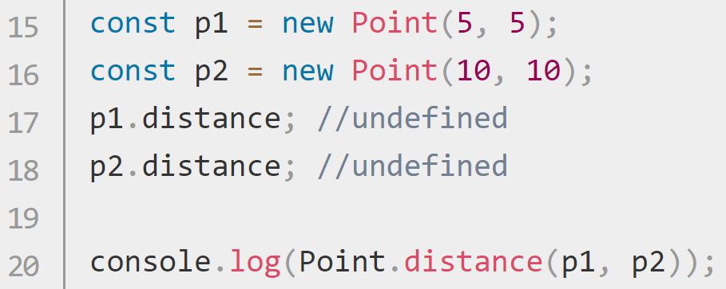
JS Class Parts https://developer.mozilla.org/en-US/docs/Web/JavaScript/Reference/Classes
The constructor method creates and initializes an object created with a class template. There can be only one… (constructor in a class).
Instance Properties - must be defined inside of class methods.
Prototype Methods – Declared in the class. Available through an instance of the class.
Static Methods - called without instantiating their class and cannot be called through a class instance. (below)

Slide 11
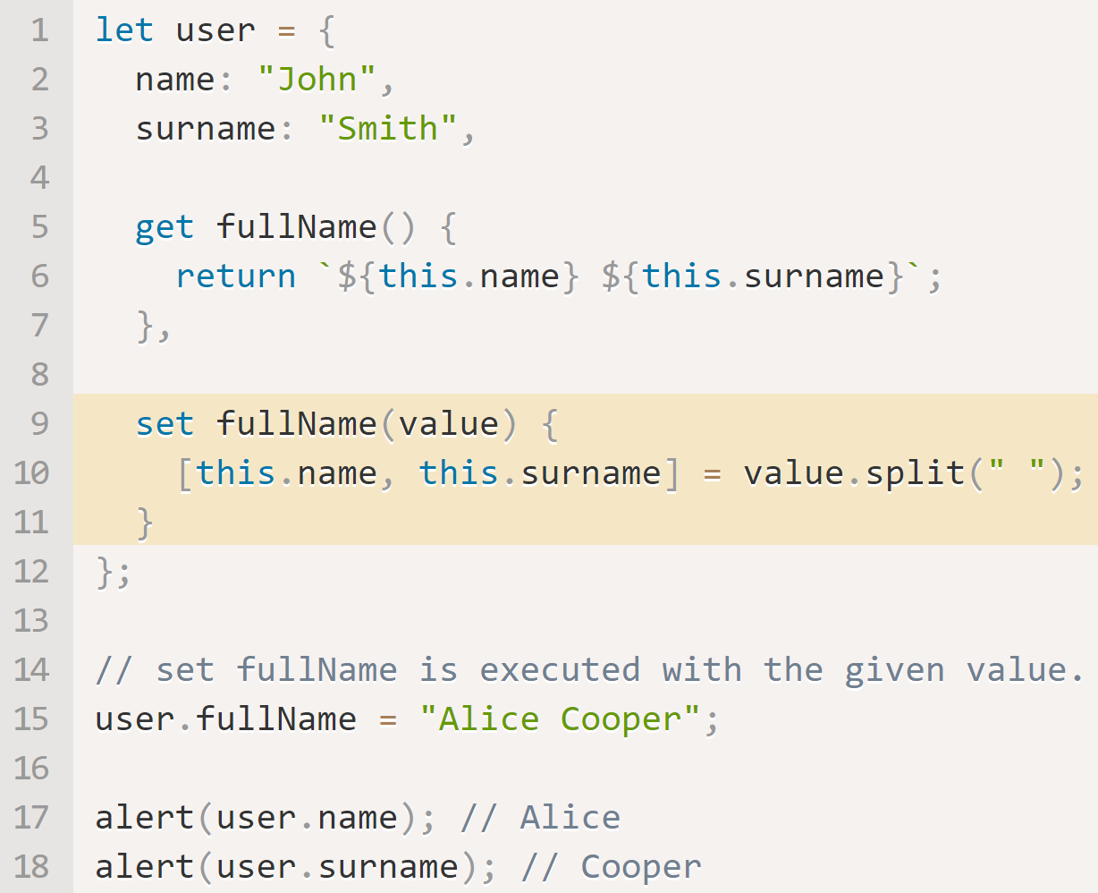
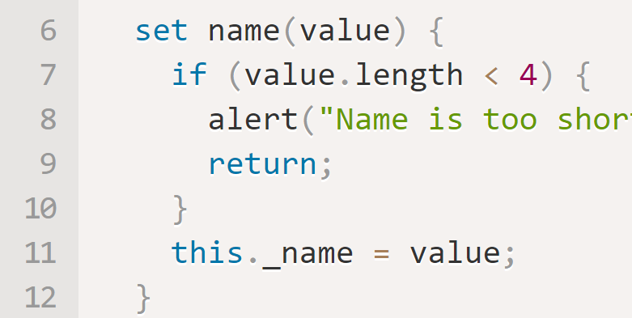
Getters and Setters https://javascript.info/property-accessors#getters-and-setters
Accessor properties are new to JS. They are functions that work on getting and setting a value but look like regular properties to external code.
Getters and Setters are accessed like properties. (instanceName.getterName).
Getters and Setters allow validation to be written inside the class.

Slide 12
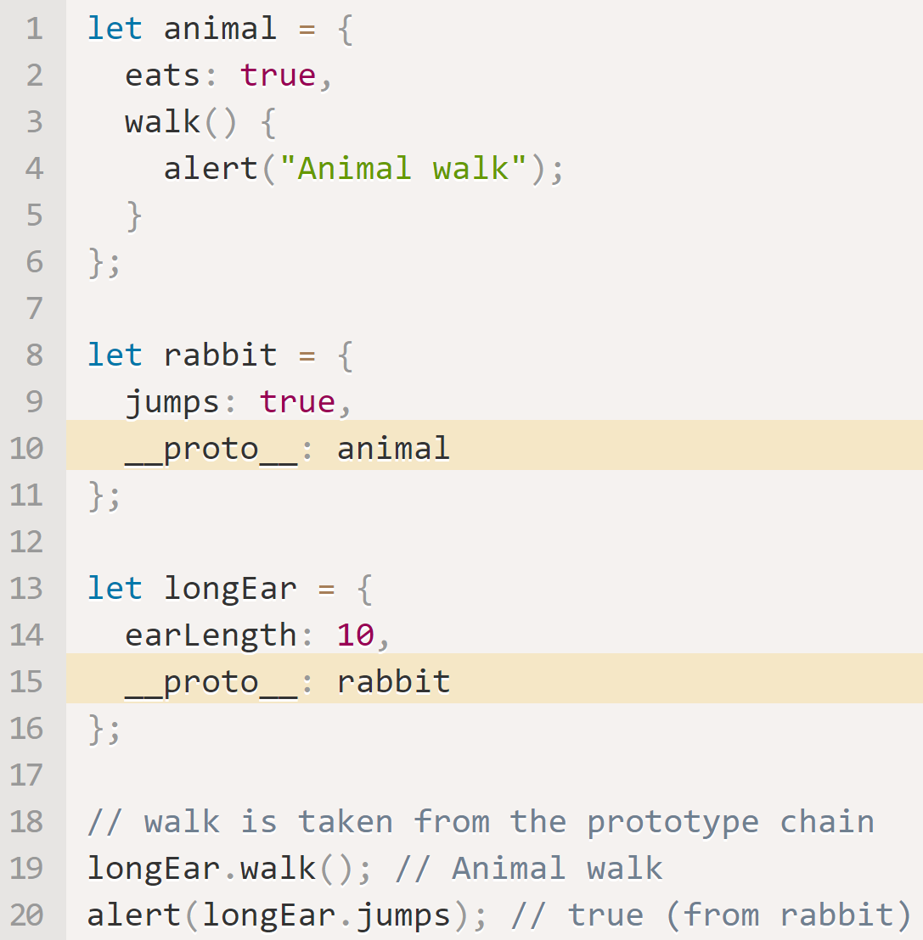
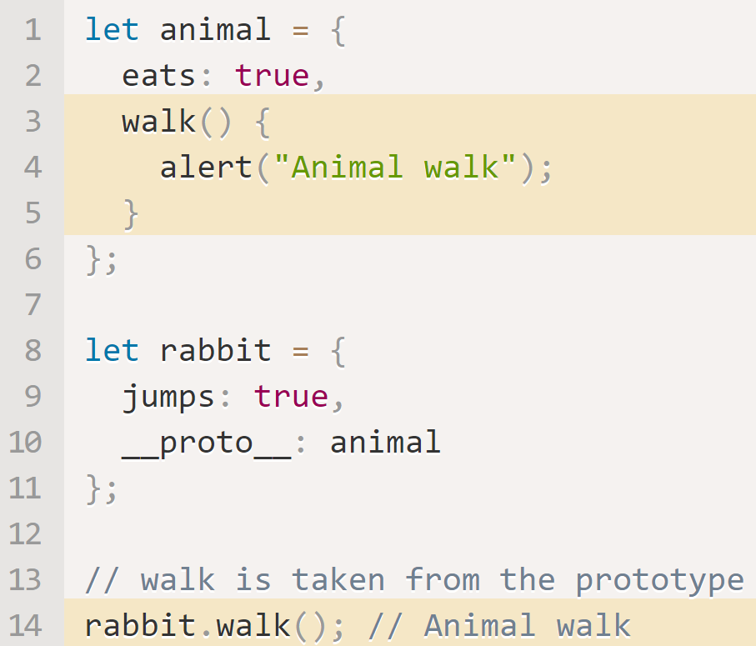
JavaScript [[Prototypes]] https://javascript.info/prototype-inheritance
In JavaScript, objects have a special hidden property [[Prototype]] (as named in the specification), that is either null or references another object. That object is called “a prototype”. When we want to read a property from object, and it’s missing, JavaScript automatically takes it from the prototype. In programming, such thing is called “prototypal inheritance”. The property [[Prototype]] is internal and hidden, but there are many ways to set it.
Multiple prototype inheritance is not allowed.
__proto__ doesn’t support…
write (overwriting) actions.
References can be chained
References cannot go in circles.
Getter/setter functions are inherited.
Hierarchical Inheritance
Inherit Methods

Slide 13
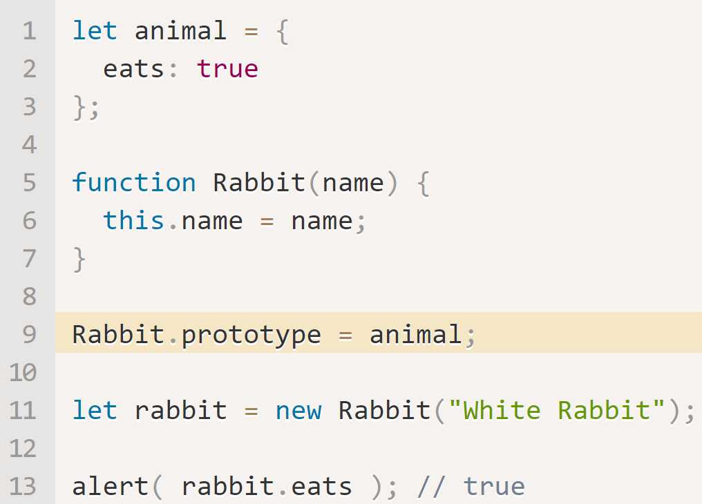
JavaScript Prototypes https://javascript.info/function-prototype https://javascript.info/prototype-methods
Prototypal Inheritance was one of the core features of JS originally, but there was no direct access to it. The only thing that worked reliably was a "prototype" property of the constructor function. There are many scripts that still use it. Remember, prototype is a default property provided in the constructor.
In this example, setting Rabbit.prototype = animal sets its prototype to animal.

Slide 14
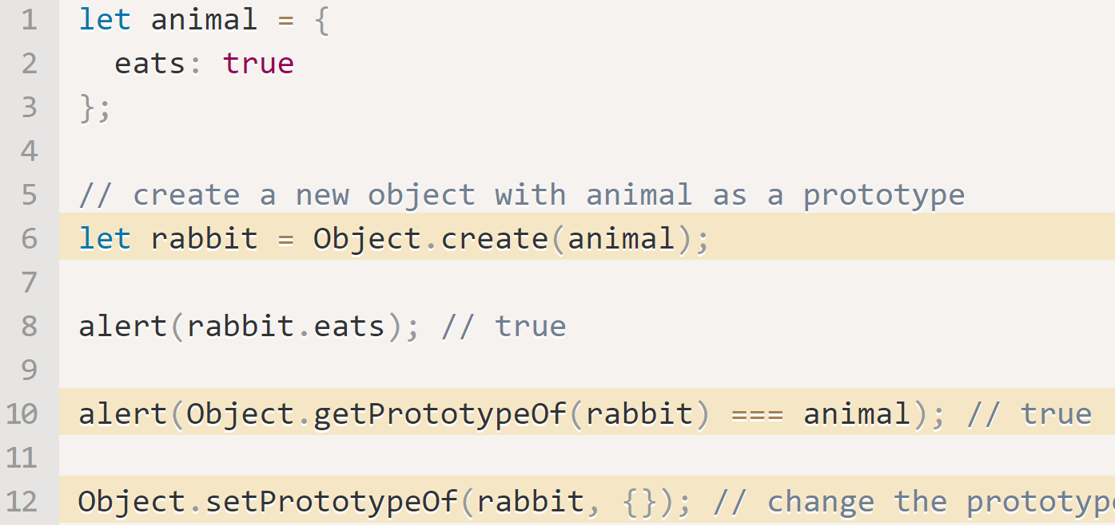
JavaScript Objects without __proto__ https://javascript.info/function-prototype https://javascript.info/prototype-methods
__proto__ is considered outdated and somewhat deprecated (in browser-only part of the JavaScript standard).
Instead of __proto__, use:
Object.create(proto[, descriptors]) – creates an empty object with given proto as [[Prototype]] and optional property descriptors.
Object.getPrototypeOf(obj) – returns the [[Prototype]] of obj.
Object.setPrototypeOf(obj, proto) – sets the [[Prototype]] of obj to proto.

Slide 15
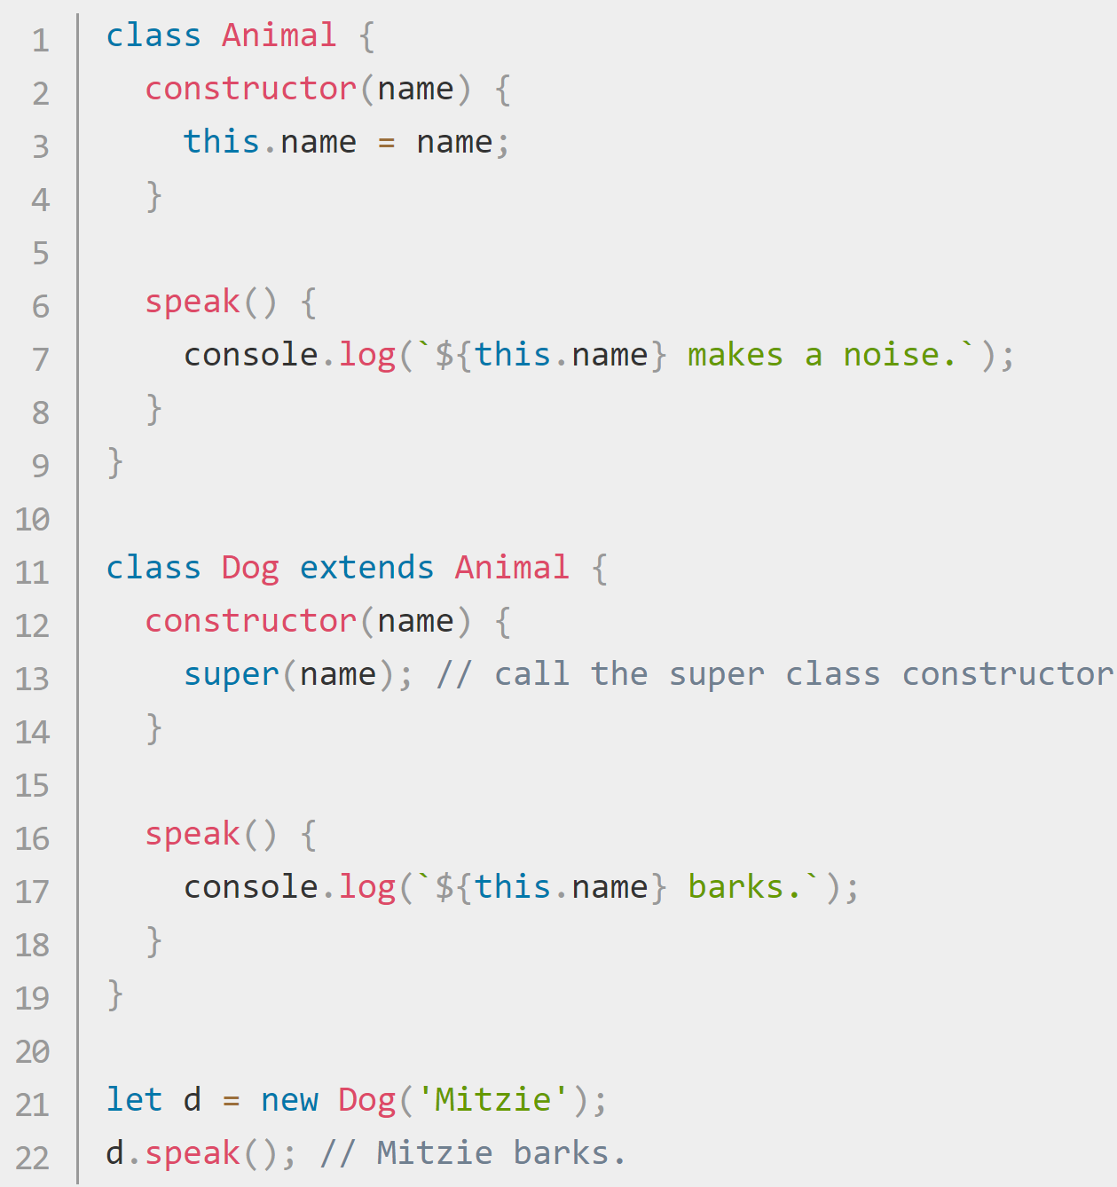
JS Class Inheritance https://developer.mozilla.org/en-US/docs/Web/JavaScript/Reference/Classes https://developer.mozilla.org/en-US/docs/Web/JavaScript/Reference/Classes#Sub_classing_with_extends
The extends keyword is used in class declarations or class expressions to create a class as a child of another class.
If there is a constructor present in the subclass, it needs to first call super() before using "this".
If you want to inherit from a regular object, you can instead use Object.setPrototypeOf()

