Slide 1

MVC Concepts
.NET

Slide 2
The Model-View-Controller (MVC) architectural pattern separates an application into three main groups of components: Models, Views, and Controllers. This pattern helps to achieve separation of concerns.
https://docs.microsoft.com/en-us/aspnet/core/mvc/overview?view=aspnetcore-3.1

Slide 3
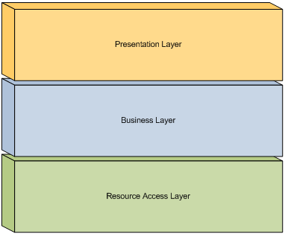
MVC - Separation of Concerns https://docs.microsoft.com/en-us/dotnet/architecture/modern-web-apps-azure/architectural-principles#separation-of-concerns
An application should be partitioned based on the kinds of work it performs.
Consider an application that includes logic for identifying noteworthy items to display to the user, and which then formats such items in a way to make them more noticeable.
There are two separate behaviors responsible for:
choosing which items to format
formatting the items.
These are separate concerns that are only coincidentally related to one another.
Applications should be built to separate core business behavior from infrastructure and user interface logic.
This ensures that the application is easy to test and can evolve without being tightly coupled to low-level implementation details.
Separation of concerns is a key consideration behind the use of layers in application architectures.

Slide 4
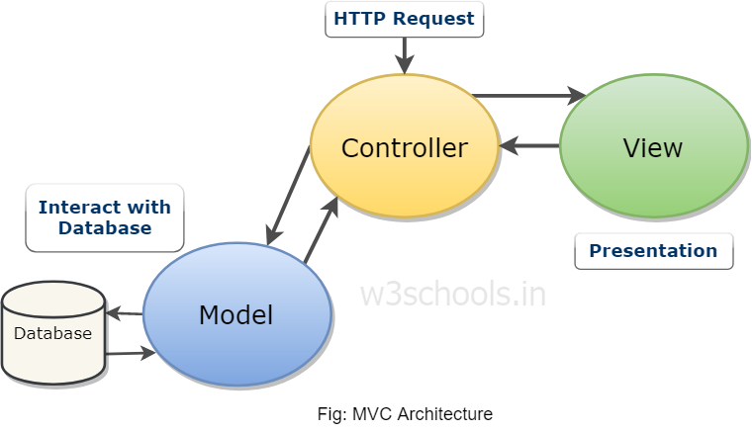
MVC – Control/Data Flow https://docs.microsoft.com/en-us/aspnet/core/mvc/overview?view=aspnetcore-3.1#what-is-the-mvc-pattern
The Model-View-Controller (MVC) architectural pattern separates an application into Models, Views, and Controllers.
User requests are routed to a Controller which
works with the Model to perform user actions and/or retrieve results of queries.
The Controller then chooses the appropriate View and
provides it with the Model data it requires to display results to the user.

Slide 5
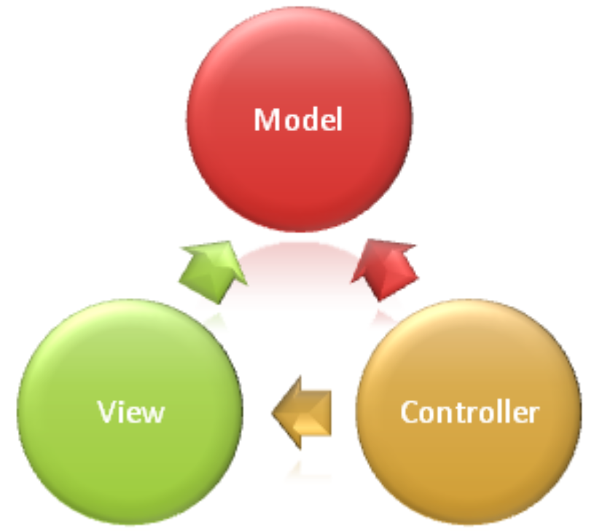
MVC – Model https://docs.microsoft.com/en-us/aspnet/core/mvc/overview?view=aspnetcore-3.1#model-responsibilities
The Model part of an MVC application represents the state of the application and any business logic or operations that should be performed by it.
Business logic is encapsulated in the Model, along with any implementation logic (DbContext) for persisting the state of the application (the DataBase).
Strongly-typed views typically use ViewModel types designed to contain the data to display on that view. The controller creates and populates these ViewModel instances from the model.
State
Business Logic
Implementation Logic

Slide 6
MVC – View https://docs.microsoft.com/en-us/aspnet/core/mvc/overview?view=aspnetcore-3.1#model-responsibilities
Views are responsible for presenting content through the user interface.
Views use the Razor view engine to embed .NET code in HTML markup.
Logic in Views should relate to presenting content. If logic is necessary in order to display data from a complex model, use a View Component or ViewModel simplify the view.
State
Business Logic
Implementation Logic
Presentation
Minimal logic

Slide 7
MVC – Controller https://docs.microsoft.com/en-us/aspnet/core/mvc/overview?view=aspnetcore-3.1#model-responsibilities
Controllers are the components that
handle user input,
work with the model, and
select a view to render.
The controller handles and responds to user input. In the MVC pattern, the controller is the initial entry point, and is responsible for selecting which model types to work with and which view to render (hence its name - it controls how the app responds to a given request).
Contains State,
Business Logic,
Implementation Logic
Presentation
Minimal logic
Handles user input
Uses Model
Selects View

Slide 8
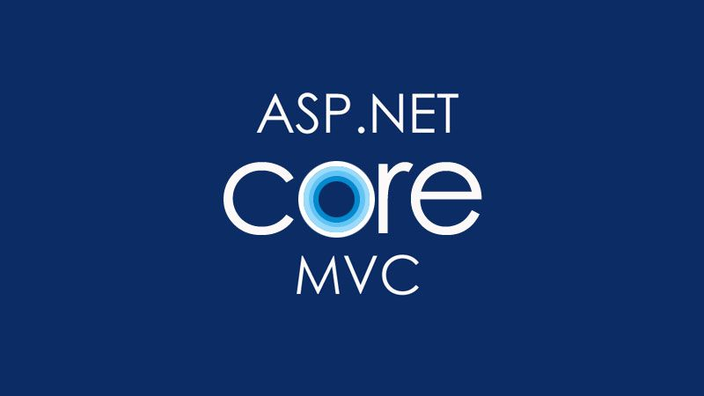
Why ASP.NET Core MVC?
Use of the MVC approach helps you create applications that separate the different aspects of your application (input logic, business logic, and UI logic), while providing a loose coupling between these elements. The pattern specifies where each kind of logic should be located in the application.
This architecture is good but what about testing? What about dynamic web pages? What about model validation and Web API’s? Wouldn’t it be nice to have a framework with all those technologies built in?
This is where ASP.NET Core MVC comes into the picture.

Slide 9
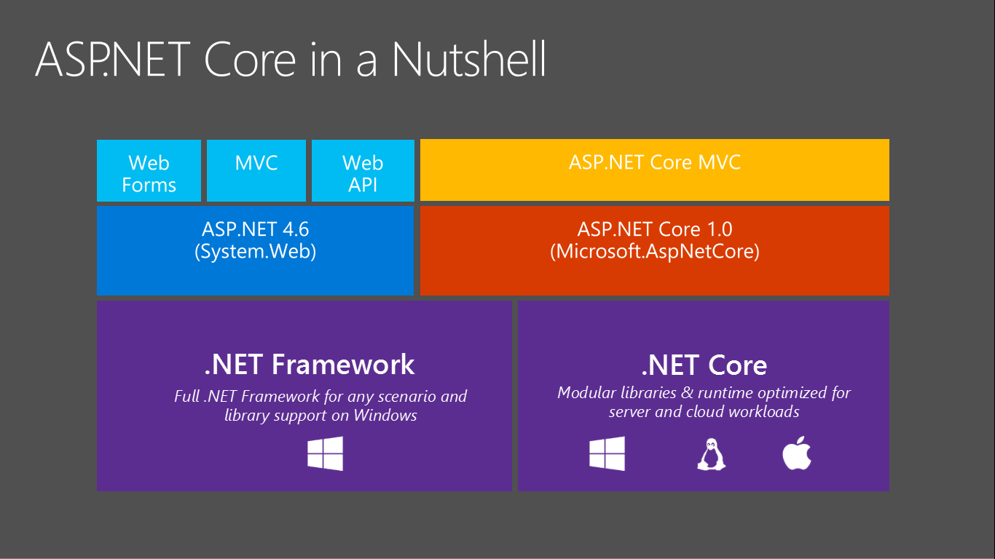
ASP.NET Core MVC - Overview https://docs.microsoft.com/en-us/aspnet/core/mvc/overview?view=aspnetcore-3.1&source=docs#what-is-aspnet-core-mvc
The ASP.NET Core MVC framework is a lightweight, open source, highly testable presentation framework optimized for use with ASP.NET Core but using the MVC architectural pattern..
ASP.NET Core MVC provides a patterns-based way to build dynamic websites that enables a clean separation of concerns.
ASP.NET Core MVC:
full control over markup,
supports TDD-friendly development
uses the latest web standards.

Slide 10
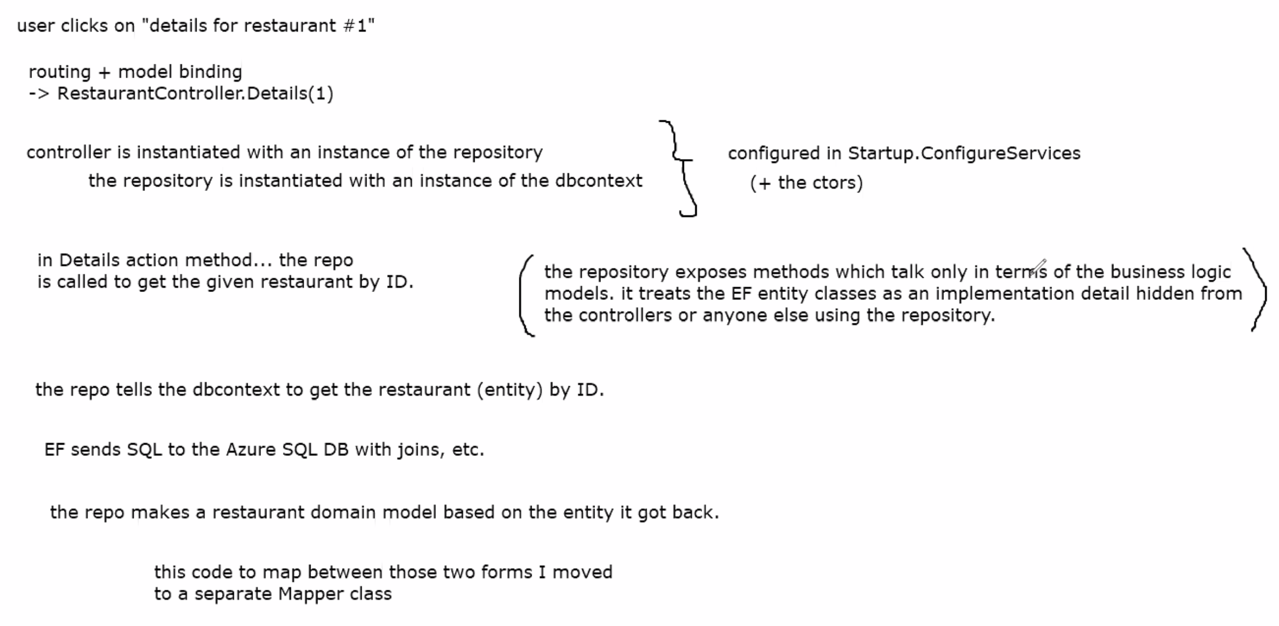
Nicks p1 notes on whiteboard.

