Slide 1

Dependency Injection
.NET

Slide 2
A dependency is any object that, to function, another object requires. The Dependency injection (DI) design pattern is a technique for achieving Inversion of Control (IoC) between classes and their dependencies.
https://docs.microsoft.com/en-us/aspnet/core/fundamentals/dependency-injection?view=aspnetcore-3.1

Slide 3
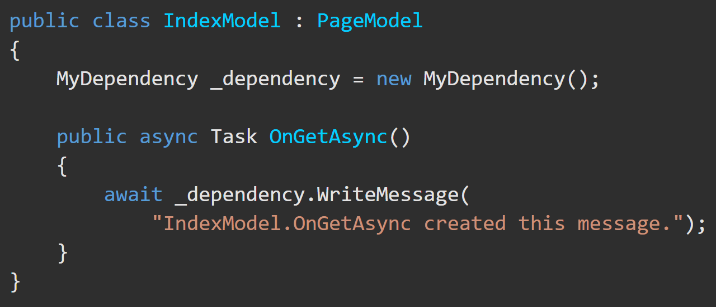
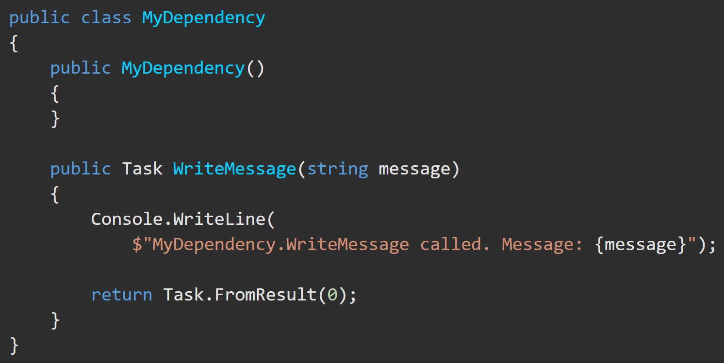
Dependencies – Overview https://docs.microsoft.com/en-us/aspnet/core/fundamentals/dependency-injection?view=aspnetcore-3.1
An instance of the MyDependency class can be created in another class to make the WriteMessage method available to that class.
MyDependency class is a dependency of IndexModel class.

Slide 4
Dependency Inversion – Overview https://docs.microsoft.com/en-us/aspnet/core/fundamentals/dependency-injection?view=aspnetcore-3.1
Code dependencies like this are problematic and should be avoided.
To replace MyDependency with a different implementation, the class must be modified.
If MyDependency has dependencies, they must be configured by the class.
This implementation is difficult to unit test.

Slide 5
Dependency Injection – A better way https://docs.microsoft.com/en-us/aspnet/core/fundamentals/dependency-injection?view=aspnetcore-3.1
Dependency injection addresses service dependency problems by:
providing (through ASP.NET Core) a built-in service container called IServiceProvider.
registering dependencies in the service container.
registering services through the app's Startup.ConfigureServices (in Startup.cs) method.
using an interface (or base class) to abstract the dependency implementation.
injecting the service into the constructor of the class where it's used.
The framework takes on the responsibility of creating an instance of the dependency and disposing of it when it's no longer needed.

Slide 6
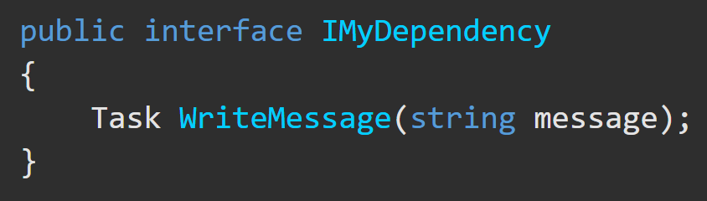
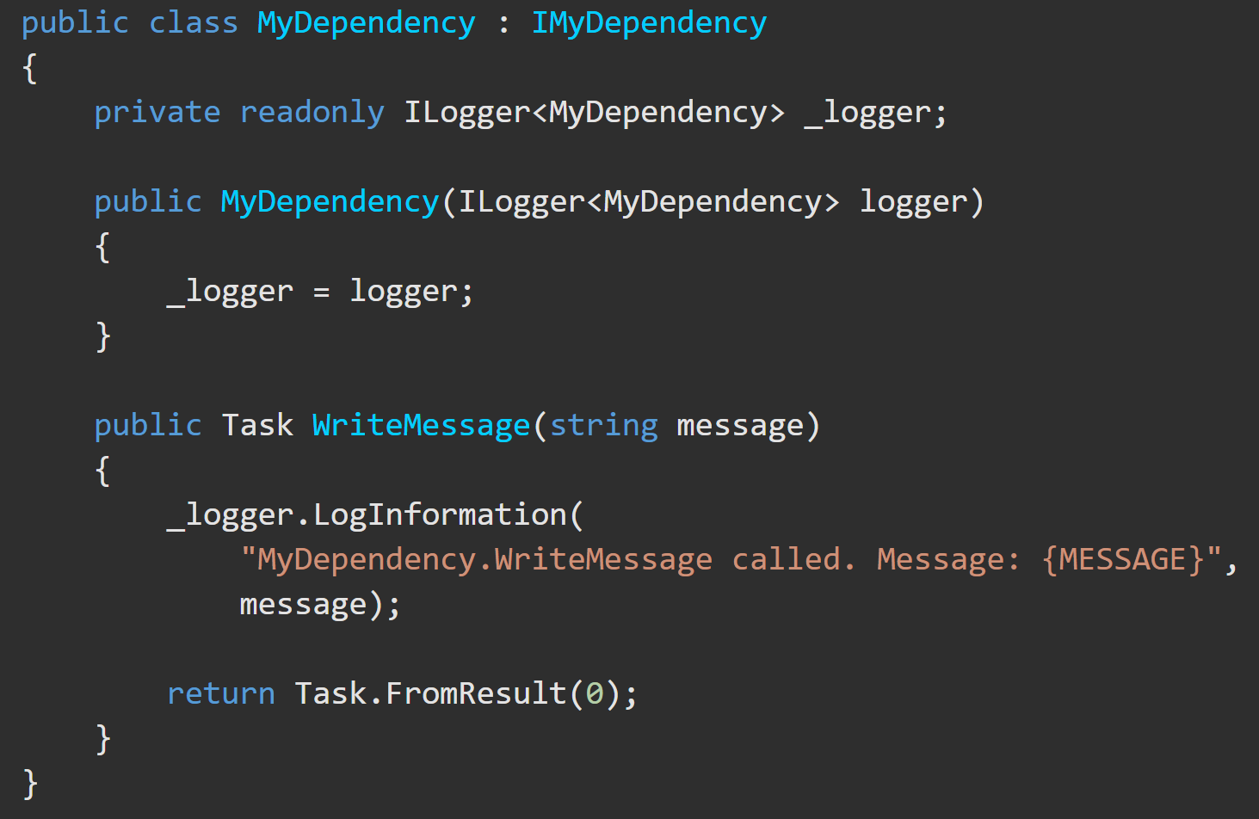
Dependency Injection – Step by Step(1) https://docs.microsoft.com/en-us/aspnet/core/fundamentals/dependency-injection?view=aspnetcore-3.1
2)Define the method in a class that implements the Interface.
1) Create an interface where you declare a method that you want to make available through Dependency Injection.

Slide 7
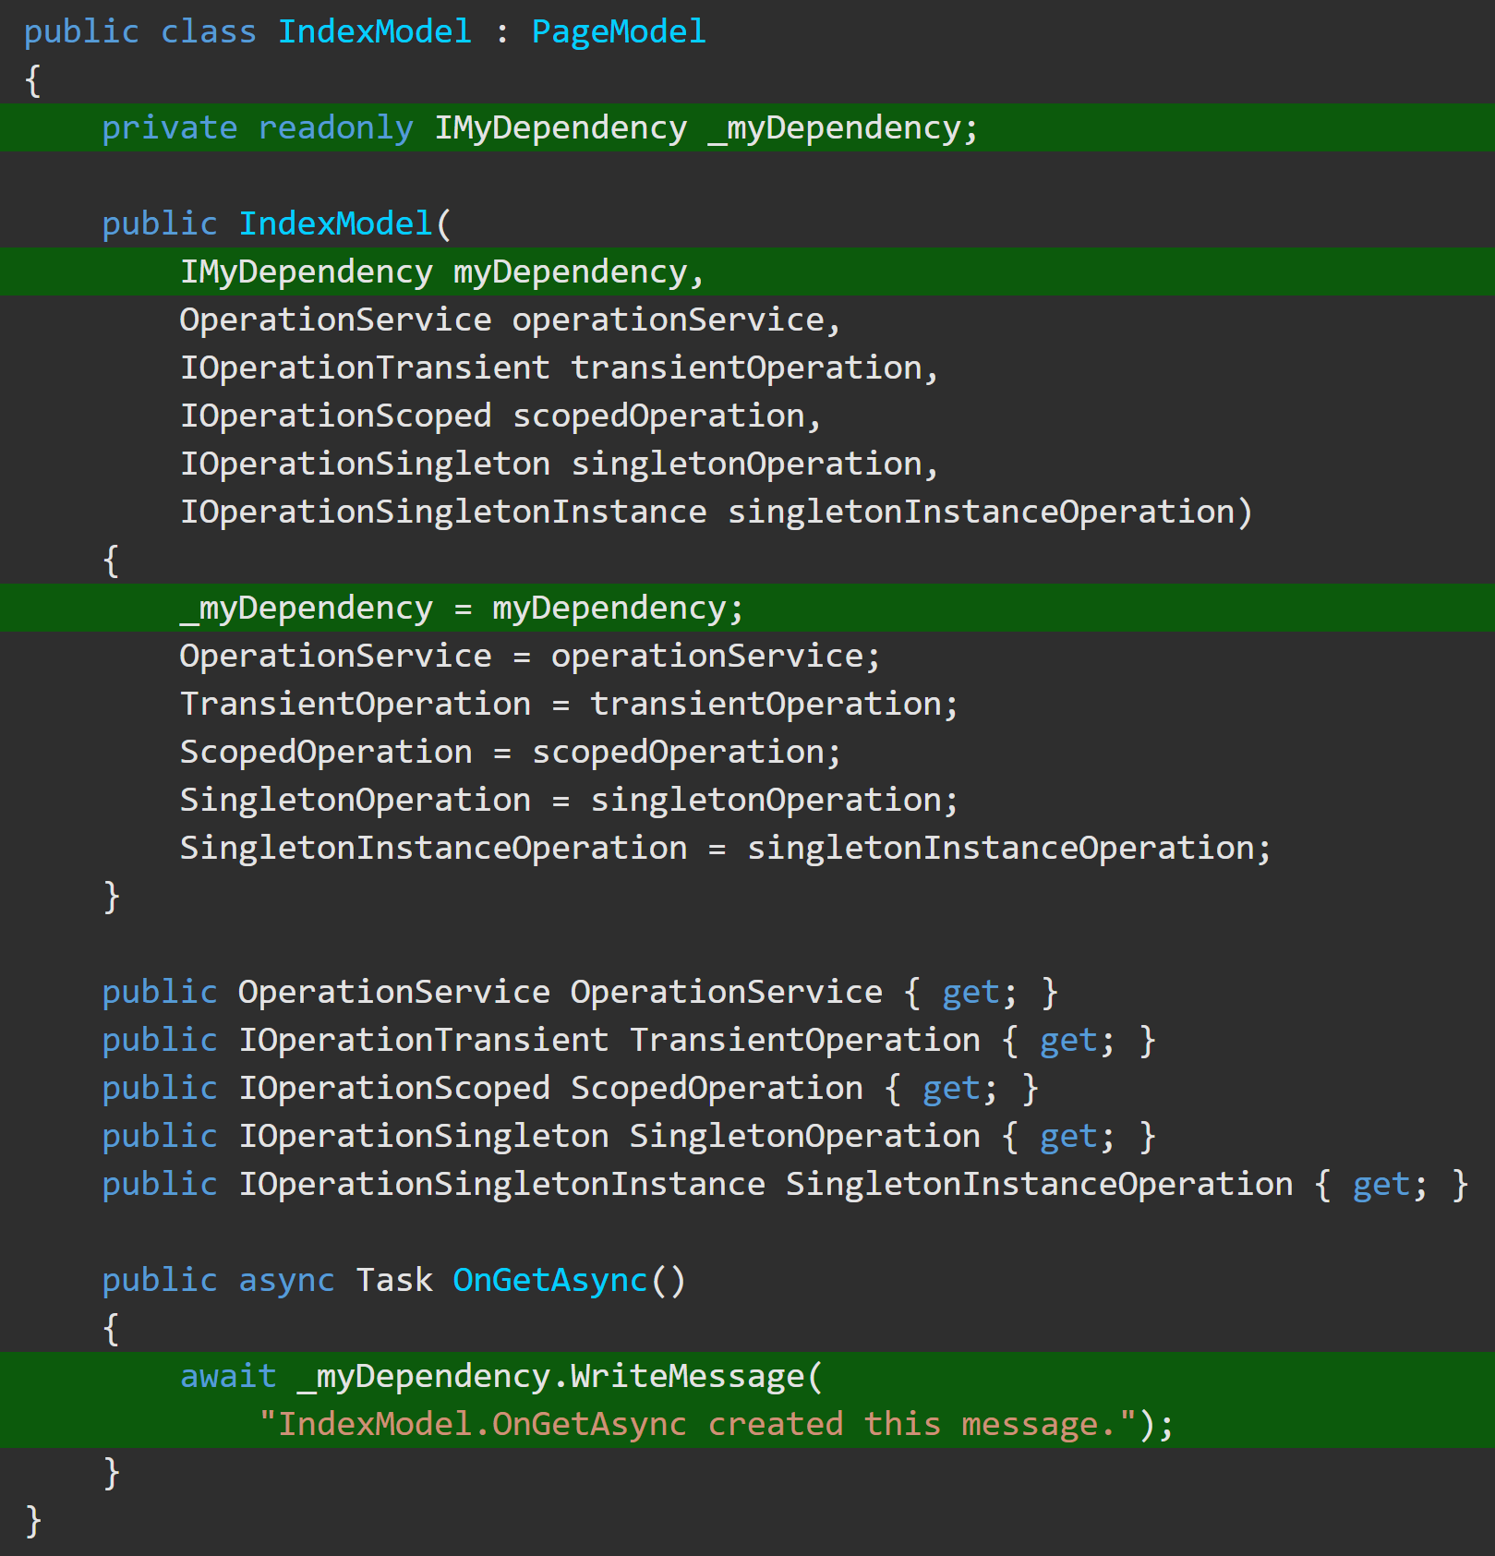
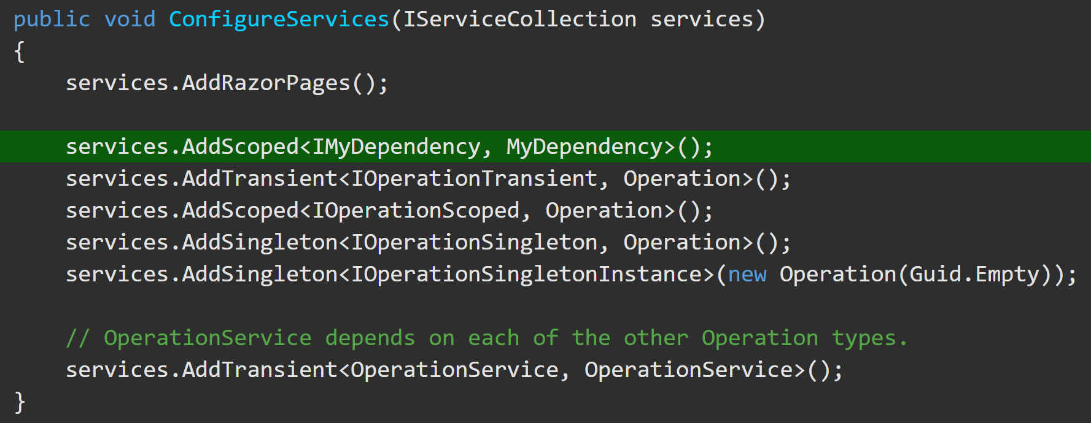
Dependency Injection – Step by Step(2) https://docs.microsoft.com/en-us/aspnet/core/fundamentals/dependency-injection?view=aspnetcore-3.1
3)Add the dependency to ConfigureServices with services.[desiredScope]<[interface], [class]>();
4) Inject the dependency into the constructor of the dependent class and assign it to a private variable of the interface type.

Slide 8
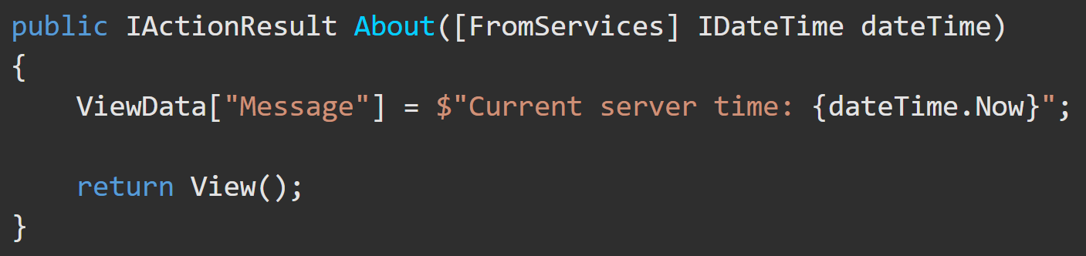
Dependency Injection – [FromServices] Alternative to Constructor Injection https://docs.microsoft.com/en-us/aspnet/core/mvc/controllers/dependency-injection?view=aspnetcore-3.1#action-injection-with-fromservices
After registering a service with the service container, the [FromServices] attribute enables injecting the registered service directly into an action method without using constructor injection in the Controller.

Slide 9
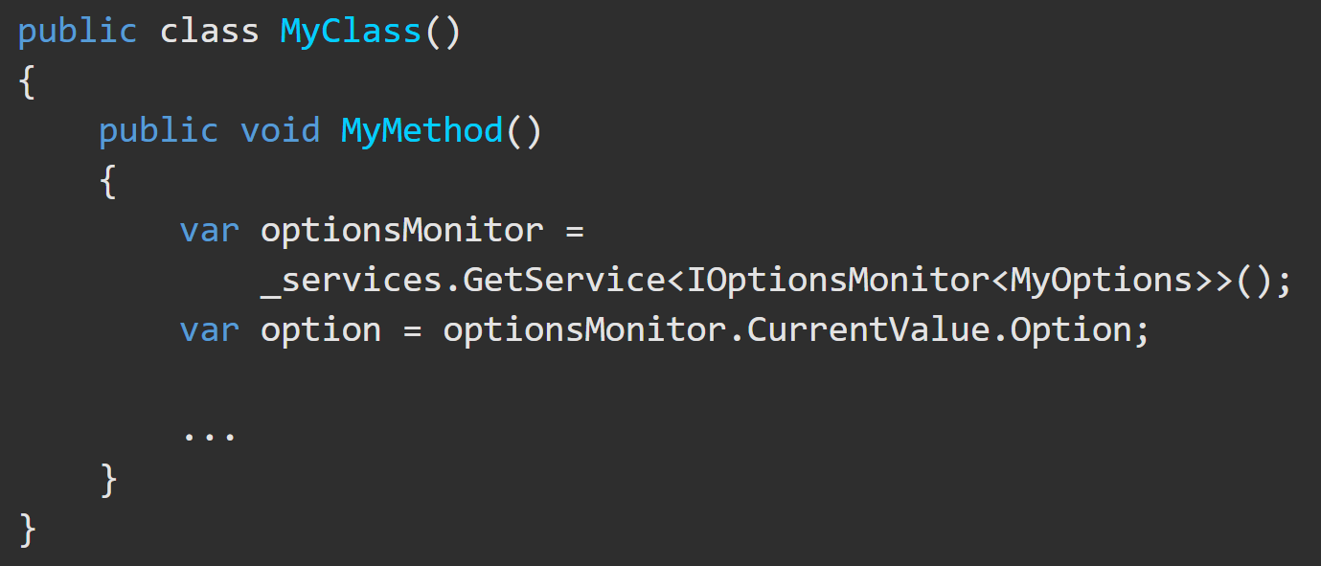
Dependency Injection – .GetService<>() Alternative to Constructor Injection https://docs.microsoft.com/en-us/aspnet/core/mvc/controllers/dependency-injection?view=aspnetcore-3.1#action-injection-with-fromservices
When you are unable to obtain an instance of a needed service by Dependency Injection, .GetService<> can be used to get a service object.
*Don't invoke GetService to obtain a service instance when you can use DI instead.

Slide 10
Service Type Lifetimes https://docs.microsoft.com/en-us/aspnet/core/fundamentals/dependency-injection?view=aspnetcore-3.1#transient
Service | Description
Transient | Transient services (AddTransient) are created each time they're requested from the service container. Best for lightweight, stateless services.
Scoped | Scoped lifetime services (AddScoped) are created once per HTTP request (connection).
Singleton | Singleton services (AddSingleton) are created the first time they're requested (or when Startup.ConfigureServices is run). Every subsequent request uses the same instance.

Slide 11
Dependency Injection - Scopes Examples.

Slide 12
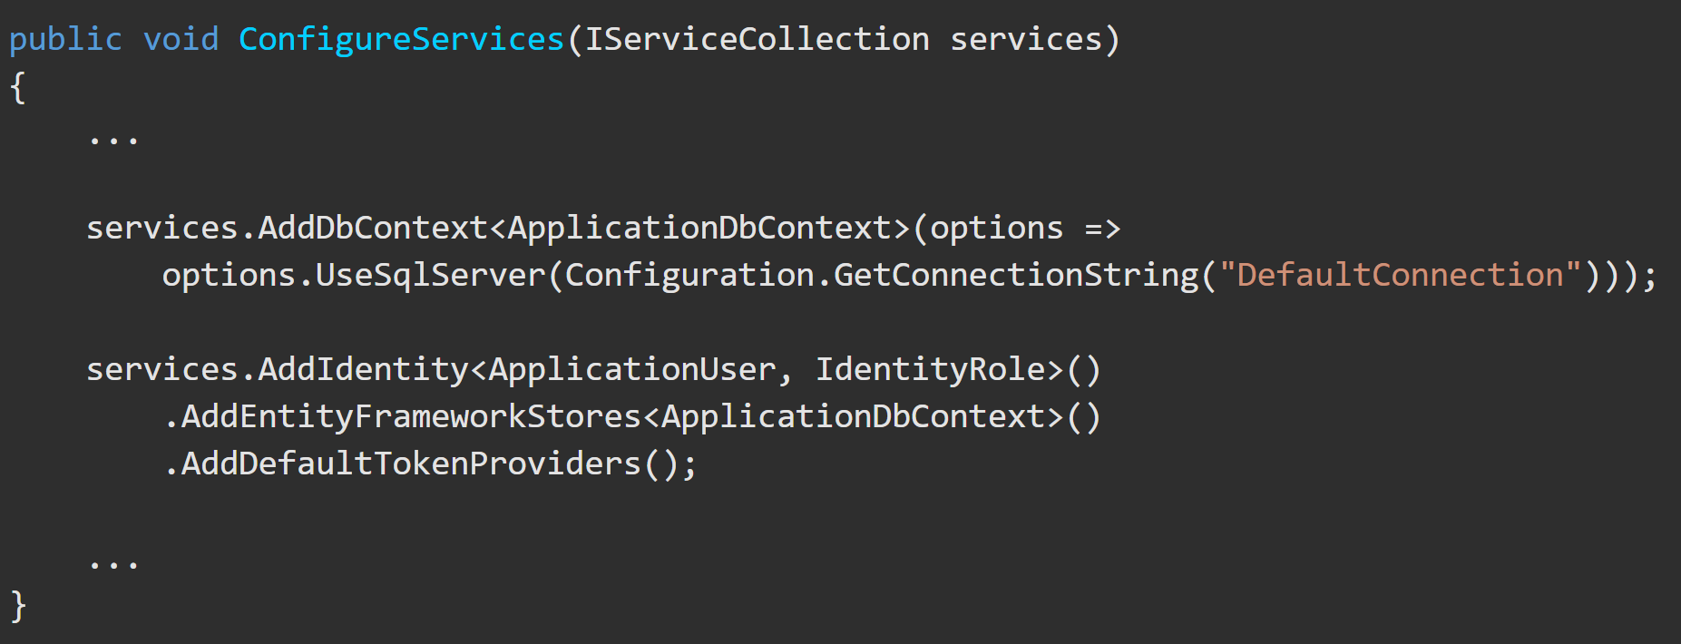
Dependency Injection - .addDbContext https://docs.microsoft.com/en-us/dotnet/api/microsoft.extensions.dependencyinjection.entityframeworkservicecollectionextensions.adddbcontext?view=efcore-3.1 https://docs.microsoft.com/en-us/aspnet/core/fundamentals/dependency-injection?view=aspnetcore-3.1#entity-framework-contexts
Entity Framework contexts are usually added to the service container using the scoped lifetime because web app database operations are normally scoped to the client request. The default lifetime is scoped if a lifetime isn't specified by an AddDbContext<TContext> overload when registering the database context. Services of a given lifetime shouldn't use a database context with a shorter lifetime than the service.

Slide 13
Dependency Injection – Best Practices https://docs.microsoft.com/en-us/aspnet/core/fundamentals/dependency-injection?view=aspnetcore-3.1#design-services-for-dependency-injection
Best design practices are to:
Design services to use dependency injection to obtain their dependencies.
Avoid stateful, static classes and members. Design apps to use singleton services instead, which avoid creating global state.
Avoid direct instantiation of dependent classes within services. Direct instantiation couples the code to a particular implementation.
Make classes small, well-factored, and easily tested.
If a class seems to have too many injected dependencies, it’s a sign that the class has too many responsibilities and is violating the Single Responsibility Principle (SRP).

Slide 14
(Cont.) Dependency Injection –
Best Practices https://docs.microsoft.com/en-us/aspnet/core/fundamentals/dependency-injection?view=aspnetcore-3.1#design-services-for-dependency-injection
https://docs.microsoft.com/en-us/aspnet/core/fundamentals/dependency-injection?view=aspnetcore-3.1#recommendations
When services are resolved by IServiceProvider, constructor injection requires a public constructor.
The built-in service container is designed to serve the needs of the framework and most consumer apps. It is recommended to use the built-in container unless you need a specific feature that the built-in container doesn't support.
Dependency Injection is an alternative to static/global object access patterns. You may not be able to realize the benefits of DI if you mix it with static object access.

