Slide 1

Client-Side and Server-Side Validation
.NET

Slide 2
Client-Side validation gives users instant feedback on the information they submitted to a web page. It is an expected feature in today’s applications. Server-Side validation is necessary because information arriving from the network should never be trusted .
https://www.c-sharpcorner.com/article/custom-data-annotation-validation-in-mvc/

Slide 3

Why Validate User Input?
Client-Side validation is implemented mostly to enhance the users experience. The user gets faster error checking and doesn’t need to submit a form to see that their input was invalid.
For Client-Side validation, you can use the built-in HTML validation attributes, but they are limited. .NET Tag Helpers are designed to work with the jQuery Unobtrusive Validation script. Microsoft jQuery Validation Library, uses jQuery’s Validate Plugin.
Tag Helpers put HTML5 data attributes into form controls, which the Validation Library uses to configure validation logic and display validation messages on the Client-Side. This enables data annotations to drive consistent validation on both the Server-Side and the Client-Side (before sending to server).
Custom Client-Side validation is also possible.
Server-Side validation is still necessary. The user could have their JavaScript disabled or have malicious intent.

Slide 4

jQuery Unobtrusive Validation https://docs.microsoft.com/en-us/aspnet/core/mvc/models/validation?view=aspnetcore-3.1#client-side-validation
The jQuery Unobtrusive Validation script is a custom Microsoft front-end library that builds on the popular jQuery Validate plugin. Without jQuery Unobtrusive Validation, Tag Helpers and HTML helpers use the validation attributes and type metadata from model properties to render HTML 5 data-attributes. jQuery Unobtrusive Validation parses the data-attributes and passes the logic to jQuery Validate, effectively "copying" the server-side validation logic to the client. This way you can display validation errors to the client using Tag Helpers.
The below scripts import the jQuery Unobtrusive Validation scripts.
In _Layout.cshtml
In _ValidationScriptsPartial.cshtml

Slide 5
Model State https://docs.microsoft.com/en-us/aspnet/core/mvc/models/validation?view=aspnetcore-3.1#model-state
Model state represents errors that come from two subsystems: model binding and model validation.
Model Binding errors are generally data conversion errors.
an "x" is entered in an integer field.
Model validation occurs after model binding and reports errors where data doesn't conform to business rules.
a 0 is entered in a field that expects a rating between 1 and 5.

Slide 6
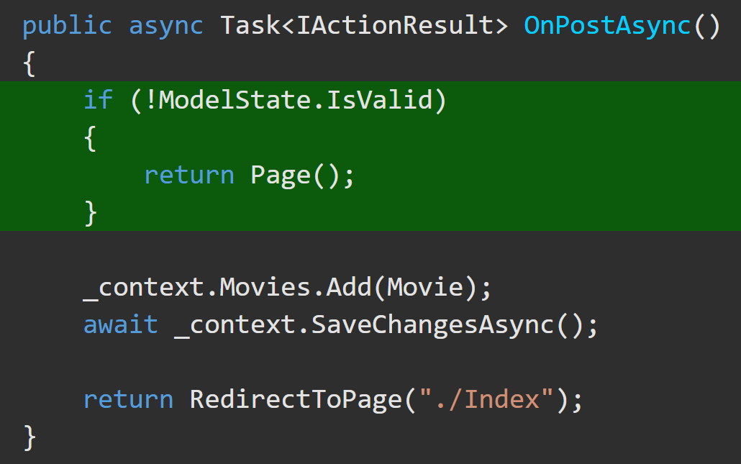
Model State Validation https://docs.microsoft.com/en-us/aspnet/core/mvc/models/validation?view=aspnetcore-3.1#model-state https://docs.microsoft.com/en-us/aspnet/core/web-api/?view=aspnetcore-3.1#automatic-http-400-responses
Both model binding and model validation occur before the execution of a controller action. For web apps, it's the app's responsibility to inspect ModelState.IsValid and react appropriately. When !ModelState.IsValid, web apps typically redisplay the page with an error message.
Web API controllers don't have to check ModelState.IsValid if they have the [ApiController] attribute. If they do, an automatic HTTP 400 response containing error details is returned.

Slide 7
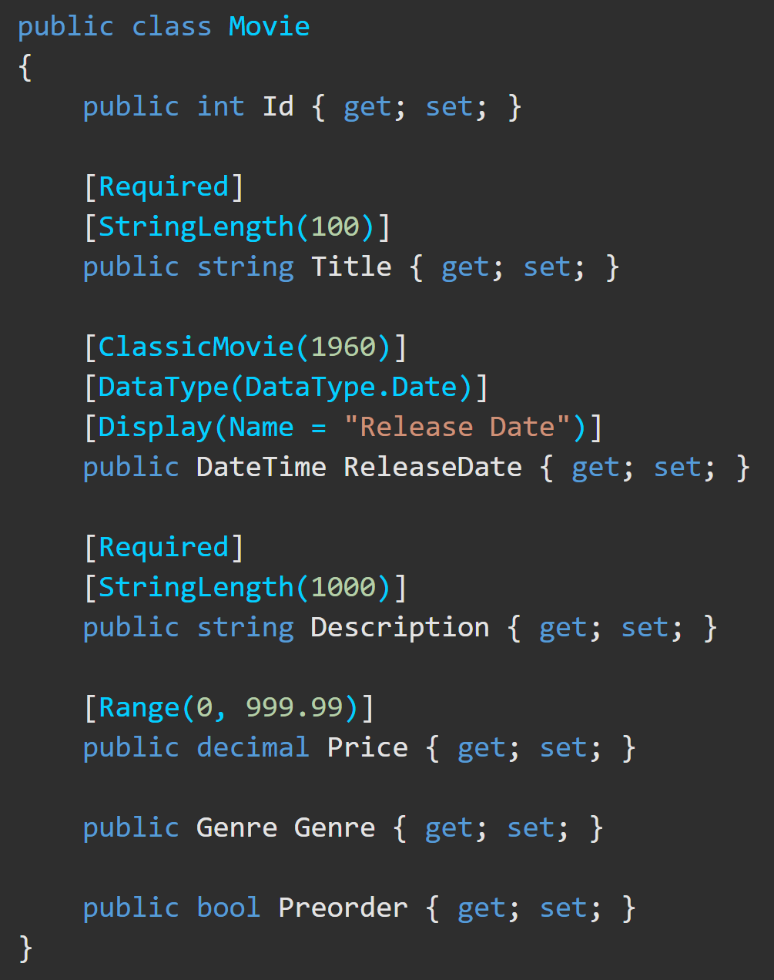
Validation – Client-Side https://docs.microsoft.com/en-us/aspnet/core/mvc/models/validation?view=aspnetcore-3.1#validation-attributes
Attribute | Purpose
[CreditCard] | Validates the property has a credit card format.
[Compare] | Validates two properties in a model match.
[EmailAddress] | Validates the property has an email format.
[Phone] | Validates the property has a telephone number format.
[Range] | Validates the property value falls within a specified range.
[RegularExpression] | Validates the property value matches a specified regular expression.
[Required] | Validates the field is not null.
[StringLength] | Validates a string property value doesn't exceed a specified length limit.
[Url] | Validates the property has a URL format.
[Remote] | Validates input on the client by calling an action method on the server. (very cool!)
See a complete list of validation attributes.

Slide 8
Validation – Client-Side Error Messages https://docs.microsoft.com/en-us/aspnet/core/mvc/models/validation?view=aspnetcore-3.1#error-messages
Error messages get displayed on the web page for the user to see.
When applied to a Name property, the error message created by the preceding code would be "Name length must be between 6 and 8.".

Slide 9
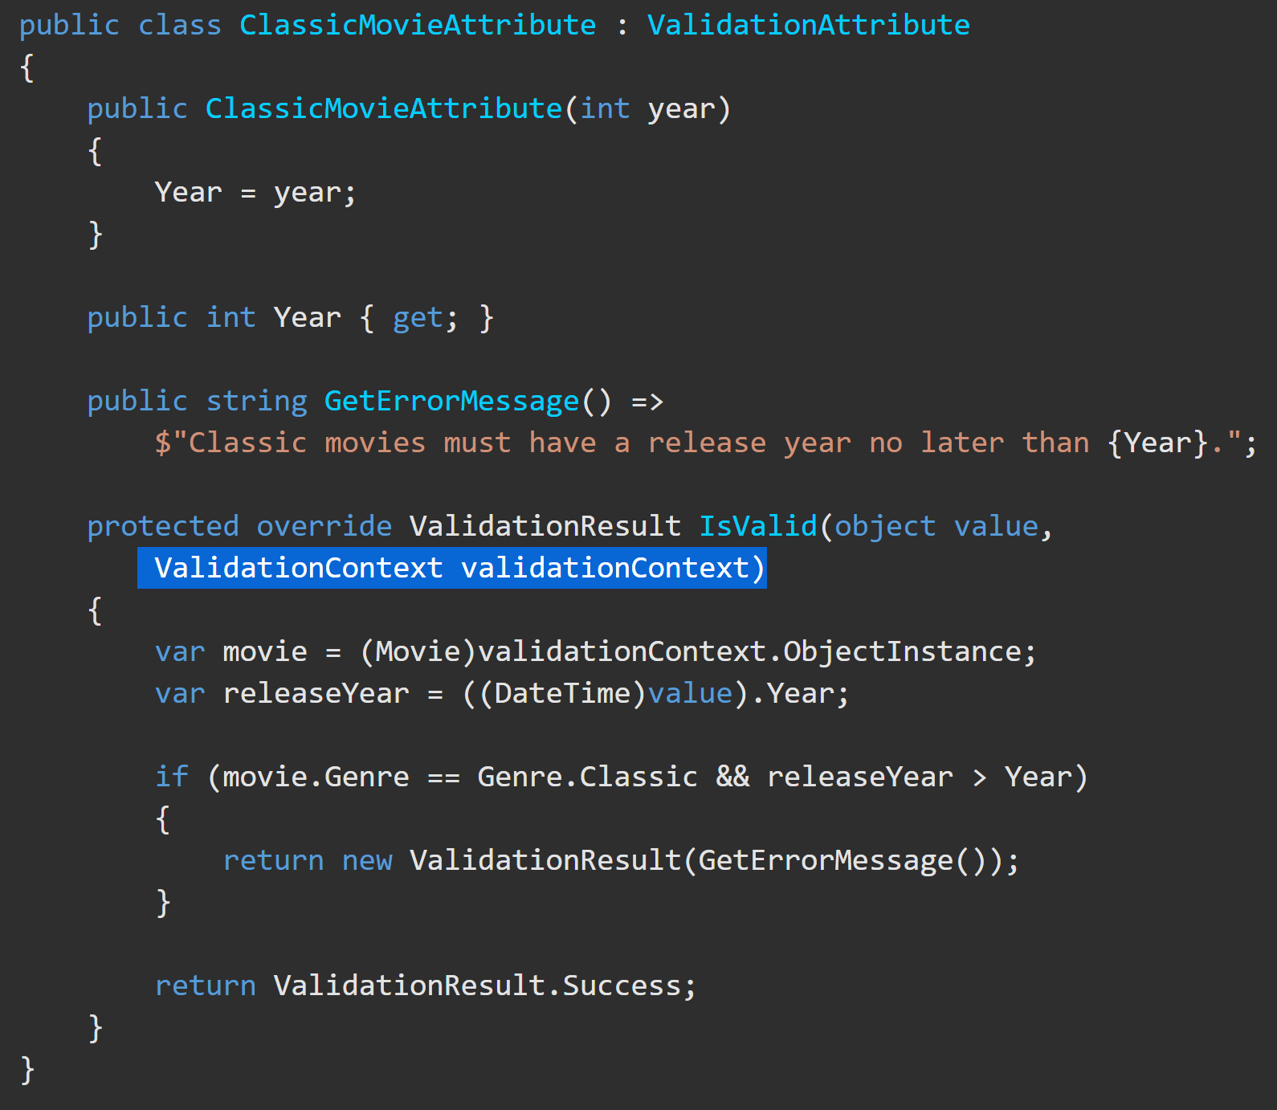
Validation – Custom Data Annotations https://docs.microsoft.com/en-us/aspnet/core/ mvc/models/validation?view=aspnetcore-3.1 #custom-attributes
Create custom validation attributes.
1) Create a class that inherits from ValidationAttribute.
2) Override the IsValid method.
The IsValid method accepts an object named value, which is the input to be validated. An overload also accepts a ValidationContext object, which provides additional information, such as the model instance created by model binding.
This example validates that the release date for a movie in the Classic genre isn’t after a specified year. The [ClassicMovie] attribute is only run on the server.
The Data Annotation in the Model would look like this → [ClassicMovie(1957)]

Slide 10
Validation – [Required] Server-Side https://docs.microsoft.com/en-us/aspnet/core/mvc/models/validation?view=aspnetcore-3.1#required-validation-on-the-server
The validation system in .NET Core treats non-nullable parameters or bound properties as if they had a [Required] attribute. Value types such as decimal and int are non-nullable. This behavior can be disabled by configuring SuppressImplicitRequiredAttributeForNonNullableReferenceTypes in Startup.ConfigureServices (in Startup.cs).
services.AddControllers(options => options.SuppressImplicitRequiredAttributeForNonNullableReferenceTypes = true);

Slide 11
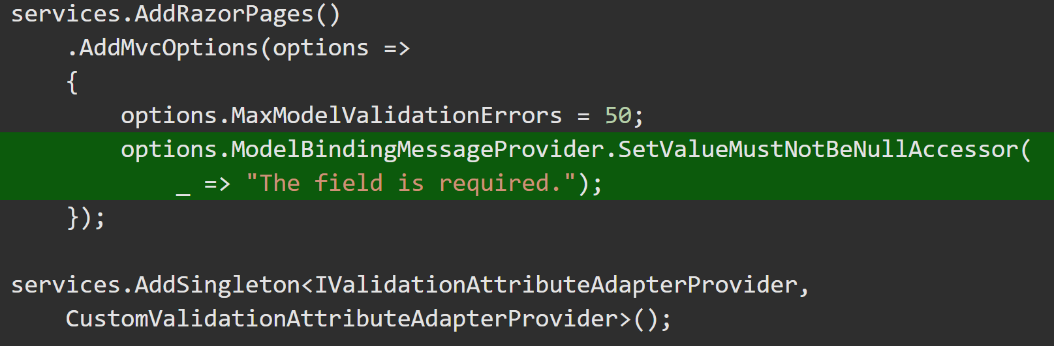
Validation – [Required] Server-Side https://docs.microsoft.com/en-us/aspnet/core/mvc/models/validation?view=aspnetcore-3.1#required-validation-on-the-server
Model binding for a non-nullable property can FAIL which leaves the value null. On the server, a [Required] value is considered missing if the property is null, but a non-nullable field (int or decimal) is always valid server-side. This means the [Required] attribute's error message is never displayed.
There are two options to specify a custom error message for server-side validation of non-nullable types.
Make the field nullable (Ex, decimal? instead of decimal).
(not recommended) Specify the default error message to be used by model binding.

Slide 12
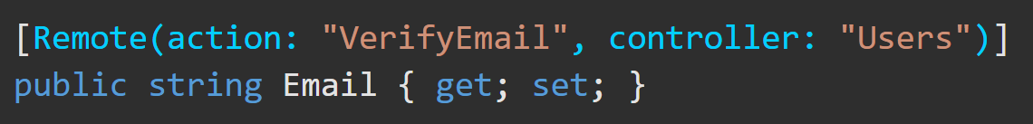
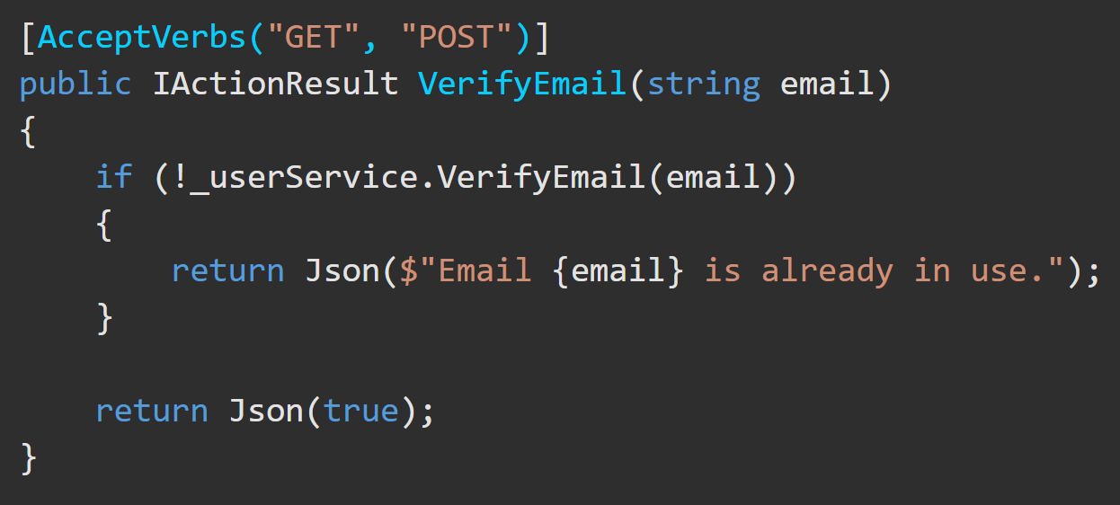
Validation – [Remote] Server-Side https://docs.microsoft.com/en-us/aspnet/core/mvc/models/validation?view=aspnetcore-3.1#remote-attribute
The [Remote] attribute implements client-side validation that requires calling an action method on the server to determine whether field input is valid. For example, the app may need to verify whether a userName is already in use.
Create an action method for JavaScript to call. The jQuery Validate remote method expects a JSON response:
true means the input data is valid.
false, undefined, null or any other string means the input is invalid. Display the default error message.
Display the string as a custom error message.
*You can also check multiple fields in combination

Slide 13
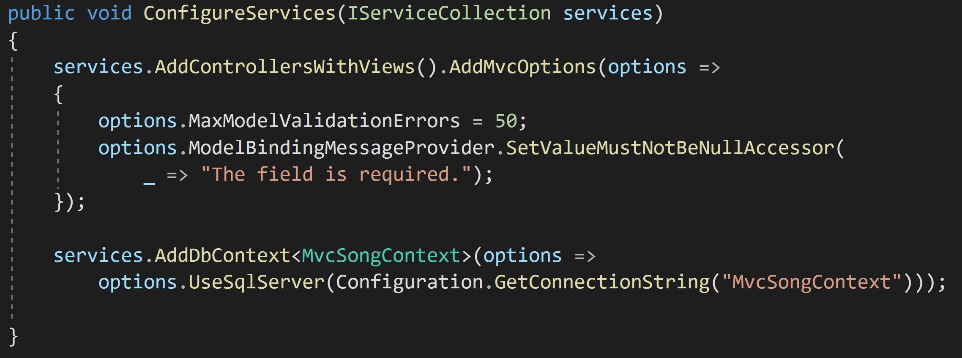
Validation – Maximum Errors https://docs.microsoft.com/en-us/aspnet/core/mvc/models/validation?view=aspnetcore-3.1#maximum-errors
Validation stops when the maximum number of errors is reached (200 by default). You can configure this number with the following code in Startup.ConfigureServices:
*You can also set Maximum Recursion.

Slide 14
Over-Posting https://docs.microsoft.com/en-us/aspnet/mvc/overview/getting-started/getting-started-with-ef-using-mvc/implementing-basic-crud-functionality-with-the-entity-framework-in-asp-net-mvc-application#overpost

Slide 15
CSRF (Cross Site Request Forgery) https://docs.microsoft.com/en-us/aspnet/mvc/overview/security/xsrfcsrf-prevention-in-aspnet-mvc-and-web-pages

Slide 16
Validate on leaving a field https://docs.microsoft.com/en-us/aspnet/web-pages/overview/ui-layouts-and-themes/validating-user-input-in-aspnet-web-pages-sites#adding-client-side-validation

