Slide 1

.NET Solution
.NET / Microsoft dynamics 365

Slide 2
A project is contained within a solution. Despite its name, a solution is not an "answer". It's simply a container for one or more related projects, along with build information, Visual Studio window settings, and any miscellaneous files that aren't associated with a particular project. A solution is described by a text file (extension .sln) with its own unique format; it's not intended to be edited by hand.
- https://docs.microsoft.com/en-us/visualstudio/ide/solutions-and-projects-in-visual-studio?view=vs-2019

Slide 3
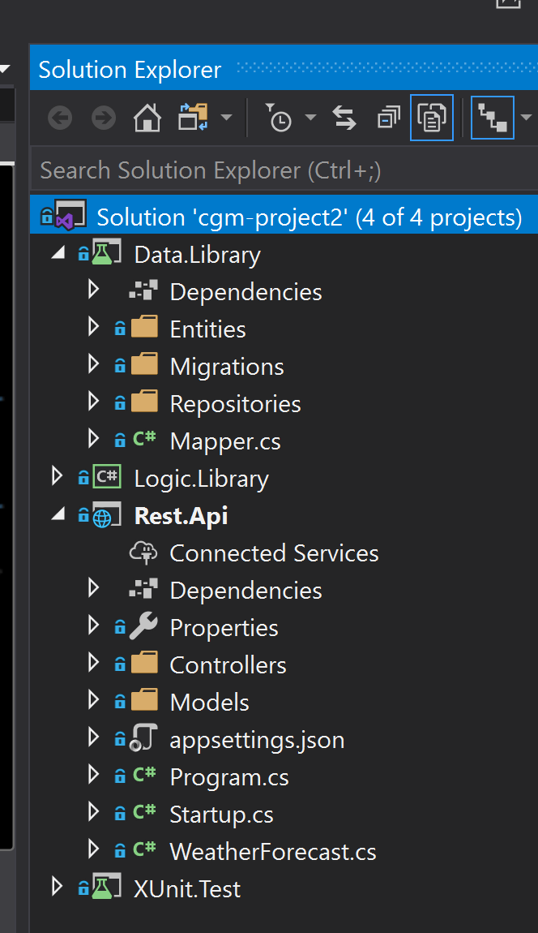
.NET Solution https://docs.microsoft.com/en-us/visualstudio/ide/solutions-and-projects-in-visual-studio?view=vs-2019#solutions
Projects are contained within solutions. A Solution is a container for one or more related projects along with build information, Visual Studio window settings, and any miscellaneous files that aren't associated with a particular project.
A solution is described by a text file (extension .sln) with its own unique format; it's not intended to be edited by hand.

Slide 4
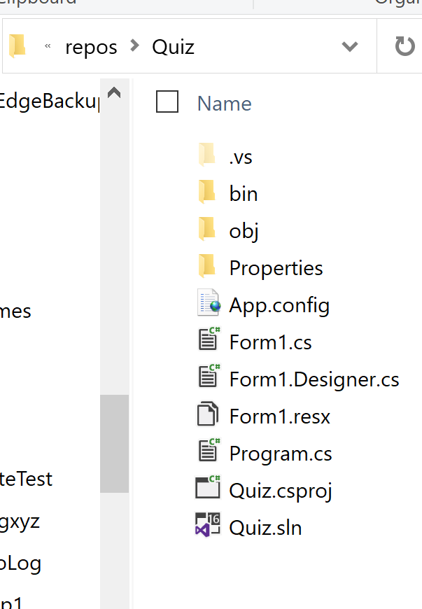
.NET Solution - Projects https://docs.microsoft.com/en-us/visualstudio/ide/solutions-and-projects-in-visual-studio?view=vs-2019 https://docs.microsoft.com/en-us/dotnet/csharp/tour-of-csharp/program-structure
An app or website in Visual Studio starts with a project. A project contains all files that are compiled into an executable, library, or website.
Those files can include source code, icons, images, data files, etc.
A project also contains compiler settings and other configuration files that might be needed by various services or components that your program communicates with.
Visual Studio uses MSBuild to build each project in a solution, and each project contains an MSBuild project file. The file extension for a C# project is .csproj.
The project file is an XML document that contains all the information and instructions that MSBuild needs in order to build your project, including the content, platform requirements, versioning information, web server or database server settings, and the tasks to perform.

Slide 5
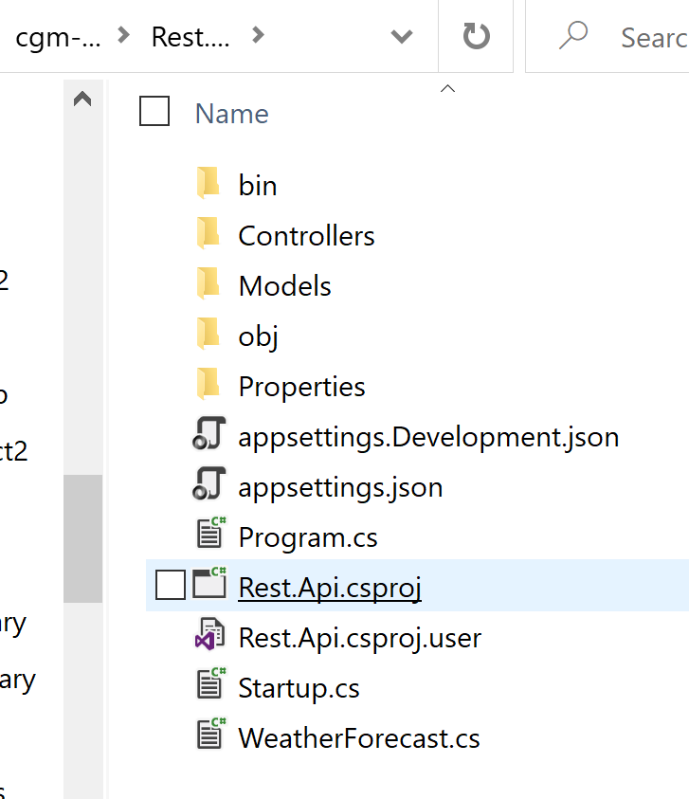
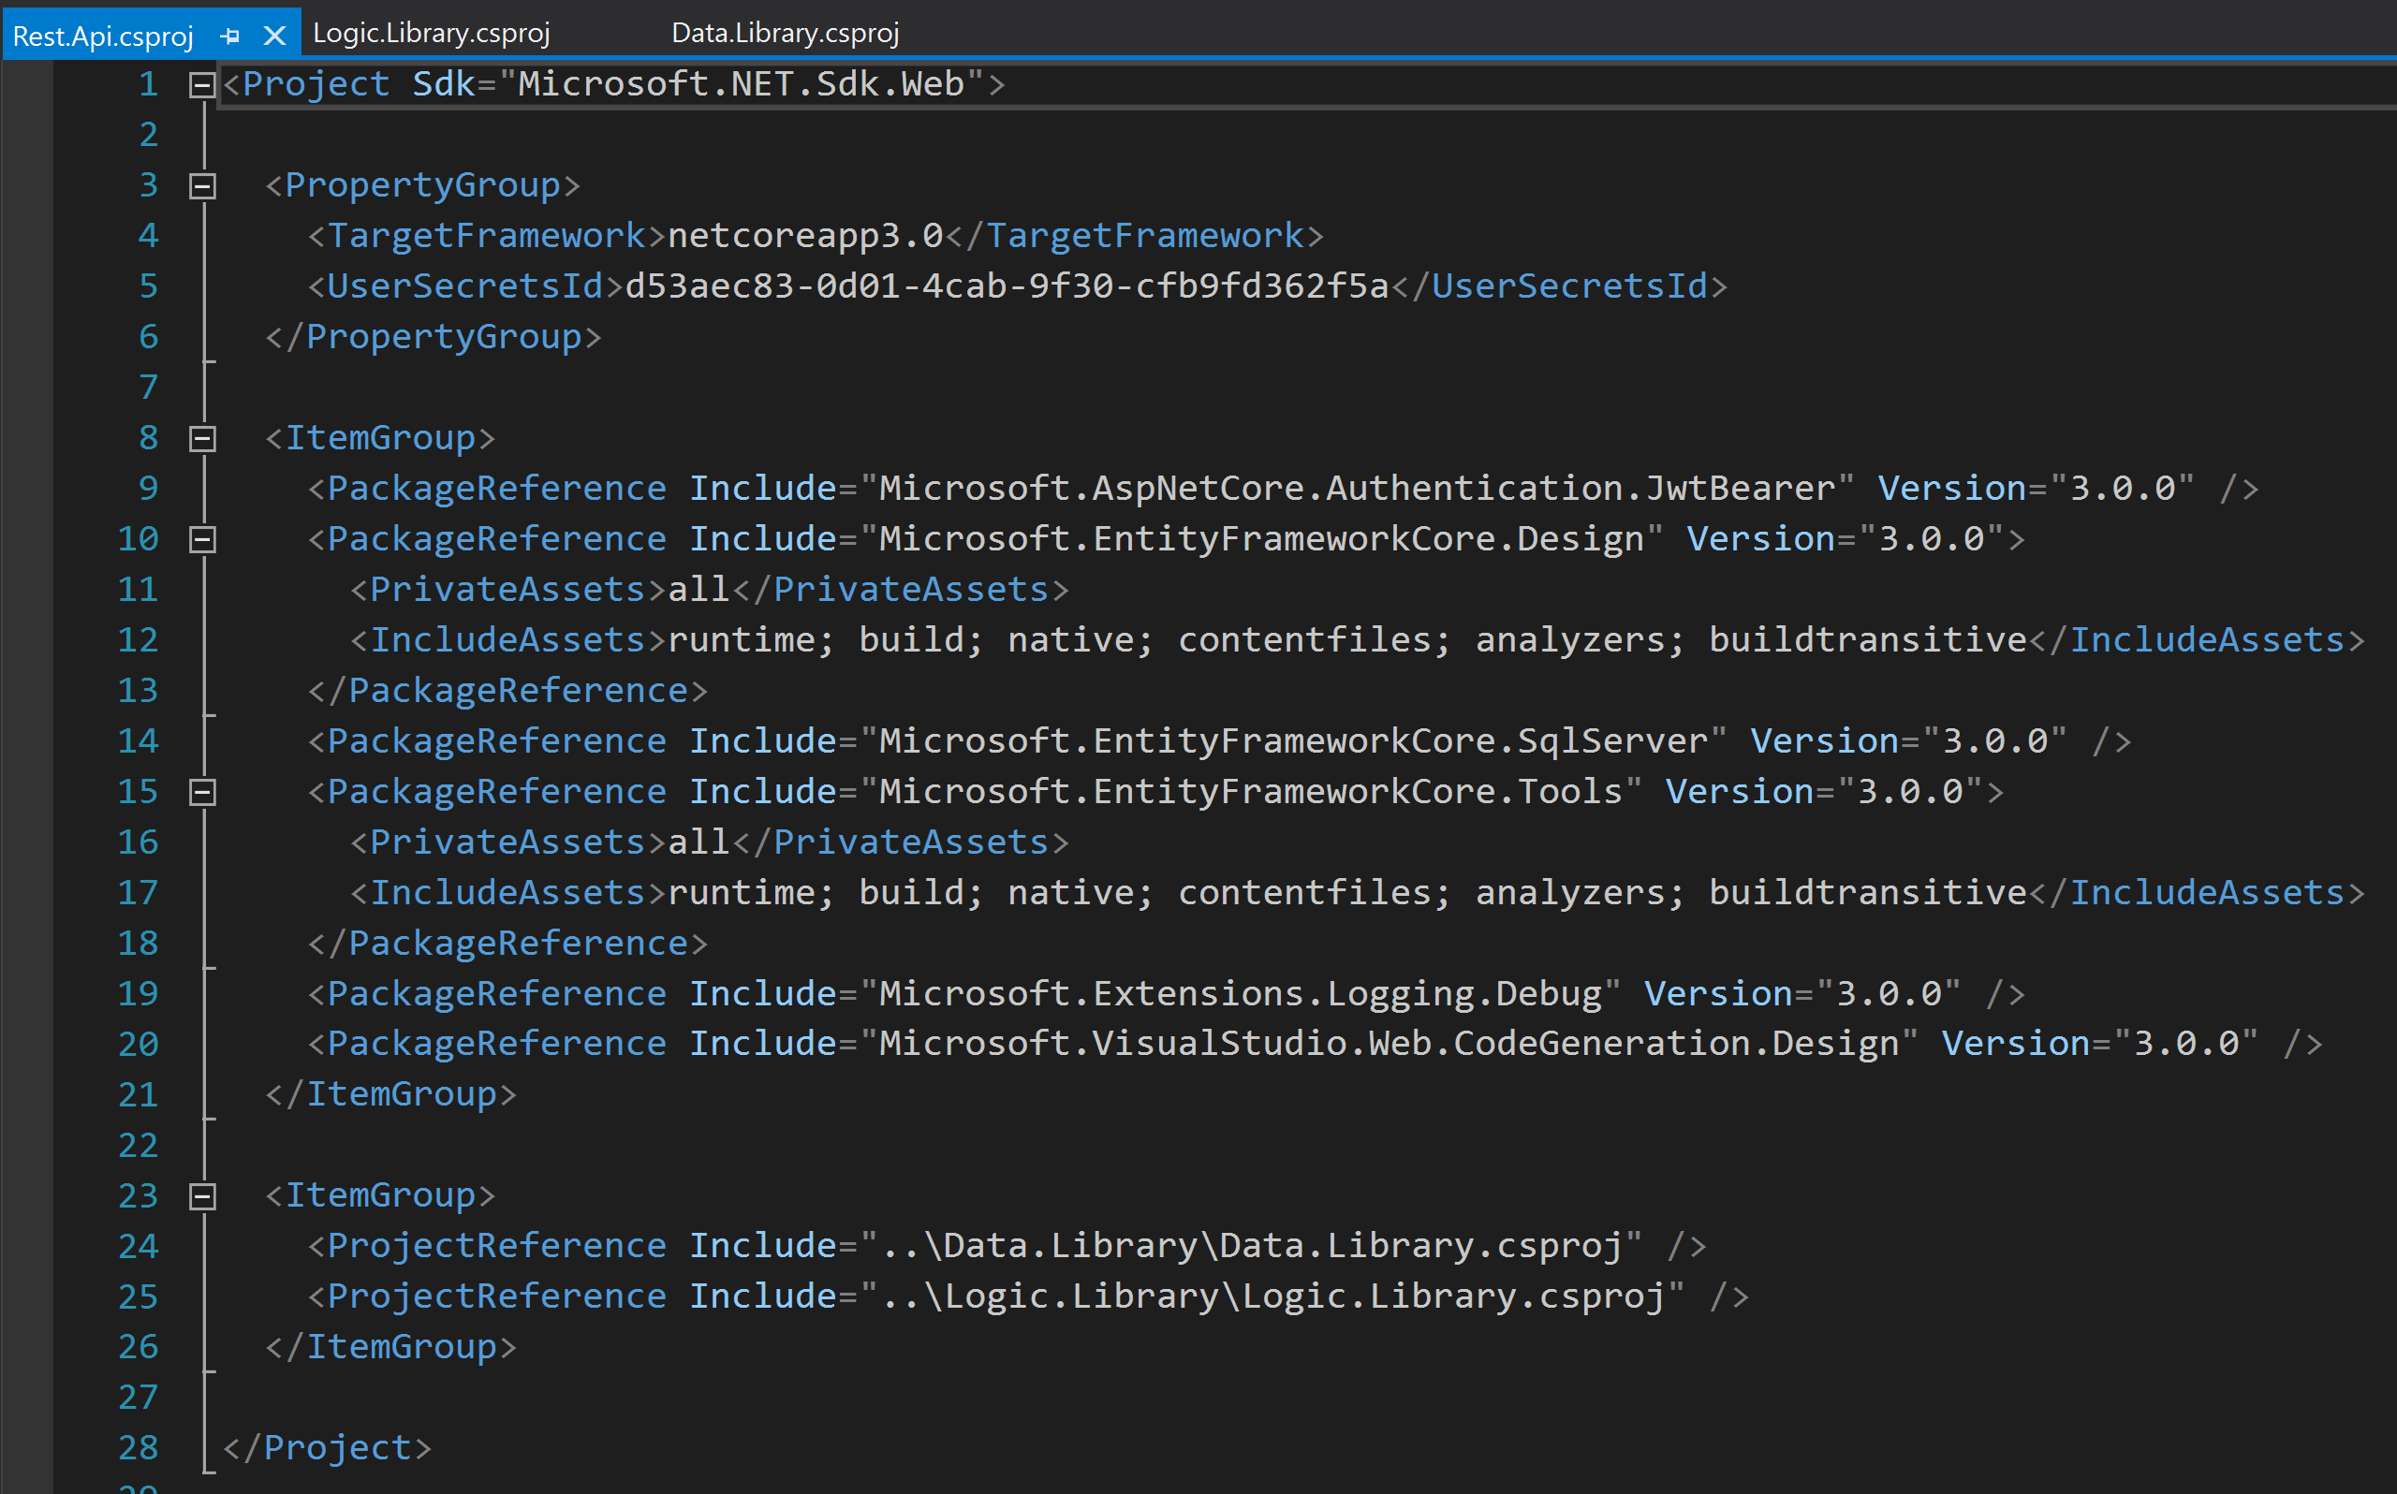
.NET Solution - Projects https://docs.microsoft.com/en-us/visualstudio/ide/solutions-and-projects-in-visual-studio?view=vs-2019 https://docs.microsoft.com/en-us/dotnet/csharp/tour-of-csharp/program-structure

Slide 6
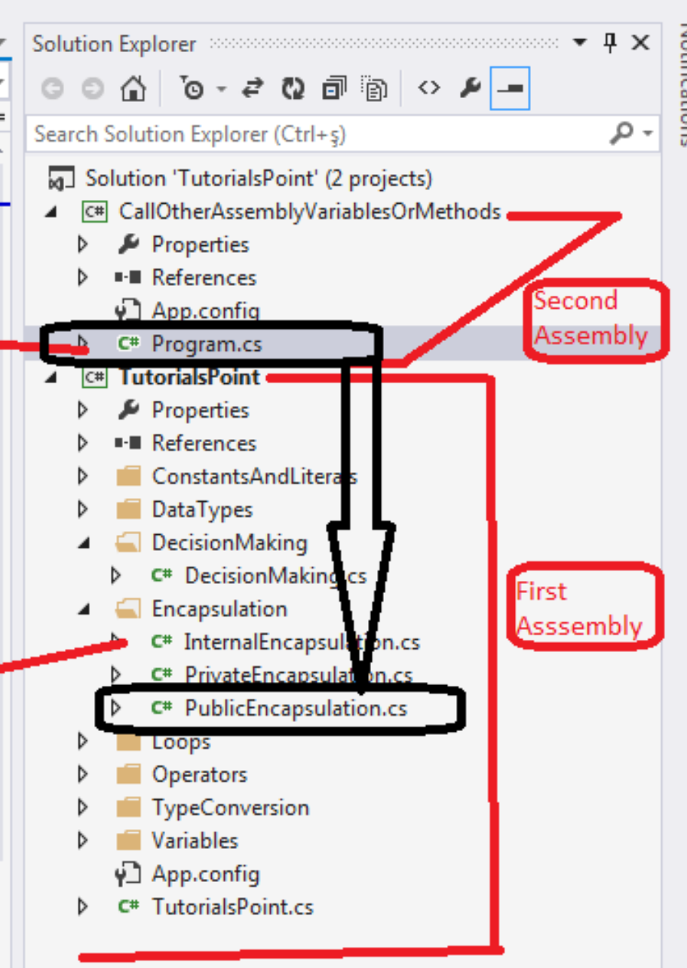
.NET Solution - Assembly https://docs.microsoft.com/en-us/dotnet/standard/assembly/
Assemblies:
form the fundamental units of deployment, version control, reuse, activation scoping, and security permissions for .NET-based applications.
is a collection of types and resources that are built to work together and form a logical unit of functionality.
take the form of executable (.exe) or dynamic link library (.dll) files.
are the building blocks of .NET applications.
provide the Common Language Runtime with the information it needs to be aware of type implementations.
In .NET Core and .NET Framework, you can build an assembly from one or more source code files. Each Projects files are compiled (combined) into one big .dll file called an Assembly.

Slide 7
.NET Solution - Assembly https://docs.microsoft.com/en-us/dotnet/standard/assembly/
An assembly is:
Code that the CLR executes. Each assembly can have only one entry point (Main).
Security boundary. An assembly is the unit at which permissions are requested and granted.
Version boundary. The assembly is the smallest versionable unit in the CLR. All types and resources in the same assembly are versioned as a unit.
Deployment unit. When an application starts, only the assemblies that the application initially calls must be present. Other assemblies are retrieved on demand.

