Slide 1

Common Language Runtime
.net / Microsoft dynamics 365

Slide 2
Common Language Runtime (CLR) is a managed execution environment that is part of Microsoft's .NET framework. CLR manages the execution of programs written in different supported languages. CLR transforms source code into a form of bytecode known as CIL (Common Intermediate Language).
https://www.techopedia.com/definition/5225/common-language-runtime-clr#:~:text=

Slide 3
CLR (Common Language Runtime) https://docs.microsoft.com/en-us/dotnet/standard/clr https://docs.microsoft.com/en-us/dotnet/framework/get-started/overview
The .NET Framework consists of the Common Language Runtime (CLR) and the .NET Framework class library.
As the foundation for .NET Framework, CLR manages/runs the code and provides services like memory management, remoting, type enforcement (through the CTS), security, etc.
These services (Compilers and tools) expose the CLR’s functionality and enable you to write code that benefits from this managed execution environment.
Benefits of CLR:
cross-language integration | cross-language exception handling | enhanced security
versioning and deployment support | a simplified model for component interaction | debugging and profiling services.

Slide 4
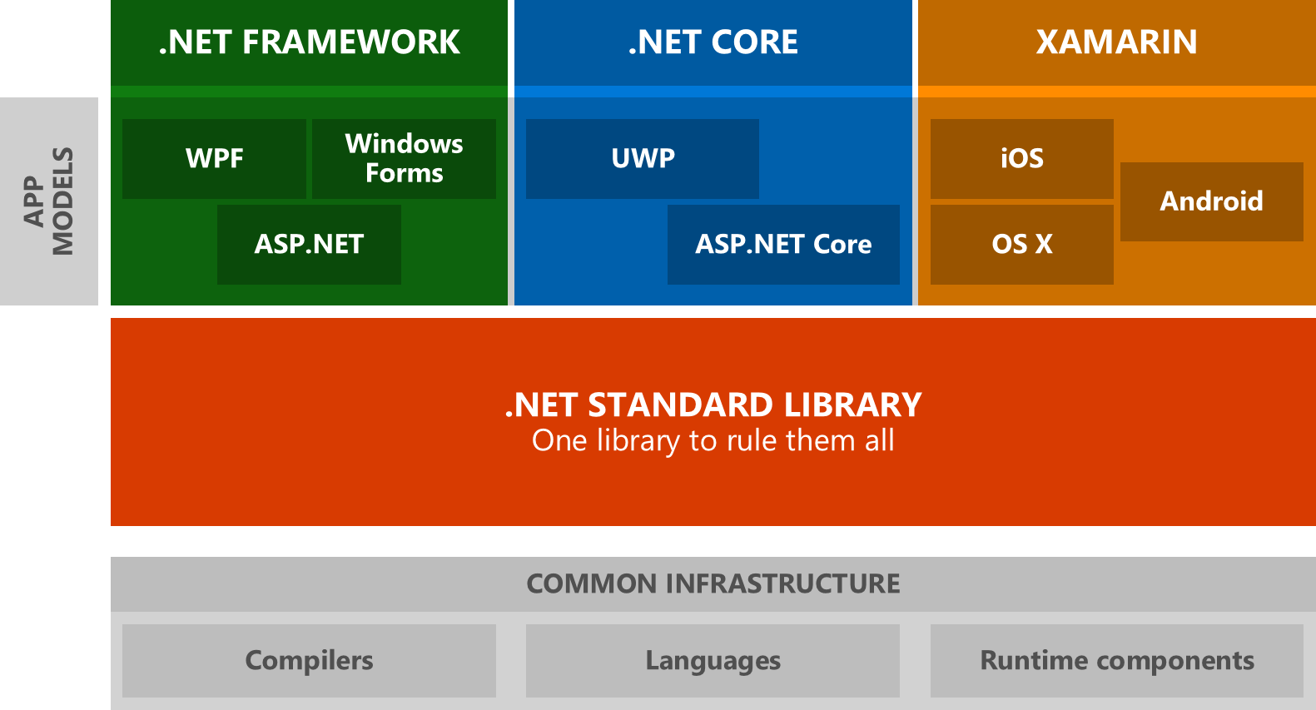

.NET Class Libraries - BCL (Base Class Library) https://docs.microsoft.com/en-us/dotnet/standard/clr
BCL stands for Base Class Library (AKA, Class library (CL)). A .NET Framework library, Base Class Library is the foundation for the C# runtime library and one of the Common Language Infrastructure (CLI) standard libraries. BCL provides types representing the built-in CLI data types, basic file access, collections, custom attributes, formatting, security attributes, I/O streams, string manipulation, etc.
Base Class Library here

Slide 5
.NET Class Libraries https://docs.microsoft.com/en-us/dotnet/framework/get-started/overview
A class library is a comprehensive, object-oriented collection of reusable types that you use to develop apps ranging from traditional command-line or graphical user interface (GUI) apps to apps based on the latest innovations provided by ASP.NET, such as Web Forms and XML Web services.
Base Class Library here

Slide 6
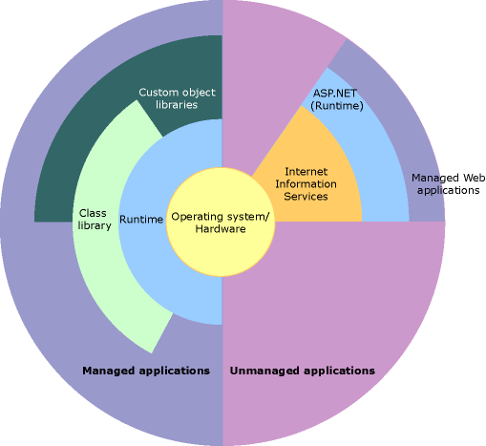
.NET CLR and Class Library Relationship https://docs.microsoft.com/en-us/dotnet/framework/get-started/overview
This illustration shows the relationship of the Common Language Runtime and the class library to your apps and to the overall system. The illustration also shows how managed code operates within a larger architecture.

Slide 7
.NET CoreFX https://docs.microsoft.com/en-us/dotnet/standard/glossary#corefx
Think of CoreFX as a fork of the .NET Framework BCL.
CoreFX is the foundational class library for .NET Core. It defines the types for primitives, collections, file systems, console, JSON, XML, async and many others.
CoreFX makes up the .NET Core Base Class Library (BCL).
Base Class Library here

Slide 8
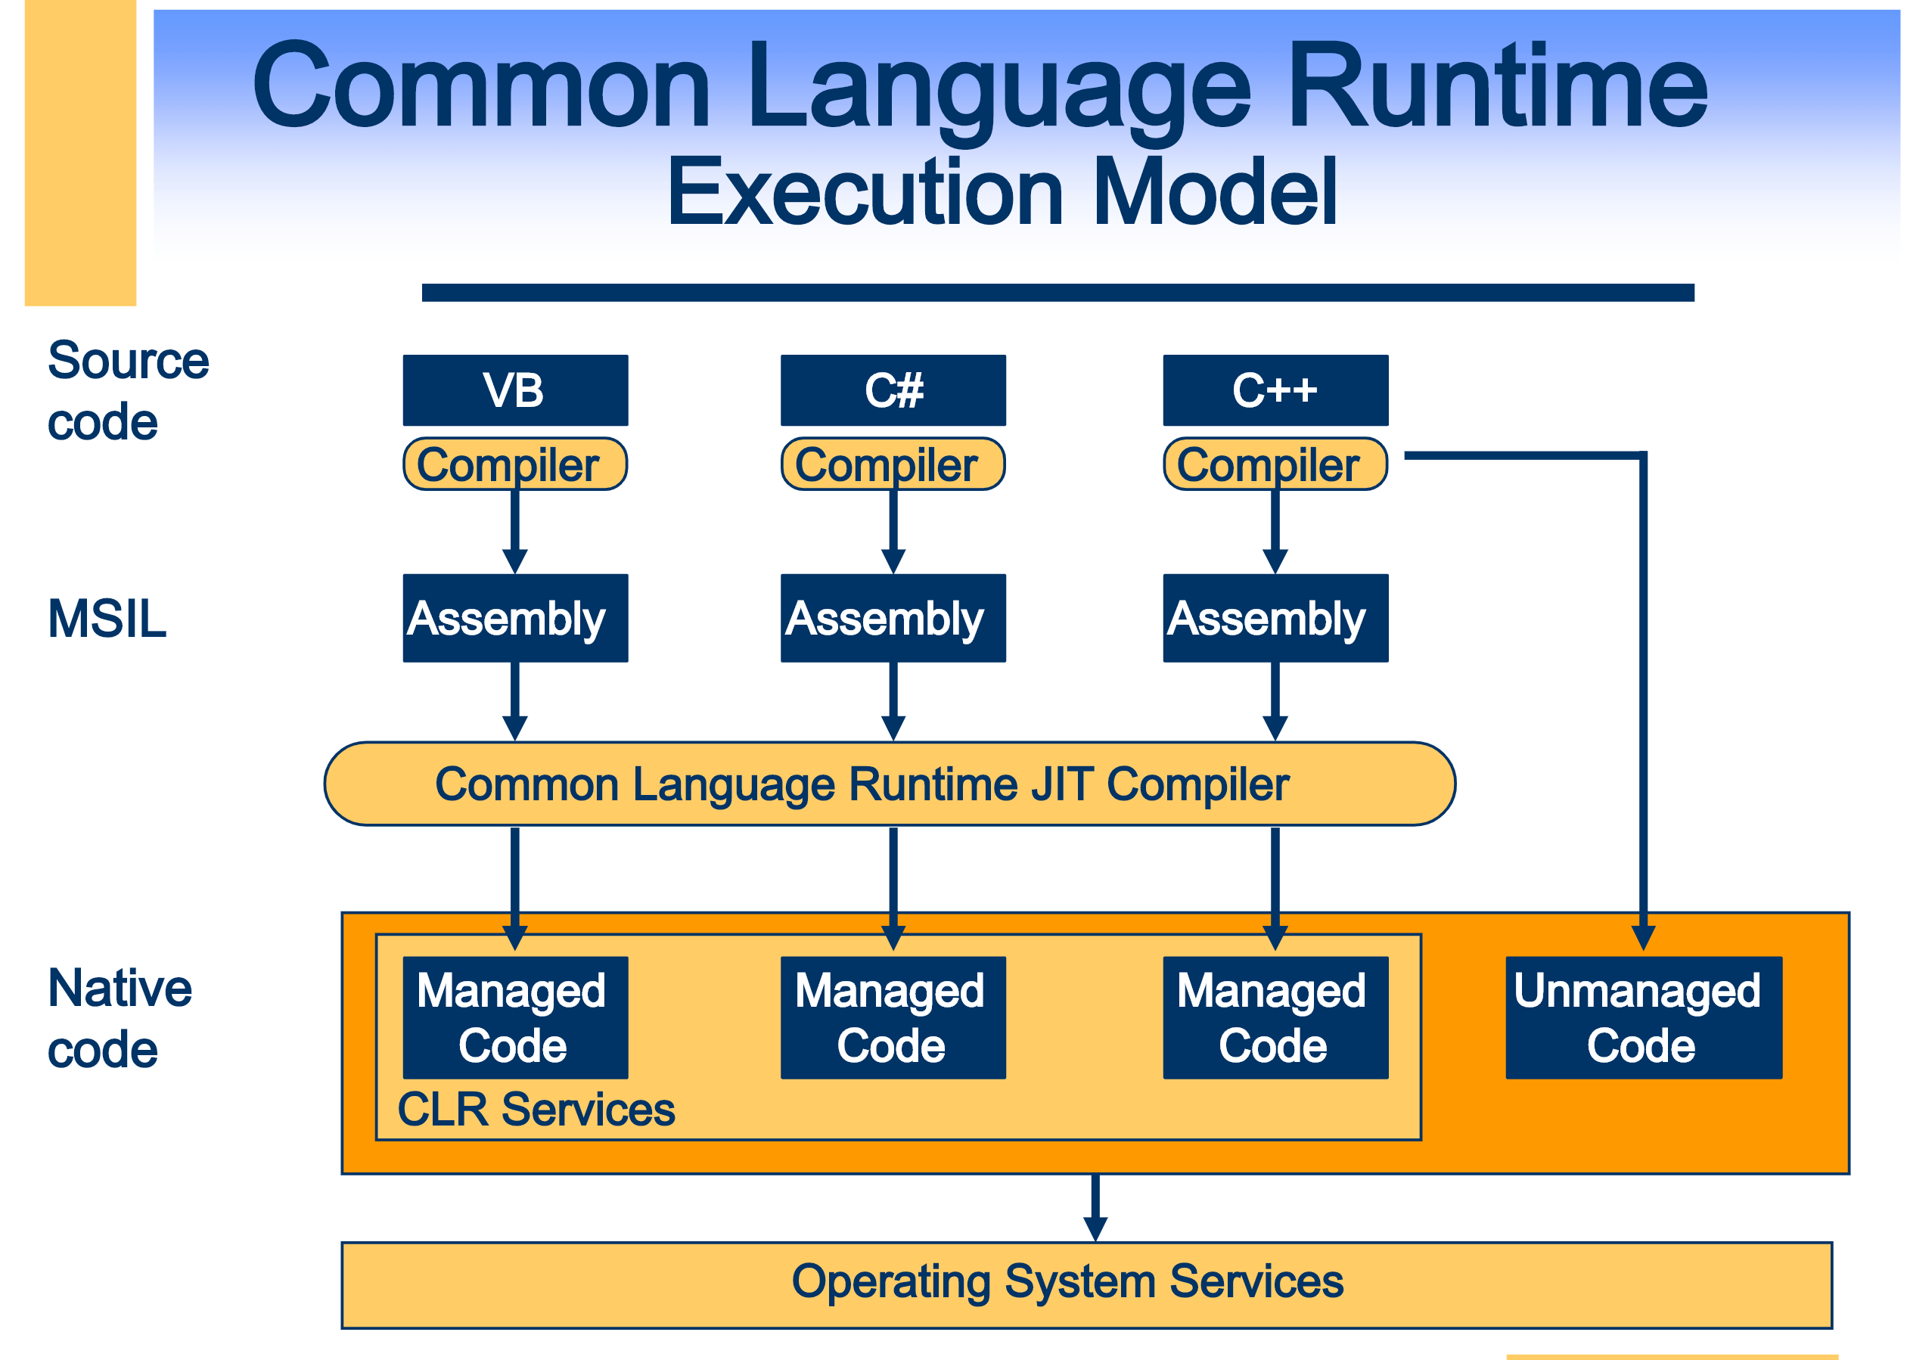
Managed Code https://docs.microsoft.com/en-us/dotnet/standard/managed-code
Managed code managed by the Common Language Runtime (CLR) at runtime.
The CLR provides memory management (GC), security boundaries, type safety, etc.
Managed code is written in a high-level language that can be run on top of .NET.
Code is compiled into Intermediate Language (IL [AKA, MISL, AKA CIL]) code, which the CLR compiles and executes.
The CLR manages the Just-In-Time compiling code from IL to machine code that can be run on a CPU.
The CLR knows what your code is doing and can manage it.

Slide 9
Unmanaged Code https://docs.microsoft.com/en-us/dotnet/framework/interop/
Code that runs outside the CLR is called Unmanaged Code.
The .NET Framework promotes interaction with COM components, COM+ services, external type libraries, and many operating system services. Data types, method signatures, and error-handling mechanisms vary between managed and unmanaged object models.
Examples of Unmanaged Code:
COM components,
ActiveX interfaces,
Windows API functions.

Slide 10
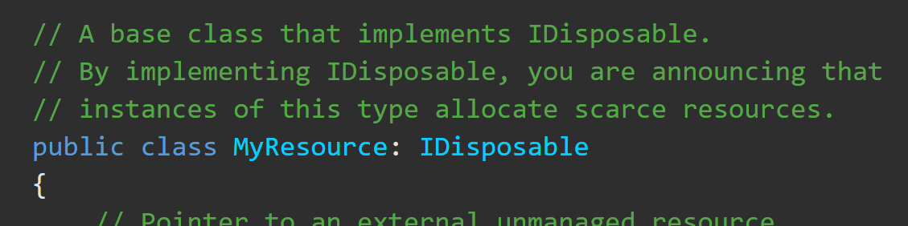
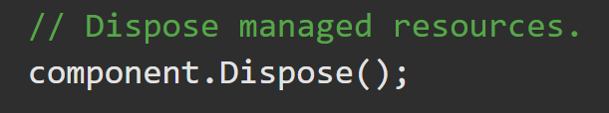
Idisposable Interface https://docs.microsoft.com/en-us/dotnet/api/system.idisposable?view=netframework-4.8
The Garbage Collector (GC) has no knowledge of unmanaged resources (window handles, or open files and streams).
Idisposable provides a method for releasing unmanaged resources.
If your app uses an object that implements the Idisposable interface, call the object’s IDisposable.Dispose implementation when finished using it.

Slide 11
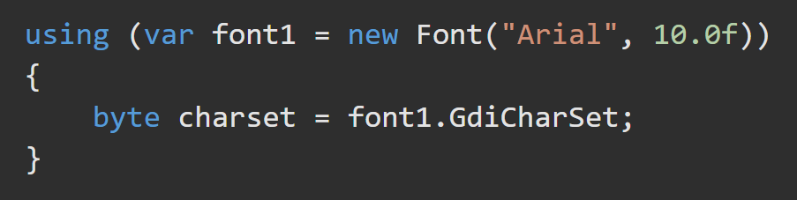
Using Block https://docs.microsoft.com/en-us/dotnet/csharp/language-reference/keywords/using-statement
Provides a convenient syntax that ensures the correct use of IDisposable objects.
When the lifetime of an IDisposable object is limited to a single method, you should declare and instantiate it in the using statement. The using statement calls the Dispose method on the object in the correct way, and (when you use it as shown earlier) it also causes the object itself to go out of scope as soon as Dispose is called. Within the using block, the object is read-only and cannot be modified or reassigned.

Slide 12
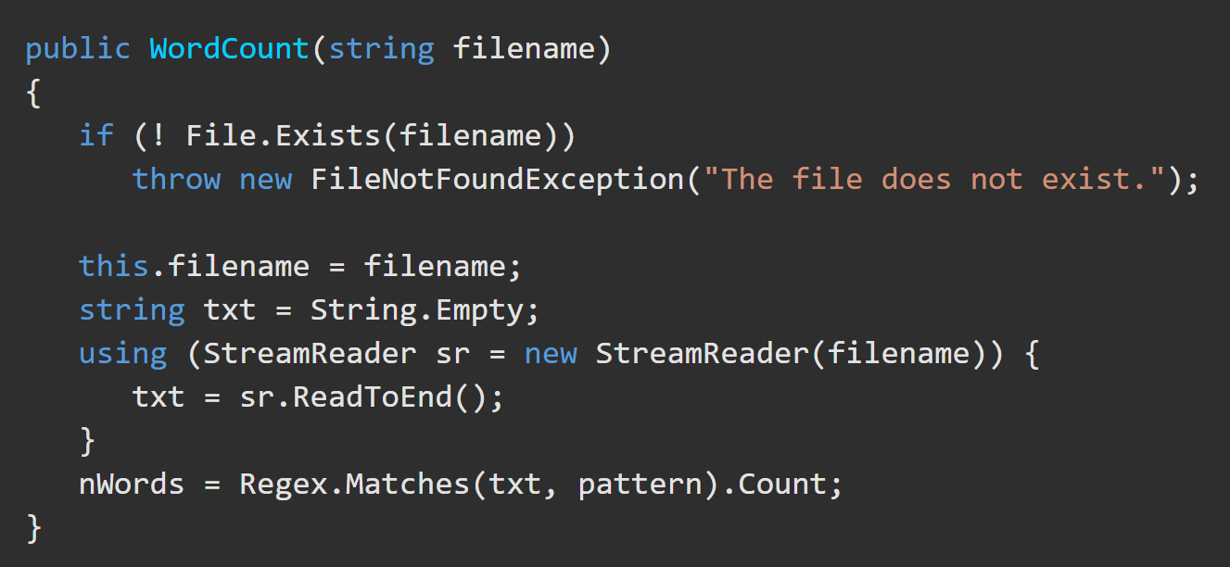
Using Block https://docs.microsoft.com/en-us/dotnet/api/system.idisposable?view=netframework-4.8
If your language supports a construct such as the using statement in C#, you can use it instead of explicitly calling IDisposable.Dispose yourself.
The using statement is a syntactic convenience. At compile time, the language compiler implements the intermediate language (IL) for a try/finally block.

Slide 13
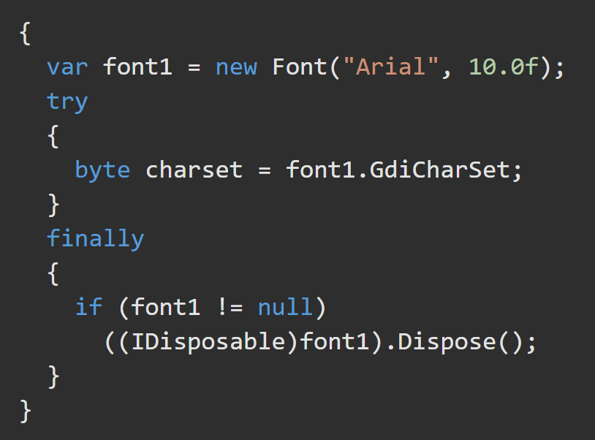
Using Block https://docs.microsoft.com/en-us/dotnet/csharp/language-reference/keywords/using-statement
The using statement ensures that .Dispose is called even if an exception occurs within the using block. You can achieve the same result by putting the object inside a try block and then calling Dispose in a finally block.
A using block is expanded to a try/catch block at compile time (note the extra curly braces to create the limited scope for the object).

