Slide 1

Source Control Management
.net / Microsoft dynamics 365

Slide 2
A component of software configuration management, version control, also known as revision control or source control, is the management of changes to documents, computer programs, large web sites, and other collections of information.
- https://en.wikipedia.org/wiki/Version_control

Slide 3
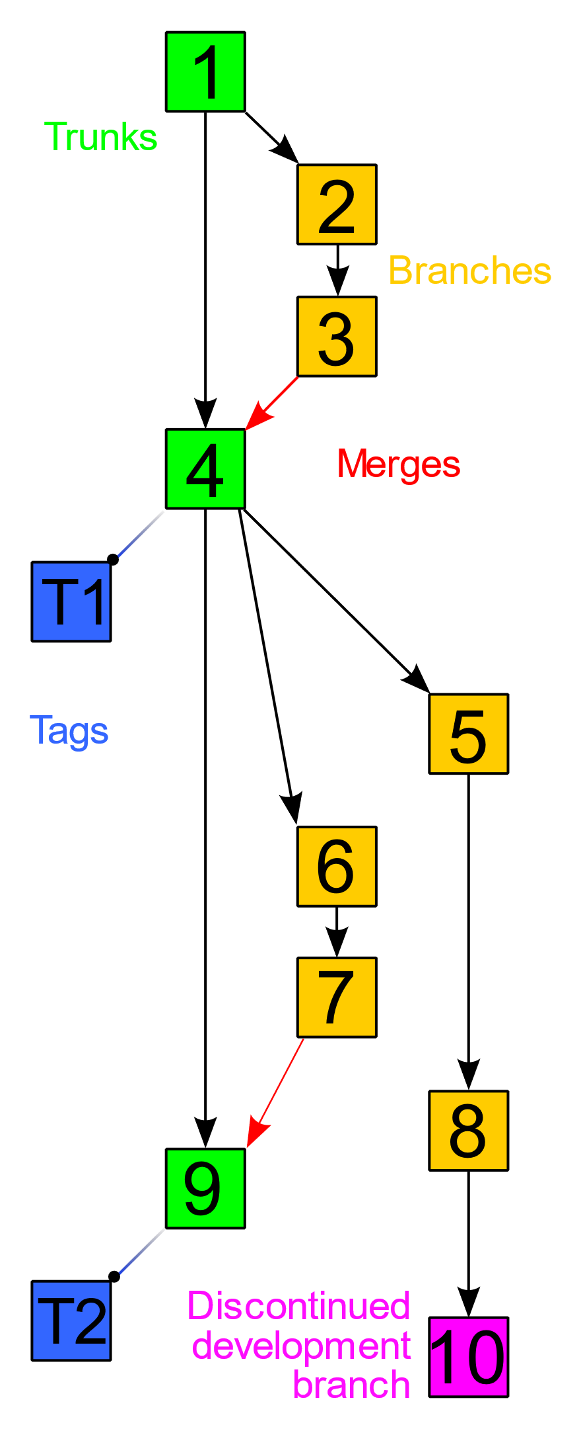
VCS (Version Control Management)
Version Control Systems (VCS) have seen great improvements over the past few decades and some are better than others. VCS are sometimes known as SCM (Source Code Management) tools or RCS (Revision Control System). One of the most popular VCS tools in use today is called Git.

Slide 4
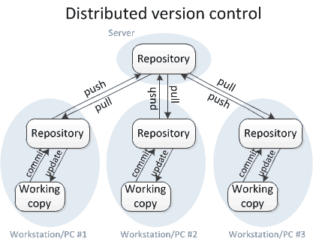
DVCS (Distributed VCS) https://www.teamstudio.com/blog/distributed-vs-centralized-version-control-systems-for-lotus-notes https://homes.cs.washington.edu/~mernst/advice/version-control.html
work on a peer-to-peer model.
the code base is distributed amongst the individual developers’ computers.
the entire history of the code is mirrored on each system.
There is still a master copy of the code base kept on a client machine rather than a server.
There are no locking of parts of the code;
developers make changes in their local copy. When they’re ready to integrate their changes into the master copy, they issue a request to the owner of the master copy to merge their changes into the master copy.

Slide 5
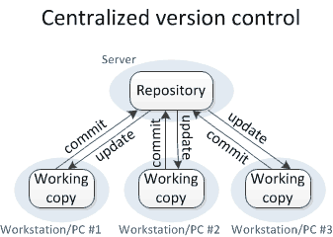
CVCS (Centralized Version Control System) https://www.teamstudio.com/blog/distributed-vs-centralized-version-control-systems-for-lotus-notes https://homes.cs.washington.edu/~mernst/advice/version-control.html
A centralized version control system works on a client-server model. There is a single, (centralized) master copy of the code base, and pieces of the code that are being worked on are typically locked, (or “checked out”) so that only one developer is allowed to work on that part of the code at any one time. Access to the code base and the locking is controlled by the server. When the developer checks their code back in, the lock is released so it’s available for others to check out.

Slide 6
Create a Github Repo(sitory)
Create a github account.
Give Mark your Github username.
Accept the invitation he sends.
In Terminal, Clone your repo to your chosen location. (right-click gitBash here) “git clone url”
In Terminal, ‘git checkout testBranch1’
Create a .txt file inside the repo.
Write a sentence in the .txt file.
Save the file inside your repo.
In Terminal, navigate to the repo.
In Terminal, git add . (to add all changes)
In Terminal, git commit –m “message here” (to commit all changes)
In Terminal, git push (to push all changes to your repo)

Slide 7
Simple (NO-CONFLICTS) Github Workflow

