Slide 1

Serialization
.net / Microsoft dynamics 365

Slide 2
Serialization is the process of converting an object into a stream of bytes to store an object, a database, or file. Serialization saves the state of an object to be able to recreate it later. The reverse process is called deserialization.
https://docs.microsoft.com/en-us/dotnet/csharp/programming-guide/concepts/serialization/

Slide 3
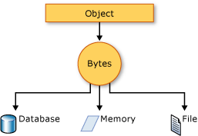
Serialization – Uses https://docs.microsoft.com/en-us/dotnet/csharp/programming-guide/concepts/serialization/#uses-for-serialization
Serialization allows you to save/recreate the state of an object, providing storage of objects as well as data exchange.
Sending the object to a remote application by using a web service
Passing an object from one domain to another
Passing an object through a firewall as a JSON or XML string
Maintaining security or user-specific information across applications

Slide 4

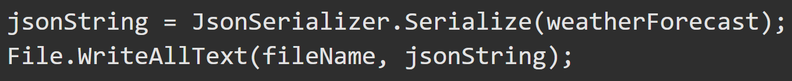
JSON - JavaScript Object Notation https://docs.microsoft.com/en-us/dotnet/csharp/programming-guide/concepts/serialization/#json-serialization https://docs.microsoft.com/en-us/dotnet/standard/serialization/system-text-json-how-to
The System.Text.Json namespace contains classes for JSON serialization and deserialization. JSON is an open standard that is increasingly used for sharing data across the web.
JSON serialization serializes the public properties of an object into a string, byte array, or stream that conforms to the RFC 8259 JSON specification. To control the way JsonSerializer serializes or deserializes an instance of the class:
Use a JsonSerializerOptions object
Apply attributes from the System.Text.Json.Serialization namespace to classes or properties
Implement custom converters

Slide 5
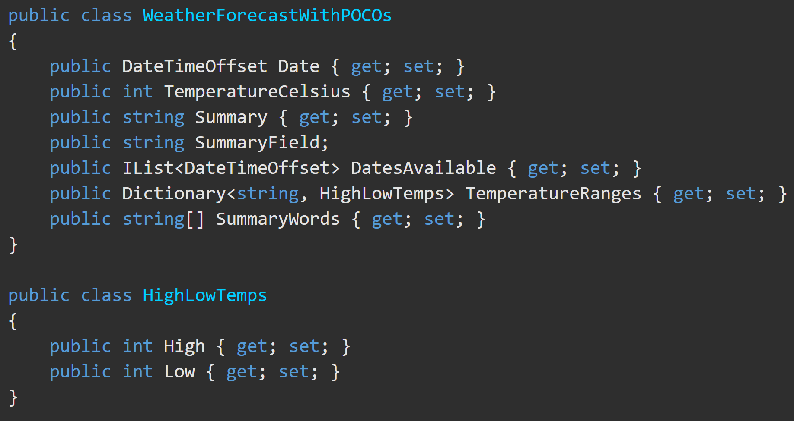
JSON - JavaScript Object Notation https://docs.microsoft.com/en-us/dotnet/csharp/programming-guide/concepts/serialization/#json-serialization https://docs.microsoft.com/en-us/dotnet/standard/serialization/system-text-json-how-to
The JSON output from serializing an instance of this this class looks like this.
The JSON output is minified by default:

Slide 6
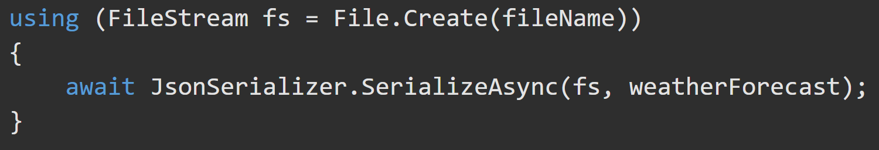
Async JSON - JavaScript Object Notation https://docs.microsoft.com/en-us/dotnet/csharp/programming-guide/concepts/serialization/#json-serialization https://docs.microsoft.com/en-us/dotnet/standard/serialization/system-text-json-how-to
asynchronous code to create a JSON file

Slide 7
JSON - JavaScript Object Notation https://docs.microsoft.com/en-us/dotnet/csharp/programming-guide/concepts/serialization/#json-serialization
All public properties are serialized. You can specify properties to exclude.
The default encoder escapes non-ASCII characters, HTML-sensitive characters within the ASCII-range, and characters that must be escaped according to the RFC 8259 JSON spec.
JSON is minified. You can pretty-print the JSON.
Casing of JSON names matches the .NET names. You can customize JSON name casing.
Circular references are detected and exceptions thrown.
Fields are excluded.

Slide 8
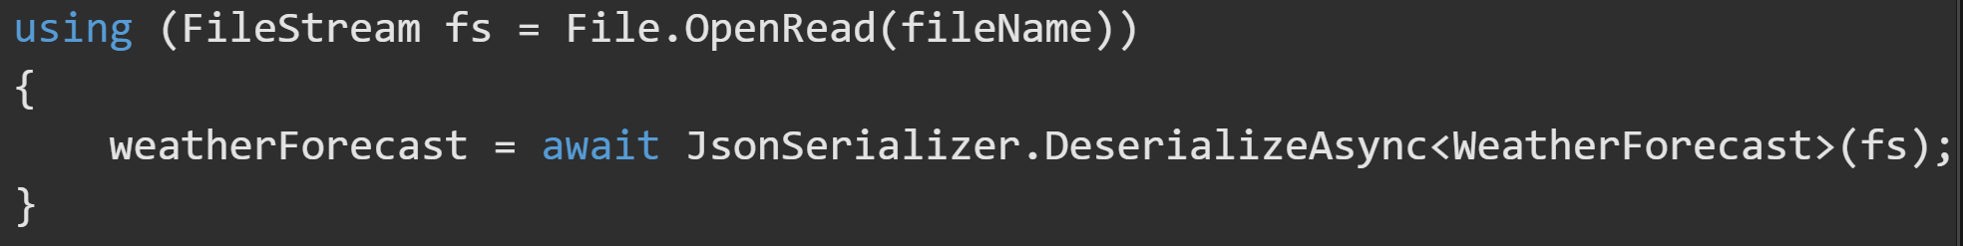
JSON – Deserialization https://docs.microsoft.com/en-us/dotnet/standard/serialization/system-text-json-how-to
Read JSON from a string and create an instance of the WeatherForecast class.
Deserialize from a file by using synchronous code. Read the file into a string.
To deserialize from a file by using asynchronous code. Call the DeserializeAsync method.

Slide 9
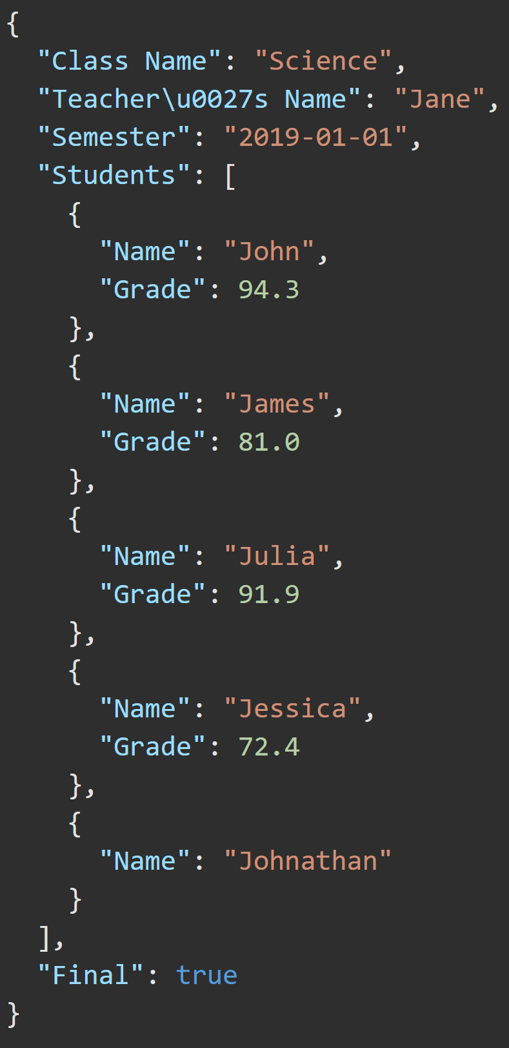
JSON – Deserialization Behavior https://docs.microsoft.com/en-us/dotnet/standard/serialization/system-text-json-how-to#deserialization-behavior
By default, property name matching is case-sensitive. You can specify case-insensitivity.
read-only properties are ignored. No exception is thrown.
Deserialization to reference types without a parameterless constructor isn't supported.
Deserialization to immutable objects or read-only properties isn't supported.
By default, enums are supported as numbers. You can serialize enum names as strings.
Fields aren't supported.
Comments or trailing commas in the JSON throw exceptions. You can allow comments and trailing commas.
The default maximum depth is 64.
Learn to “Pretty-Print” your JSON → → → → → → → → → → → →

Slide 10
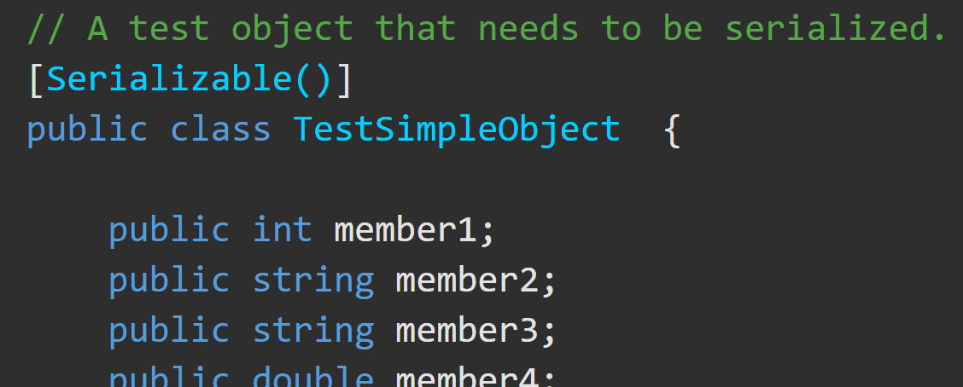
XML Serialization https://docs.microsoft.com/en-us/dotnet/csharp/programming-guide/concepts/serialization/#binary-and-xml-serialization
XML serialization serializes the public fields and properties of an object (or the parameters and return values of methods) into an XML stream that conforms to a specific XML Schema definition language (XSD) document.
System.Xml.Serialization contains classes for serializing and deserializing XML. You apply attributes to classes and class members to control the way the XmlSerializer serializes or deserializes.
For XML serialization, you need:
Apply the SerializableAttribute attribute to the type
to avoid an exception.
The object to be serialized
A stream to contain the serialized object
A System.Runtime.Serialization.Formatter instance

Slide 11
XML Serialization https://docs.microsoft.com/en-us/dotnet/csharp/programming-guide/concepts/serialization/#binary-and-xml-serialization
Apply the SerializableAttribute attribute even if the class also implements the ISerializable interface.
When SerializableAttribute attribute is applied, all private and public fields are serialized.
You can control serialization by implementing the ISerializable interface to override the serialization process.
Exclude fields from serialization by applying NonSerializedAttribute to the field.
If a field of a serializable type contains a data structure that cannot be reconstituted in a different environment, apply the NonSerializedAttribute attribute to that field.

Slide 12
Modifiers – Async https://docs.microsoft.com/en-us/dotnet/csharp/language-reference/keywords/async
Use the async modifier to specify that a method, lambda expression, or anonymous method is asynchronous. If you use this modifier on a method or expression, it's referred to as an async method.
An async method uses the await operator to do potentially long-running work without blocking the caller’s thread
An async method runs synchronously until it reaches its first await expression, at which point the method is suspended until the awaited task is complete. In the meantime, control returns to the caller of the method, as the example in the next section shows.
The async keyword is contextual in that it's a keyword only when it modifies a method, a lambda expression, or an anonymous method. In all other contexts, it's interpreted as an identifier.
The async method can't declare any in, ref or out parameters, nor can it have a reference return value, but it can call methods that have such parameters.

Slide 13
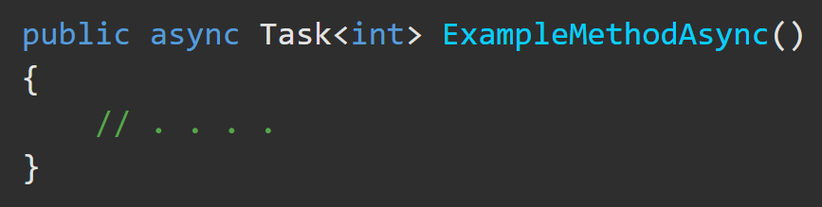
Modifiers – Async https://docs.microsoft.com/en-us/dotnet/csharp/language-reference/keywords/async
An async method can have only the following return types:
Task
Task<TResult>
void async void methods are generally discouraged.
The async method can't declare any in, ref or out parameters, nor can it have a reference return value, but it can call methods that have such parameters.

Slide 14
Modifiers – Async (in action) https://docs.microsoft.com/en-us/dotnet/csharp/programming-guide/concepts/async/
WiP

