Slide 1

Casting and Type Conversion
.net / Microsoft dynamics 365

Slide 2
C# is statically-typed at compile time.
After a variable is declared, it cannot be declared again or assigned a value of another type unless that type is implicitly convertible to the variable's type.
What if you need to copy a value into a variable or method parameter of another type? What if you have an integer variable that you need to pass to a method whose parameter is typed as double? What if you need to assign a class variable to a variable of an interface type?
These operations are called type conversions.
https://docs.microsoft.com/en-us/dotnet/csharp/programming-guide/types/casting-and-type-conversions

Slide 3
Casting and Type Conversion https://docs.microsoft.com/en-us/dotnet/csharp/programming-guide/types/casting-and-type-conversions
There are 2 types of conversions in C#:
Implicit conversions: No special syntax required, is type safe, no data loss.
Explicit conversions (casts): Explicit conversions require the cast operator (). Required when data might be lost in the conversion, or when failure could occur.

Slide 4
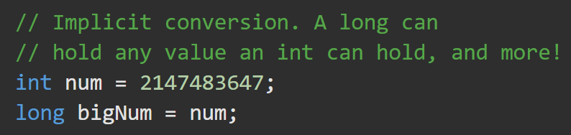

Implicit Conversion https://docs.microsoft.com/en-us/dotnet/csharp/programming-guide/types/casting-and-type-conversions#implicit-conversions
numeric types
when the value to be stored can fit into the variable memory without being truncated.
integral types
The range of the source type is at least as big as the target type.
reference types
an implicit conversion always exists from a class to any one of its direct or indirect base classes or interfaces. No special syntax is necessary. Derived classes always contains all the members of a base class.

Slide 5
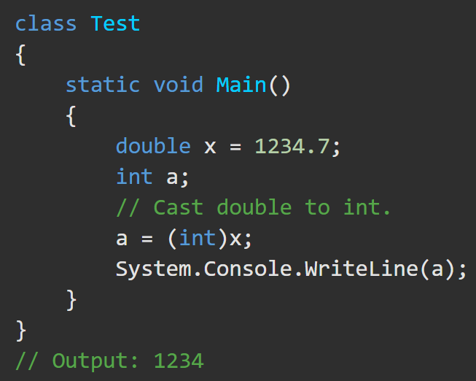
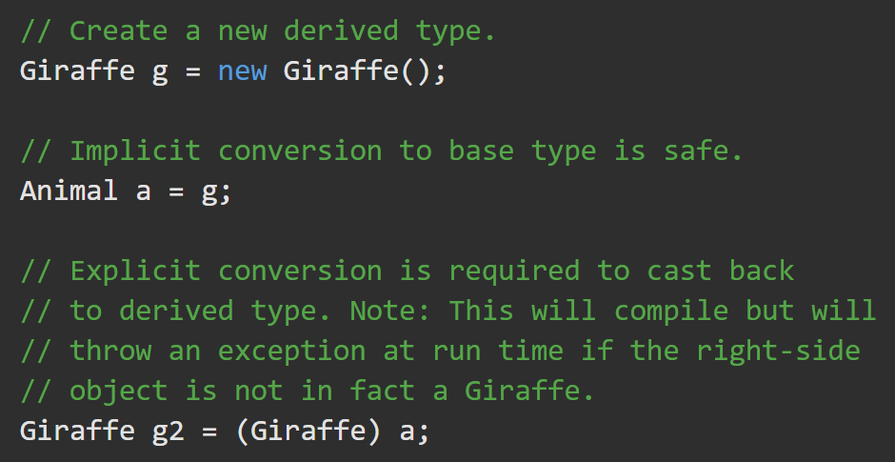
Explicit Conversion https://docs.microsoft.com/en-us/dotnet/csharp/programming-guide/types/casting-and-type-conversions#explicit-conversions
If there is a risk of losing information, you must perform a Cast. Specify the type that you are casting to in ( ) in front of the value or variable to be converted.
*This doesn’t prevent the loss of data.
An explicit cast is required if you need to convert from a base type to a derived type.

Slide 6
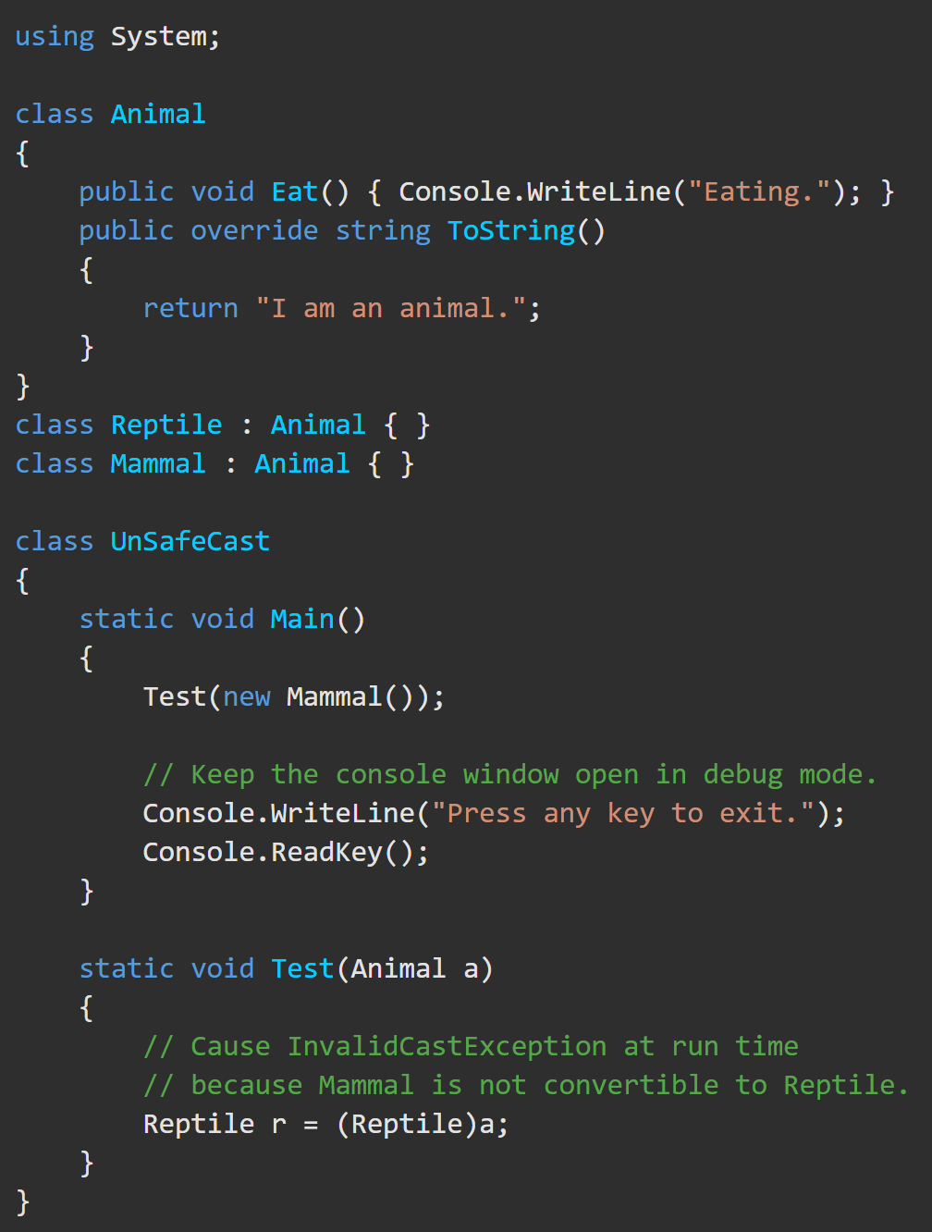
Type conversion exceptions at run time https://docs.microsoft.com/en-us/dotnet/csharp/programming-guide/types/casting-and-type-conversions#type-conversion-exceptions-at-run-time
In some reference type conversions, It is possible for a cast operation that compiles correctly to fail at run time.
A type cast that fails at run time will cause an InvalidCastException to be thrown.
*The is operator enables you to test for compatibility before performing a cast.

Slide 7
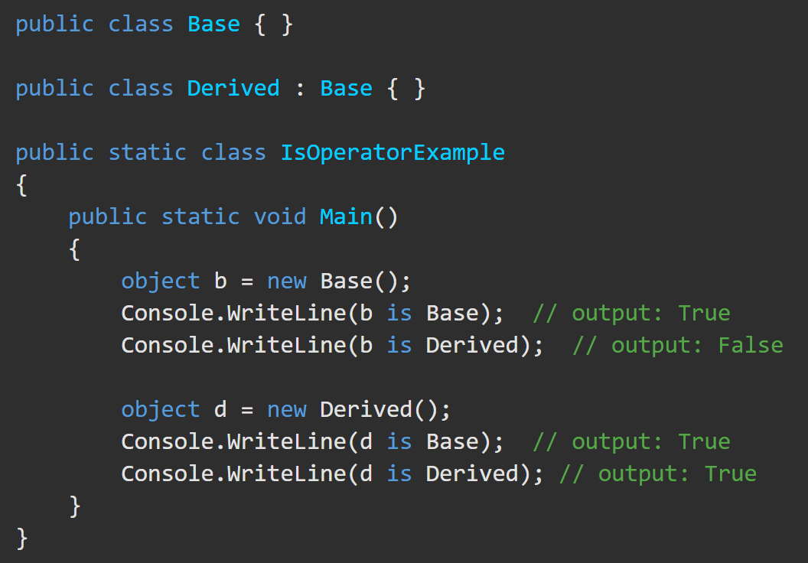

Type-testing and cast operators – ‘is’ operator https://docs.microsoft.com/en-us/dotnet/csharp/language-reference/operators/type-testing-and-cast#typeof-operator
The is operator checks if the runtime type of an expression result is compatible with a given type.
returns true if E is non-null and can be converted to type T by a reference conversion, a boxing conversion, or an unboxing conversion.

Slide 8
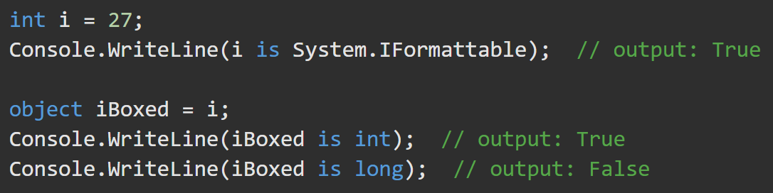
Type-testing and cast operators – ‘is’ operator https://docs.microsoft.com/en-us/dotnet/csharp/language-reference/operators/type-testing-and-cast#typeof-operator
The is operator takes into account boxing and unboxing conversions but doesn't consider numeric conversions:

Slide 9


Type-testing and cast operators – ‘as’ operator https://docs.microsoft.com/en-us/dotnet/csharp/language-reference/operators/type-testing-and-cast#as-operator
The as operator explicitly converts the result of an expression to a given reference or nullable value type. If the conversion is not possible, the as operator returns null. Unlike the cast operator (), the as operator never throws an exception.
produces the same result as
The as operator considers only reference, nullable, boxing, and unboxing conversions.
You cannot use the as operator to perform a user-defined conversion. To do that, use the cast operator ().

Slide 10
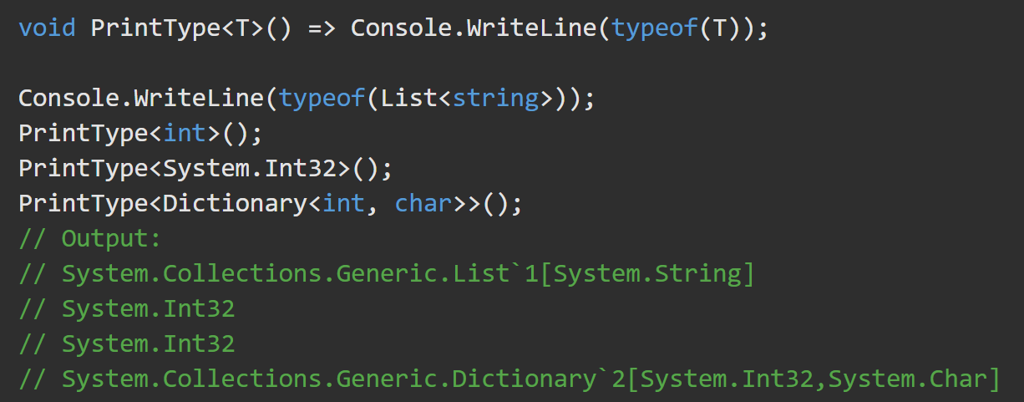
typeof https://docs.microsoft.com/en-us/dotnet/csharp/language-reference/operators/type-testing-and-cast#typeof-operator
The typeof operator obtains the System.Type instance type. The argument to the typeof operator must be the name of a type or a type parameter. *
Watch for this in XML Serialization.

Slide 11
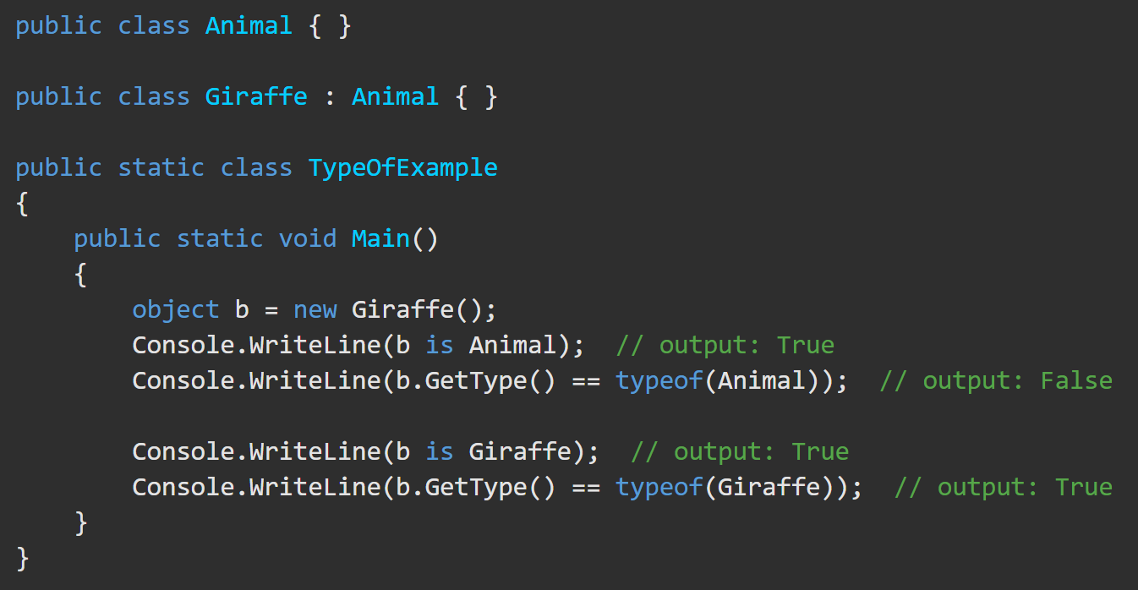
typeof Operator https://docs.microsoft.com/en-us/dotnet/csharp/language-reference/operators/type-testing-and-cast#typeof-operator
An expression cannot be an argument of the typeof operator. To get the System.Type instance for the runtime type of an expression result, use the Object.GetType method.
Use the typeof operator to check if the runtime type of the expression result exactly matches a given type.
This example demonstrates the difference between type checking performed with the typeof operator and the is operator.

