Slide 1

LINQ (Language-Integrated Query)
.net

Slide 2
Language-Integrated Query (LINQ) is the name for a set of technologies based on the integration of query capabilities directly into the C# language.
https://docs.microsoft.com/en-us/dotnet/csharp/linq/

Slide 3
LINQ - Overview https://docs.microsoft.com/en-us/dotnet/csharp/linq/ https://docs.microsoft.com/en-us/dotnet/csharp/programming-guide/concepts/linq/
Traditionally, queries against data (in a DB or file) have been expressed as simple strings without type checking at compile time or IntelliSense support!
You’d have to learn a different query language for each type of data source:
SQL databases,
XML documents,
various Web services, etc.
With LINQ, a query is a language construct, just like classes, methods, events.
Query expressions are written in a declarative query syntax.
You can perform filtering, ordering, and grouping operations on data sources with minimum code.
You use the same basic query expression patterns to query and transform data in SQL databases, ADO .NET Datasets, XML documents and streams, and .NET collections.

Slide 4
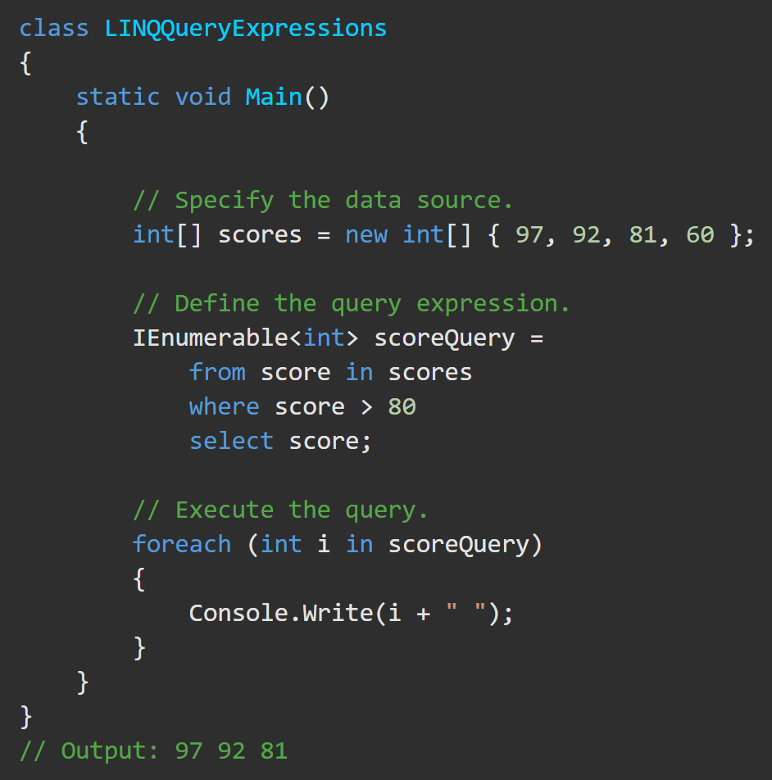
LINQ - Overview https://docs.microsoft.com/en-us/dotnet/csharp/linq/
A complete LINQ query operation includes
creating a data source,
defining the query expression, and
executing the query in a foreach statement.

Slide 5
LINQ – Query Expression Basics
A query expression is a query expressed in query syntax. A query is a set of instructions that describes what data to retrieve from a given data source (or sources) and what shape and organization the returned data should have.
Generally, the source data is organized logically as a sequence of elements of the same kind. For example:
a SQL database table contains a sequence of rows.
In an XML file, there is a "sequence" of XML elements
An ‘in-memory’ collection contains a sequence of objects.
A query expression must begin with a from clause and must end with a select or group clause. Between the first from clause and the last select or group clause, it can contain one or more of: where, orderby, join, let and even more from clauses. You can also use the into keyword to enable the result of a join or group clause to serve as the source for additional query clauses in the same query expression.
From an application's viewpoint, the specific type and structure of the original source data is not important. The application always sees the source data as an IEnumerable<T> or IQueryable<T> collection.

Slide 6
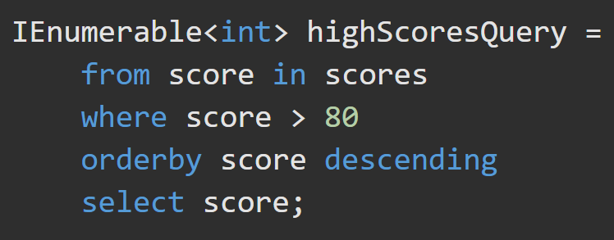
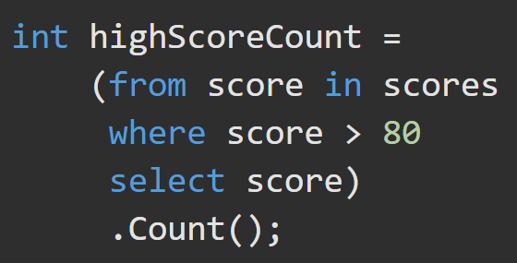
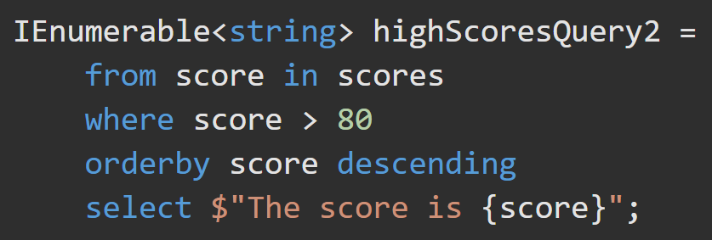
LINQ – Query Expression Examples https://docs.microsoft.com/en-us/dotnet/csharp/linq/query-expression-basics https://docs.microsoft.com/en-us/dotnet/csharp/linq/query-expression-basics#what-is-a-query-expression
A query can:
1. Retrieve a subset of the elements to produce a new sequence without modifying the individual elements. The query may then sort or group the returned sequence in various ways
2. Retrieve a sequence of elements but transform them to a new type of object.
Retrieve a singleton value about the source data, such as:
The number of elements that match a certain condition.
The element that has the greatest or least value.
The first element that matches a condition, or the sum of particular values in a specified set of elements.

Slide 7
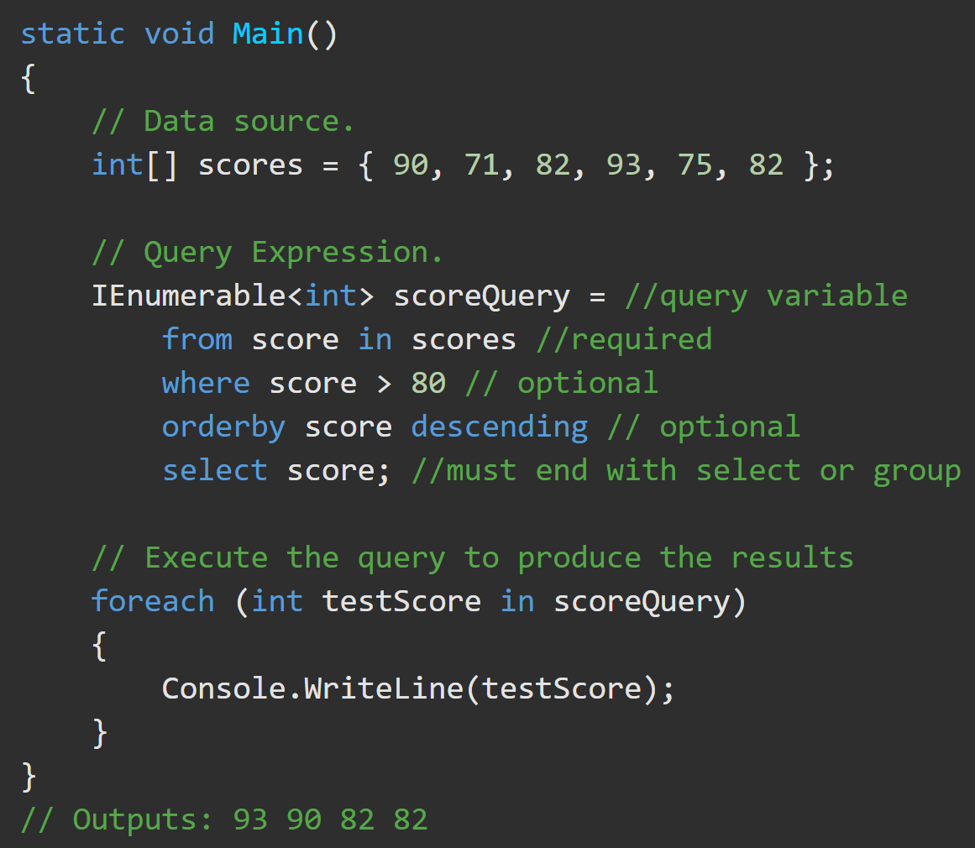
LING – Query Variables https://docs.microsoft.com/en-us/dotnet/csharp/linq/query-expression-basics#query-variable
A query variable is any variable that stores a query instead of the result of a query. More specifically, a query variable is always an enumerable type that will produce a sequence of elements when it is iterated over in a foreach statement or a direct call to its IEnumerator.MoveNext method.

Slide 8
LINQ – Additional Practice
Starting a query expression Ending a query expression
select clause Continuations with "into“
Filtering, ordering, and joining where clause
orderby clause join clause
let clause Subqueries in a query expression

Slide 9
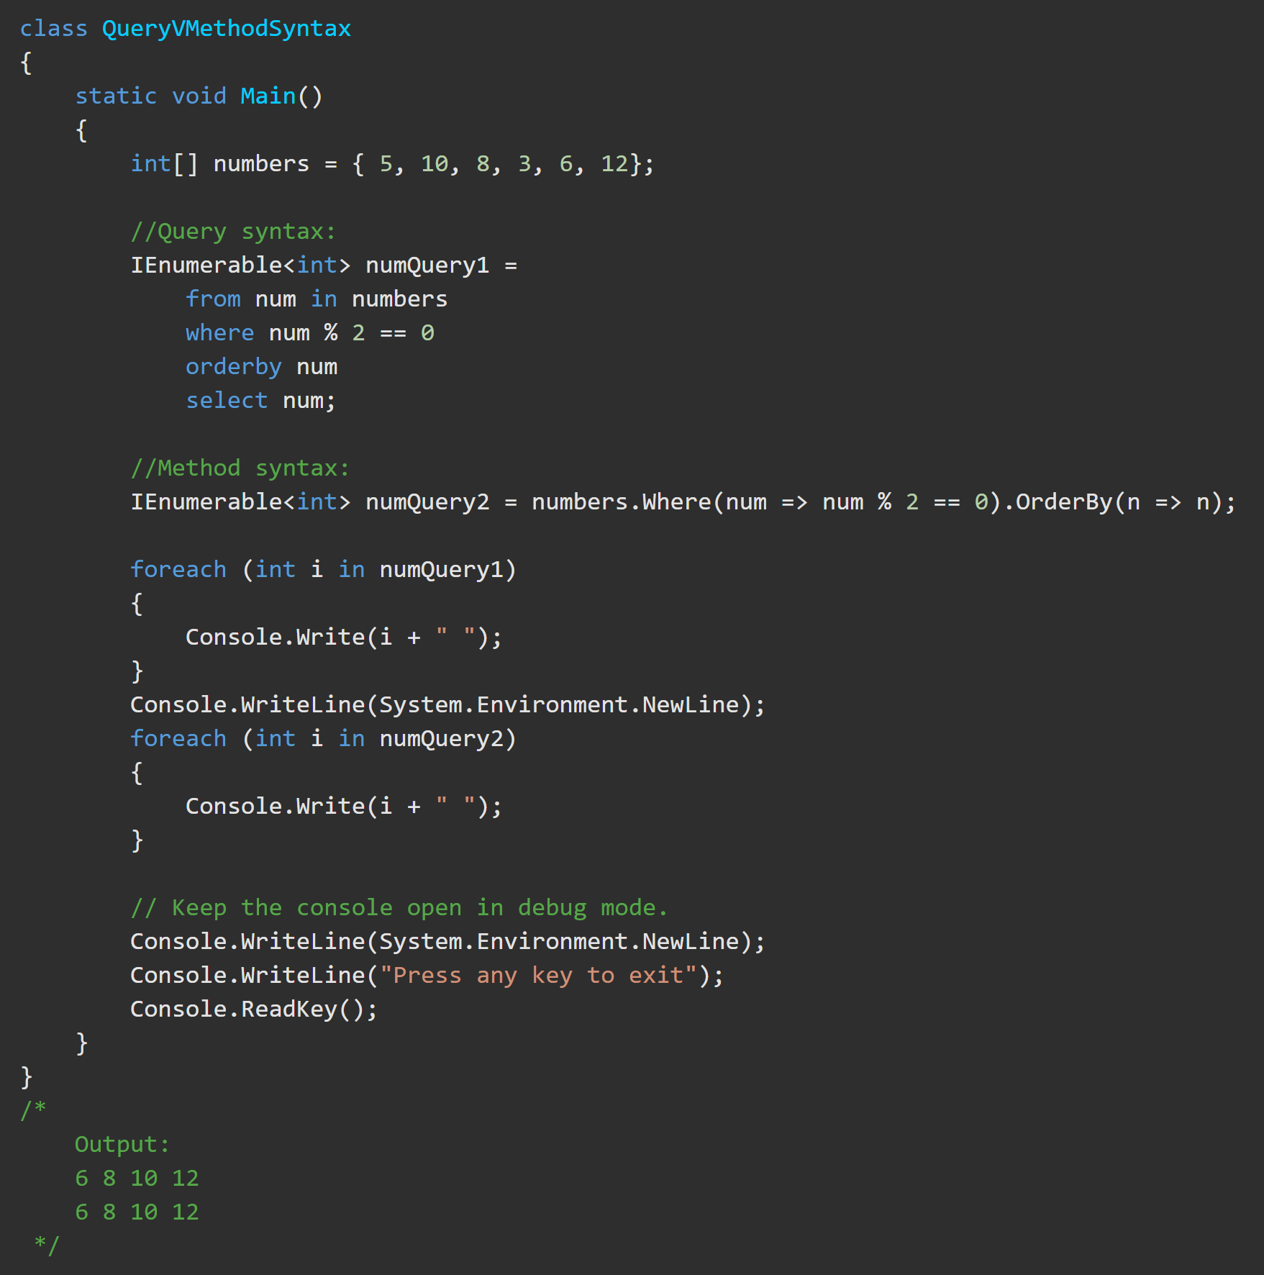
LINQ – Method Expressions https://docs.microsoft.com/en-us/dotnet/csharp/programming-guide/concepts/linq/query-syntax-and-method-syntax-in-linq
As a rule when you write LINQ queries, it is recommended to use query syntax whenever possible and method syntax whenever necessary.
Some queries must be expressed as method calls. Such as:
to retrieve the number of elements that match a specified condition.
to retrieve the element that has the maximum value in a source sequence.

Slide 10
LINQ – Activity https://docs.microsoft.com/en-us/dotnet/csharp/tutorials/working-with-linq
Complete the tutorial at the above link.
Write all queries in METHOD syntax.

