Slide 1

HTTP Request Lifestyle
.NET

Slide 2
HTTP sessions consist of three phases. The client establishes a TCP connection (or the appropriate connection if the transport layer is not TCP). The client sends its request and waits for the answer. The server processes the request, sending back its answer, providing a status code and appropriate data.
https://developer.mozilla.org/en-US/docs/Web/HTTP/Session

Slide 3
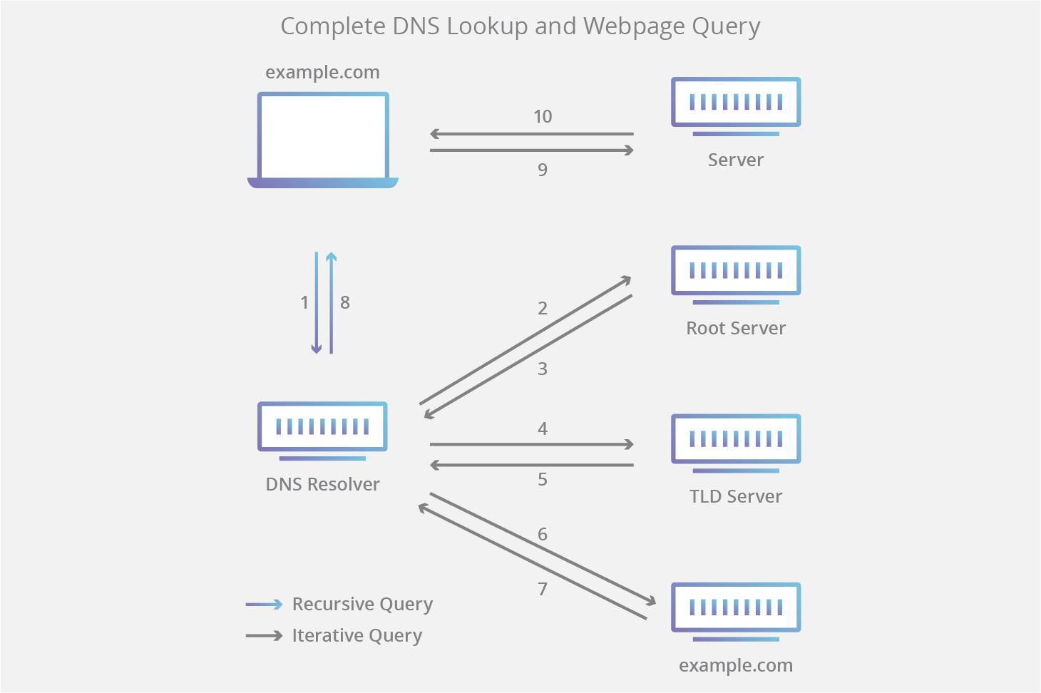
DNS (Domain Name System) https://en.wikipedia.org/wiki/Domain_Name_System
The Domain Name System (DNS) is essentially a directory of names and IP addresses.
It translates more readily memorized domain names (www.revature.com) to the numerical IP addresses (255.255.255) needed for locating and identifying computer services and devices over the web.
The DNS also associates identifying data with the unique domain names assigned to each connected entity.

Slide 4
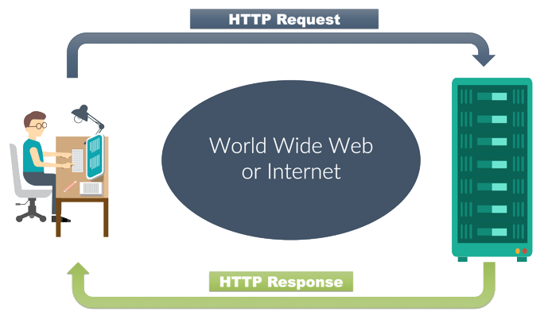
HTTP Request LifeCycle https://developer.mozilla.org/en-US/docs/Web/HTTP/Session
HTTP sessions consist of three basic phases:
The client establishes a TCP connection.
The client sends its Request and waits for the Response.
The server processes the request and sends back its Response with a status code and appropriate data.

Slide 5
Establish a connection https://developer.mozilla.org/en-US/docs/Web/HTTP/Session
The client establishes the connection.
The HTTP default port is port :80.
The URL of a page to fetch contains both the domain name, and the port number.
The client-server model does not allow the server to send data to the client without an explicit Request. - workarounds are: ping the server periodically via the XMLHTTPRequest, Fetch APIs, using the WebSockets API, etc

Slide 6
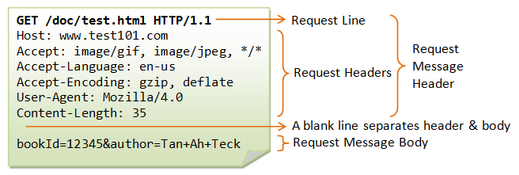
Sending A Request https://developer.mozilla.org/en-US/docs/Web/HTTP/Session
On connection, the user-agent (web browser) can send the request
A client request consists of text directives, separated by CRLF (carriage return, line feed), divided into three blocks:
Line 1 - request method followed by the absolute URL doc path without the protocol or domain name and the HTTP protocol version

Slide 7
Sending A Request https://developer.mozilla.org/en-US/docs/Web/HTTP/Session
The next lines have an HTTP header, giving the server:
information about what type of data is appropriate (e.g., what language, what MIME types)
other data which informs and may alter its behavior (e.g., not sending an answer if it is already cached).
an empty line.
an (optional) data block, mainly used by the POST method which contains further data.

Slide 8
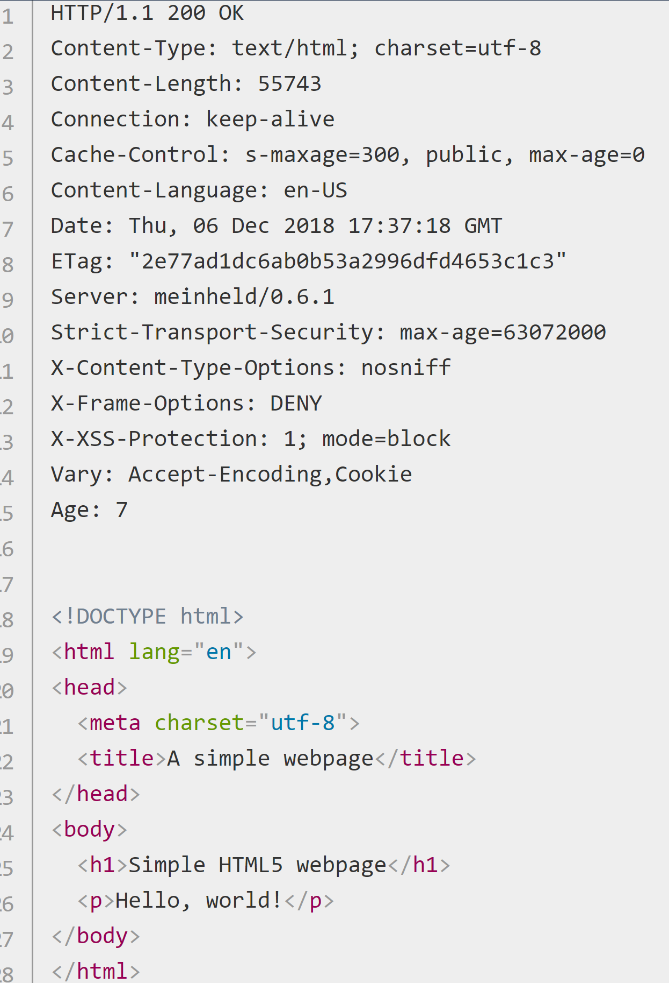
Response https://developer.mozilla.org/en-US/docs/Web/HTTP/Session
The server processes the Request and returns a Response. A server Response is formed of text directives, separated by CRLF, divided into three blocks:
Line 1 (the status line) :an acknowledgment of the HTTP version used, and a request status code (and its meaning).
Subsequent lines represent specific HTTP headers, giving the client information like data type and size, compression algorithm used, hints about caching, etc. It ends with an empty line.
The final block is a data block which contains the (optional) data

Slide 9
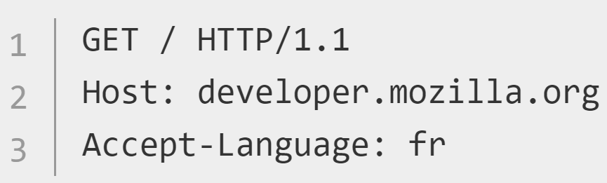
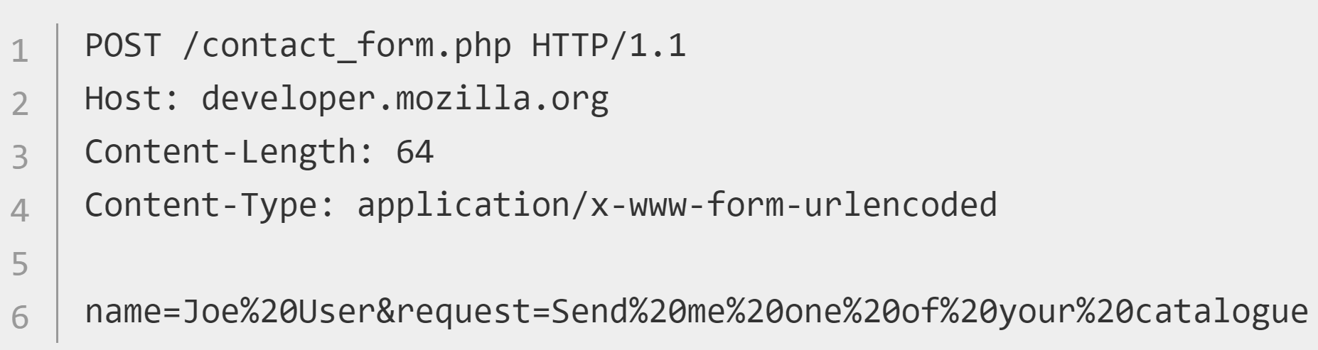
Request Methods https://developer.mozilla.org/en-US/docs/Web/HTTP/Methods https://developer.mozilla.org/en-US/docs/Web/HTTP/Session
Request methods (HTTP verbs) indicate the desired action to be performed on a resource. The most common requests are GET and POST. There are also PUT, DELETE, TRACE, HEAD, CONNECT, OPTIONS.
The POST method sends data to a server. POST is used mainly for HTML Forms.
The GET method only retrieves data.

Slide 10
Request Methods https://developer.mozilla.org/en-US/docs/Web/HTTP/Methods
HTTP Verb | Description
*GET | Requests a representation of the specified resource. GET should only retrieve data.
HEAD | Asks for a response identical to that of a GET request, but without the response body.
*POST | Used to submit an entity to the specified resource.
*PUT | Replaces all current representations of the target resource with the request payload.
*DELETE | Deletes the specified resource.
CONNECT | Establishes a tunnel to the server identified by the target resource.
OPTIONS | Describes the communication options for the target resource.
TRACE | Performs a message loop-back test along the path to the target resource.
PATCH | Applies partial modifications to a resource.
*most common

Slide 11
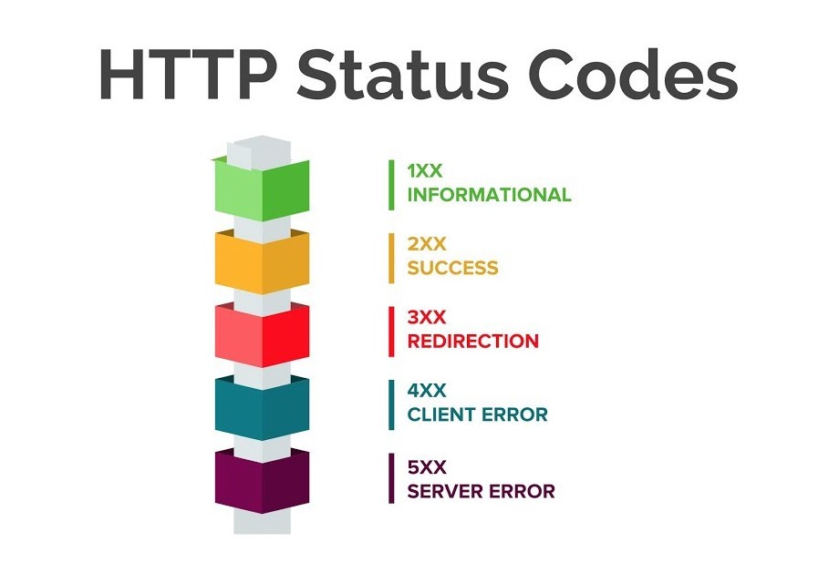
Response Status Codes https://developer.mozilla.org/en-US/docs/Web/HTTP/Session https://developer.mozilla.org/en-US/docs/Web/HTTP/Status https://tools.ietf.org/html/rfc2616#section-10
HTTP response status codes give the result of an HTTP request. Responses are grouped in five classes:
Informational responses (100–199),
Successful responses (200–299),
Redirects (300–399),
Client errors (400–499),
and Server errors (500–599).
Cheat Sheet

Slide 12
Response Status Codes https://www.smartlabsoftware.com/ref/http-status-codes.htm https://developer.mozilla.org/en-US/docs/Web/HTTP/Status
Code number | Code Meaning
200 OK, 201 | The request has succeeded., request has been fulfilled resulting in new resource(s) created.
300 Multiple Choices | The requested resource has different choices and cannot be resolved into one.
301 Moved Permanently | The requested resource has been assigned a new permanent URI
304 Not Modified | Client performed a conditional GET request. Access is allowed. The document is unmodified
307 Temporary Redirect | The requested resource resides temporarily under a different URI.
400 Bad Request | The request could not be understood by the server due to malformed syntax.
401 Unauthorized | The request requires user authentication.
403 Forbidden | The server understood the request but is refusing to fulfill it.
404 Not Found | The server has not found anything matching the Request-URI.
410 Gone | The requested resource is no longer available at the server and no forwarding address is known.
500 Internal Server Error | The server encountered an unexpected condition which prevented it from fulfilling the request.
501 Not Implemented | The server does not support the functionality required to fulfill the request.
503 Service Unavailable | Your web server is unable to handle your HTTP request at the time.
550 Permission Denied | Your account does not have permission to perform the action you are attempting.
Some of the most useful Status Codes.

Slide 13

Safe, Idempotent,
https://developer.mozilla.org/en-US/docs/Glossary/safe
https://developer.mozilla.org/en-US/docs/Glossary/Idempotent

Slide 15
Additional Resources
This may be a better place for accurate info than the sources I used.
https://developer.mozilla.org/en-US/docs/Web/HTTP/Overview#HTTP_Messages
https://docs.microsoft.com/en-us/azure/architecture/best-practices/api-design

