Slide 1

Routing
.NET

Slide 2
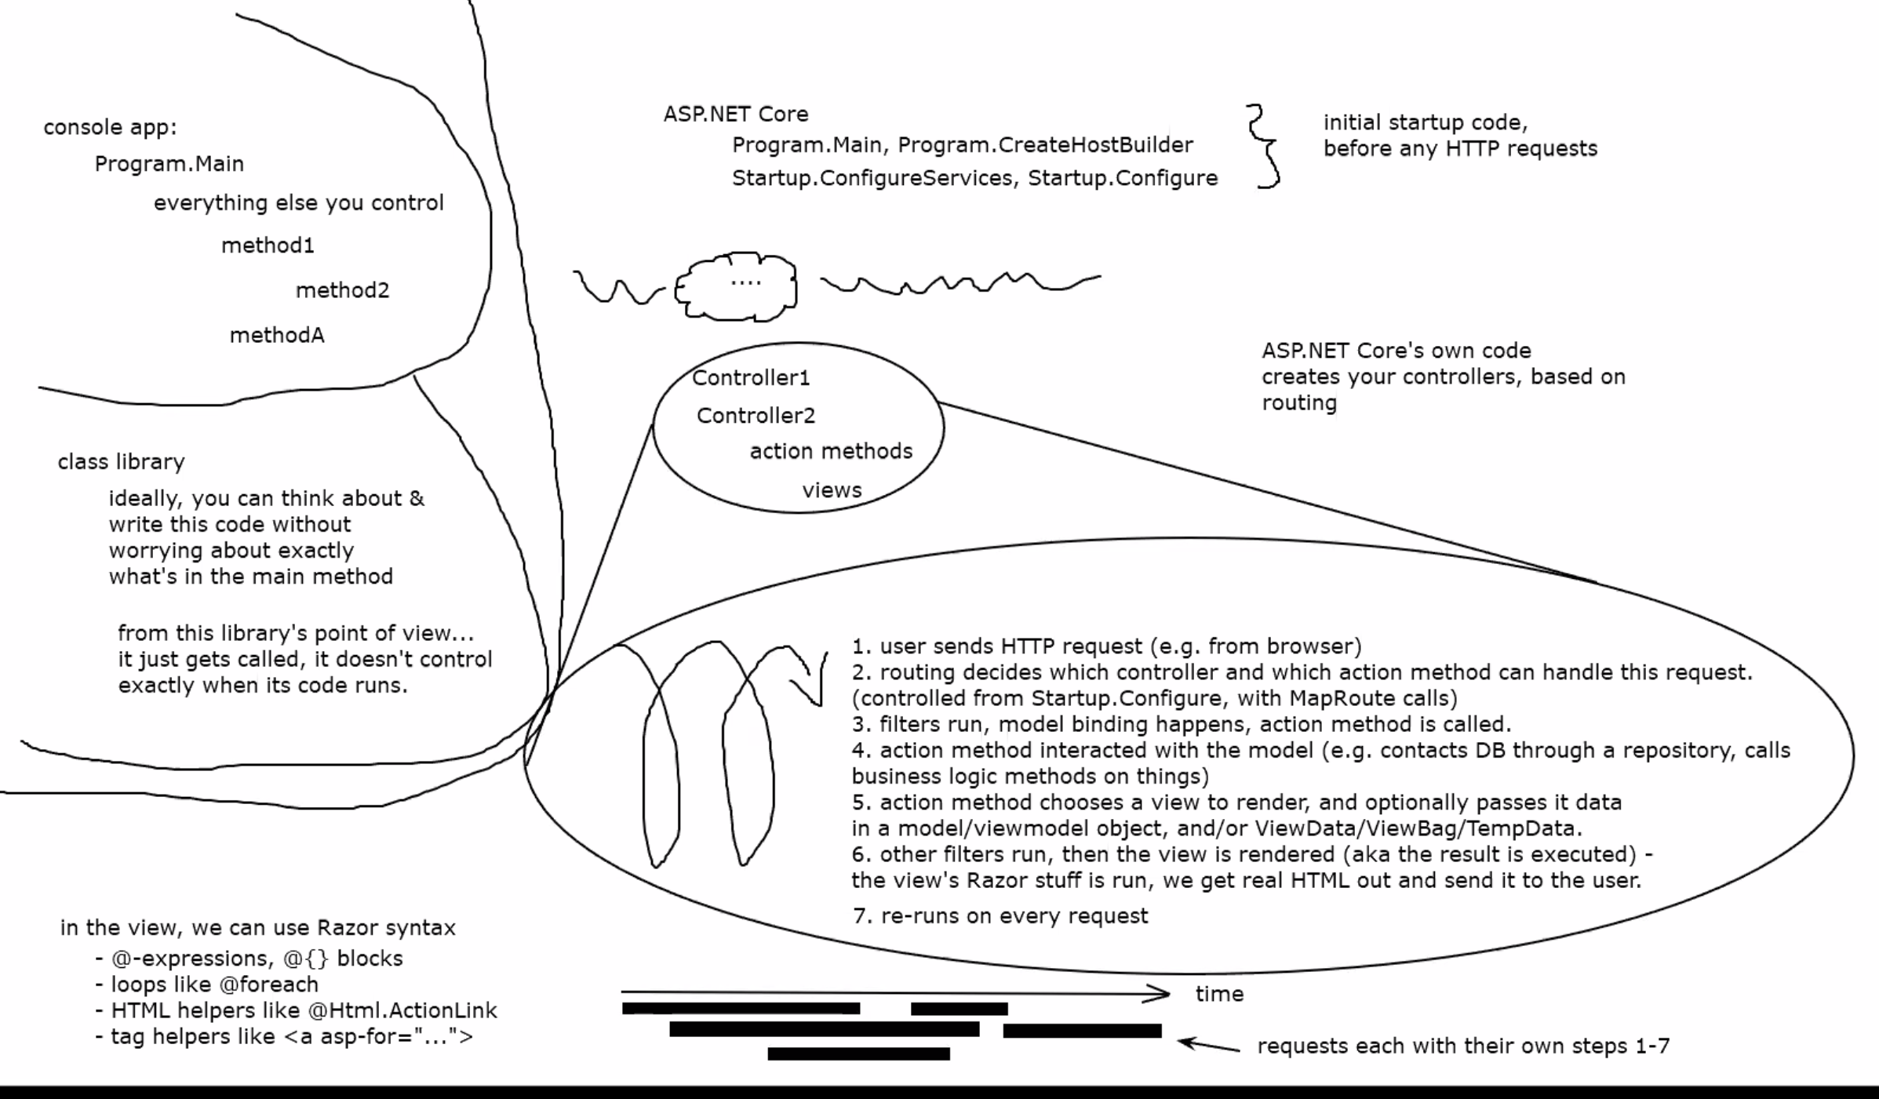

Slide 3
ASP.NET Core controllers use the Routing middleware to match the URLs of incoming requests and map them to actions. Routes templates are defined in startup code or attributes, describe how URL paths are matched to actions, and are used to generate URLs for links. Actions are either conventionally-routed or attribute-routed.
https://docs.microsoft.com/en-us/aspnet/core/mvc/controllers/routing?view=aspnetcore-3.1

Slide 4
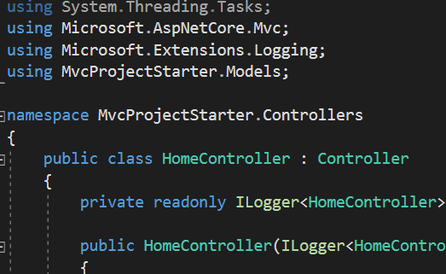
Controllers https://docs.microsoft.com/en-us/aspnet/core/mvc/controllers/actions?view=aspnetcore-3.1
A controller is a class used to define and group a set of actions. Controllers logically group similar actions together. This allows routing, caching, and authorization, to be applied collectively.
Within the Model-View-Controller pattern, a controller is responsible for the initial processing of a request and instantiation of a model. Business decisions should be performed within the model.
To be a controller, at least one of the following conditions is true:
The class name is suffixed with Controller.
The class inherits from a class whose name is suffixed with Controller.
The [Controller] attribute is applied to the class.
Ccontroller classes reside in the project's root-level Controllers folder and inherit from Microsoft.AspNetCore.Mvc.Controller.

Slide 5
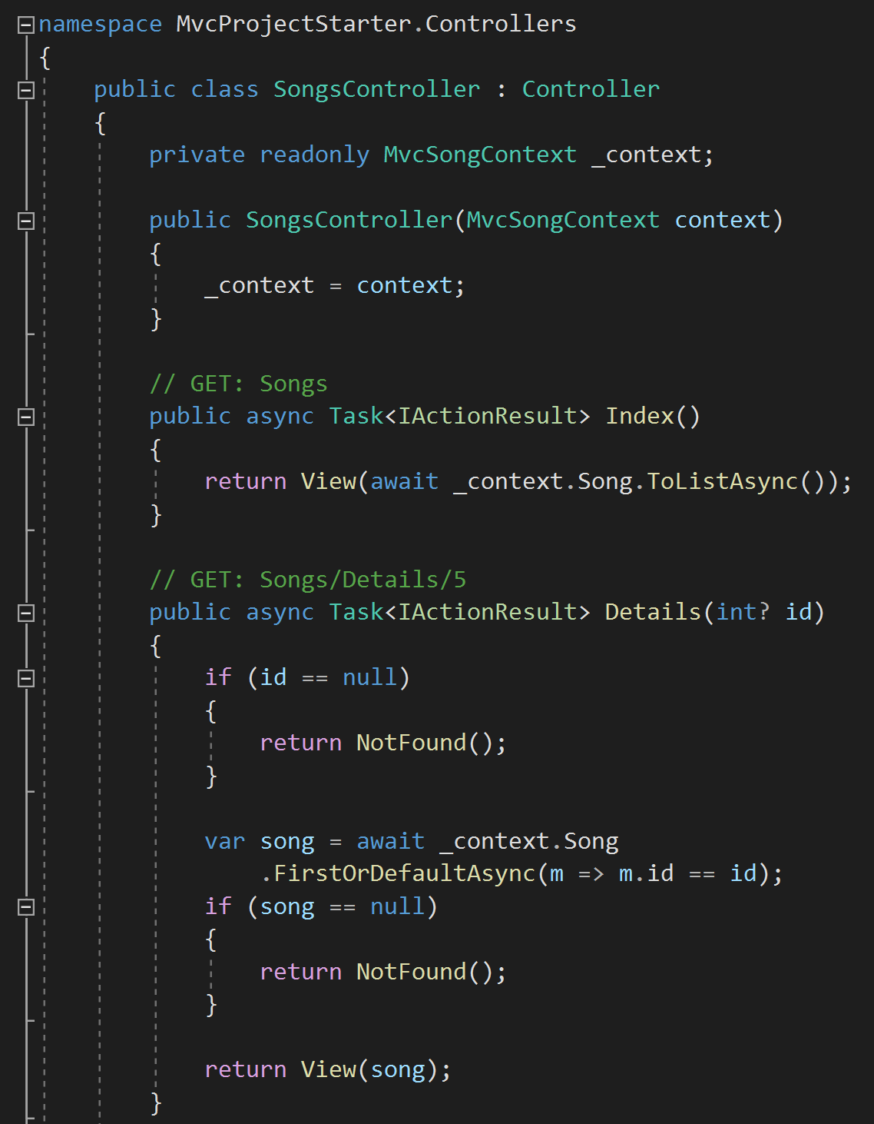
Action Methods https://docs.microsoft.com/en-us/aspnet/core/mvc/controllers/actions?view=aspnetcore-3.1#defining-actions
An action method is a method in a controller which handles requests. All public methods in a controller (except those with the [NonAction] attribute) are actions. Parameters on actions are bound to request data and are validated using Model Binding. Model validation occurs for everything that’s Model-Bound. The ModelState.IsValid property value indicates whether Model Binding and validation succeeded.
Action methods should contain logic for mapping a request to a business concern. Business concerns should typically be represented as services that the controller accesses through dependency injection.
Actions can return anything, but usually return an IActionResult or Task<IActionResult> (for async methods).

Slide 6
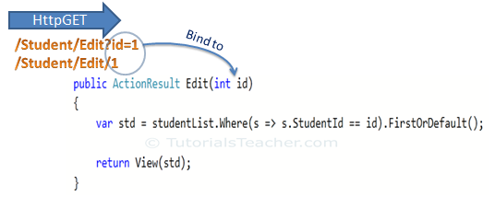
Model Binding https://docs.microsoft.com/en-us/aspnet/core/mvc/models/model-binding?view=aspnetcore-3.1
Controllers and Action Methods work with data that comes from HTTP requests. (Ex. POSTed form fields provide values for the properties of the model.)
Writing code to retrieve each of these values and convert them from strings to .NET types would be tedious and error-prone. Model Binding automates this process.
The Model Binding system:
Retrieves data from various sources such as route data, form fields, and query strings.
Provides the data to controllers in Action Method parameters and public properties.
Converts string data to .NET types.
Updates properties of complex types.

Slide 7
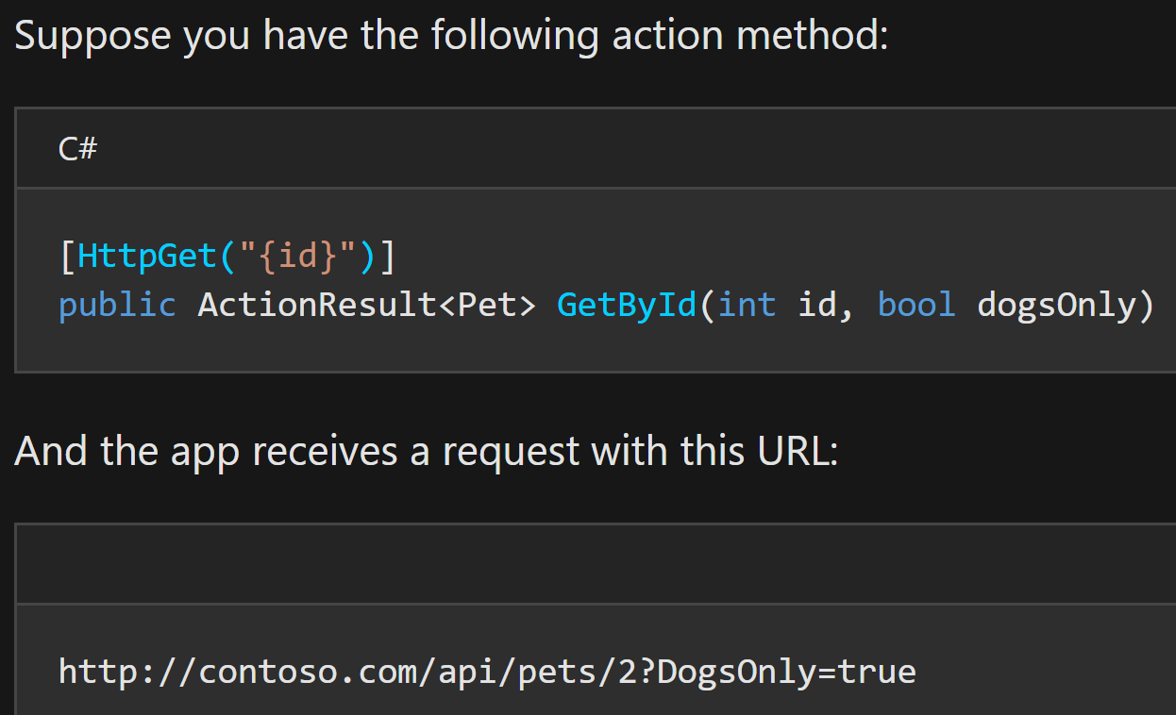
Model Binding https://docs.microsoft.com/en-us/aspnet/core/mvc/models/model-binding?view=aspnetcore-3.1
Model Binding goes through the following steps after the routing system selects the action method:
Finds the first parameter of GetByID (id).
Looks through the HTTP request and finds id = "2" in route data.
Converts the string "2" into integer 2.
Finds the next parameter of GetByID (dogsOnly).
Finds "DogsOnly=true" in the query string. Name matching is not case-sensitive.
Converts the string "true" to a boolean true.

Slide 8
Different Controller Helper (Action) Methods https://docs.microsoft.com/en-us/aspnet/core/mvc/controllers/actions?view=aspnetcore-3.1#controller-helper-methods
Controller provides access to three categories of helper methods, resulting in
an empty response body | a non-empty response body with a predefined content type | a non-empty response body formatted in a content type negotiated with the client
HTTP Status Code – Ex. BadRequest, NotFound, and Ok | View - view which uses a model to render HTML. (EX. Return View(customer); | This category is better known as Content Negotiation. Content negotiation applies whenever an action returns an ObjectResult type or something other than an IActionResult. (Ex. BadRequest, CreatedAtRoute, and Ok)
Redirect - returns a redirect to an action or destination (Redirect, LocalRedirect, RedirectToAction, or RedirectToRoute). | Formatted Response - JSON or a similar data exchange format to represent an object, (Ex. Json(customer);)

Slide 9
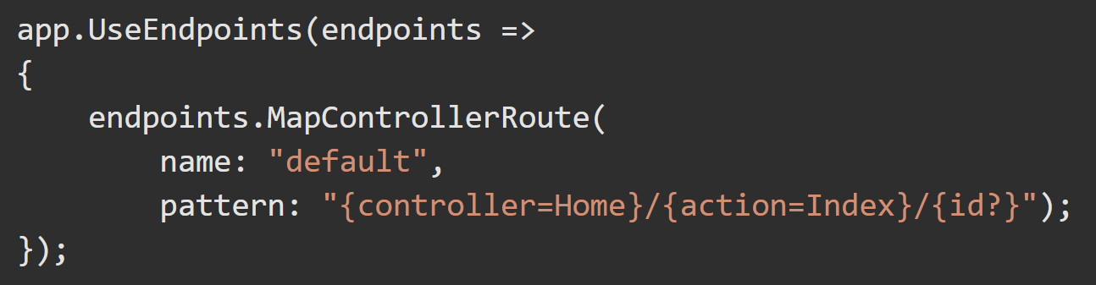
Conventional Routing https://docs.microsoft.com/en-us/aspnet/core/mvc/controllers/routing?view=aspnetcore-3.1#cr
Startup.Configure typically has code similar to the following when using conventional routing. Inside the call to UseEndpoints, MapControllerRoute is used to create a single route. The single route is named the default route.

Slide 10
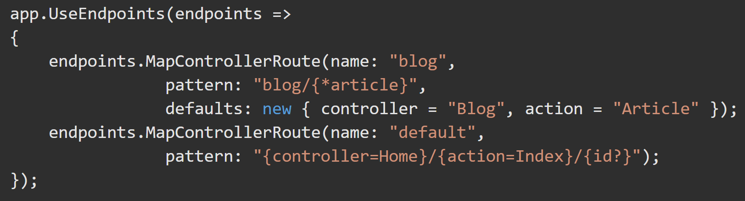
Conventional Routing https://docs.microsoft.com/en-us/aspnet/core/mvc/controllers/routing?view=aspnetcore-3.1#set-up-conventional-route https://docs.microsoft.com/en-us/aspnet/core/mvc/controllers/routing?view=aspnetcore-3.1#multiple-conventional-routes
The route template (in Startup.cs) "{controller=Home}/{action=Index}/{id?}“ matches a URL path like /Products/Details/5.
The route template extracts (tokenizes) the route values { controller = Products, action = Details, id = 5 } which results in a match if the app has a controller named ProductsController and a Details action. The id value is optional due to the ?.

Slide 11
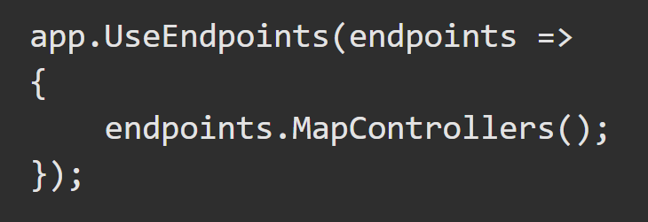
Attribute Routing – REST API’s https://docs.microsoft.com/en-us/aspnet/core/mvc/controllers/routing?view=aspnetcore-3.1#attribute-routing-for-rest-apis
REST APIs should use attribute routing to model the app's functionality as a set of resources where operations are represented by HTTP verbs.
Attribute routing uses sets of attributes on each controller action to map actions directly to route templates. The following StartUp.Configure code is typical for a REST API. MapControllers() is called inside UseEndpoints() to map attribute routed controllers.

Slide 12
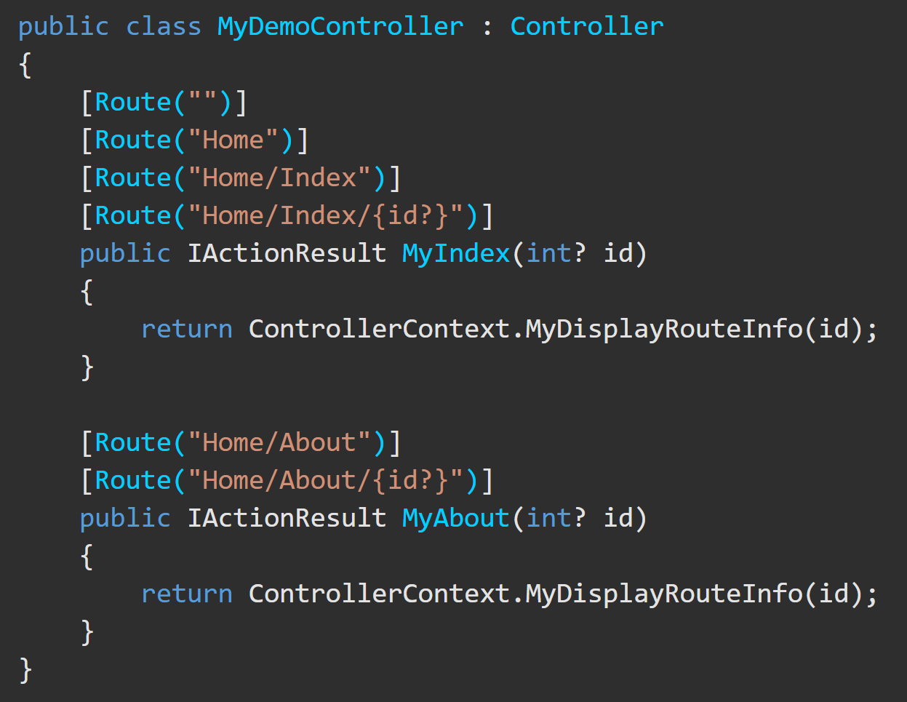
Attribute Routing – REST API’s https://docs.microsoft.com/en-us/aspnet/core/mvc/controllers/routing?view=aspnetcore-3.1#attribute-routing-for-rest-apis
In this example, the Configure method is used.
HomeController matches a set of URLs similar to what the default conventional route {controller=Home}/{action=Index}/{id?} matches. Attribute routing requires more input to specify a route. Conventional Routing handles routes more succinctly, but Attribute Routing allows (and requires) precise control of which route templates apply to each action.
With attribute routing, the controller name and action names play no role in which action is matched.

Slide 13
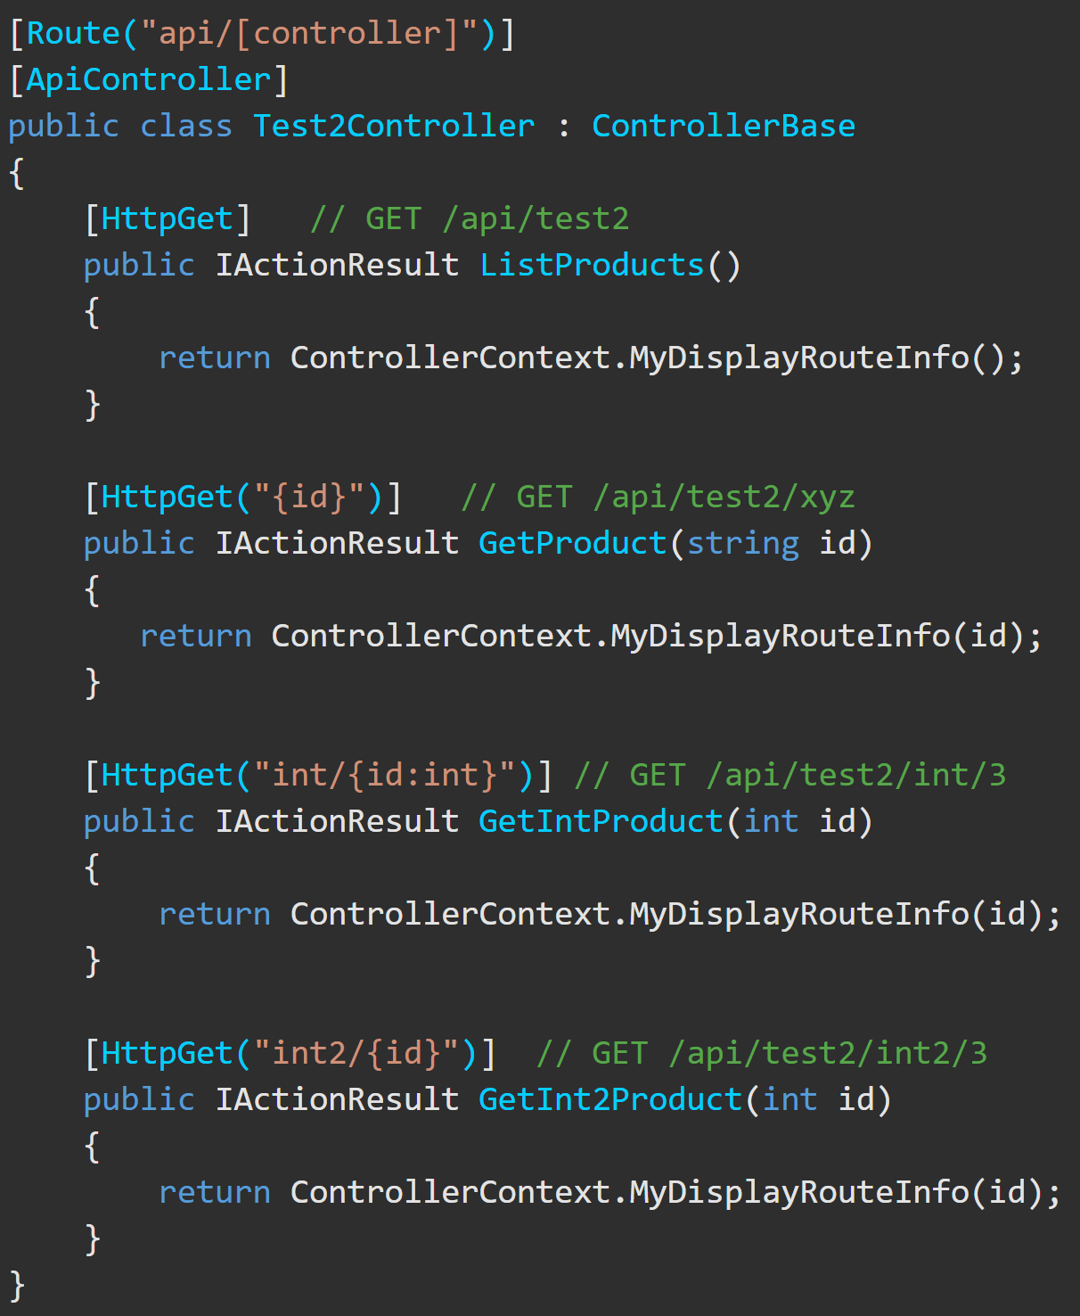
Attribute Routing - HTTP Verb Templates https://docs.microsoft.com/en-us/aspnet/core/mvc/controllers/routing?view=aspnetcore-3.1#http-verb-templates
ASP.NET Core has the following HTTP verb templates: [HttpGet], [HttpPost], [HttpPut], [HttpDelete], [HttpHead], [HttpPatch]
The GetProduct action includes the "{id}" template, therefore id is appended to the "api/[controller]" template on the controller, so GetProduct’s template is "api/[controller]/"{id}"".
Therefore, this action only matches GET requests of the form /api/test2/123, /api/test2/{any string}.

