Slide 1

Docker Fundamentals
.NET

Slide 2
Docker provides the ability to package and run an application in a loosely isolated environment called a container. You can run many containers simultaneously on a given host. Containers are lightweight because they don’t need the extra load of a hypervisor. They run directly within the host machine’s kernel. You can even run Docker containers within virtual host machines.
https://docs.docker.com/engine/docker-overview/

Slide 3
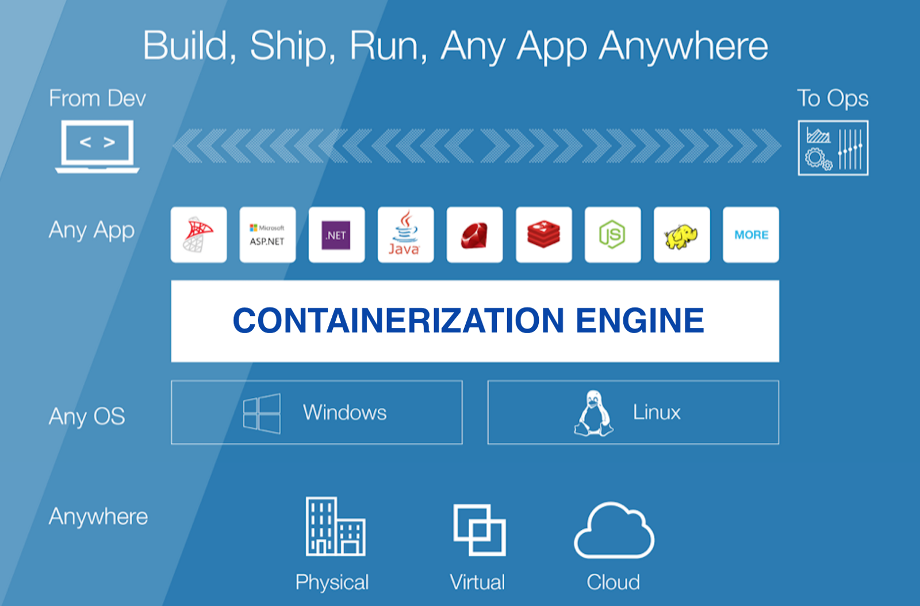
Containerization https://hackernoon.com/what-is-containerization-83ae53a709a6
Containerization involves bundling an application together with all its related configuration files, libraries, and dependencies required for it to run efficiently and bug-free across different computing environments.
The most popular containerization ecosystems are Docker and Kubernetes.

Slide 4
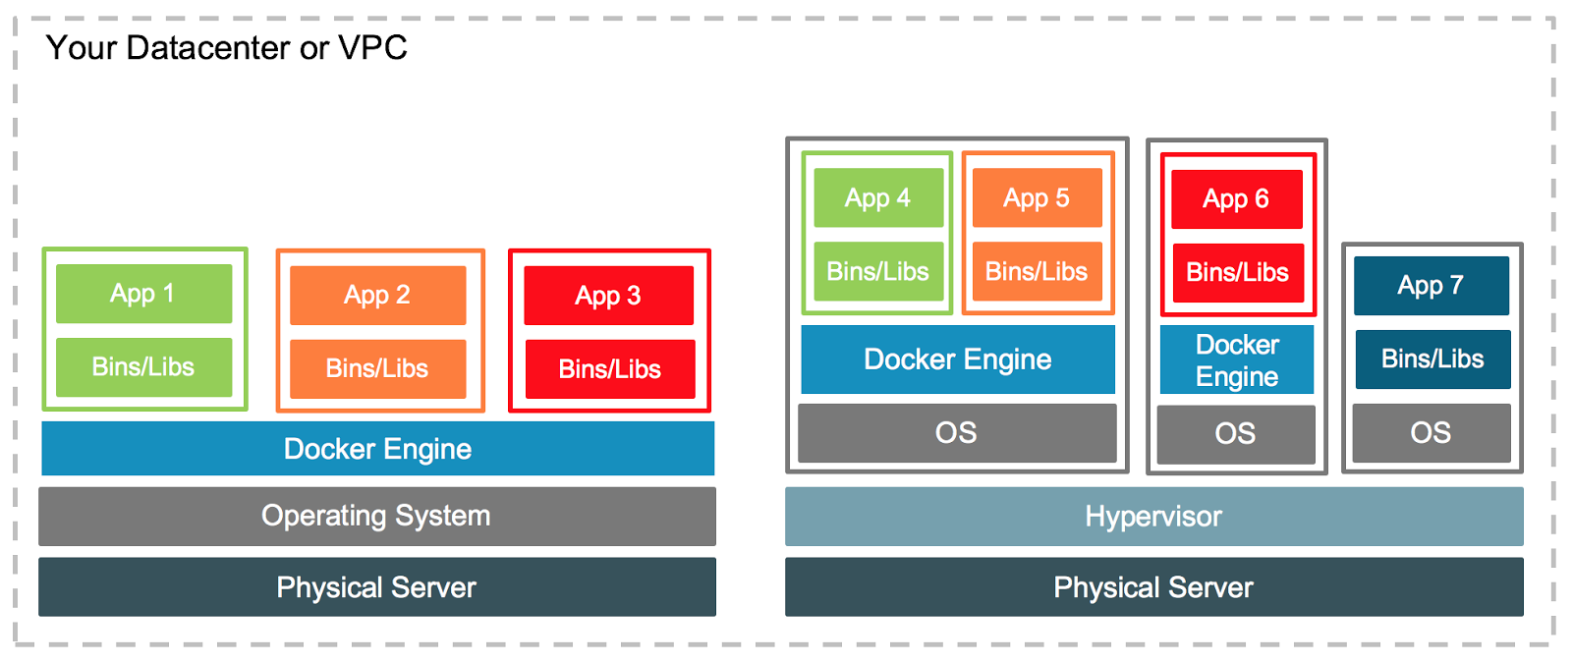
Virtualization https://en.wikipedia.org/wiki/Virtualization#Hardware_virtualization https://www.docker.com/blog/containers-and-vms-together/
In computing, virtualization refers to the act of creating a virtual (rather than actual) version of something.
Hardware virtualization or platform virtualization refers to the creation of a virtual machine (an application) that simulates a real computer with an operating system.
Software executed on a virtual machine is separated from the underlying hardware resources.

Slide 5
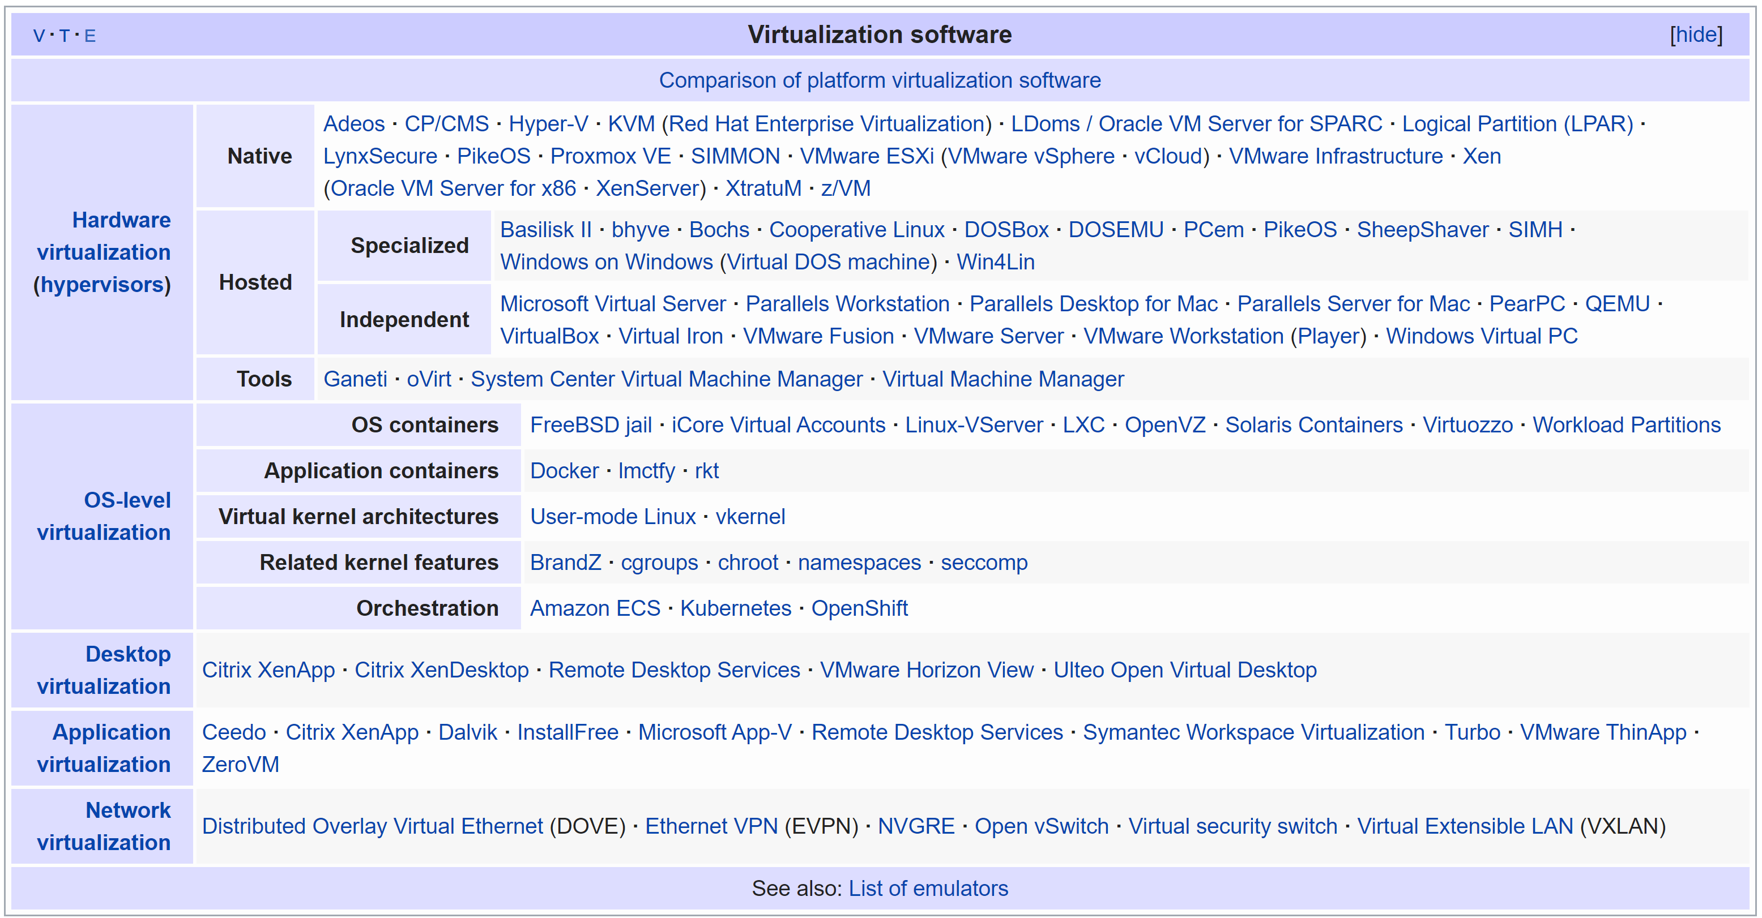

Slide 6
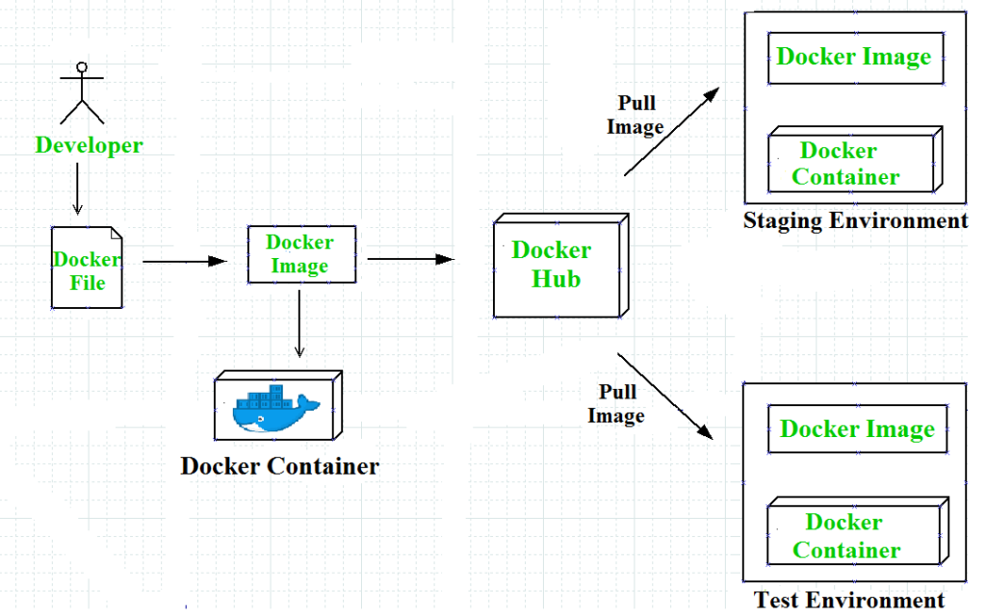
Docker – Purpose https://docs.docker.com/engine/docker-overview/#what-can-i-use-docker-for
Docker allows developers to work in standardized environments using local containers which provide applications and services. Containers are great for CI/CD workflows like this.
Developers write code locally in a development environment and share their work using Docker containers.
They use Docker to push their applications into a test environment to execute automated and manual tests.
Bugs can be fixed in the development environment and redeployed to the test environment for re-testing and validation.
When testing is complete, just push the updated image to the production environment.

Slide 7
Docker – Purpose https://docs.docker.com/engine/docker-overview/#what-can-i-use-docker-for
Responsive deployment and scaling
Docker Containers are portable and can run on a developer’s local laptop, on physical and virtual machines in a data center, or on cloud providers.
You can scale up or tear down applications (and services) as business needs dictate.
Running more workloads on the same hardware
Docker is lightweight and fast.
Docker is NOT a Virtual Machine.
a virtual machine (VM) runs a full-blown “guest” operating system with virtual access to host resources through a hypervisor. VMs incur a lot of overhead.

Slide 8
The Docker Platform https://www.docker.com/resources/what-container
Docker provides a platform to manage the entire lifecycle of your containers:
Develop an application and its supporting components using containers.
The container becomes the unit for distributing and testing your application.
When you’re ready, deploy your application into your production environment as a container. This works the same whether your production environment is a local data center, a cloud provider, or a hybrid of the two.

Slide 9
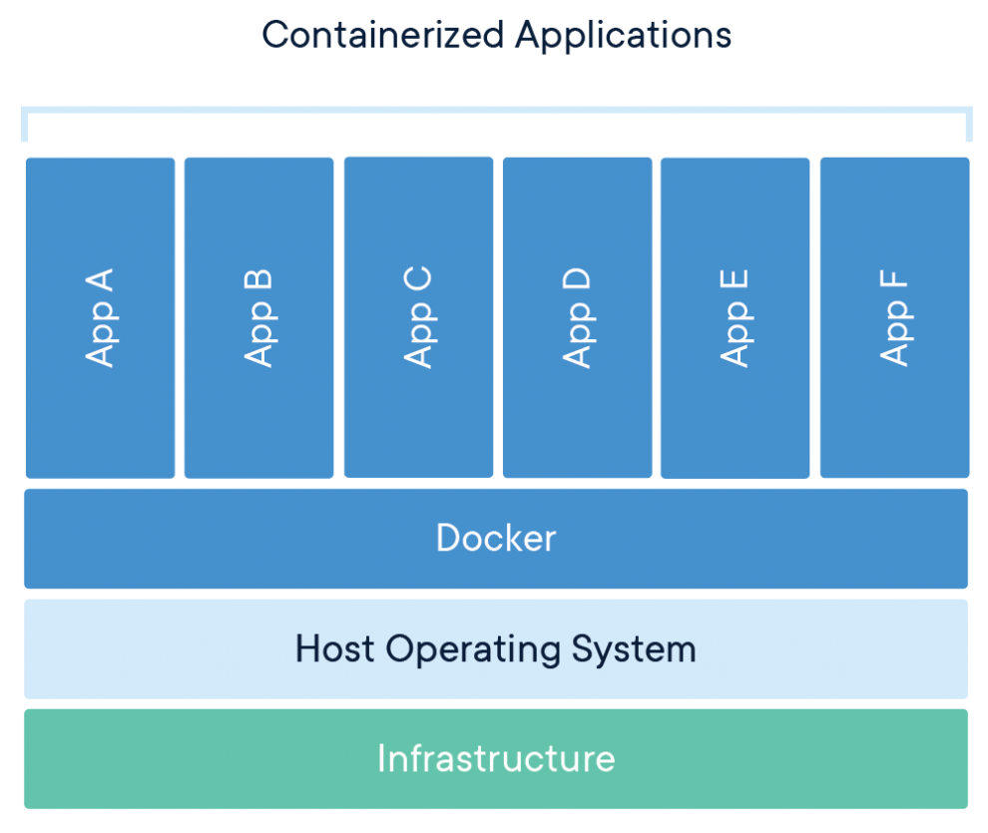
Docker Container https://www.docker.com/resources/what-container https://docs.docker.com/get-started/
A Docker Image is a standalone executable package of software that includes everything needed to run an application: code, runtime, system tools, system libraries and settings.
Docker Images become Docker Containers at runtime when run on the Docker Engine. Containers run identically, regardless of the infrastructure (Linux or PC).
A Docker Container isolates software from its environment. Each container interacts with its own private filesystem.

Slide 10
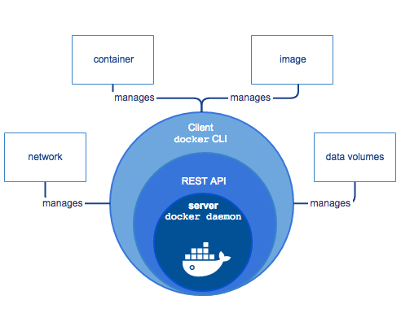
Docker Engine https://docs.docker.com/engine/docker-overview/#docker-engine
Docker Engine is a client-server application with three major components:
A server which is a type of long-running program called a daemon process (the dockerd command).
A REST API which specifies interfaces that programs can use to talk to the daemon and instruct it what to do.
A command line interface (CLI) client (the docker command).
Docker Engine

Slide 11
Docker Engine https://docs.docker.com/engine/docker-overview/#docker-engine
The CLI uses the Docker REST API to control or interact with the Docker daemon through scripting or direct CLI commands. Many other Docker applications use the underlying API and CLI.
The daemon creates and manages Docker objects, such as images, containers, networks, and volumes.
Docker Engine

Slide 12
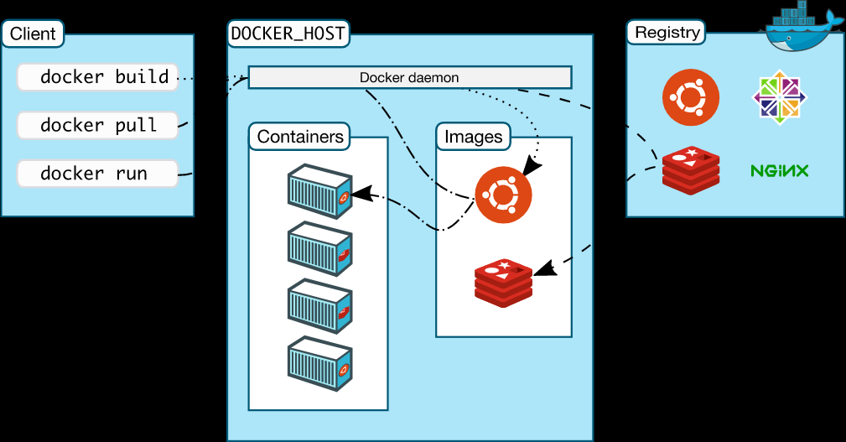
Docker Architecture https://docs.docker.com/engine/docker-overview/#docker-architecture
Docker uses a client-server architecture. The Docker client talks to the Docker daemon (server), which does the heavy lifting of building, running, and distributing Docker containers.
The Docker client and daemon can run on the same system, or you can connect a Docker client to a remote Docker daemon.
The Docker client and daemon communicate using a REST API.

Slide 13
Docker Client | Docker daemon | Docker registries
The Docker client (docker) is the primary way that most Docker users interact with Docker. With docker run, the client sends these commands to dockerd, which carries them out. The docker command uses the Docker API. | The Docker daemon (dockerd) listens for Docker API requests and manages Docker objects such as images, containers, networks, and volumes. | A Docker registry stores Docker images. Docker Hub is a public registry. With the docker pull or docker run commands, images are pulled from the configured registry. When you use the docker push command, the image is pushed to the configured registry.

Slide 14
An image is a read-only template with instructions for creating a Docker container. An image can be based on another image, with some additional customization.
An image could be based on the ubuntu image, but install the Apache web server and your application as well as the configuration details needed to make your application run. Images can be published in a registry.
To build an image, create a Dockerfile defining the steps to create an image and run it.
When you change a Dockerfile and rebuild the image, only those layers which have changed are rebuilt
A container is a runnable instance of an image. You can create, start, stop, move, or delete a container using the Docker API or CLI. You can connect a container to one or more networks, attach storage to it, or even create a new image based on its current state.
A container is defined by its image as well as any configuration options you provide to it when you create or start it.

Slide 15
List of Basic Docker commands
Command | Purpose
docker start [containername] | Start a container.
docker images | List images installed
docker container command | Manage containers
docker stop [containername] | Stop a running container
docker image ls | list the images downloaded to your machine.
docker ps --a | Lists all containers
docker run [containername]
docker build –t myimage –f dockerfile . | Build an image called myimage from a Dockerfile
docker stop [containername] | Stop a running container
docker rm [containername] | Delete a container
docker push [imagename] | Push an image to your repo in the Docker Registry
docker create myimage | Create an unstarted container from an image
docker ps | Show running containers
docker attach [containername] | Connect to a running container

Slide 16
Docker in action
The following command runs an ubuntu container, attaches interactively to your local command-line session, and runs /bin/bash.
$ docker run -i -t ubuntu /bin/bash
The following happens (assuming you are using the default registry configuration):
If you do not have the ubuntu image locally, Docker pulls it from your configured registry, as though you had run docker pull ubuntu manually.
Docker creates a new container, as though you had run a docker container create command manually.
Docker allocates a read-write filesystem to the container, as its final layer.
This allows a running container to create or modify files and directories in its local filesystem.
Docker creates a network interface to connect the container to the default network,
because you did not specify any networking options.
This includes assigning an IP address to the container.
By default, containers can connect to external networks using the host machine’s network connection.
Docker starts the container and executes /bin/bash.
Because the container is running interactively and attached to your terminal (due to the -i and -t flags), you can provide input using your keyboard while the output is logged to your terminal.
When you type exit to terminate the /bin/bash command, the container stops but is not removed.
You can start it again or remove it.

Slide 17
Next Steps
Now you can move on to creating your own Dockerfiles, Images, and Containers!

