Slide 1

Data Annotations
.NET

Slide 2
Data Annotation validators enable you to perform validation simply by adding one or more attributes to a Model class property.
https://docs.microsoft.com/en-us/aspnet/mvc/overview/older-versions-1/models-data/validation-with-the-data-annotation-validators-cs

Slide 3
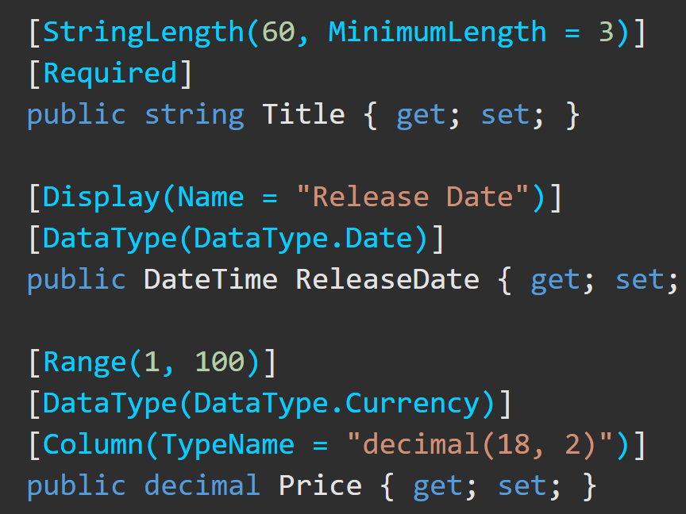
Data Annotations – Overview https://docs.microsoft.com/en-us/aspnet/mvc/overview/older-versions-1/models-data/validation-with-the-data-annotation-validators-cs
The DataAnnotations namespace provides a set of built-in validation attributes that are applied declaratively to a class or property. DataAnnotations also contains formatting attributes like DataType that help with formatting and don't provide any validation.

Slide 4
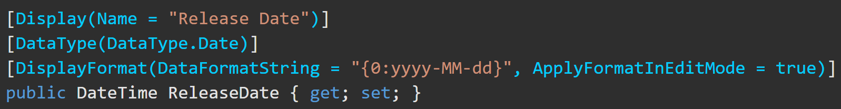
Annotations to Display and Edit
[Display()] | [DataType()]
[Display(Name ="Film Genre")] This gives the View the desired name for Display in the browser | [DataType(DataType.Password)] This will display the types text as dots to obscure the actual content.

Slide 5
Annotations for Validation https://docs.microsoft.com/en-us/aspnet/mvc/overview/getting-started/introduction/adding-validation
Annotation | Purpose
[Required] | The property is not allowed to be null
[Range(x,y)] | X is the minimum. Y is the maximum.
[StringLength(x)] | X is the maximum length of the property
[RegularExpression] | [RegularExpression(@"^[A-Z]+[a-zA-Z0-9""'\s-]*$")]
[MinLength(x)] | Minimum length is x. Also sets DB column size max.
[MaxLength(x)] | Maximum length is x. Also sets DB column size max.
*Custom validation is also possible.

Slide 6
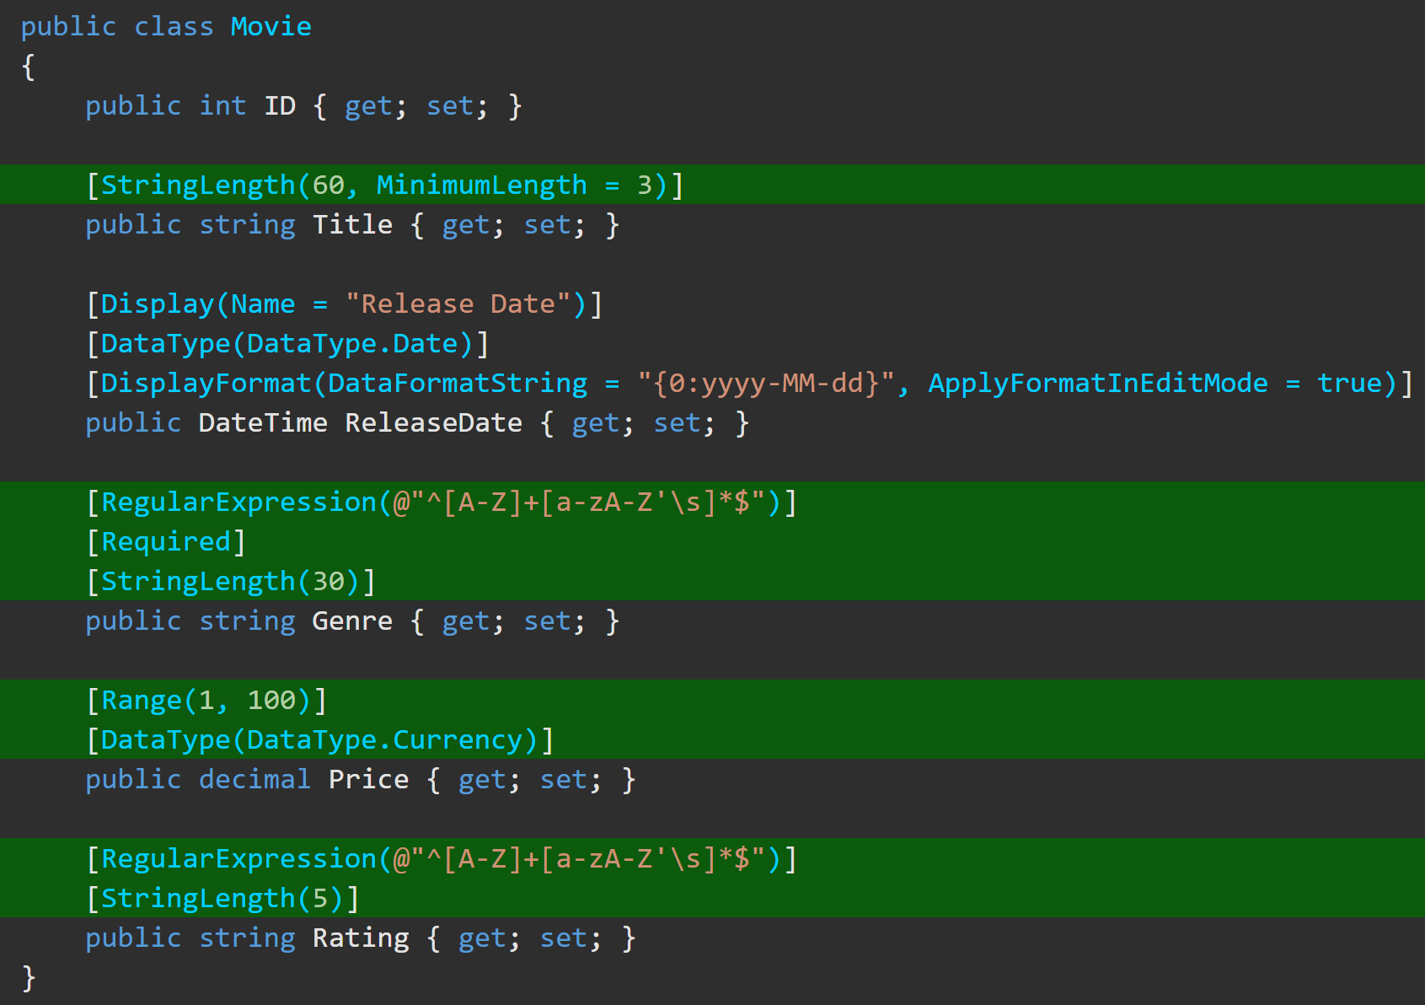
Data Annotations – Examples https://docs.microsoft.com/en-us/aspnet/mvc/overview/getting-started/introduction/adding-validation

