Slide 1

Filters
.NET

Slide 2
Filters in ASP.NET Core allow code to be run before or after specific stages in the request processing pipeline. Filters help developers encapsulate cross-cutting concerns, like exception handling or authorization
https://docs.microsoft.com/en-us/aspnet/core/mvc/controllers/filters?view=aspnetcore-3.1

Slide 3
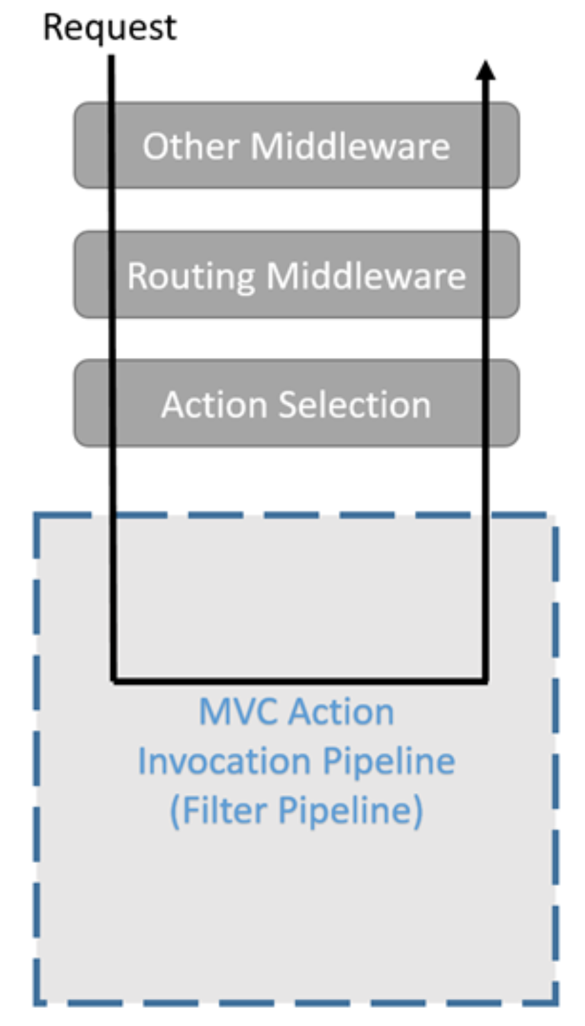
Filters – Overview https://docs.microsoft.com/en-us/aspnet/core/mvc/controllers/filters?view=aspnetcore-3.1
.NET built-in filters handle tasks such as Authorization and Response caching.
Custom filters can be created to handle cross-cutting concerns like error handling, caching, configuration, authorization, and logging.
Filters don't work directly with Razor components. Filters run within the ASP.NET Core action invocation pipeline. The action invocation pipeline runs after ASP.NET Core selects the action to execute.

Slide 4
Filter Types https://docs.microsoft.com/en-us/aspnet/core/mvc/controllers/filters?view=aspnetcore-3.1#action-filters
Filter | Description
Authorization | Run first. Used to determine if the user is authorized for the request. Authorization filters short-circuit the pipeline if the request is not authorized.
Resource | Run after authorization. OnResourceExecuting runs code before model binding and after the rest of the pipeline has completed.
Action | Run code immediately before and after an action method is called. Can change the arguments passed into an action and the result returned from the action. Are not supported in Razor Pages.
Exception | Apply global policies to unhandled exceptions that occur before the response body has been written to.
Result | Run code immediately before and after the execution of action results. They run only when the action method has executed successfully.

Slide 5
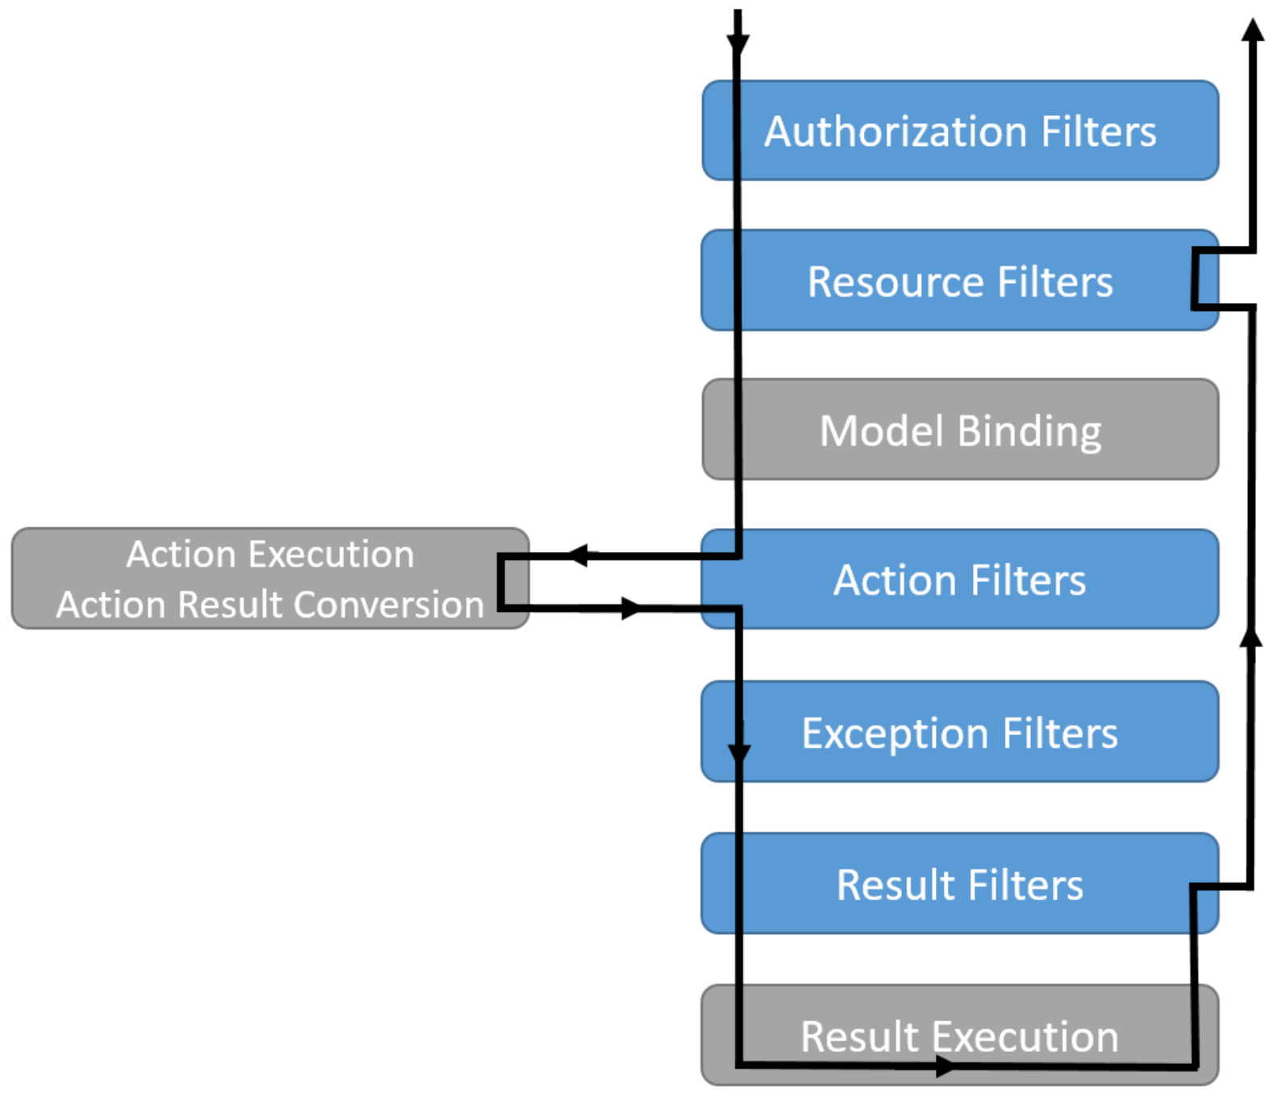
Filter Interaction in the Filter Pipeline https://docs.microsoft.com/en-us/aspnet/core/mvc/controllers/filters?view=aspnetcore-3.1#filter-types https://docs.microsoft.com/en-us/aspnet/core/mvc/controllers/filters?view=aspnetcore-3.1#using-middleware-in-the-filter-pipeline
Filters work like middleware in that they surround the execution of everything that comes later in the pipeline.
Even if you don't have any filters, middleware, try-catch, etc, ASP.NET Core will itself catch any exceptions within the pipeline of controller, action method, filters, view, etc. An exception in the Startup class will probably crash the whole app, but not exceptions anywhere else. They'll be caught and typically an HTTP 500 will be sent.

Slide 6
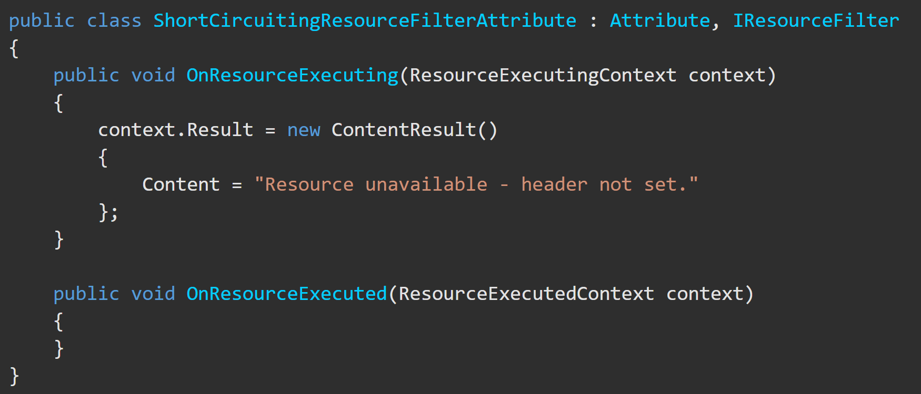
Resource Filters https://docs.microsoft.com/en-us/aspnet/core/mvc/controllers/filters?view=aspnetcore-3.1#resource-filters
Resource filters:
Implement either the IResourceFilter or IAsyncResourceFilter interface.
Execution wraps most of the filter pipeline.
Only Authorization filters run before resource filters.
Resource filter examples:
The short-circuiting resource filter.
DisableFormValueModelBindingAttribute
Prevents model binding from accessing the form data.
Used for large file uploads to prevent the form data from being read into memory.

Slide 7
Authorization Filter https://docs.microsoft.com/en-us/aspnet/core/mvc/controllers/filters?view=aspnetcore-3.1#authorization-filters
Authorization filters:
Are the first filters run in the filter pipeline.
Control access to action methods.
Have a before method, but no after method.
The built-in authorization filter:
Calls the authorization system.
Does not authorize requests.
Do not throw exceptions within authorization filters:
The exception will not be handled.
Exception filters will not handle the exception.

Slide 8
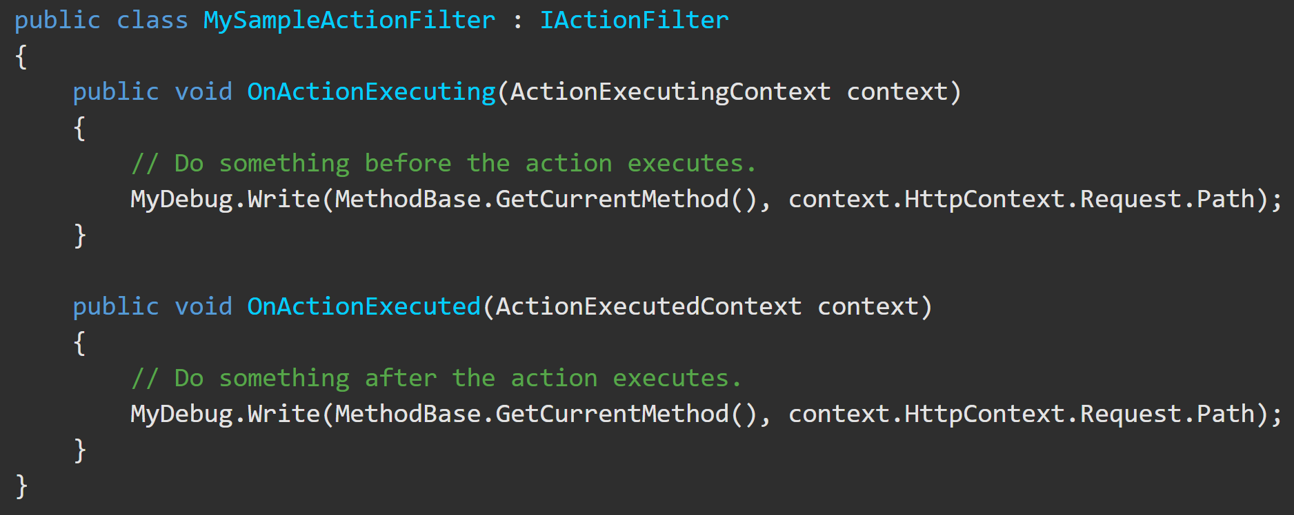
Action Filter https://docs.microsoft.com/en-us/aspnet/core/mvc/controllers/filters?view=aspnetcore-3.1#action-filters
The ActionExecutingContext provides the following properties:
ActionArguments - enables reading the inputs to an action method.
Controller - enables manipulating the controller instance.
Result - setting Result short-circuits execution of the action method and subsequent action filters.
Action filters:
Implement either the IActionFilter or IAsyncActionFilter interface.
Their execution surrounds the execution of action methods.

Slide 9
Action Filter https://docs.microsoft.com/en-us/aspnet/core/mvc/controllers/filters?view=aspnetcore-3.1#action-filters
The ActionExecutedContext provides Controller and Result plus the following properties:
Canceled - True if the action execution was short-circuited by another filter.
Exception - Non-null if the action or a previously run action filter threw an exception. Setting this property to null:
Effectively handles the exception.
Result is executed as if it was returned from the action method.
Action filters:
Implement either the IActionFilter or IAsyncActionFilter interface.
run just before or just after the action method to manipulate inputs or
result can do server-side validation here in just one place

Slide 10
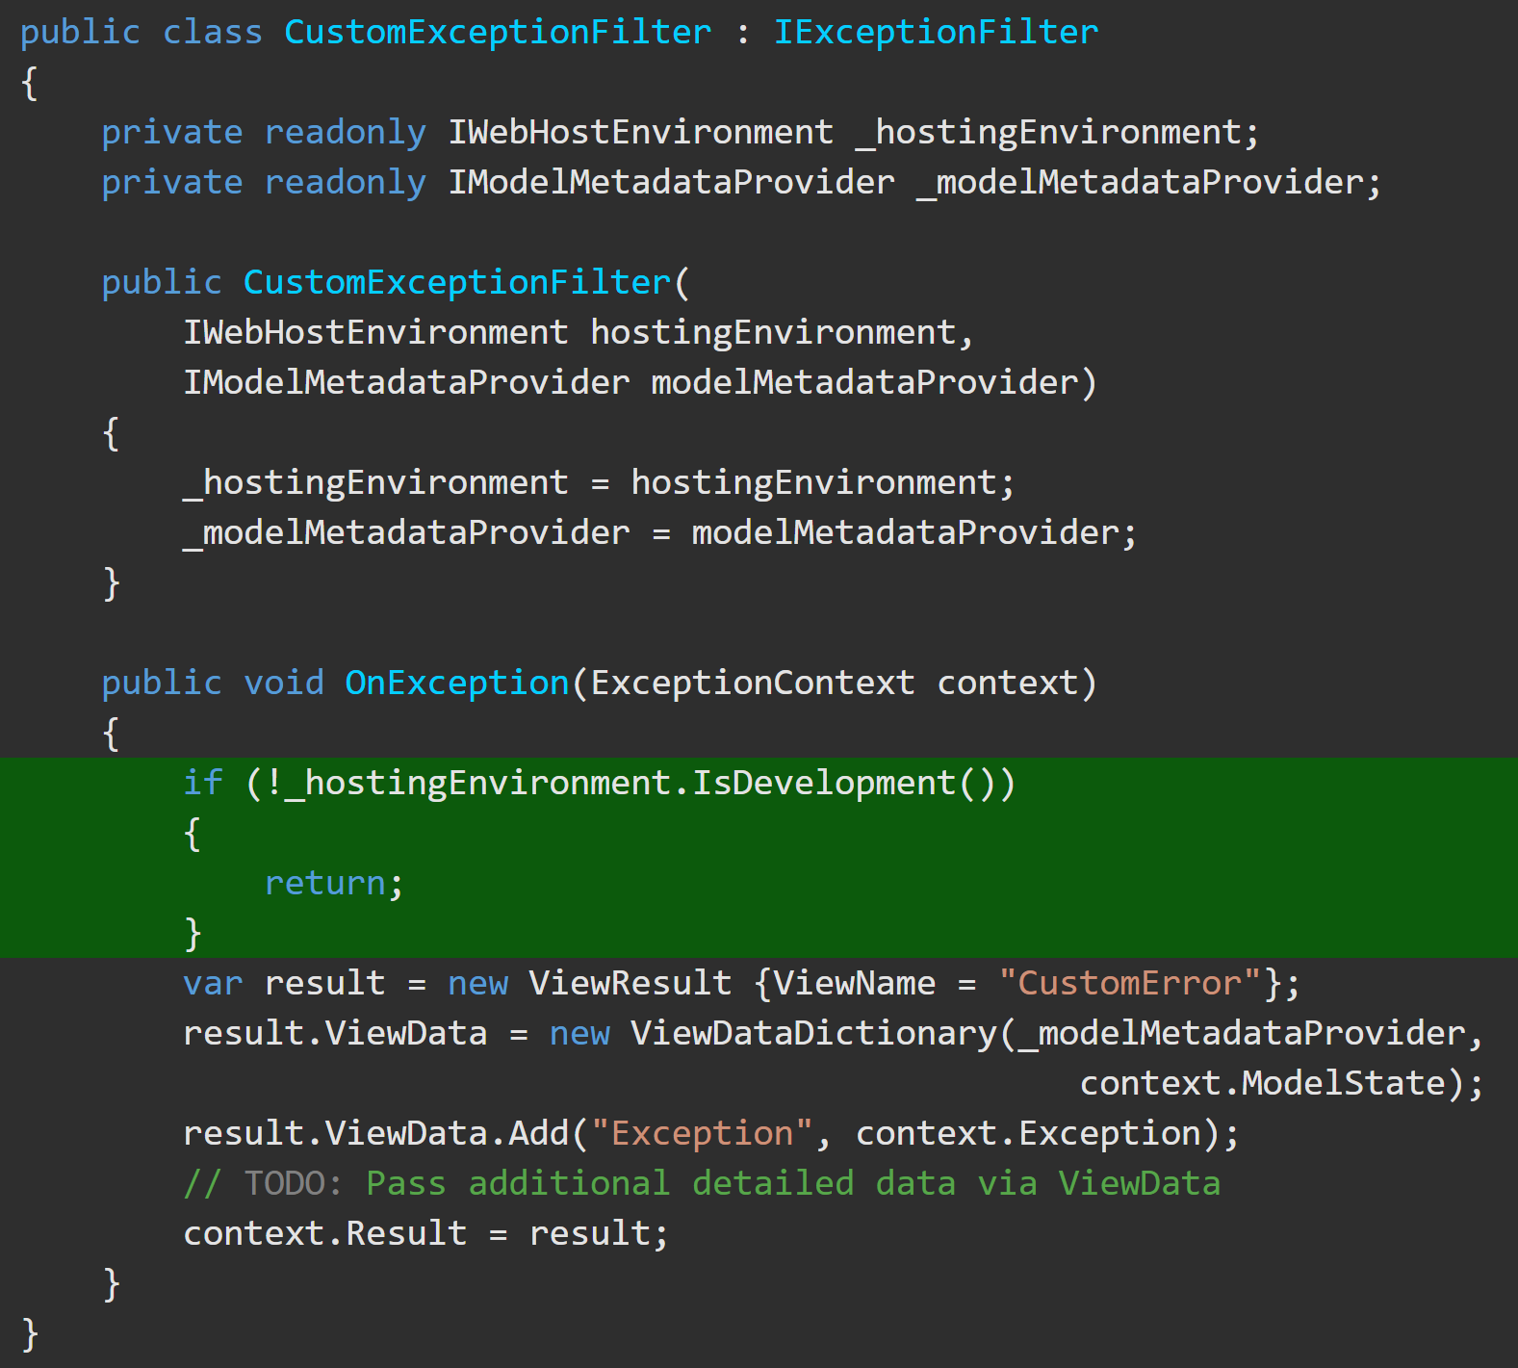
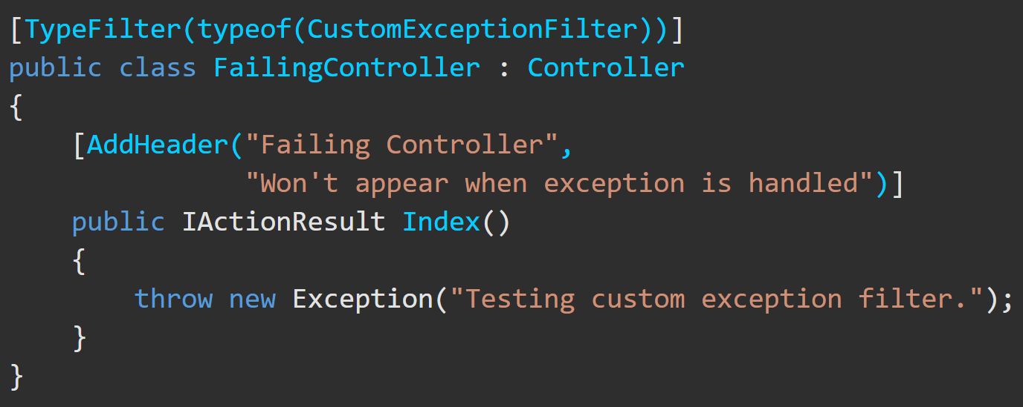
Exception Filter https://docs.microsoft.com/en-us/aspnet/core/mvc/controllers/filters?view=aspnetcore-3.1#exception-filters
Exception filters:
handle exceptions thrown at any previous step
Are an alternative to error-handling middleware (e.g. UseExceptionHandler), which is put in startup.cs and is global
Implement IExceptionFilter or IAsyncExceptionFilter.
Can be used to implement common error handling policies.
This sample exception filter uses a custom error view to display details about exceptions that occur when the app is in development.
This code tests the exception filter

Slide 11
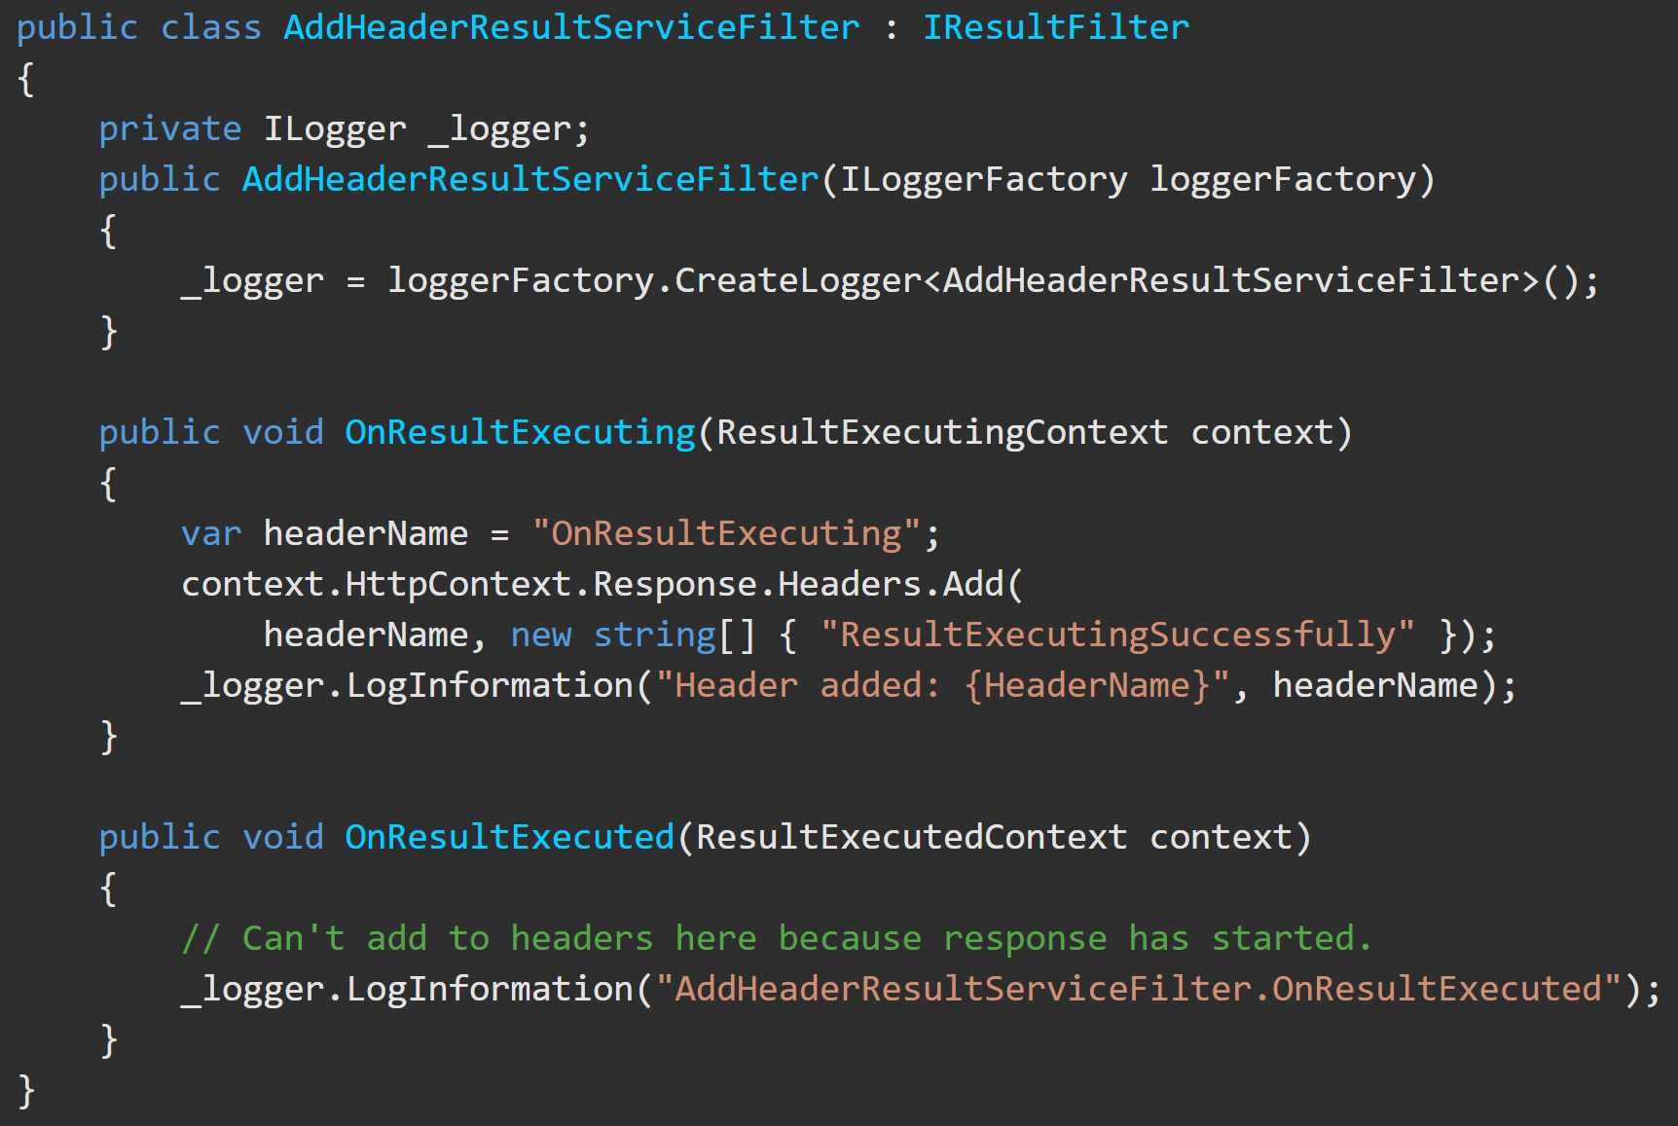
Result Filter https://docs.microsoft.com/en-us/aspnet/core/mvc/controllers/filters?view=aspnetcore-3.1#result-filters
Result filters:
Implement an interface:
IResultFilter or IAsyncResultFilter
IAlwaysRunResultFilter or IAsyncAlwaysRunResultFilter
Run just before & just after preparing the result to be sent and sending it a [HttpPost] attribute.
This code shows a result filter that adds an HTTP header:

