Slide 1

Tag Helpers
.NET

Slide 2
Tag Helpers enable server-side code to participate in creating and rendering HTML elements in Razor files.
https://docs.microsoft.com/en-us/aspnet/core/mvc/views/tag-helpers

Slide 3
What are Tag Helpers? https://docs.microsoft.com/en-us/aspnet/core/mvc/views/tag-helpers/intro?view=aspnetcore-3.1#what-are-tag-helpers
Tag Helpers are authored in C#, and they target HTML elements based on element name, attribute name, or parent tag. Tag Helpers reduce the explicit transitions between HTML and C# in Razor views.
In many cases, HTML Helpers provide an alternative approach to a specific Tag Helper, but it's important to recognize that Tag Helpers don't replace HTML Helpers and there's not a Tag Helper for each HTML Helper
Tag helpers provide a HTML-friendly environment because the syntax is familiar to front-end designers. Tag helpers provide IntelliSense. Most built-in Tag Helpers target standard HTML elements and provide server-side attributes for the element.

Slide 4
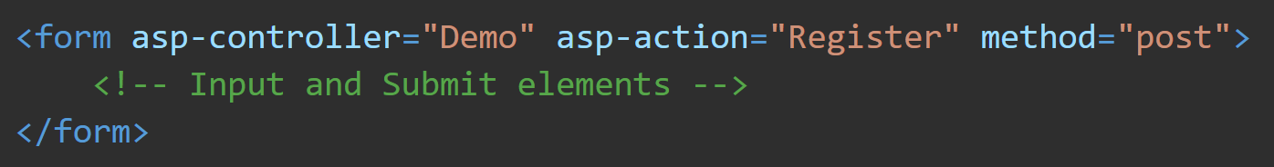
<Form> Tag Helper https://docs.microsoft.com/en-us/aspnet/core/mvc/views/working-with-forms?view=aspnetcore-3.1#the-form-tag-helper
Generates a hidden Request Verification Token to prevent cross-site request forgery (CSRF) when used with the [ValidateAntiForgeryToken] attribute in the HTTP Post action method.
The Alternative, Html.BeginForm, doesn't automatically include anti-forgery token. It’s used with a using statement to wrap the form
In HTML, the default form method is GET, but the form tag helper's default method is POST.

Slide 5
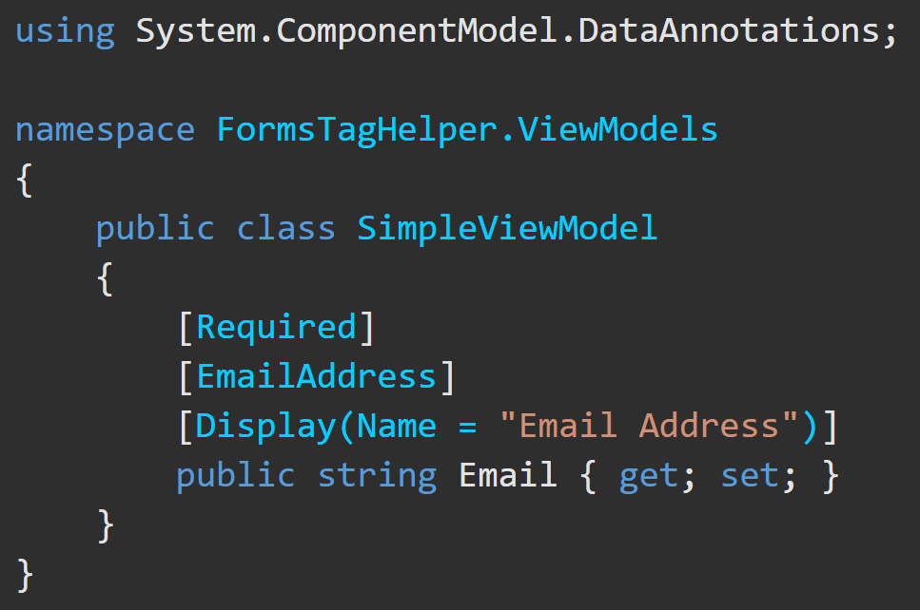
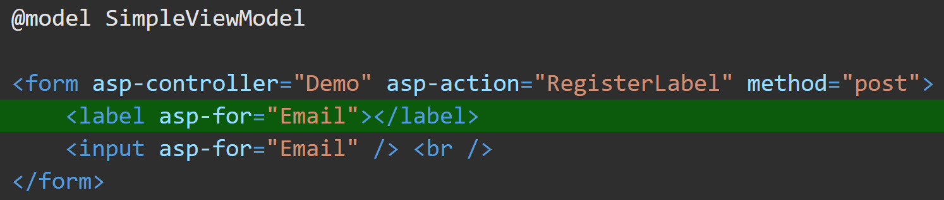
<label> Tag Helper https://docs.microsoft.com/en-us/aspnet/core/mvc/views/working-with-forms?view=aspnetcore-3.1#the-label-tag-helper
The <label> tag helper <label asp-for="Name">, gives the label for a model value. It’s html helper equivalent is Html.LabelFor.
The <label> Tag Helper provides the following benefits over a pure HTML label element:
Get the descriptive label value from the [Display] attribute in the Model.
Less markup in source code
Strong typing with the Model property.

Slide 6
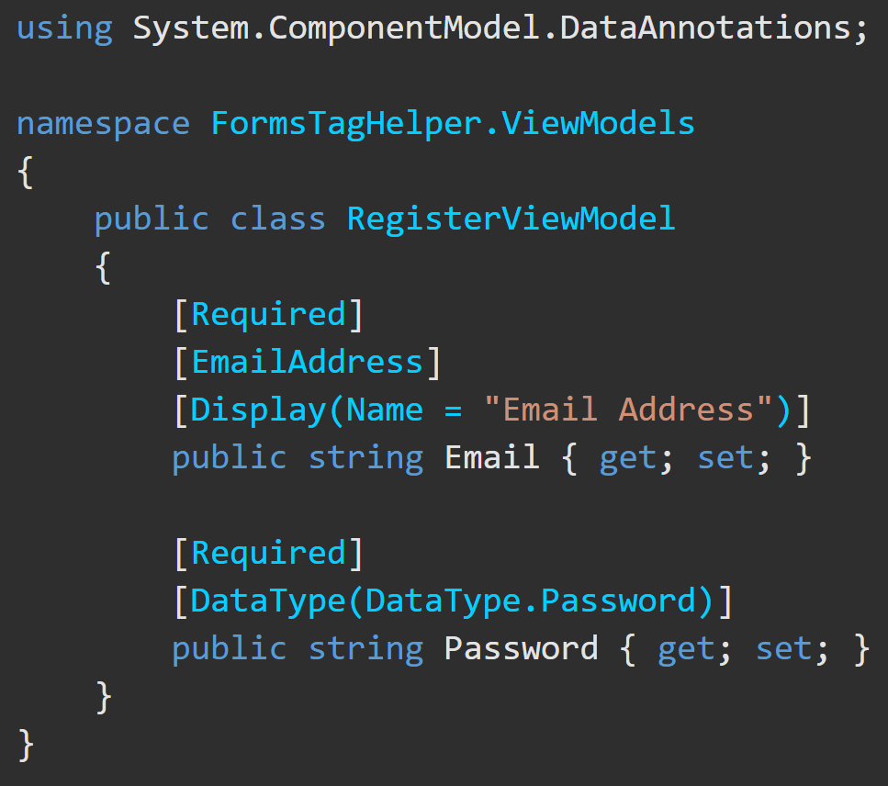
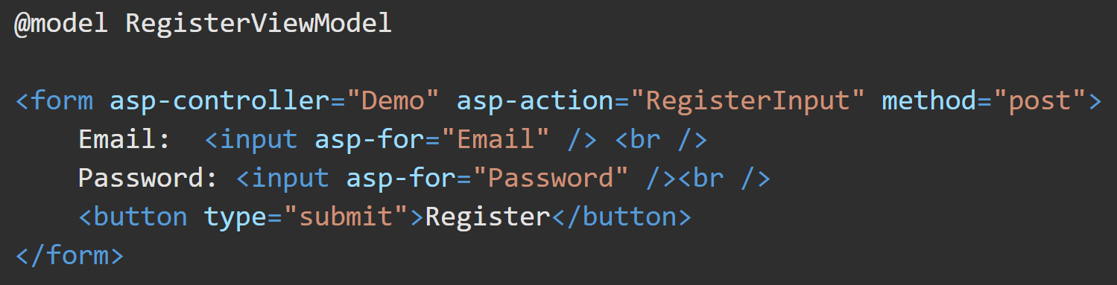
<Input> Tag Helper https://docs.microsoft.com/en-us/aspnet/core/mvc/views/working-with-forms?view=aspnetcore-3.1#the-input-tag-helper
The <input> Tag Helper binds an HTML <input> element to a model expression.
<input asp-for="Name" /> is equal to @Html.EditorFor(m => m.Name)
If a model is passed to the view, the form control will begin already populated with the model’s values.
Generates HTML5 validation attributes from data annotation attributes applied to the models properties.

Slide 7

Validation Message Tag Helper https://docs.microsoft.com/en-us/aspnet/core/mvc/views/working-with-forms?view=aspnetcore-3.1#the-validation-message-tag-helper
Used for client-side validation and the results of server-side validation when form is rejected.
<span asp-validation-for=""> is equal to html helper Html.ValidationMessageFor
Leverages model data attributes and jQuery to display validation error messages in the body of the <span> element and prevent the form from being submitted.
It will also display server-side ModelState errors.

Slide 8
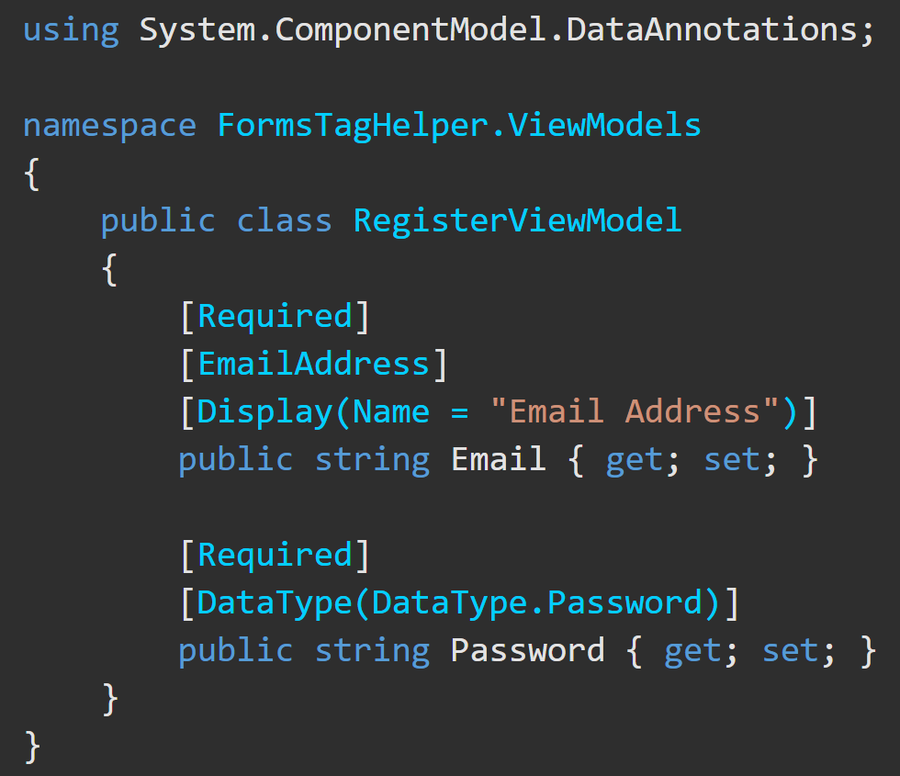
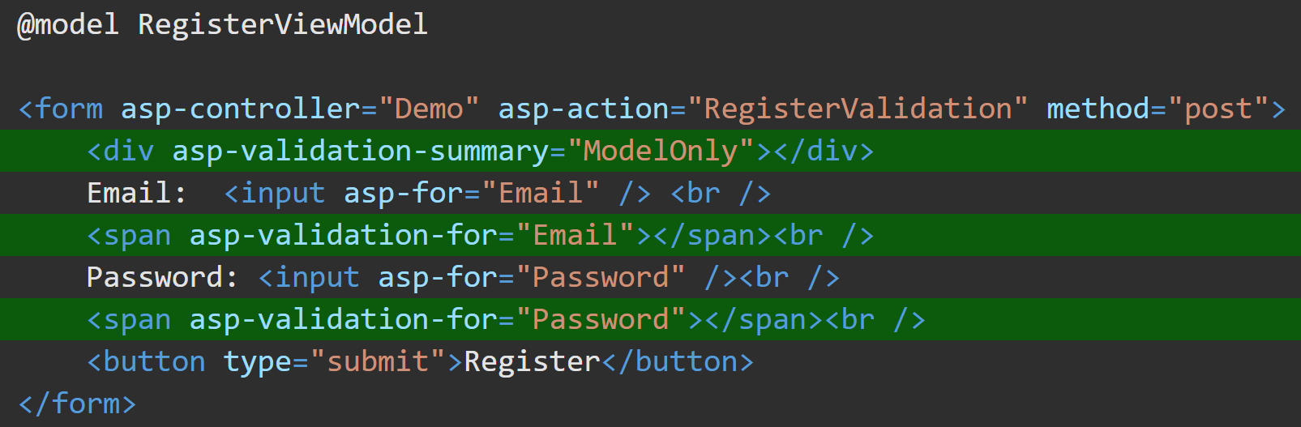
Validation Summary Tag Helper https://docs.microsoft.com/en-us/aspnet/core/mvc/views/working-with-forms?view=aspnetcore-3.1#the-validation-summary-tag-helper
asp-validation | Validation messages
= All | Property and model level
y = ModelOnly | Model
None | None
asp-validation-summary is equal to html helper Html.ValidationSummary.
also displays server-side ModelState errors.
used to display a summary of validation messages.

Slide 9
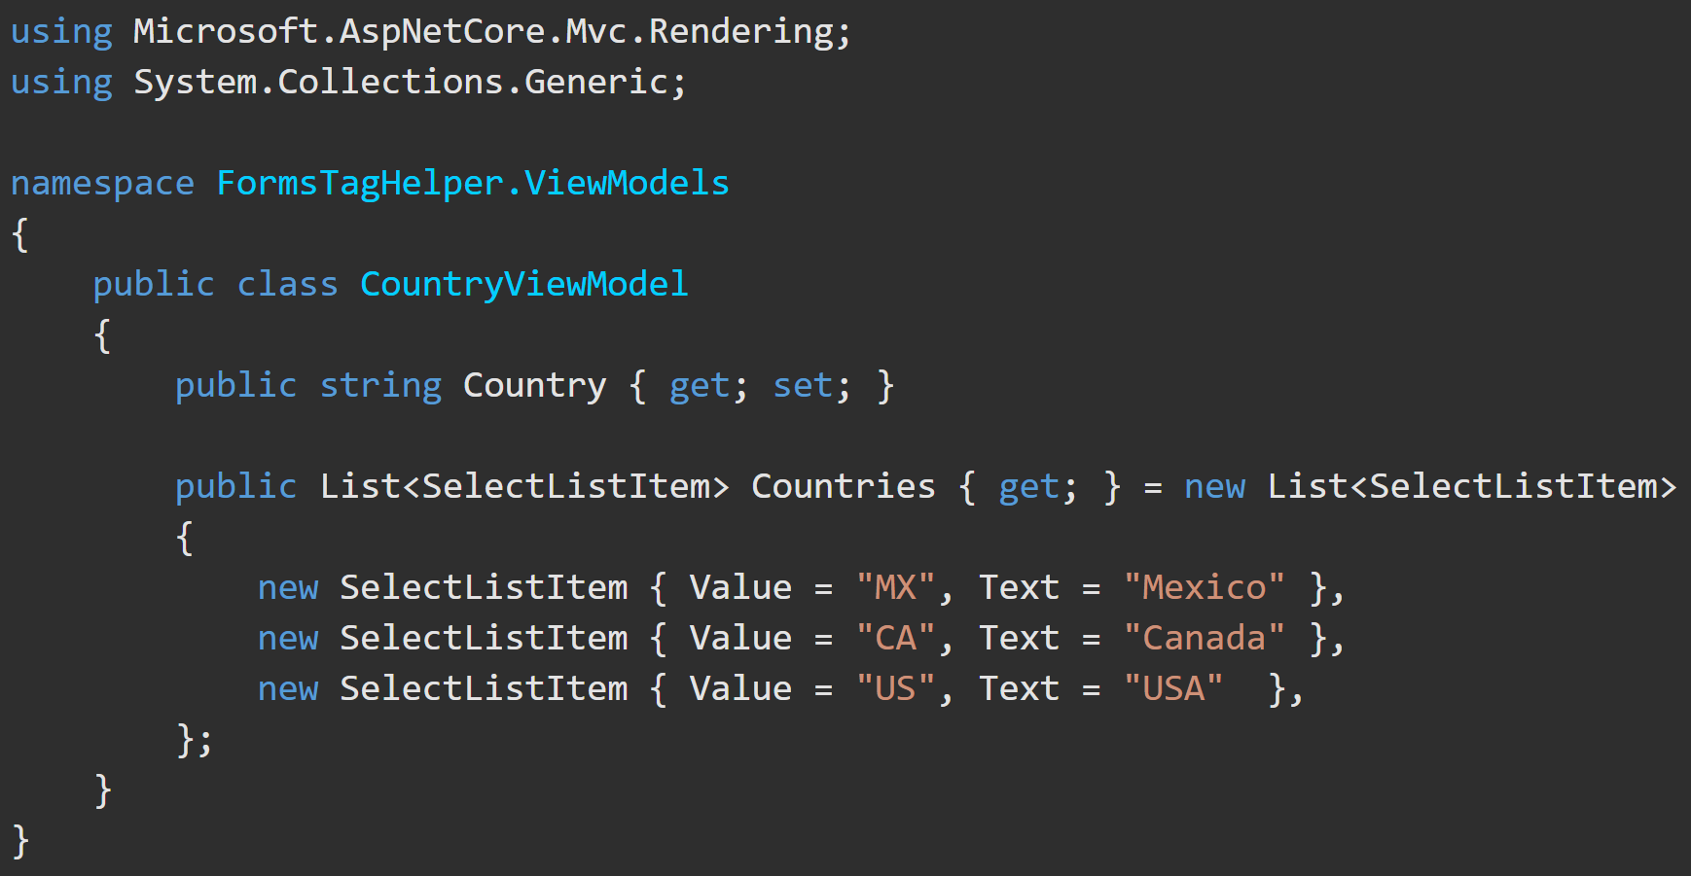
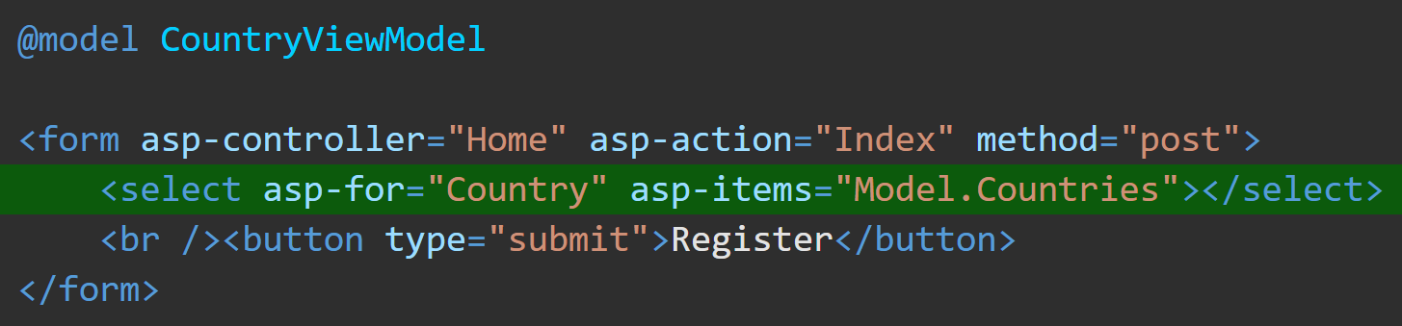
<select> Tag Helper https://docs.microsoft.com/en-us/aspnet/core/mvc/views/working-with-forms?view=aspnetcore-3.1#the-select-tag-helper
The <select> tag helper is equal to Html.DropDownListFor
You give it the list of items and the property to put the selected item into.
The list should be some IEnumerable<SelectListItem> (e.g. SelectList) property on the model.

Slide 10
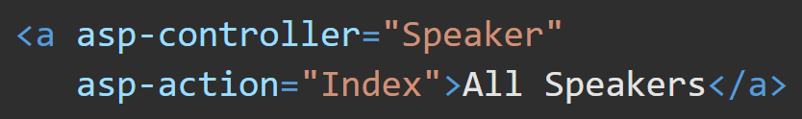
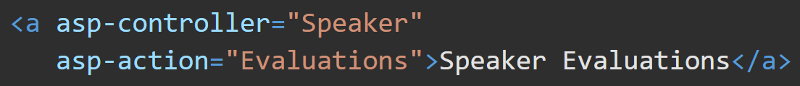
<a> (anchor) Tag Helper https://docs.microsoft.com/en-us/aspnet/core/mvc/views/tag-helpers/built-in/anchor-tag-helper?view=aspnetcore-3.1#anchor-tag-helper-attributes
The <a> TAG Helper is equal to Html.ActionLink. It is used to create a link to specify a controller/action method.
If the asp-controller attribute is specified and asp-action isn't, the default asp-action value is the action associated with the currently executing view.

Slide 11
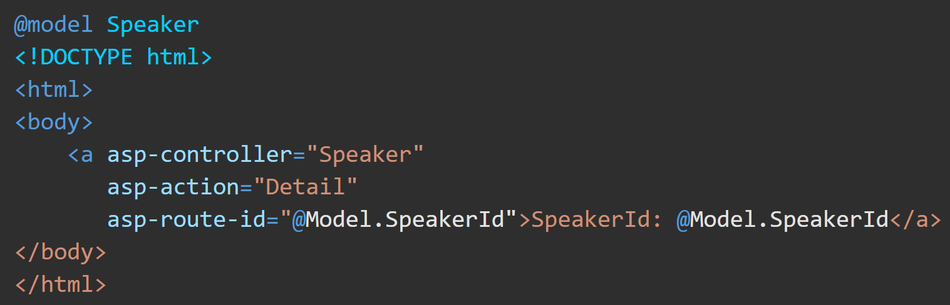
<a> (anchor) Tag Helper https://docs.microsoft.com/en-us/aspnet/core/mvc/views/tag-helpers/built-in/anchor-tag-helper?view=aspnetcore-3.1#anchor-tag-helper-attributes
asp-route-id enables a wildcard route prefix. Any value occupying the {value} placeholder in the URL is interpreted as a potential route parameter. If a default route isn't found, this route prefix is appended to the generated href attribute as a request parameter and value.

