Slide 1

Datatypes
.NET / Microsoft dynamics 365

Slide 2
In computer science and computer programming, a data type or simply type is an attribute of data which tells the compiler or interpreter how the programmer intends to use the data.
https://en.wikipedia.org/wiki/Data_type

Slide 3
Primitive Types (there are none in C#)
https://medium.com/omarelgabrys-blog/primitive-data-types-in-c-vs-java-5b8a597eef05#:~:text=
The most famous primitive data types are: int, object, short, char, float, double, char, bool. They are called primitive because they are the main built-in types and could be used to build other data types. In C#, primitive data types are actually objects. It means when you write the following code, the variable foo is actually an Object. int foo = 10;

Slide 4
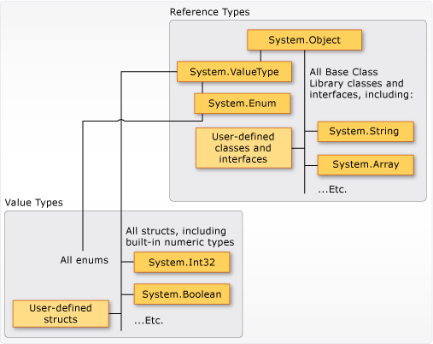
C# Datatypes Structure https://docs.microsoft.com/en-us/dotnet/csharp/programming-guide/types/
All data types inherit from the base Class Object. When an int is declared, you are declaring an instance of the struct, ‘int’

Slide 5
DataTypes https://docs.microsoft.com/en-us/dotnet/csharp/tour-of-csharp/types-and-variables
C# supports two kinds of variable types:
Value types
These are the built-in primitive data types, such as char, int, and float, as well as user-defined types declared with struct.
Reference types
Classes and other complex data types that are constructed from the primitive types. Variables of such types do not contain an instance of the type, but merely a reference to an instance.

Slide 6
Value Types – Simple Types https://docs.microsoft.com/en-us/dotnet/csharp/tour-of-csharp/types-and-variables
Signed Integral | values
Sbyte | -128 to 127
Short | -32768 to 32767
Int | -2147483648 to 2147483647
Long | -9223372036854775808 to 9223372036854775807
Unsigned Integral | values
Byte | 0 to 255
Ushort | 0 to 65535
Uint | 0 to 4294967295
Ulong | 0 to 18446744073709551615

Slide 7
Value Types – Simple Types
Unicode Characters | value
char | 0 and 65535
boolean | Value
bool | true and false (NOT 0/1)
IEEE binary floating-point | values
float | Approx. 1.5 * 10^-45 to 3.4 * 10^38 with precision of 7 digits.
double | Approx. 5.0 * 10^-324 to 1.7 × 10^308 with precision of 15-16 digits.
High-precision decimal floating-point | Values
decimal | 1.0 * 10^-28 to approx. 7.9 * 10^28 with 28-29 significant digits

Slide 8
Value Types – Enum Types
An enumeration type (or enum type) is a value type defined by a set of named constants of the underlying integral numeric type. To define an enumeration type, use the enum keyword and specify the names of enum members. Enums are immutable.
https://docs.microsoft.com/en-us/dotnet/csharp/language-reference/builtin-types/enum
enum Season
{
Spring,
Summer,
Autumn,
Winter
}

Slide 9
Value Types – Struct Types
A structure type (or struct type) is a value type that can encapsulate data and related functionality. You use the ’struct’ keyword to define a structure type:
public struct Coords
{
public Coords(double x, double y)
{
X = x;
Y = y;
}
public double X { get; }
public double Y { get; }
public override string ToString() => $"({X}, {Y})";
}

Slide 10
Reference Type – Class https://docs.microsoft.com/en-us/dotnet/csharp/language-reference/keywords/class
class TestClass
{
// A class is a blueprint for a specific object.
// Methods, properties, fields, events, delegates, and nested classes go here.
}

Slide 11
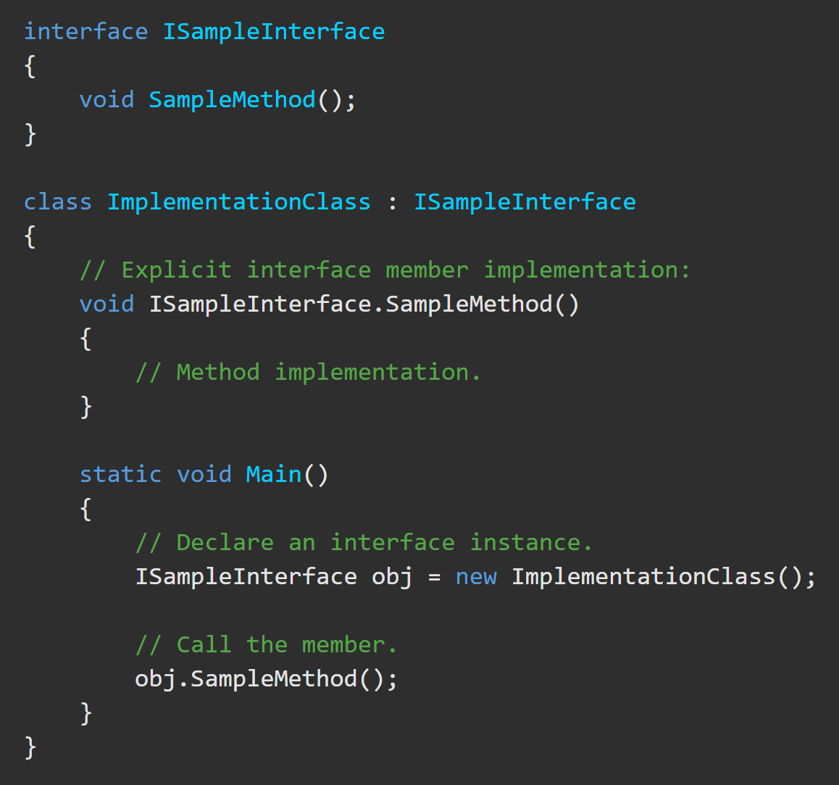
Reference Type – Interface https://docs.microsoft.com/en-us/dotnet/csharp/language-reference/keywords/interface
An interface defines a contract. Any class or struct that implements that contract must provide an implementation of the members defined in the interface. An interface contains definitions for a group of related functionalities that a non-abstract class or a struct must implement.

Slide 12
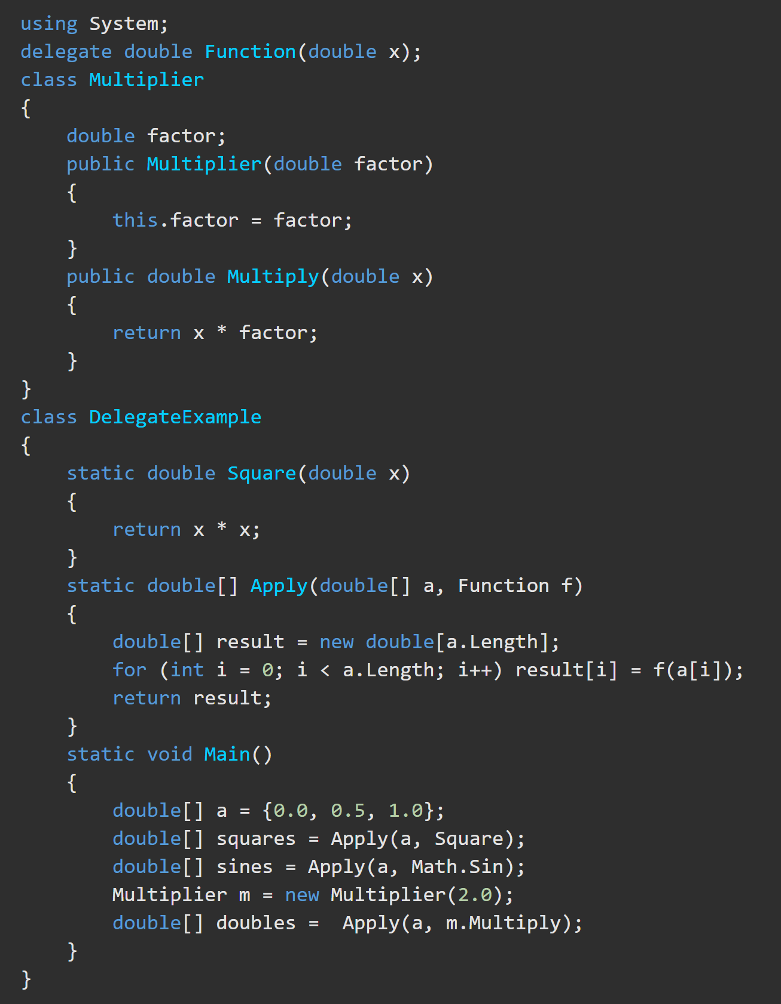
Reference Type – Delegate https://docs.microsoft.com/en-us/dotnet/csharp/tour-of-csharp/delegates https://docs.microsoft.com/en-us/dotnet/csharp/language-reference/builtin-types/reference-types
A delegate type represents references to methods with a particular parameter list and return type. Delegates make it possible to treat methods as entities that can be assigned to variables and passed as parameters. Delegates are similar to the concept of function pointers found in some other languages, but unlike function pointers, delegates are object-oriented and type-safe.

Slide 13
Reference Type – Object https://docs.microsoft.com/en-us/dotnet/csharp/language-reference/builtin-types/reference-types
The ‘object’ type is an alias for System.Object in .NET. In the unified type system of C#, all types, predefined and user-defined, reference types and value types, inherit directly or indirectly from System.Object. You can assign values of any type to variables of type object. Any object variable can be assigned to its default value using the literal null. When a variable of a value type is converted to object, it is said to be boxed. When a variable of type object is converted to a value type, it is said to be unboxed. For more information, see Boxing and Unboxing.

Slide 14
Reference Type – String https://docs.microsoft.com/en-us/dotnet/csharp/language-reference/builtin-types/reference-types
The string type represents a sequence of zero or more Unicode characters. string is an alias for System.String in .NET.
Although string is a reference type, the equality operators == and != are defined to compare the values of string objects, not references. This makes testing for string equality more intuitive. For example:
string a = "hello";
string b = "h";
// Append to contents of 'b'
b += "ello";
Console.WriteLine(a == b);//true
Console.WriteLine(object.ReferenceEquals(a, b));//false
This displays "True" and then "False" because the content of the strings are equivalent, but a and b do not refer to the same string instance.

Slide 15
Reference Type – String https://docs.microsoft.com/en-us/dotnet/csharp/language-reference/builtin-types/reference-types
Strings are immutable--the contents of a string object cannot be changed after the object is created, although the syntax makes it appear as if you can do this. For example, when you write this code, the compiler actually creates a new string object to hold the new sequence of characters, and that new object is assigned to b. The memory that had been allocated for b (when it contained the string "h") is then eligible for garbage collection.
The + operator concatenates strings => string a = "good " + "morning"; => “good morning”
Strings are immutable--the contents of a string object cannot be changed after the object is created, although the syntax makes it appear as if you can do this. For example, when you write this code, the compiler actually creates a new string object to hold the new sequence of characters, and that new object is assigned to b. The memory that had been allocated for b (when it contained the string "h") is then eligible for garbage collection.
string b = "h";
b += "ello";

Slide 16
Reference Type – String https://docs.microsoft.com/en-us/dotnet/csharp/language-reference/builtin-types/reference-types
The [] operator can be used for readonly access to individual characters of a string. Valid index values start at 0 and must be less than the length of the string:
string str = "test";
char x = str[2]; // x = 's’;
_______________________________________________
In similar fashion, the [] operator can also be used for iterating over each character in a string
string str = "test";
for (int i = 0; i < str.Length; i++)
{
Console.Write(str[i] + " ");
}
// Output: t e s t

