Slide 1

ACID (Atomicity, Consistency, Isolation, Durability)
.NET

Slide 2
ACID (atomicity, consistency, isolation, durability) is a set of properties of database transactions intended to guarantee validity even in the event of errors or power failures.
https://en.wikipedia.org/wiki/ACID

Slide 3
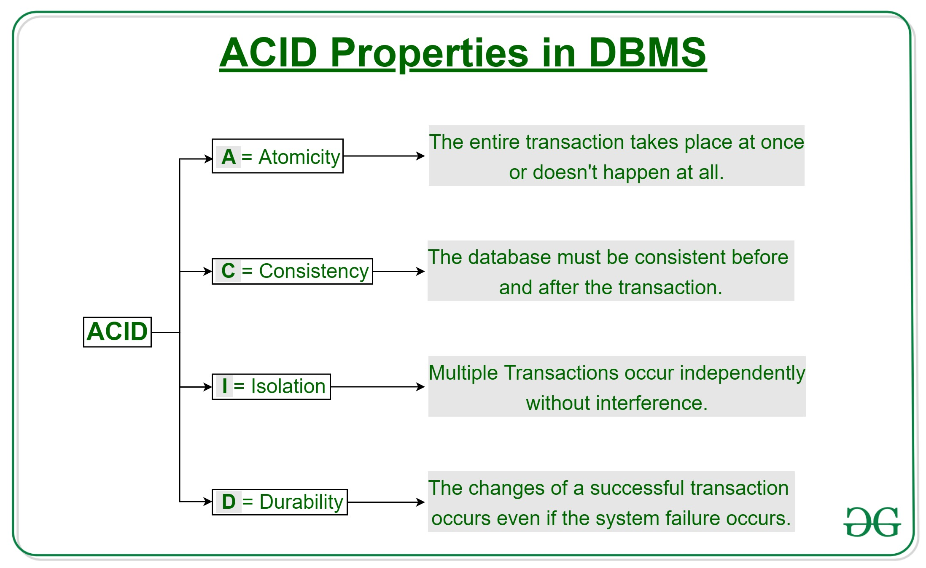
ACID – Atomicity https://docs.microsoft.com/en-us/windows/win32/cossdk/acid-properties
A transaction must execute exactly once and must be atomic (either all of the work is done or none of it is).
By performing only a subset of interdependent operations, the overall intent of a transaction would be compromised.
Atomicity eliminates the chance of processing only a subset of operations.

Slide 4
ACID - Consistency
A transaction must preserve the consistency of data.
Referential Integrity must be maintained when transforming one consistent state of data into another consistent state of data.

Slide 5
ACID - Isolation
A transaction must be completed in isolation. This means that Concurrent Transactions should behave as if each were the only transaction running in the system.
A high degree of isolation can limit the number of concurrent transactions.

Slide 6
ACID - Durability
A transaction must have durability (i.e., be recoverable.
If a transaction commits, its updates will persist even if the computer crashes immediately after the commit.
Specialized logging allows the system's restart procedure to complete unfinished operations required by the transaction. This makes the transaction durable.

