Slide 1

Relational Databases Anomalies Normalization
.NET

Slide 2
A database is made up of a collection of tables that stores a specific set of structured data. A table contains a collection of rows, also referred to as records or tuples, and columns, also referred to as attributes. Each column in the table is designed to store a certain type of information.
- Neil Armstrong

Slide 3
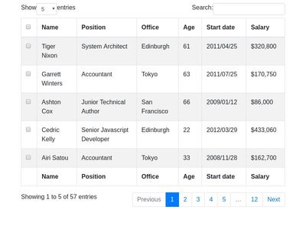
Databases – Instances/Users https://docs.microsoft.com/en-us/sql/relational-databases/databases/databases?view=sql-server-ver15
There are one (or many) schemas within a database. Within each schema there are database objects such as tables and views.
This is a table. →→→→→
Foreign Key
A row(Tuple) makes up an entity
Primary Key
Attributes / keys

Slide 4
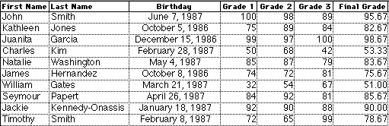
DBMS (Database Management System) https://www.tutorialspoint.com/dbms/dbms_overview.htm
Data is a collection of facts and figures that can be processed to produce information.
A Database is a collection of related data.
A DBMS stores data in such a way that it becomes easier to retrieve and manipulate.
If we have data about grades of all students, we can extrapolate average grades and highest grades.
Primary Key

Slide 5
DBMS - Benefits https://www.tutorialspoint.com/dbms/dbms_overview.htm
Relation-based tables − A Relational DBMS allows entities and relations among them to form tables.
Separation of data and application − A database is separated from its data. A database is an active entity, whereas data on which the database works is said to be passive.
Less redundancy − DBMS follows the rules of normalization, which splits a relation when any of its attributes is having redundancy in values. Normalization is a mathematically rich and scientific process that reduces data redundancy.
Consistency − Consistency is a state where every relation in a database remains consistent.
Query Language − DBMS (or RDBMS) is equipped with query language (usually SQL), which makes it more efficient to retrieve and manipulate data.
ACID Properties − A DBMS follows the concepts of Atomicity, Consistency, Isolation, and Durability.
Isolation Levels − A DBMS supports a multi-user environment and applies restrictions on the access and manipulation of data in parallel.

Slide 6
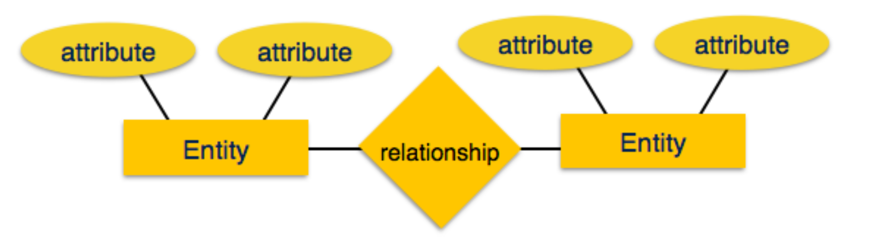
Database – Entity-Relationship Models https://www.tutorialspoint.com/dbms/dbms_data_models.htm
Data models define the structure of a database. Data Models are entities that introduce abstraction in a DBMS.
Data models define how data is connected to each other and how they are processed and stored inside the database.
An Entity-Relationship (ER) Model is based on the notion of real-world entities and the relationships between them. An ER Model is used for the conceptual design of a database.

Slide 7
Database – Entity-Relationship Models https://www.tutorialspoint.com/dbms/dbms_data_models.htm
Entity − a real-world thing having properties called attributes.
Attribute - the details about an entity.
Relationship − The logical association among entities. Relationships are mapped with entities in various ways.
Mapping cardinalities defines the number of associations between two entities.
Mapping cardinalities −
one to one
one to many
many to one
many to many
Address
sport
teachers
Principal
Student
attends
School
Does this ER Model need to be normalized?

Slide 8
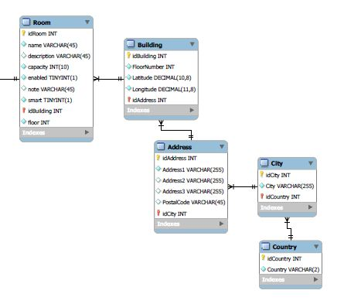
Database – Schema Diagram https://www.tutorialspoint.com/dbms/dbms_data_schemas.htm
A database schema is the skeleton structure that represents the logical view of the entire database.
It defines how the data is organized and how the relations among them are associated.
It displays all the constraints that are to be applied on the data.
A schema diagram contains a descriptive detail of the database.

Slide 9
Databases – Primary and Candidate Keys https://www.tutorialspoint.com/dbms/er_model_basic_concepts.htm https://docs.microsoft.com/en-us/ef/core/modeling/keys?tabs=data-annotations
Candidate Key − An attribute of an entity. An entity set may have more than one candidate key.
Primary Key − A Candidate Key chosen to uniquely identify the entity set(tuple).
Foreign Key – The Primary Key of another table. Used to represent to other entity.
Foreign Key
Tuple makes up an entity
Primary Key
Attributes / Keys

Slide 10
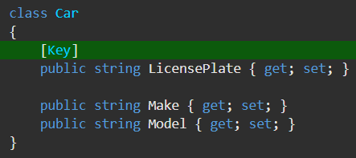
Database - Keys in Entity Framework https://docs.microsoft.com/en-us/ef/core/modeling/keys?tabs=data-annotations
A key serves as a unique identifier for each entity instance. Most entities in EF have a single key, which maps to the concept of a primary key in relational databases. It’s possible for an entity to have no keys. Entities can have additional keys (Alternate Keys) beyond the Primary Key. By convention, any property named Id or <type name>Id will be automatically configured by EF as the Primary Key of an entity.
You can force configure any single property to be the primary key of an entity.

Slide 11
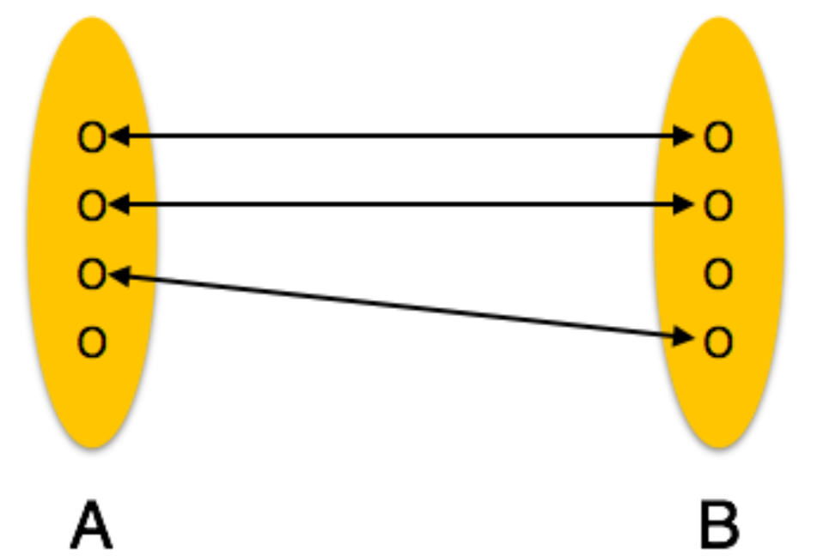
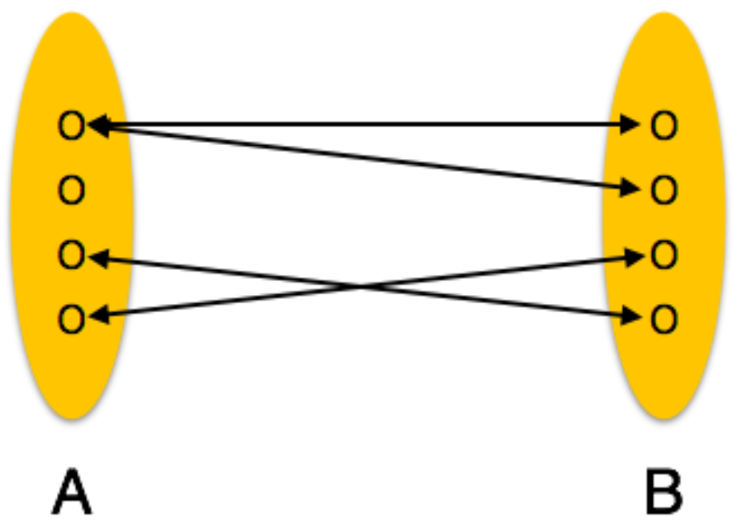
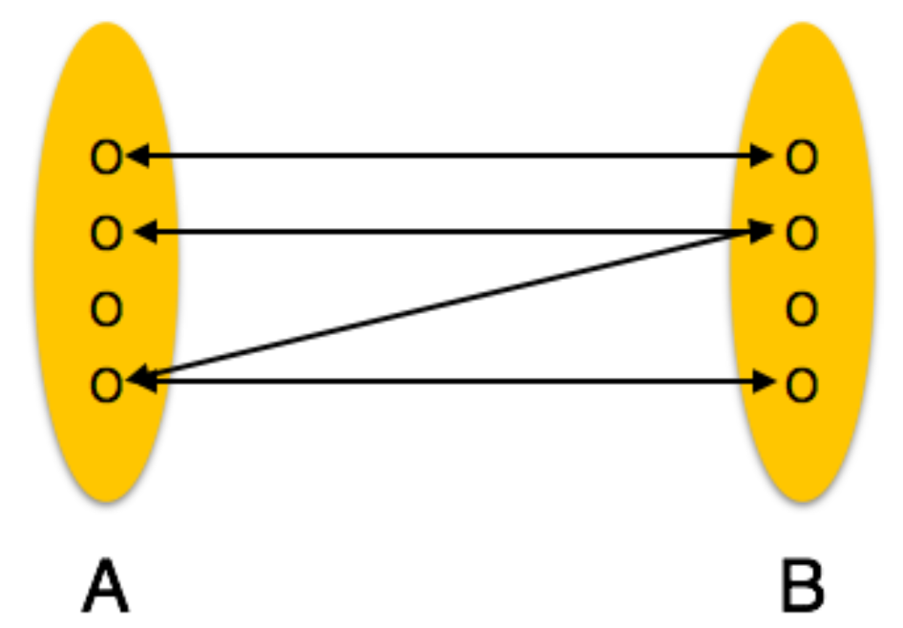
Database – Relationships https://www.tutorialspoint.com/dbms/er_model_basic_concepts.htm
Cardinality
One-to-one | One-to-many | Many-to-many
One entity from entity set A can be associated with at most one entity of entity set B and vice versa. | One entity from entity set A can be associated with more than one entities of entity set B however an entity from entity set B, can be associated with at most one entity | One entity from A can be associated with more than one entity from B and vice versa.

Slide 12
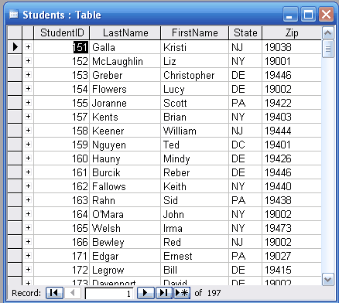
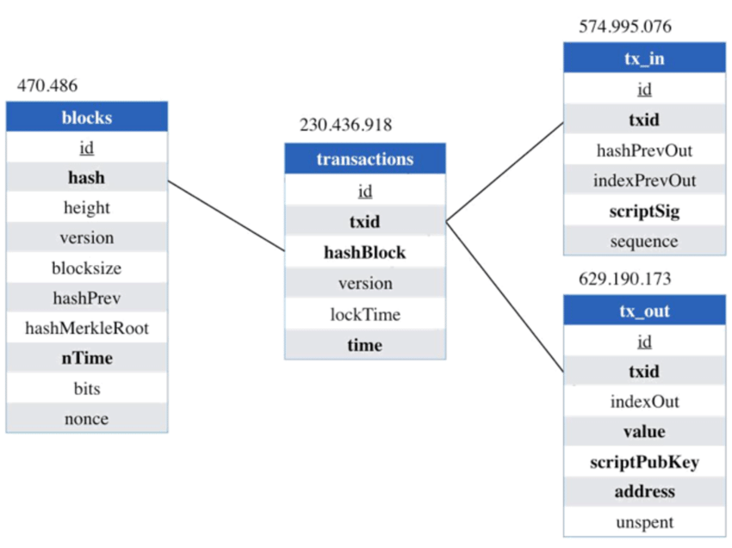
Relational Databases https://en.wikipedia.org/wiki/Relational_database#RDBMS
A RDBMS allows entities to form tables with relations between them. One can understand the architecture of a database just by looking at the table names.
A DBMS is a "software system that enables users to define, create, maintain and control access to the database". A RDBMS is an extension of that acronym that is sometimes used when the underlying database is relational.

Slide 13
Relational Databases – Concepts https://www.tutorialspoint.com/dbms/relational_data_model.htm
Tables − relations are saved in table format. This format stores the relation among entities. A table has rows and columns, where rows represent entities and columns represent attributes.
Tuple − A single row of a table, which contains a single record for that entity is called a tuple.
Relation schema − A relation schema describes the relation name (table name), attributes, and their names.
Primary Key − Each row has one or more attributes, chosen as Primary keys. These identify the row in the table uniquely.
Composite Key – Multiple Candidate Keys that together form the Primary Key.
Index – A unique number given to each tuple in a table to serve as the Primary Key.

Slide 14
Relational Databases – Constraints https://www.tutorialspoint.com/dbms/relational_data_model.htm
Key Constraints | Domain Constraints | Referential Integrity Constraints
Candidate Keys must uniquely identify an entity. A Candidate Key can not have NULL values. | Every attribute must have a specific range of values. | A Foreign Key refers to a Primary key of a different table. If a tuple has a Foreign Key, that PK must exist.

Slide 15
Databases – Anomalies https://www.tutorialspoint.com/dbms/database_normalization.htm
If a Database has inconsistent data, it will incur anomalies. A DB with anomalies can give wrong data.
There are three types of anomalies
Update anomaly − If data items are not linked to each other properly, when one data item is updated, a few instances may get updated properly while a few others are left with old values
Deletion anomaly − When a record is deleted, but linked parts of it were left undeleted because of unawareness or when deletion deletes other data unintentionally.
Insertion anomaly − When data is inserted into a record that does not exist or cannot be inserted without an unrelated data.

Slide 16
Normalization Assignment- Create an unnormalized table.
List the information of your family members.
There must be at least 5 attributes to each tuple and at least 5 entities.

Slide 17

Databases – Normalization https://www.tutorialspoint.com/dbms/database_normalization.htm https://www.c-sharpcorner.com/UploadFile/0146e3/database-normalization/
Normalization is a method to prevent anomalies and keep the database to a consistent state. Fields and tables of a relational DB are organized to minimize redundancy and dependency. Normalization usually involves dividing large tables into smaller (and less redundant) tables and defining relationships among them.
There are many normal forms but there are 1NF, 2NF, and 3NF are primarily used.

Slide 18
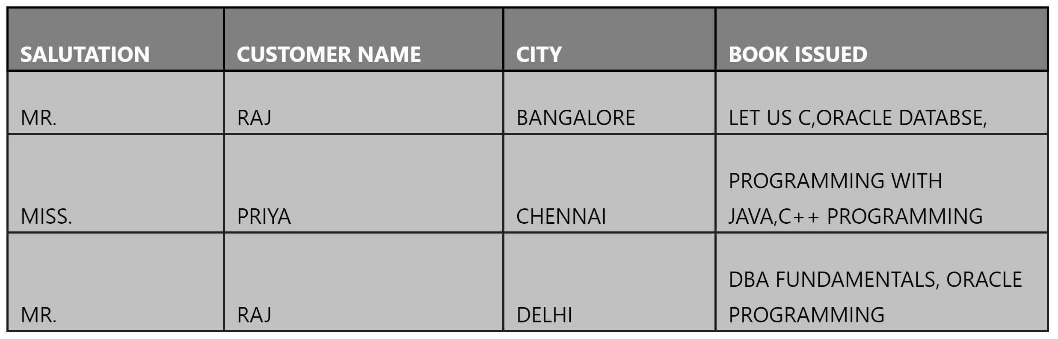
Databases – Normalization https://www.tutorialspoint.com/dbms/database_normalization.htm https://www.c-sharpcorner.com/UploadFile/0146e3/database-normalization/
This table is not normalized. All the information is stored in one table.

Slide 19
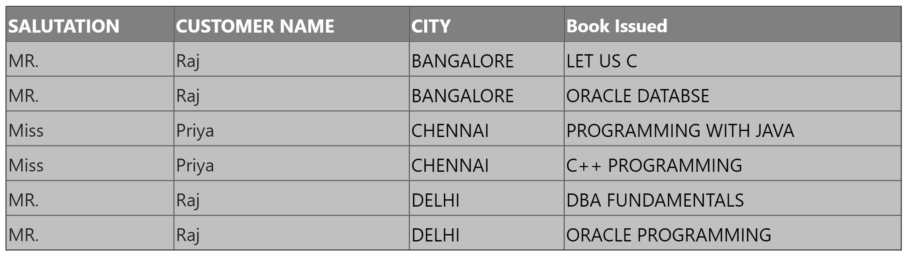
Databases – Normalization https://www.tutorialspoint.com/dbms/database_normalization.htm https://www.c-sharpcorner.com/UploadFile/0146e3/database-normalization/
1st Normal Form (1NF) –
each table cell should contain a single value.
Each record needs to be unique.
It contains atomic values only.

Slide 20
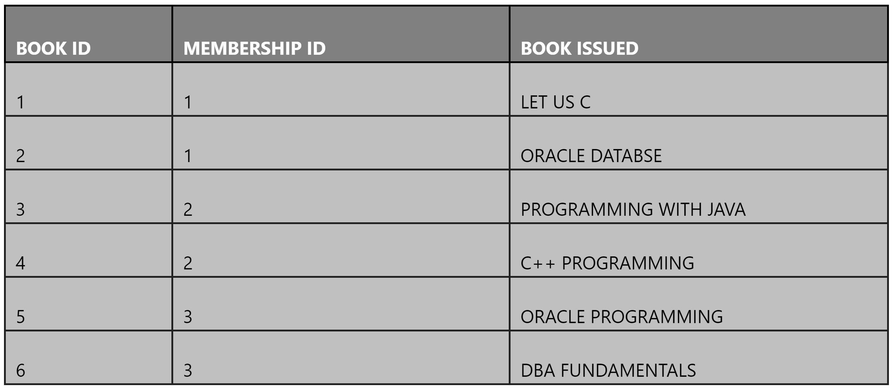
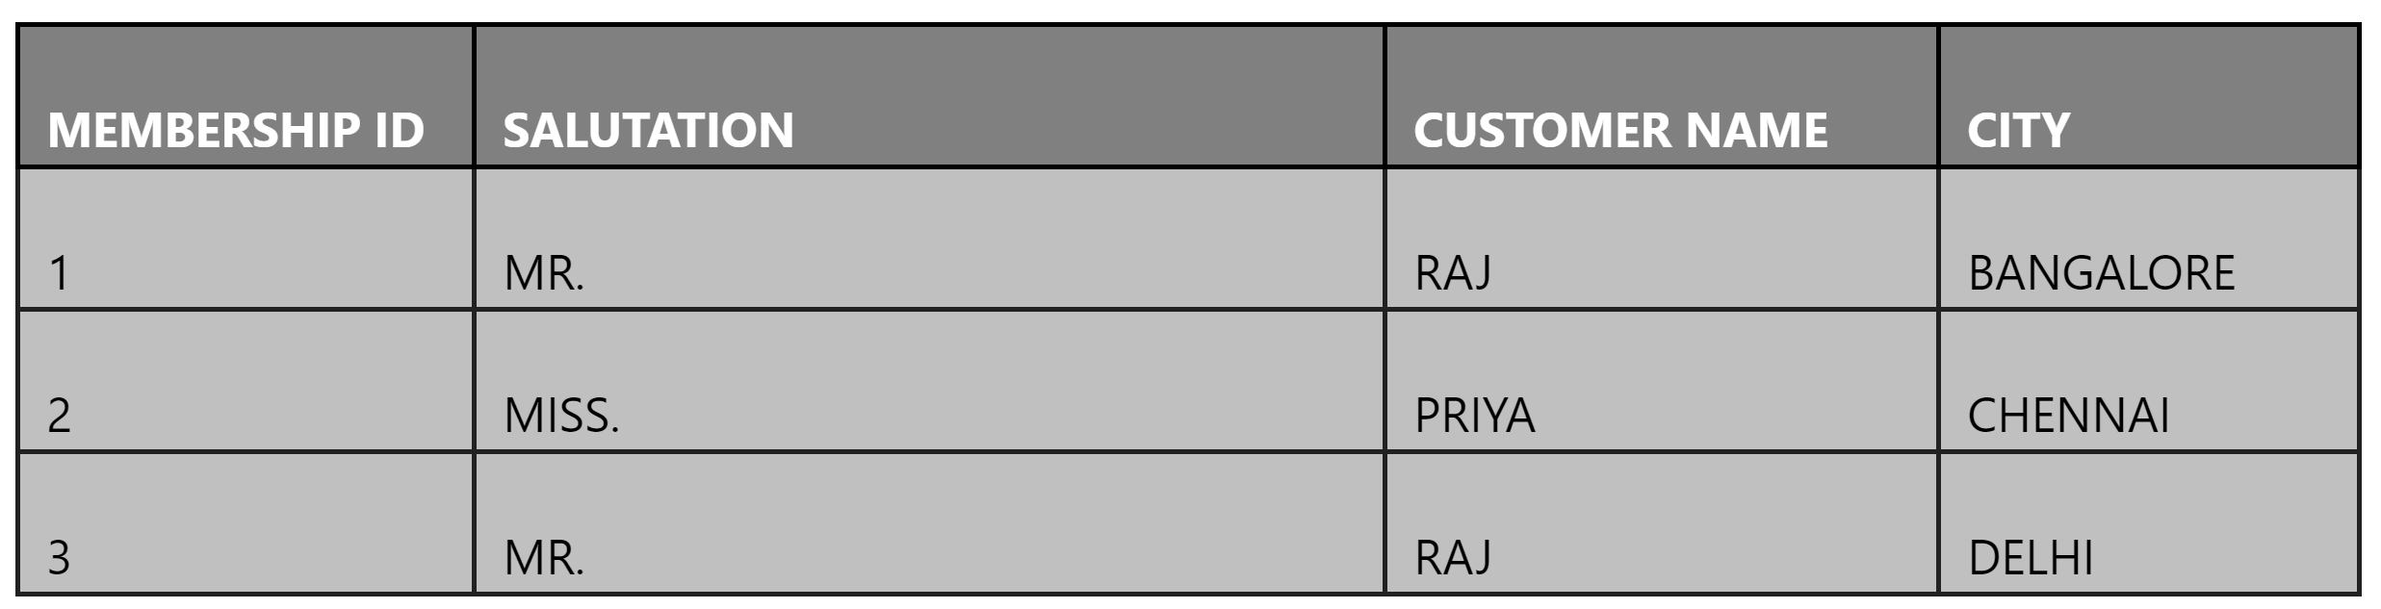
Databases – Normalization https://www.tutorialspoint.com/dbms/database_normalization.htm https://www.c-sharpcorner.com/UploadFile/0146e3/database-normalization/
2nd Normal Form (2NF) –
First, be in 1NF.
Have a single Column Primary Key.
Remove subsets of data that apply to multiple rows of a table and place them in separate tables with PK → FK relationships among the new tables.
If it is in 1NF and every non-key attribute is dependent on the Primary Key. then 2NF is automatic.
The 1NF table divides into two tables.
Table 1 contains only member information. Membership_id is created. It’s the Primary Key for table 1.
Table 2 contains the information for each book. Table 2’s new column is book_id. It is the Primary Key for table 2.

Slide 21
Databases – Normalization https://www.tutorialspoint.com/dbms/database_normalization.htm https://www.c-sharpcorner.com/UploadFile/0146e3/database-normalization/
“Is field A dependent upon field B, or vice versa?" This means: "Given a value for A, do we then have only one possible value for B, and vice versa?"
If the answer is yes, then A and B should be put into a new table, with A becoming the Primary Key. A should be left in the original relation and marked as a foreign key.

Slide 22
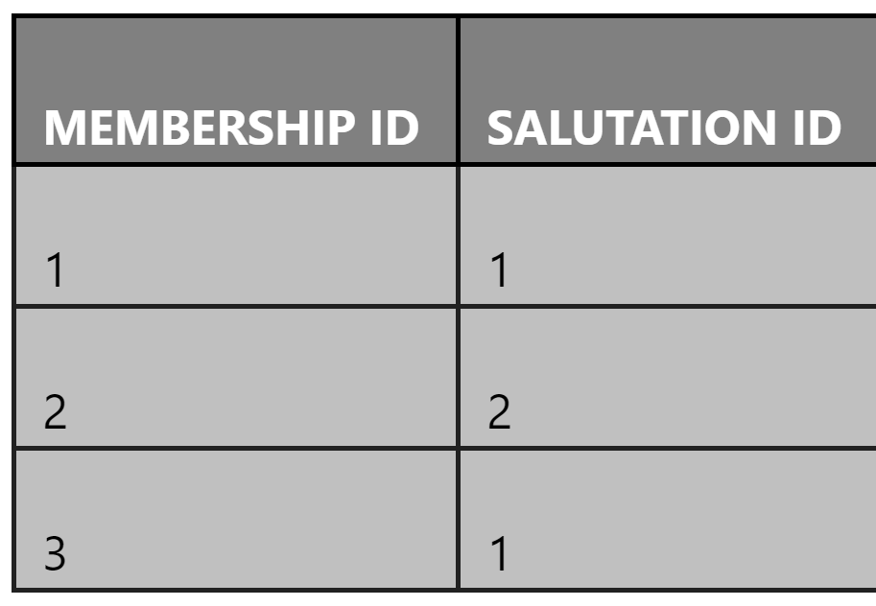
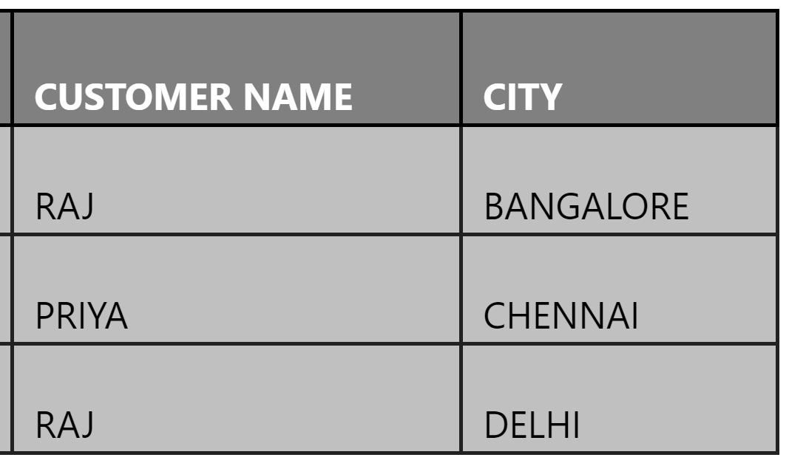

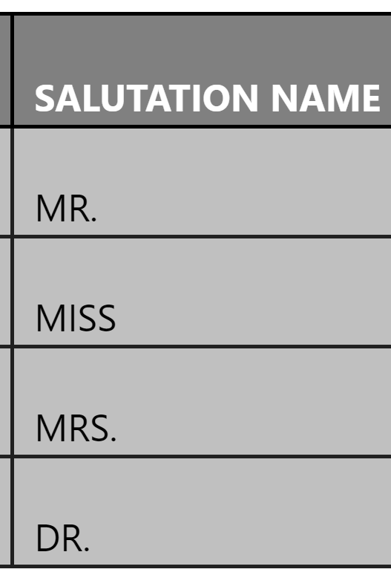
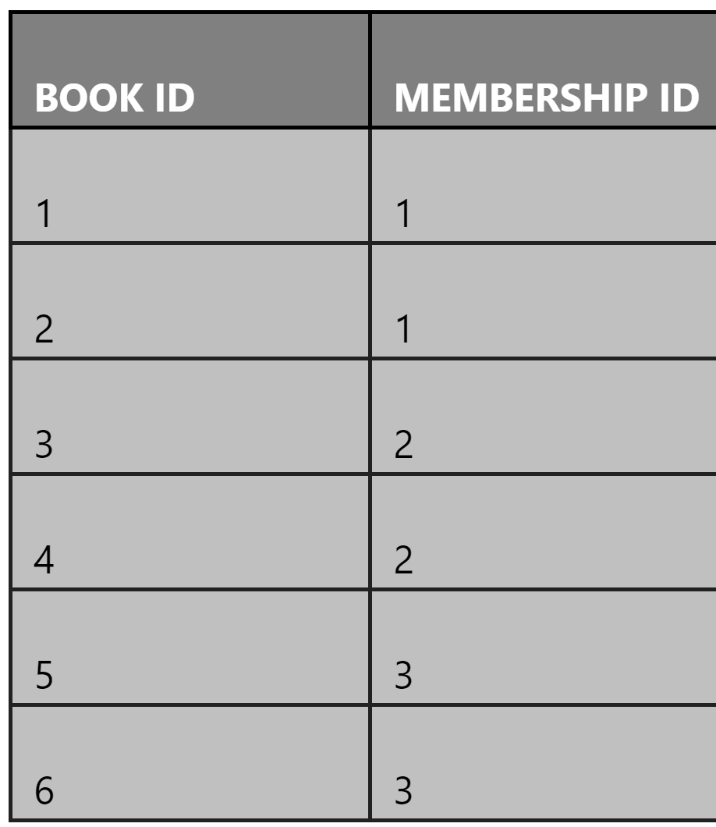
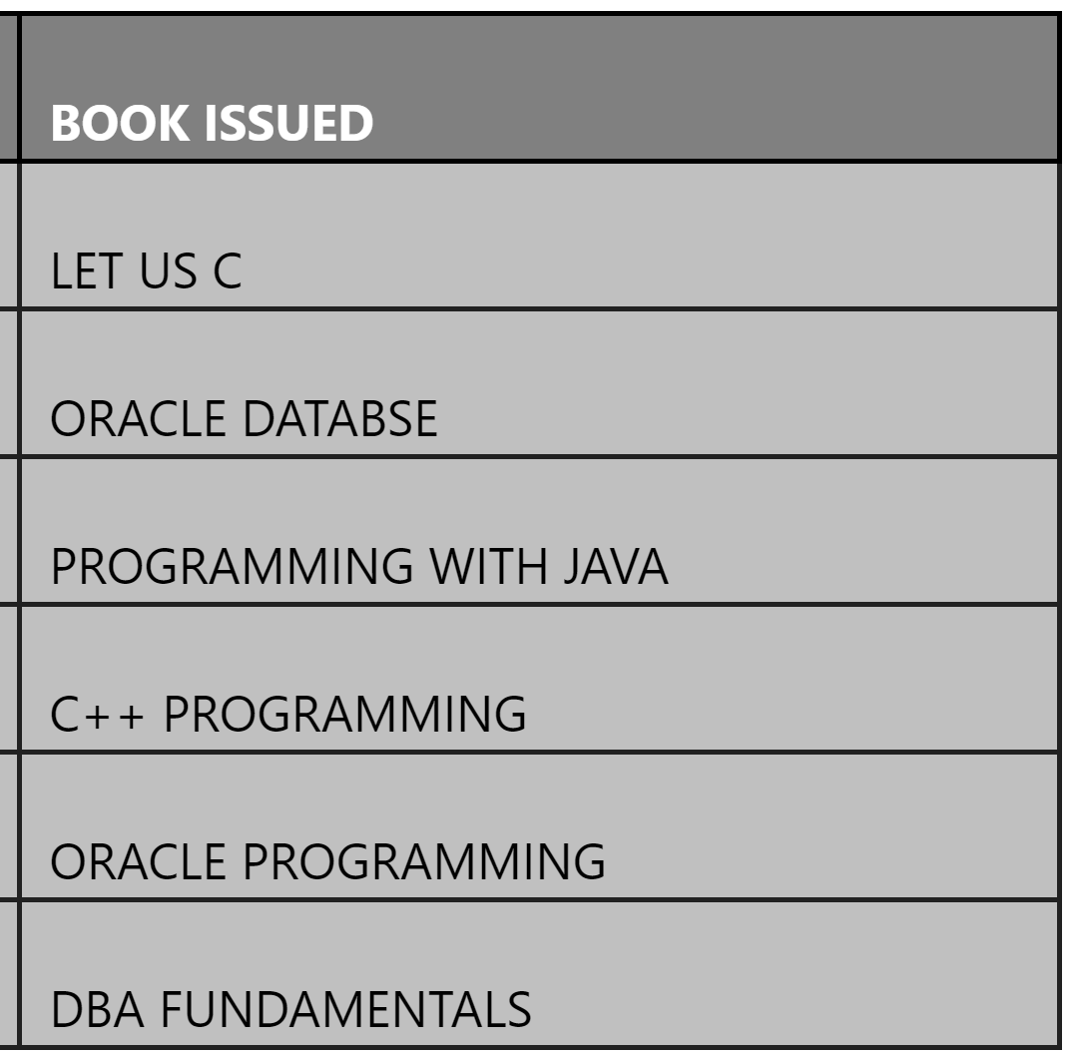
Databases – Normalization https://www.tutorialspoint.com/dbms/database_normalization.htm https://www.c-sharpcorner.com/UploadFile/0146e3/database-normalization/
A transitive functional dependency occurs when changing a Candidate Key column might cause any of the other Candidate Key columns to change. Consider table 1. Changing the non-key column Customer Name may change Salutation.
Table 1
Again, the table is divided and a new table is created that stores Salutation only. The database is in 3NF.
Table 3
Table 2

Slide 23
Assignment- Convert your table to a 3NF table.
List the information of your family members.
There must be at least 5 attributes to each tuple and at least 5 entities.

