Slide 1

Data Definition Language SQL Data Types
.NET

Slide 2
A software system used to maintain relational databases is a Relational Database Management System (RDBMS). Many relational database systems use SQL (Structured Query Language) for querying and maintaining the database.
https://docs.microsoft.com/en-us/sql/t-sql/language-reference?view=sql-server-ver15

Slide 3

(RDBMS) Relational Database Management System – History https://en.wikipedia.org/wiki/Relational_database
Relational databases are based on the relational model of data, as proposed by E. F. Codd in 1970.
Edgar Frank "Ted" Codd (August 23, 1923 – April 18, 2003) was a British computer scientist and winner of the 1981 Turing Award.

Slide 4
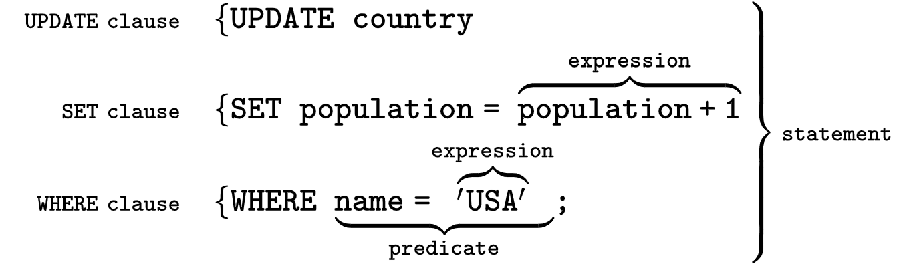
SQL (Structured Query Language) https://en.wikipedia.org/wiki/SQL
Originally based upon relational algebra and tuple relational calculus, SQL consists of many types of statements which may be informally classed as sublanguages.
The most important sublanguages (for our usage) are:
Data Definition Language (DDL)
Data Manipulation Language (DML).
The scope of SQL includes data query, data manipulation (insert, update and delete), data definition (schema creation and modification), and data access control.
SQL is a declarative language. We say what data we want, not how to get it. We cannot manage how SQL obtains the data.

Slide 5
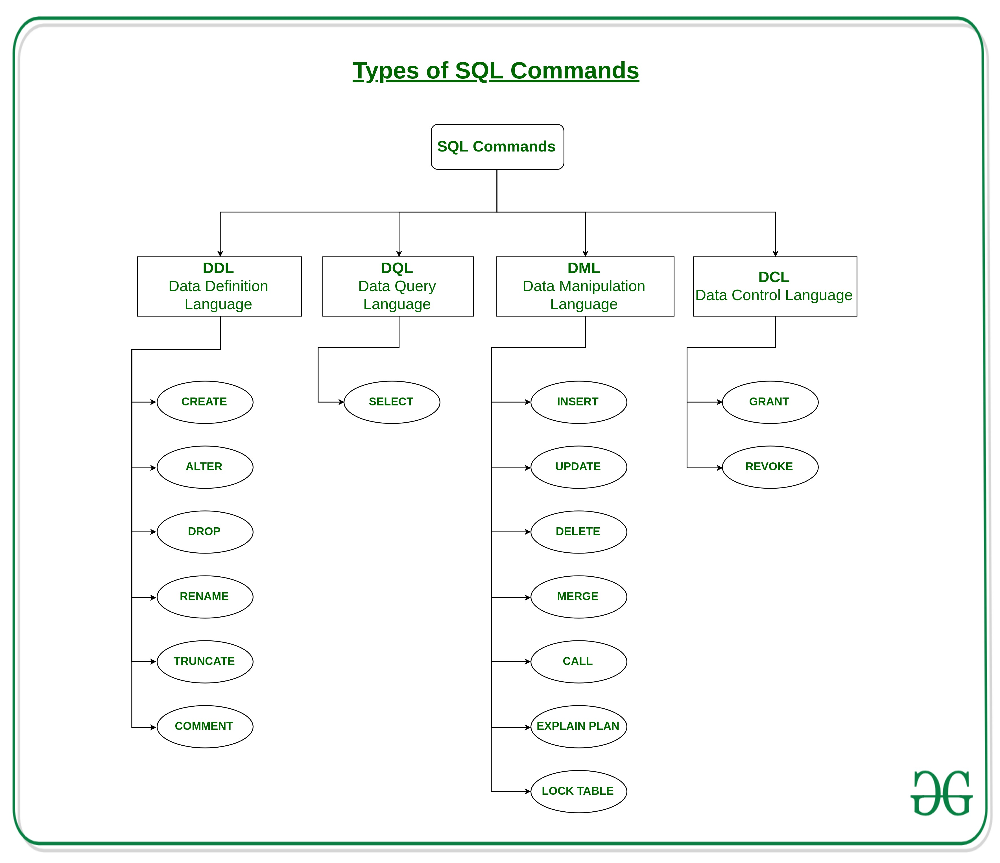

Slide 6
Data Definition Language https://docs.microsoft.com/en-us/sql/t-sql/statements/statements?view=sql-server-ver15#data-definition-language
Data Definition Language (DDL) statements defines the data structure. Use these statements (and others) to create, alter, or drop data structures in a database.
ALTER - Modifies a table definition by altering, adding, or dropping columns and constraints.
CREATE - This statement creates a new database
DROP - Removes one or more table definitions and all data, indexes, triggers, constraints, and permission specifications for those tables.

Slide 7
SQL – Create and Drop a DB
*Deleting a database will result in complete loss of information stored in the database! Create a DB inside Azure to avoid costs.

Slide 8
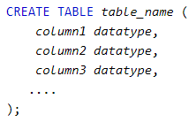
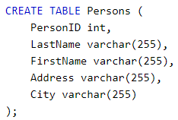
SQL – Create and Drop a table
*Deleting a table will result in loss of complete information stored in the table!

Slide 9
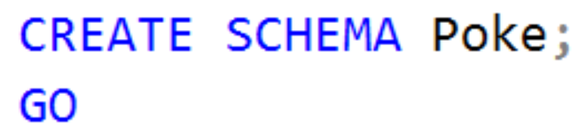
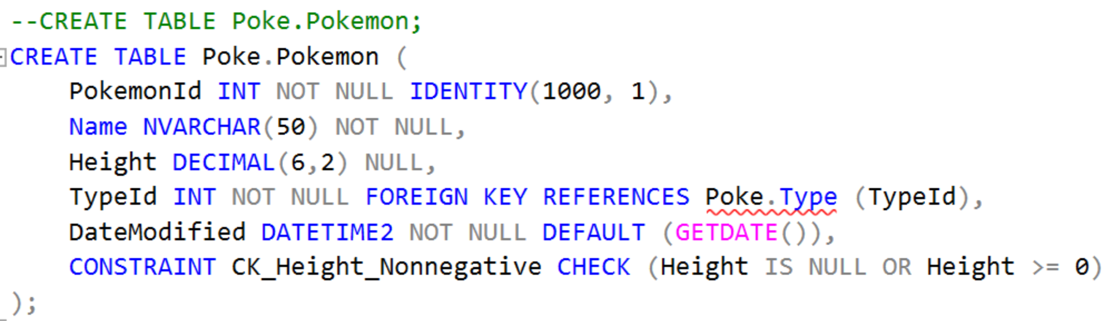
SQL with SQL Server
In SQL, every object (e.g. table) must be in a schema.
SQL Server has a default schema named dbo.
You can create a Schema.

Slide 10
SQL – Attribute Constraints https://docs.microsoft.com/en-us/sql/t-sql/statements/alter-table-table-constraint-transact-sql?view=sql-server-ver15
NOT NULL | column does not accept NULL as a value
NULL | column explicitly accepts NULL as a value. (NULL will be the default value)
PRIMARY KEY | value must be unique within this column
UNIQUE | implies NOT NULL and UNIQUE, and by default sets a CLUSTERED INDEX.
FOREIGN KEY | by default sets a NONCLUSTERED INDEX
CHECK | enforces that some expression is true for every row
DEFAULT | configures a default value for that column
IDENTITY | this sets up an auto-incrementing default, AND prevents anyone from inserting their own value

Slide 11
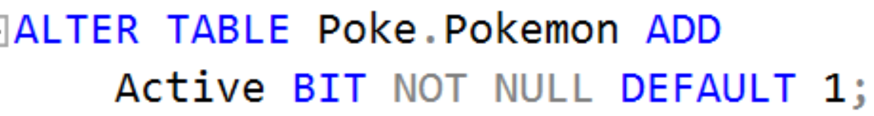
ALTER Table https://docs.microsoft.com/en-us/sql/t-sql/statements/alter-table-transact-sql?view=sql-server-ver15
ALTER TABLE
modifies a table definition by altering, adding, or dropping columns and constraints.
reassigns and rebuilds partitions or disables and enables constraints and triggers.

Slide 12
AGGREGATE Functions https://docs.microsoft.com/en-us/sql/t-sql/functions/aggregate-functions-transact-sql?view=sql-server-ver15 https://docs.microsoft.com/en-us/sql/t-sql/functions/functions?view=sql-server-ver15#aggregate-functions
Aggregate functions:
perform a calculation on a set of values and returns a single value.
ignore null values (except for COUNT).
are often used with the GROUP BY clause of the SELECT statement.
return the same value each time they are called.
APPROX_COUNT_DISTINCT | MIN
AVG | STDEV
CHECKSUM_AGG | STDEVP
COUNT | STRING_AGG
COUNT_BIG | SUM
GROUPING | VAR
GROUPING_ID | VARP
MAX
These are Aggregate functions

Slide 13

AVG( ) - Average https://docs.microsoft.com/en-us/sql/t-sql/functions/avg-transact-sql?view=sql-server-ver15
AVG( ) computes the average of a set of values by dividing the sum of those values by the count of nonnull values. If the sum exceeds the maximum value for the data type of the return value, AVG( ) will return an error. AVG( ) can have one of 2 arguments.
ALL – (default) Applies the aggregate function to all values.
DISTINCT - Specifies that AVG operates only on one unique instance of each value, regardless of how many times that value occurs.
EX. ‘ SELECT AVG(ALL NumbersColumn) FROM TableName; ’ returns the average of all numbers. Even duplicates.

Slide 14

COUNT( ) https://docs.microsoft.com/en-us/sql/t-sql/functions/count-transact-sql?view=sql-server-ver15
COUNT( ) returns the number of items found in a group. COUNT( ) always returns an int data type value.
It has two possible arguments
ALL - Applies the aggregate function to all values. ALL serves as the default.
DISTINCT - Specifies that COUNT returns the number of unique nonnull values.

Slide 15
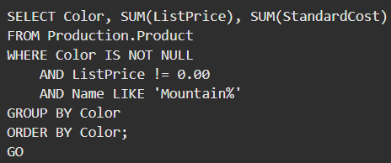
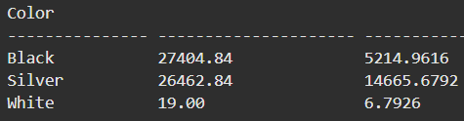
SUM( ) https://docs.microsoft.com/en-us/sql/t-sql/functions/sum-transact-sql?view=sql-server-ver15
SUM can be used with numeric columns only. Null values are ignored.
SUM( ) has two possible arguments
ALL - Applies the aggregate function to all values. ALL is the default.
DISTINCT - Specifies that SUM returns the sum of unique values.

Slide 16
SQL – String Data Types https://docs.microsoft.com/en-us/sql/t-sql/data-types/char-and-varchar-transact-sql?view=sql-server-ver15
Data Type | Description
CHAR(n) | Fixed-length up to n, 0 to 255, Default 1
VARCHAR(n) | VARiable length up to n. 0 to 65535
NCHAR(n) | Fixed-length, Unicode string
NVARCHAR(n) | variable-length Unicode string. (Use this unless you nee to use something else)
There are a variety of functions for strings e.g. LEN, SUBSTRING, CHARINDEX, REPLACE, LOWER, UPPER

Slide 17
SQL – Integer Data Types https://docs.microsoft.com/en-us/sql/t-sql/data-types/data-types-transact-sql?view=sql-server-ver15#exact-numerics
Data Type | Description
BIT | It’s a bit. 1 to 64. Default 1
TINYINT | Signed = -128 to 127. unsigned = 0 to 255
BOOL | Max 255 bytes. 0 = false, 1 = true
SMALLINT | Max 65535 bytes
INT | signed = 2147483648 to 2147483647. unsigned = 0 to 4294967295 (Use this unless you need something else)

Slide 18
SQL – Float Data Types https://docs.microsoft.com/en-us/sql/t-sql/data-types/data-types-transact-sql?view=sql-server-ver15#approximate-numerics
Data Type | Description
FLOAT(size,d) | size = total digits. d = number of digits after the decimal point
FLOAT(p) | If p is from 0 to 24, the data type becomes FLOAT(). If p is from 25 to 53, the data type becomes DOUBLE()
DOUBLE(size, d) | size = total digits. d = number of digits after the decimal point.
DECIMAL(size, d) | An exact fixed-point number. size = total digits(default 10, max 65). d = number of digits after the decimal point(default 0, max 30).

Slide 19
SQL – Date and Time Data Types https://docs.microsoft.com/en-us/sql/t-sql/data-types/date-and-time-types?view=sql-server-ver15
Data Type | Description
DATE | Format: YYYY-MM-DD. From '1000-01-01' to '9999-12-31'
DATETIME(fsp) | Format: YYYY-MM-DD hh:mm:ss. Add DEFAULT and ON UPDATE in the column definition to get automatic initialization and updating to the current date and time
TIMESTAMP(fsp) | The number of seconds since the Unix epoch. Format: YYYY-MM-DD hh:mm:ss. Automatic initialization and updating with DEFAULT CURRENT_TIMESTAMP and ON UPDATE CURRENT_TIMESTAMP in the column definition.
TIME(fsp) | hh:mm:ss. From '-838:59:59' to '838:59:59’
YEAR | 1901 to 2155, and 0000. MySQL 8.0 does not support year in two-digit format.
DATETIMEOFFSET | For storing intervals of time. Use YEAR() to extract parts of the dates/times, DATEPART(YEAR FROM '2019-01-01') or DATEPART(YEAR, '2019-01-01')

Slide 20
SQL – Currency Data Types https://docs.microsoft.com/en-us/sql/t-sql/data-types/data-types-transact-sql?view=sql-server-ver15#exact-numerics
Data Type | Description
MONEY | From -922,337,203,685,477.5808 to 922,337,203,685,477.5807 with ‘$’
SMALLMONEY | From -214,748.3648 to 214,748.3647 with ‘$’

