Slide 1

Relational Database Management System, DML, DDL
.NET

Slide 2
A software system used to maintain relational databases is a Relational Database Management System (RDBMS). Many relational database systems use SQL (Structured Query Language) for querying and maintaining the database.
https://docs.microsoft.com/en-us/sql/t-sql/language-reference?view=sql-server-ver15

Slide 3

(RDBMS) Relational Database Management System – History https://en.wikipedia.org/wiki/Relational_database
Relational databases are based on the relational model of data, as proposed by E. F. Codd in 1970.
Edgar Frank "Ted" Codd (August 23, 1923 – April 18, 2003) was a British computer scientist and winner of the 1981 Turing Award.

Slide 4
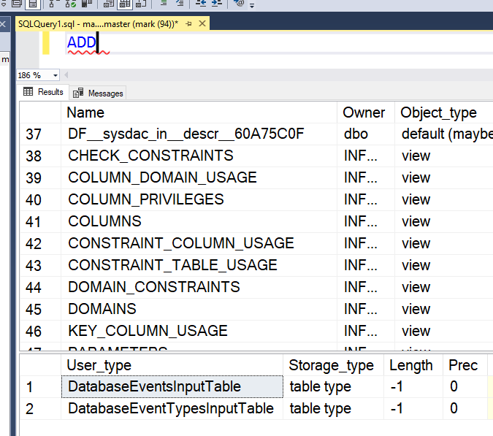
Tools That Use T-SQL https://docs.microsoft.com/en-us/sql/t-sql/language-reference?view=sql-server-ver15#tools-that-use-t-sql
T-SQL is central to using Microsoft SQL products and services. All tools and that communicate with a SQL database send T-SQL commands. SQL works on top off T-SQL.
Some of the Microsoft tools that issue T-SQL commands are:
SQL Server Management Studio (SSMS)
SQL Server Data Tools (SSDT)
Azure Data Studio
*You can type a T-SQL keyword in the SSMS Query Editor window and press F1 to get data about any T-SQL Keyword.

Slide 5
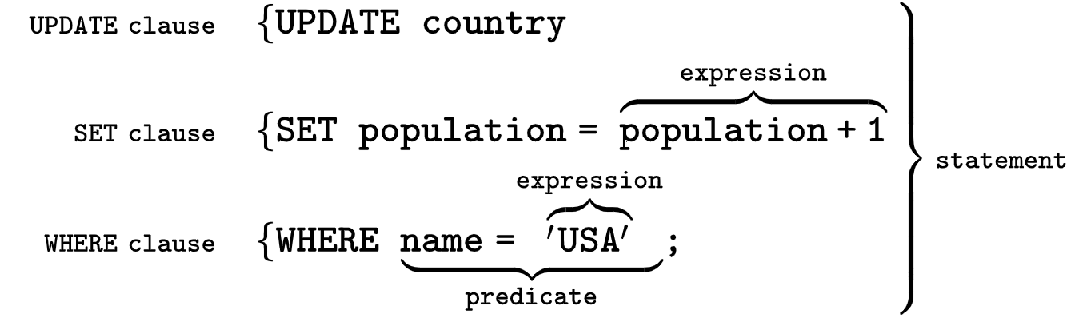
SQL (Structured Query Language) https://en.wikipedia.org/wiki/SQL
Originally based upon relational algebra and tuple relational calculus, SQL consists of many types of statements which may be informally classed as sublanguages.
The most important sublanguages (for our usage) are:
Data Definition Language (DDL)
Data Manipulation Language (DML).
The scope of SQL includes data query, data manipulation (insert, update and delete), data definition (schema creation and modification), and data access control.
SQL is a declarative language. We say what data we want, not how to get it. We cannot manage how SQL obtains the data.

Slide 6
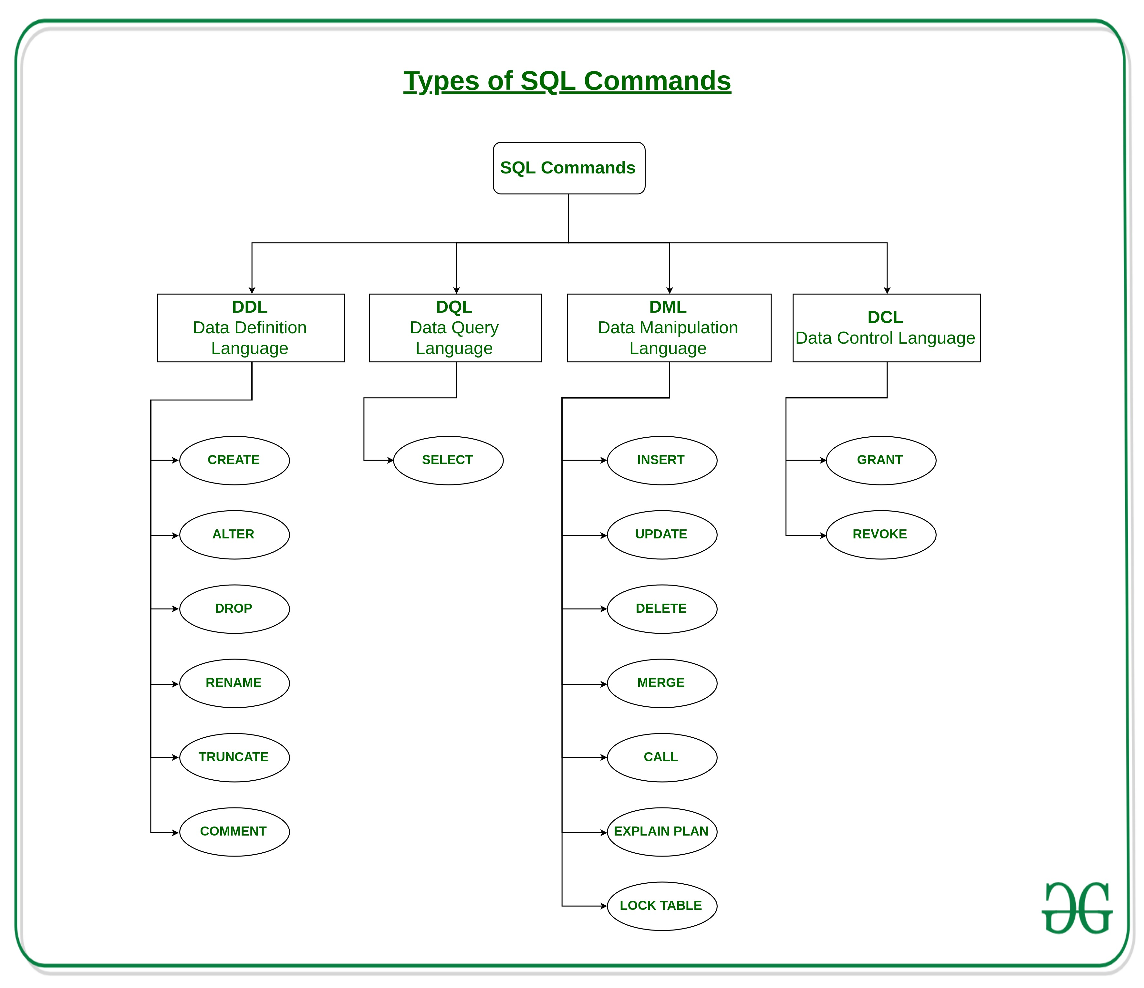

Slide 7
Data Manipulation Language https://docs.microsoft.com/en-us/sql/t-sql/statements/statements?view=sql-server-ver15#data-manipulation-language
Data Manipulation Language (DML) is vocabulary used to query a Database to retrieve and modify data from an SQL Database. Use Data Manipulation Language statements to INSERT, UPDATE, DELETE, TRUNCATE, and query the rows in the database.
INSERT – Adds one or more rows to a table or a view.
DELETE – Removes one or more rows from a table or view in SQL Server.
UPDATE – Changes existing data in a table.
TRUNCATE - Removes all rows from a table without deleting the table. Similar to the DELETE statement with no WHERE clause, but faster.

Slide 8
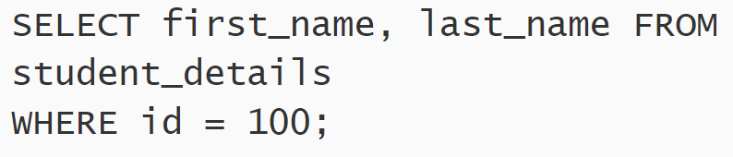
SQL - SELECT, FROM, WHERE https://docs.microsoft.com/en-us/sql/t-sql/queries/select-transact-sql?view=sql-server-ver15#logical-processing-order-of-the-select-statement
The three most common keywords in SQL Queries are SELECT, FROM, and WHERE.
SELECT - Retrieves rows from the database
FROM – Usually required on the SELECT statement. Specifies from which table(s) the results will come.
WHERE - Specifies the search conditions for the rows returned by the query.

Slide 9
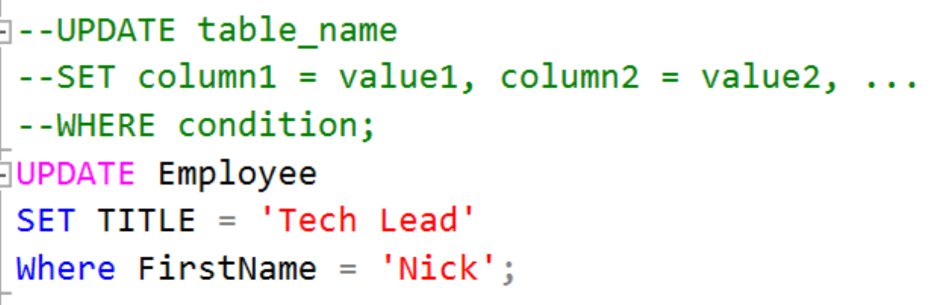

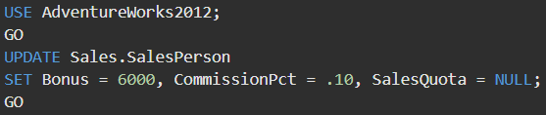
SQL – UPDATE a table https://docs.microsoft.com/en-us/sql/t-sql/queries/update-transact-sql?view=sql-server-ver15 https://docs.microsoft.com/en-us/sql/t-sql/queries/update-transact-sql?view=sql-server-ver15#a-using-a-simple-update-statement
Changes existing data in a table or view in SQL Server 2019. There are many variations to UPDATE. Check the Docs for more detail.
UPDATE multiple rows simultaneously.

Slide 10
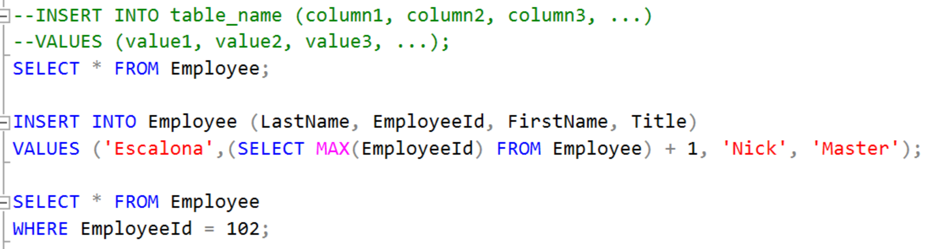
SQL – INSERT into a table https://docs.microsoft.com/en-us/sql/t-sql/statements/insert-transact-sql?view=sql-server-ver15#BasicSyntax https://docs.microsoft.com/en-us/sql/t-sql/statements/insert-transact-sql?view=sql-server-ver15#BasicSyntax
Adds one or more rows to a table or a view in SQL Server.

Slide 11
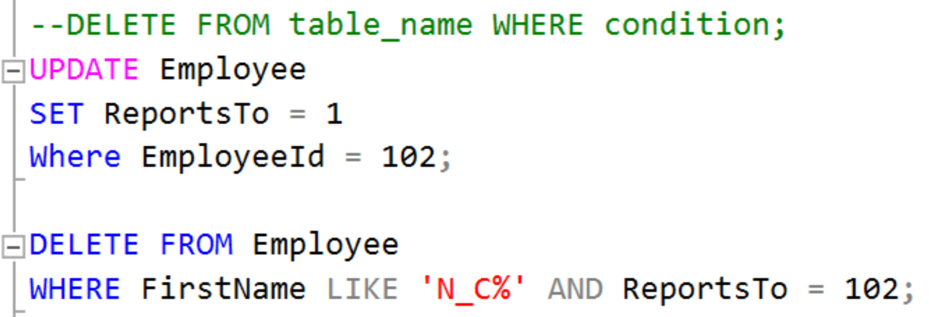
SQL – DELETE from a table https://docs.microsoft.com/en-us/sql/t-sql/statements/delete-transact-sql?view=sql-server-ver15 https://docs.microsoft.com/en-us/sql/t-sql/statements/delete-transact-sql?view=sql-server-ver15#BasicSyntax
Removes one or more rows from a table or view in SQL Server.

Slide 12
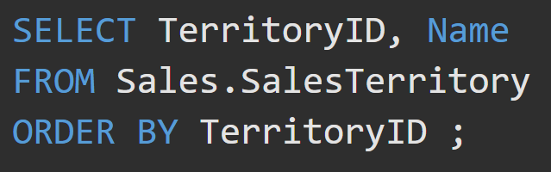
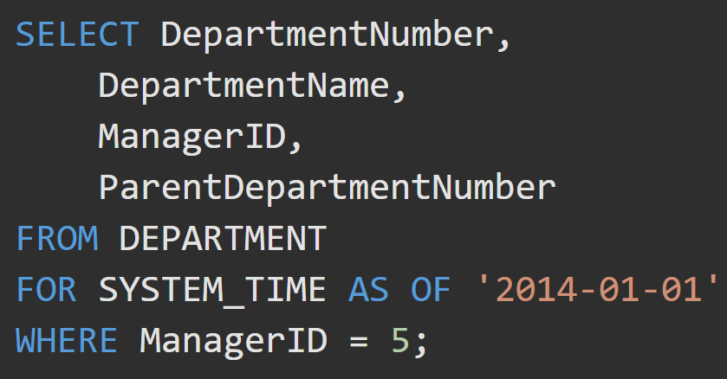
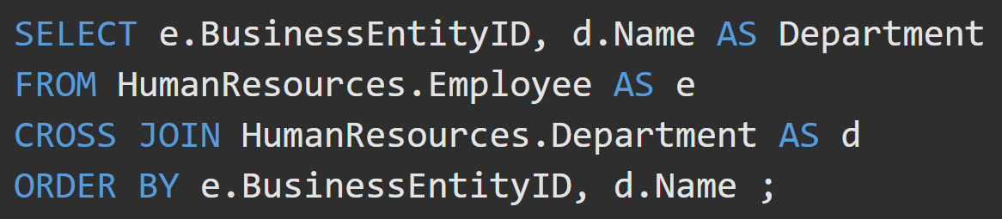
SQL - Queries
Queries are used to insert, retrieve, modify, and delete data in a SQL Database. SQL Queries have a specific syntax and structure.

Slide 13
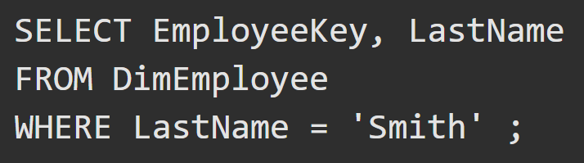
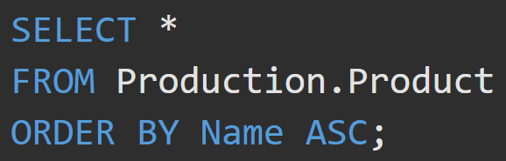
Query Examples
What do these queries do?
What do these queries do?

Slide 14
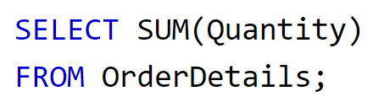
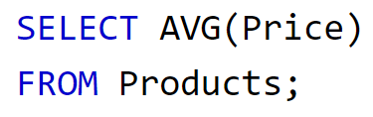
Query Examples – Aggregate Functions
What do these queries do?
What do these queries do?

Slide 15
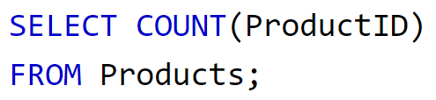
Query Examples – Aggregate Functions
What do these queries do?
What do these queries do?

Slide 16
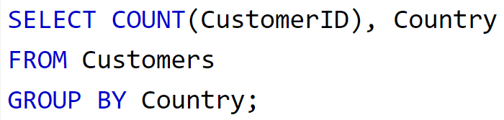
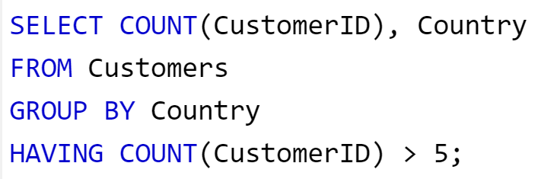
Query Examples – Aggregate Functions
What do these queries do?
What do these queries do?

Slide 17
DML Activity
-- basic exercises in groups of 3 (Chinook database)
-- 1. List all customers (full names, customer ID, and country) who are not in the US
-- 2. List all customers from brazil
-- 3. List all sales agents
-- 4. Show a list of all countries in billing addresses on invoices.
-- 5. How many invoices were there in 2009, and what was the sales total for that year?
-- 6. How many line items were there for invoice #37?
-- 7. How many invoices per country?
-- 8. Show total sales per country, ordered by highest sales first.

Slide 18
DML Activity - Answers
SELECT * FROM Customer;
-- 1. list all customers (full names, customer ID, and country) who are not in the US
SELECT CustomerId, FirstName, LastName, Country
FROM Customer
WHERE Country != 'USA';
-- 2. list all customers from brazil
-- 3. list all sales agents
SELECT *
FROM Employee
WHERE Title LIKE '%Sales%Agen?%';
-- pattern matching with the LIKE operator
-- % - 0 to many of any character
-- [abc] - one of a, b, or c
-- _ - one of any character
-- 4. show a list of all countries in billing addresses on invoices.
SELECT DISTINCT BillingCountry
FROM Invoice;
ESC, BillingCountry;
-- SELECT DISTINCT means, after you get all the result rows,
-- remove duplicate rows (where ALL column values match)
-- 5. how many invoices were there in 2009, and what was the sales total for that year?
-- (extra challenge: find the invoice count sales total for every year, using one query)
SELECT SUM(Total) AS TotalAmount, COUNT(InvoiceId) AS InvoicesIn2009
FROM Invoice
--WHERE InvoiceDate BETWEEN '2009-01-01' AND '2010-01-01';
WHERE YEAR(InvoiceDate) = 2009;
SELECT YEAR(InvoiceDate) AS Year, SUM(Total) AS TotalAmount, COUNT(InvoiceId) AS Invoices
FROM Invoice
GROUP BY YEAR(InvoiceDate);
-- 6. how many line items were there for invoice #37?
-- 7. how many invoices per country?
-- 8. show total sales per country, ordered by highest sales first.
SELECT BillingCountry, SUM(Total)
FROM Invoice
GROUP BY BillingCountry
ORDER BY SUM(Total) D

