Slide 1

S.O.L.I.D.
.net / Microsoft dynamics 365

Slide 2
In object-oriented computer programming, S.O.L.I.D. is a mnemonic acronym for five design principles intended to make software designs more understandable, flexible and maintainable.
https://en.wikipedia.org/wiki/SOLID

Slide 3
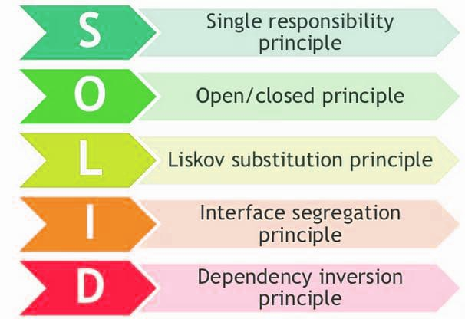
S.O.L.I.D. – Overview https://medium.com/better-programming/solid-principles-simple-and-easy-explanation-f57d86c47a7f https://www.c-sharpcorner.com/UploadFile/damubetha/solid-principles-in-C-Sharp/
SOLID Principles is a coding standard that all developers should have a clear concept for developing software properly to avoid a bad design.
When applied properly it makes your code more extendable, logical, and easier to read.
When the developer builds software following a bad design, the code can become inflexible and more brittle. Small changes in the software can result in bugs.

Slide 4
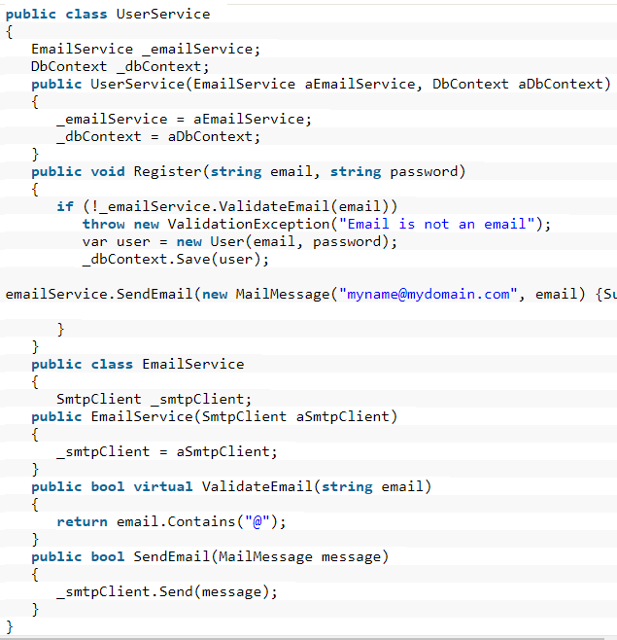
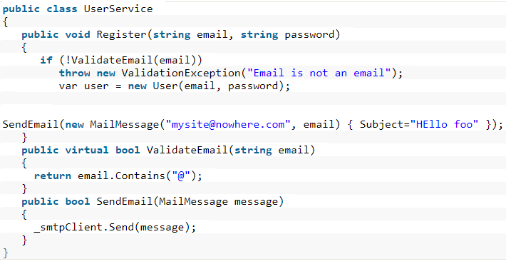
Single Responsibility Principle https://www.c-sharpcorner.com/UploadFile/damubetha/solid-principles-in-C-Sharp/
A class should only have a single responsibility. Only changes to one part of the software's specification should be able to affect the specification of the class.
The SendEmail and ValidateEmail methods have nothing to do within the UserService class. Let’s refactor it. →→→

Slide 5

Open-Closed Principle https://www.c-sharpcorner.com/UploadFile/damubetha/solid-principles-in-C-Sharp/
We need to design our module/class in such a way that the new functionality can be added only when new requirements are generated. A class should be open for extensions. We can use inheritance to do this.
Suppose we have a Rectangle class with the properties Height and Width.
An app needs the ability to calculate the total area of a collection of Rectangles.
Because of the Single Responsibility Principle, we can’t put the total area calculation code inside the rectangle!
How can this problem be solved?

Slide 6
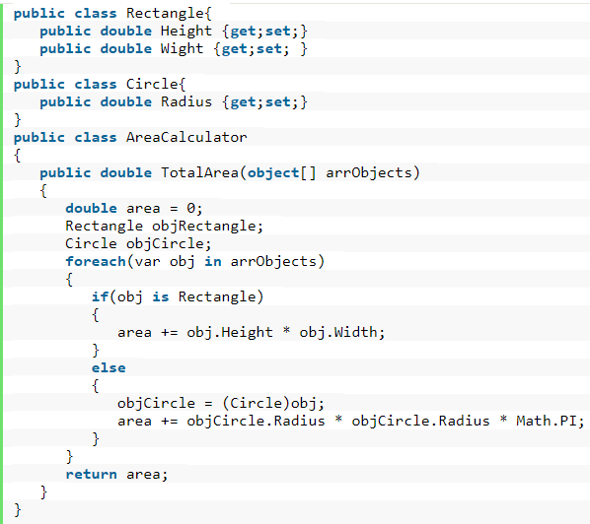
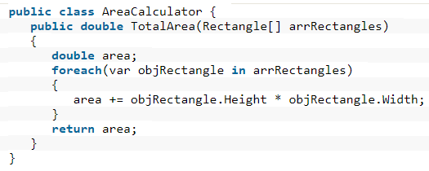
Open-Closed Principle https://www.c-sharpcorner.com/UploadFile/damubetha/solid-principles-in-C-Sharp/
We create another class specifically for the calculation of the area of a Rectangle object array?
EVEN BETTER. Create one class for the calculation of the area of any shape in the program. →→→→→→→→→→→

Slide 7
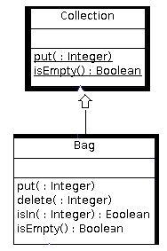
Liskov Substitution Principle https://medium.com/better-programming/solid-principles-simple-and-easy-explanation-f57d86c47a7f https://www.c-sharpcorner.com/UploadFile/damubetha/solid-principles-in-C-Sharp/
You should be able to use any derived class instead of a parent class and have it behave in the same manner without modification.
This ensures that a derived class does not affect the behavior of the parent class. A derived class must be substitutable for its base class.
Functions that use pointers of references to base classes must be able to use objects of derived classes without knowing it.

Slide 8
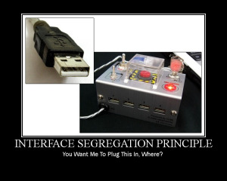
Interface Segregation Principle https://www.c-sharpcorner.com/UploadFile/damubetha/solid-principles-in-C-Sharp/
Each interface should have a specific purpose/responsibility. A class shouldn't be forced to implement an interface when the class doesn't share the interfaces purpose. The larger the interface, the more likely it includes methods that not all classes can implement. Clients should not be forced to depend upon interfaces who’s methods they don't use.

Slide 9
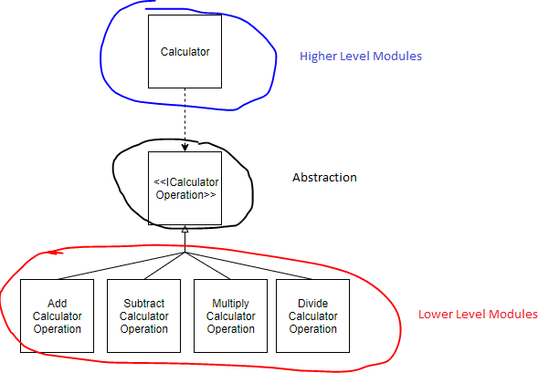
Dependency Inversion Principle https://www.c-sharpcorner.com/UploadFile/damubetha/solid-principles-in-C-Sharp/
High-level modules/classes implement business rules or logic in a system (front-end).
Low-level modules/classes deal with more detailed operations. They may deal with writing information to databases or passing messages to the operating system or services.
When a class knows explicitly about the design and implementation of another class, it raises the risk that changes to one class will break the other class. So we must keep these high-level and low-level modules/classes loosely coupled as much as we can.
To do that, we need to make both of them dependent on abstractions instead of knowing each other.

