Slide 1

19CS414-Mobile App Development
Unit III
ADVANCED DESIGN
Designing applications with multimedia and web access capabilities

Slide 2
Designing application with web access
Application with web access tries to get some data from internet.
  Example : EBook Readers
A web app that is difficult to figure out or insufficient will never win the app race.
But at the same time designing good user interface is difficult
The common problems are choosing right colors and creating right place for contents
If app developer failed to satisfy user needs then user go to another app for same task.
Example – rechargeitnow → freecharge app

Slide 3
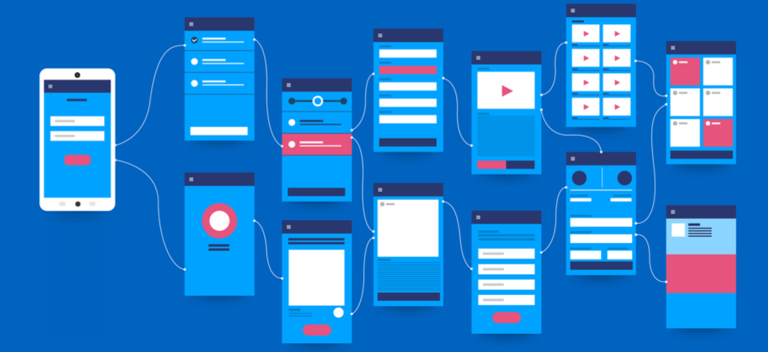
Rules for web app design
Don’t reinvent pattern
Group related elements
Less is better
Plan before developing
Provide feedback
Unobtrusive Help
Helps users decide
Focus on Target users
Where am I
Where did that come from
Design for No data
Keep Consistent
Load Quickly
Test

Slide 4
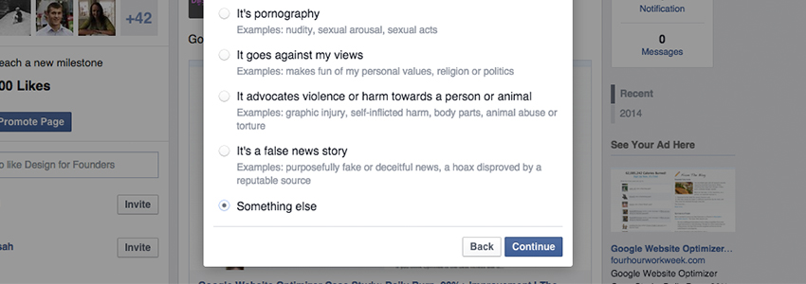
Don’t reinvent pattern
Always use the common pattern that the users are familiar.
Example : red → for error envelope → message
When reporting a post, Facebook displays the “Continue” button
placed on the right-hand side and makes it more prominent than the
secondary option “Back

Slide 5
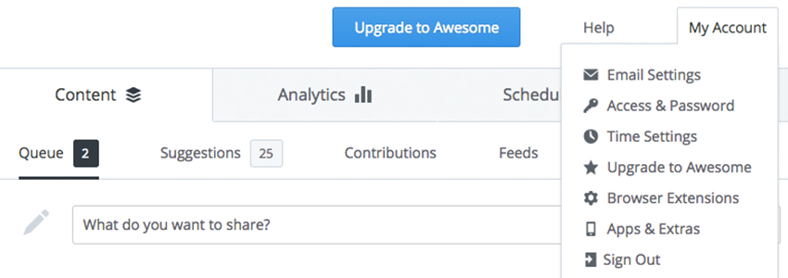
Group related elements
Always place related elements or views in single menu.
Example – Sign out and change password in setting menu
Buffer grouped all profile-related controls under one drop-down. This
way they can’t interfere with other
features in the app.

Slide 6
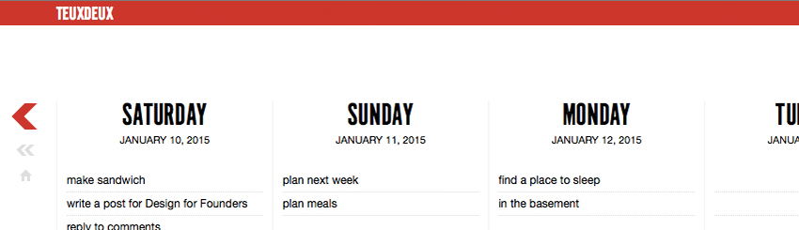
Less is better
Always give limited functionality in single app
Example : freecharge → only for recharge
TeuxDeux is an app that basically only does one thing — saves tasks for different days.

Slide 7
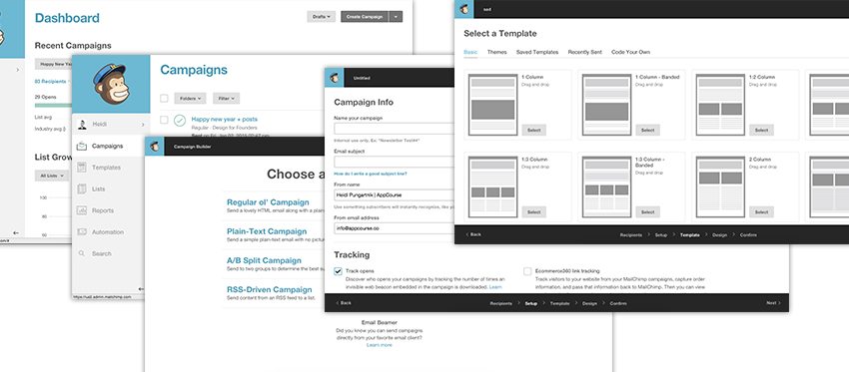
Plan before developing
Take some time to review the design before code. Changing after
Coding is difficult
Mailchimp has a nice user flow that guides you through creating an email campaign with a breeze.

Slide 8
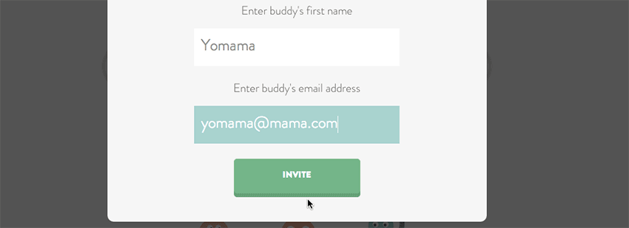
Provide feedback
Always provide feedback for each user in app, if user types some text
Then give immediate feedback by saying something about input
Beautiful button animation combined with the spinning loader in the Headspace web app lets you know your request went through.

Slide 9
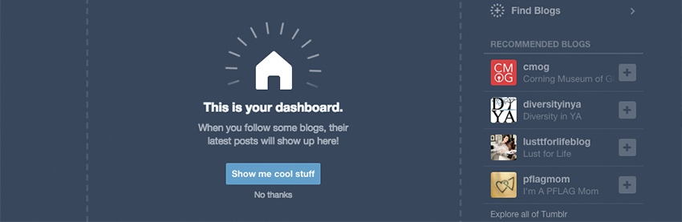
Unobtrusive help
Some time user don’t know how to use some elements so give some
Kind of tips to user for knowing about elements usage
Tumblr gives you an option to take a short tour or skip it.

Slide 10
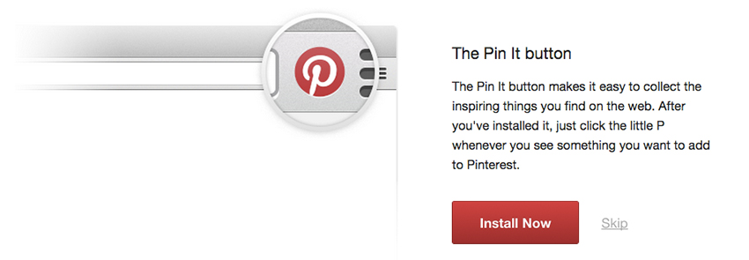
Help Users Decide
Provide help to new users to complete the task more easily
It’s hard to say no to Pinterest’s obvious “next step”.

Slide 11
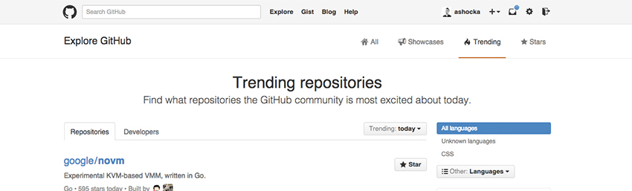
Focus On Target Users
Create a app based on target users, creating app for computer
Teachers is different from non computer teachers
Github’s clean interface isn’t rich in graphics and full of explanatory text.

Slide 12
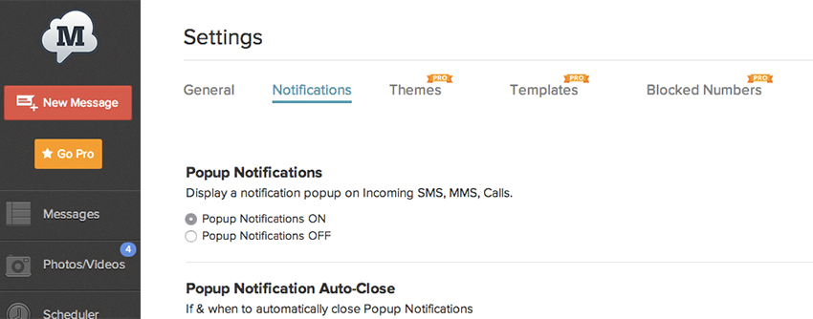
Where Am I?
Helps the user to know about their current location in app
By using methods like navigation bar
MightyText app uses double navigation in settings to help users easily navigate the interface.

Slide 13
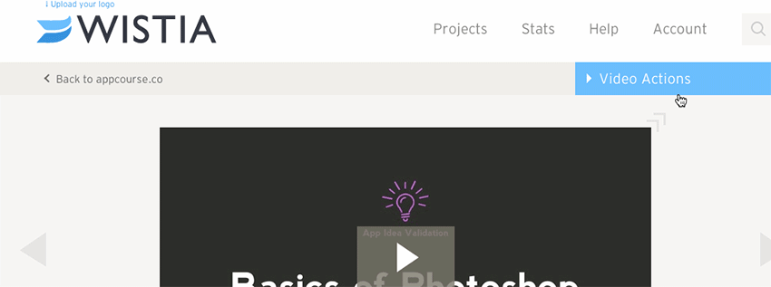
Where did that come from?
Help the user to know about the data that is app screen
Wistia shows a simple slide effect to display more tools.

Slide 14
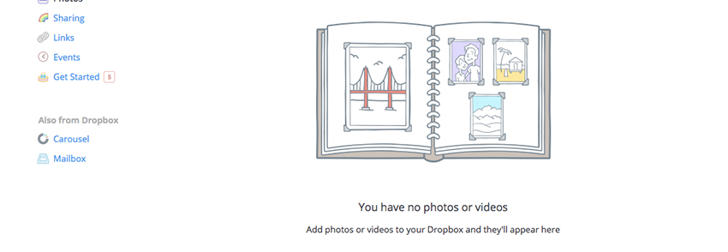
Design For No Data
Never place empty places in app, even in some place user have to
Give some data, then create a text that makes user understands
A nice illustration and a tip help new users get accustomed with Dropbox.

Slide 15
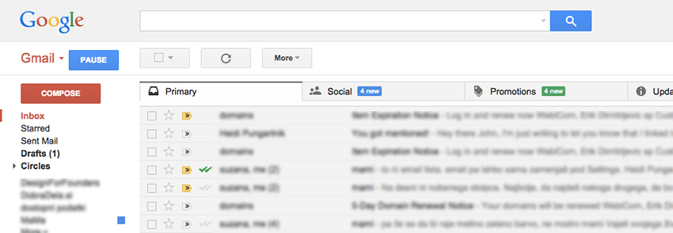
Keep Consistent
Always keep consistent design in all pages
Wherever you are, you always know where to look to find left-side links in Gmail.

Slide 16

Load Quickly
Never make the user to wait for more time
Sounddrown displays their logo with a simple animation while the app loads.

Slide 17
Test
Test the app using multiple people with multiple backgrounds

