Slide 1
Reverse Proxy
with pfSense and HAProxy

Slide 2
Agenda
Technical Background
Forward Proxy
Reverse Proxy
HAPROXY
Demo
Useful Links

Slide 3
Technical Background
pfSense
Open-Source Firewall Distribution based on FreeBSD
Uses pf as Packet Filter
Rule-based Packet Filter
Customizable with Packages

Slide 4
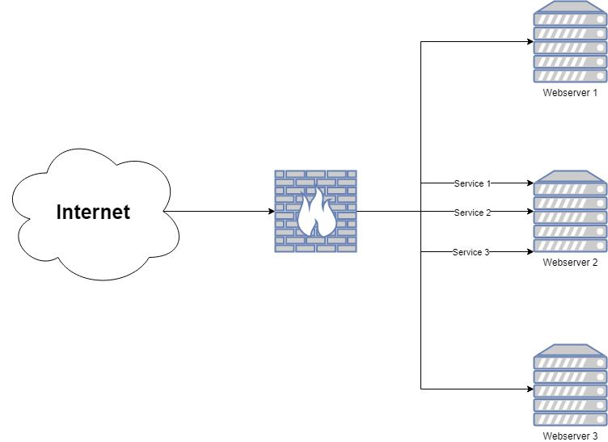
Technical Background

Slide 5
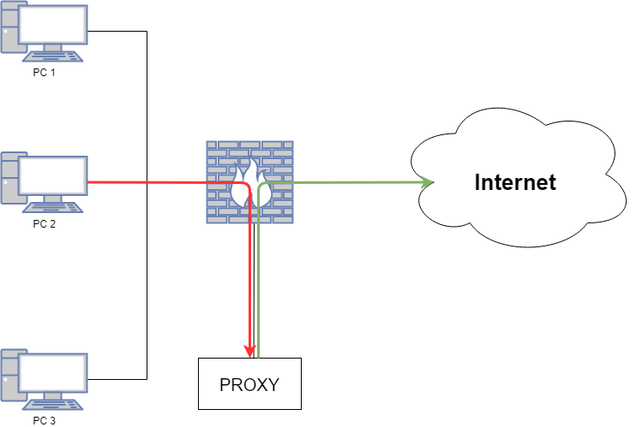
Forward Proxy

Slide 6
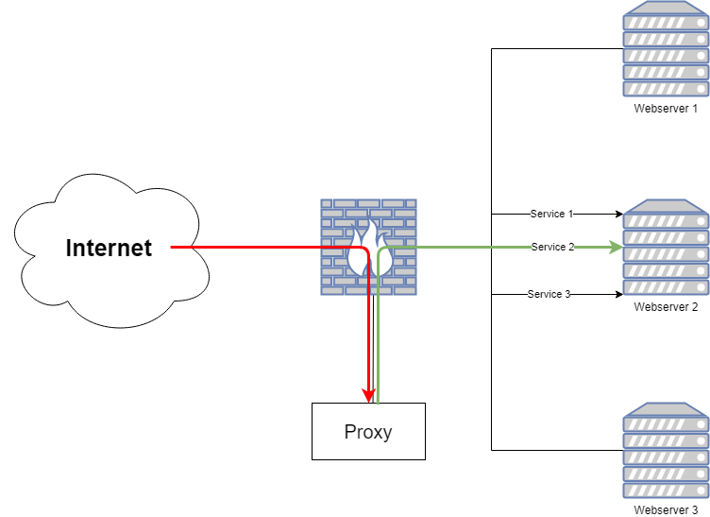
Reverse Proxy

Slide 7

HAPROXY
https://en.wikipedia.org/wiki/HAProxy#/media/File:Haproxy-logo.png
Open-Source
Reverse Proxy
High-Availability
Load Balancing
SSL-Offloading

Slide 8
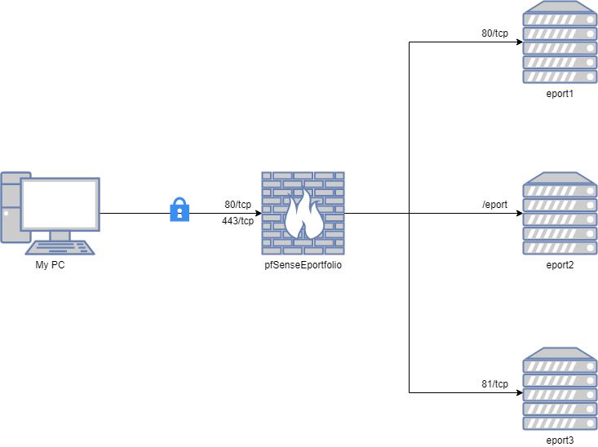
Demo

Slide 9
Useful Links
http://www.haproxy.org/
http://docs.haproxy.org/
https://docs.netgate.com/pfsense/en/latest/

